Slide 1


SUDOKU SOLVER USING PYTHON

Slide 2
PROJECT INTRODUCTION This project is all about giving the solution to the complex problem of sudoku 9x9 grid pattern. KEY FEATURES >ADJUSTING GAMEPLAY MOOD ( PROVIDES DIFFERENT PATTERN OF NUMBERS TO A SINGLE PROBLEM DEPENDING ON THE COMPLEXITY OF THE PROBLEM). >GIVING UNIQUE SOLUTION >ERROR SOLVING

Slide 3

WHAT IS SUDOKU ?

Slide 4
>GAME OF PLACING NUMBER IN A SQUARE OF 9X9. >NO NUMBER SHOULD REPEAT WITHIN A PARTICULAR ROW OR A PARTICULAR COLUMN. >WITHIN A MATRIX OF 3X3 NO NUMBER SHOULD REPEAT. >ALL WE HAVE TO DO IS FILL NUMBER FROM 1 TO 9. FOUND IT EASY?? WELL MANY DOES NOT HERE’S THE SOLUTION

Slide 5
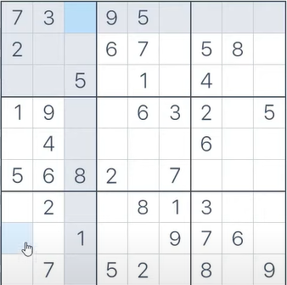


Slide 6
OUR CHALLENGE IS TO PUT NUMBER RANGING FROM 1 TO 9 WITHIN [EACH COLUMN] AND [EACH ROW ]AND [EACH SQAURE MATRIX OF 3X3] SUCH THAT NONE OF NUMBER REPEATS WITHIN THESE THREE CATEGORY IN ANY WAY . THIS IS A EASY TASK WITH A GRID OF 2X2 BUT TEDIOUS WITH 9X9. SO WE BOUGHT A SOLUTION

Slide 7
WHAT ALL WENT INTO ALGORITHM?

Slide 8
BACKTRACKING
Backtracking involves inserting a possible number in the nearest empty box and going to the next unsolved box.
This will go on until we run into an error and we place a zero in the box.
We move to the previously solved box and try the next possible number to solve it.

Slide 9
RECURSION
Recursion involves calling a function within a function. You will come to understand this when we need to call the function several times to solve an unknown number.

Slide 10
LOGIC TO SOLVE SUDOKU USING PYTHON
THE BASIC IDEOLOGY IS DEVELOPING FUNCTIONS TO VARIOUS ITERATIONS WITHIN THE DEVELOPED LIST { MUTABLE } OF THE GRID { THE STRUCTURE OF SUDOKU} WITH THE USE OF BACKTRACKING .

Slide 11
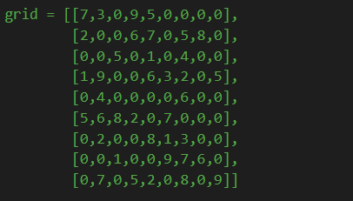
CREATING A COMMAND FOR THE SUDOKU WITH HELP OF [ LIST OF LIST ]

Slide 12
ITERATION THROUGH EACH ROW AND COLUMN WITH BACKTRACKING

Slide 13
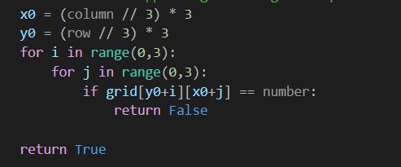
BACKTRACKING WITHIN THE SMALL GRID 3X3

Slide 14
CONCLUSION
WE GET THE POSSIBLE OUTCOME TO THE SUDOKU AS PER THE STRUCTURE OF THE SUDOKU HENCE GIVING A WIDE VARIETY TO SOLUTIONS.

Slide 15
CREATED BY
CHETANYA AGARWAL 211141

