Slide 1
TVCS CAR POOL
SOCIAL GOOD
Sanskar Gupta (Captain)
Chetas Shree .M
Tanishq Kashyap
Vartika Yaduvanshi

Slide 2
Description of the Project
Problem Statement
Approach to the Solution
Reducing pollution and traffic problem in the city.
Carpooling cuts down on
congestion, which cuts travel time.Less vehicle emissions helps combat global warming, improves air quality and has positive effects on public health
Relevance to the Theme
Techstack Involved
We are going to stick to the “social good” problem statement.
We would be using HTML,CSS ,BOOTSTRAP,JAVASCRIPT,
jQUERY ,FIREBASE

Slide 3
Details of Technology Stack
Tech1
HTML 5
Tech2
CSS 3
BOOTSTRAP
JAVASCRIPT
jQUERY
Tech3
FIREBASE
Tech4

Slide 4
Description of the Solution
Step 1
Step 2
Search
Plan
2021
Step 3
Step 4
Code
Test

Slide 5
Novelty of the Solution
Describe how your solution is unique and original.
Our proposed system overcomes the drawbacks of the existing system. It has advance facilities to make it more user-friendly.
It provides details of the owner and his/her car to maintain transparency between users of the system. It will track the location of users those who involve in pool through GPS Navigation system.
It has SMS Alerts facilities for notification purpose. The High security makes it faithful to use.
The security aspects gets more enhance by SOS facilities if the user is in trouble.
It is available on Smartphone’s so it is more flexible & dynamic to use.

Slide 6
Novelty of the Solution
Why the problem you are catering is needed to be solved.
There is acute problem of traffic on roads these days and the increasing fuel prices add to the misery of daily users of personal vehicles.
Also use of vehicles causes pollution which has its adverse affects. Car sharing is a solution but issues like security and trust come into picture.
Solution to this problem is web based Carpool system.
The Carpool system would enable its user a safe and secure way to share cars.
This could include both short daily journeys such as going to workplace within the city and also long inter-city trips.

Slide 7
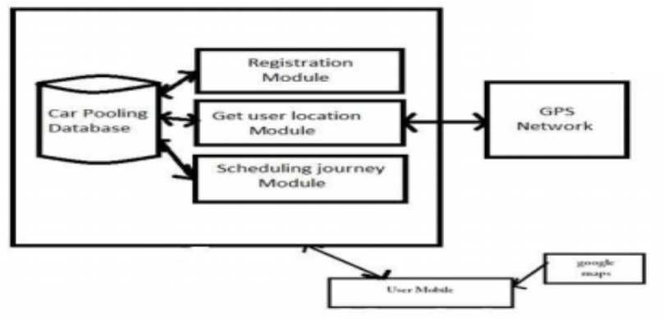
Flowchart of our Project

Slide 8
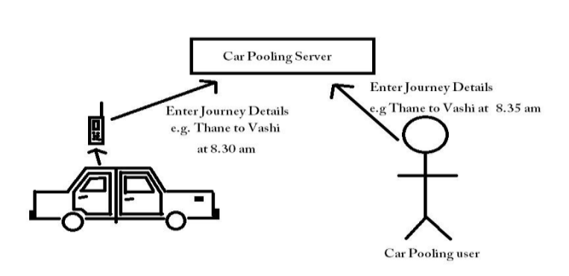
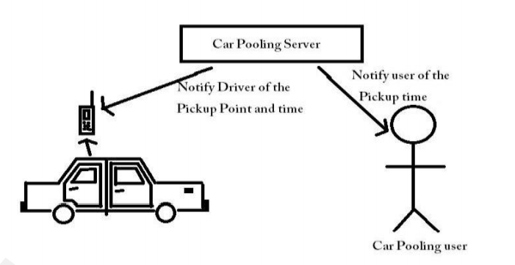
Ideation of our Project

Slide 9
Growth Plan of the Product
(You can modify percentage according to your requirement)
10%
Research and Initial Documentation
Set-up front end
Checkpoint 1
25%
Create a login / sign up
Implement UI/UX principles
Checkpoint 2
50%
Explore ways to implement our idea
Checkpoint 3
75%
Integrate front end and back end
Deploy over cloud and using firebase
Run checks
Checkpoint 4

Slide 10
Business Aspects of the Hack
01
Market Impact
It helps save money and also is a way to minimize pollution
Target Consumers
02
People who have to travel on daily and non-daily basis.
03
Financial Sustainability
When anyone opts for a car pool ,he/she saves the fuel money and reduce the extra cost of travelling.
Product > Project
04
We will be dealing this issue by building a web application

Slide 11
Social Impact
Carpooling system is very effective means to reduce pollution and the congestion of vehicles in cities.
It also provides an ecofriendly way to travel.
It also provides an opportunity to meet new people.
As today most people prefer private vehicle to travel due to delay caused in public transport system and luxuries provided by private vehicles.
Pre-registration ensures that only identified people get into the vehicle so that trust can be established.
The people registered are allotted specific days on which they should take their private vehicle, so that no inconvenience is caused to its registered passengers for daily commute.
Thus the proposed carpooling system will be effective in reducing environment pollution. It will also provide a security to citizens.
It will give the accurate pick-up time.

Slide 12
Working Prototype
Include links, images and videos of your hack.
You can duplicate this slide as per your requirement.

Slide 13
Learning Curve
What have you learnt by doing this project?
04
01
Growth 1
03
To identify the problem which are faced by many users who travel
02
Growth 2
02
To strategize the solution of the problem statement
01
03
Growth 3
To research about the problem and the requirements needed to solve it
04
Growth 4
To learn how to execute the solution

Slide 14
About Team
01
02
SANSKAR GUPTA
Chetas Shree
Team Lead
Member
03
04
Tanishq Kashyap
Vartika Yaduvanshi
Member
Member

