Slide 1
Security Camera Powered With Machine Learning For People Detection For Queue Data Analytics
PIP2001 Capstone Project
Review-0
Batch Number: CBC-G10
Under the Supervision of,
Ms. Suma N G
Assistant Professor
School of Computer Science and Engineering
Presidency University
Roll Number | Student Name
20211CBC0030 | Sai Rakshith L
20211CBC0031 | Chethak
20211CBC0032 | Khushi Dixit
20211CBC0033 | Aishwarya R
20211CBC0042 | Varshika Raj
Name of the Program: Computer Science and Engineeing (Blockchain)
Name of the HoD: Dr. S. Pravinth Raja
Name of the Program Project Coordinator: Ms. Suma NG
Name of the School Project Coordinators: Dr. Abdul Khadar A

Slide 2
Content
Problem Statement
Analysis of Problem Statement
Timeline of the Project
References

Slide 3
Problem Statement Number: PSCS-137
Organization: CISCO DevNet
Category (Hardware / Software / Both) : Software Problem Description: Long lines at some specific time ticketing windows and services counter at Railway station, Bus stand,RTO office,Banks and other places could lead to bad services experiences. On many occasions lines are longer at specific time of day but empty/short at other times. It would be very user if real-time and historical queue length can be made available via website or mobile app to user and facility managers. This would in long-term help deliver better experience and smarter cities. Key technical challenge to solve this problem is to identify persons in specific area. Cisco Meraki camera with MV Sense utilizes a powerful onboard processor to analyze videos and using Machine Learning algorithms detects persons in specific area. Cisco Meraki IoT ready camera can be used as building block in your application.
Difficutly Level : Complex

Slide 4
Analysis of Problem Statement
Technology Stack Components:
Programming Language
Machine Learning Framework
Pre-trained models
Data Analytics platform
Backend technologies
Frontend technologies
Operating System
Deployment and Monitoring

Slide 5
Analysis of Problem Statement (contd...)
Software Requirements:
Development and Deployment Tools
Pre-trained Model Libraries
Database
Machine Learning Libraries/Frameworks
AWS/GCP/Azure services

Slide 6
Analysis of Problem Statement (contd...)
Software and Hardware Requirements:
Camera (MV Sense)
Onboard Processor (Edge Computing)
Machine Learning Algorithms (for person detection)
IoT Platform (Cisco Meraki IoT-ready capabilities)
Real-time Data Analysis Software
Historical Data Storage System
Web or Mobile App Interface (for users and facility managers)
Network Infrastructure (for data transmission and connectivity)

Slide 7
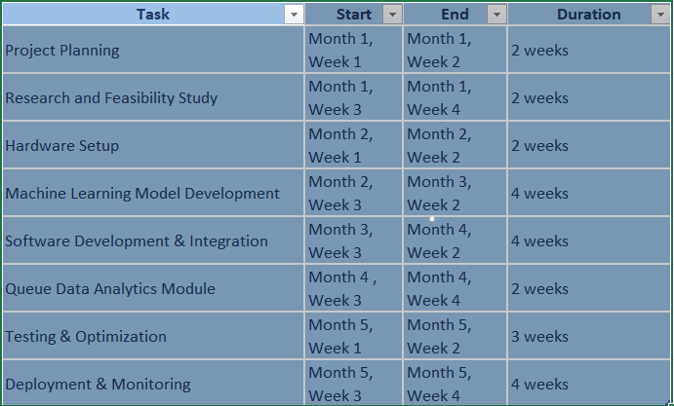
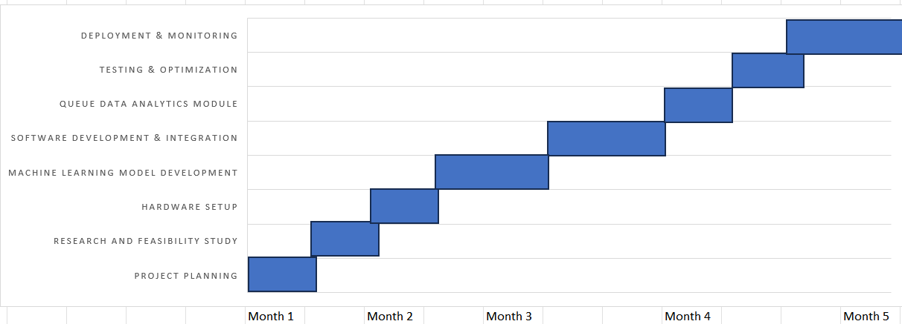
Timeline of the Project (Gantt Chart)

Slide 8
References (IEEE Paper format)
[1]Mohammed Ghazal, Rania Hamoudaand Samr Ali, “An IoT Smart Queue
Management System with Real-TimeQueue Tracking” 2015 Fifth International Conference on e-Learning.
[2]K. Nathani, R. Suthar, J. Shelke, V.Vatharkar, and A.J.Patankar, “Smart
queue management for hospitals,”IJAFRC, vol. 2, pp. 94–98, 2015.
[2]S. Shahbandari, “Uae to introducestar ratings for governmentdepartments,” Gulf News, February 11,2014. Availablehttp://gulfnews.com/news/ gulf/uae
/general/uae-to-introduce- star –ratingsforgovernmentdepartments1.1289766.
[3] S. A. M. Saleh, S. A. Suandi, and H.Ibrahim, ‘‘Recent survey on crowddensity estimation and counting for visual surveillance,’’ Eng. Appl. Artif.Intell., vol. 41, pp. 103–114, May 2015.
[Online]. Available:
http://www.sciencedirect.com/science/article/pii/S0952197615000081
[4]L. Zhang, M. Shi, and Q. Chen,‘‘Crowd counting via scale-adaptive convolutional neural network,’’ in Proc.IEEE Winter Conf. Appl. Comput. Vis.(WACV), Mar2018, pp. 1113–1121.

Slide 9


