Slide 1

SALES PERFORMANCE DASHBOARD
Task 04 – Dashboard Design
Interactive Business Intelligence Dashboard
Prepared By
Chethan G M
Data Analyst Internship
Power BI | Microsoft Excel
Task 04 | Dashboard Design | Power BI
01

Slide 2




PROJECT OVERVIEW
OBJECTIVE
TOOLS USED
• Power BI
• Microsoft Excel
Develop an interactive dashboard to analyze sales performance.
DATASET
• Superstore Dataset
KPIs ANALYZED
Total Sales • Total Profit • Total Orders • Total Customers • Profit Margin
Task 04 | Dashboard Design | Power BI
02

Slide 3
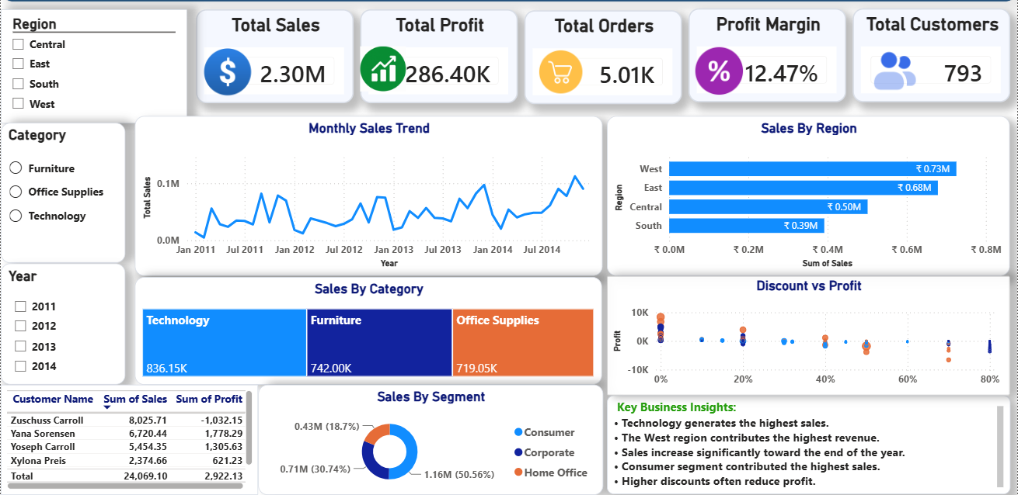
INTERACTIVE DASHBOARD
Task 04 | Dashboard Design | Power BI
03

Slide 4
KEY BUSINESS INSIGHTS
• Technology category generated highest sales.
• West region delivered strongest performance.
• Consumer segment contributed largest sales.
• Sales increased during year-end months.
• Higher discounts reduced profitability.
Task 04 | Dashboard Design | Power BI
04

Slide 5


CONCLUSION & RECOMMENDATIONS
CONCLUSION
RECOMMENDATIONS
Dashboard provides interactive business performance insights.
• Improve sales in low-performing regions. • Optimize discount strategies. • Monitor KPIs regularly • Focus on high-performing categories.
THANK YOU
For Your Attention
Task 04 | Dashboard Design | Power BI
05

