Slide 1

SwiftKanban Provider
Participants:
Chethan BG
Rekha Kumari

Slide 2
SwiftKanban
What is webMethods CloudStreams Provider for SwiftKanban and its capabilities
SwiftKanban provider can be used to add and update sprints, backlogs, tasks, comments, attachments, relations in new workspace ( called Board in SwiftKanban).
It can fetch all the activity logs mentioned in cards, backlogs and relations.
We can also fetch the details of sprints, cards, backlogs, relations or any comments.
This provider can also perform delete opeartion on any card, sprints, backlogs, tasks, comments, attachment.
We can get all the Team members’ details for your account in SwiftKanban.
We can fetch the Active Master Lists details for your account at an Org level.
The connector can be integrated to automate all the above-mentioned activities.
It enables better management of workflow and gives higher degree of transparency amongst teams.

Slide 3
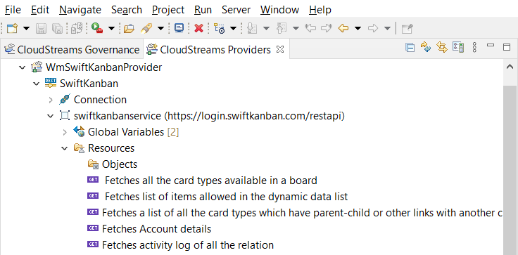
Screenshot of REST Resources

Slide 4
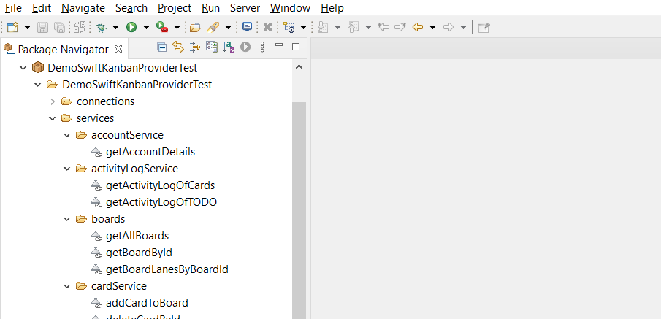
Screenshot of flow services

