Slide 1
CUSTOMER SEGMENTATION USING K-MEANS CLUSTERING
CHETHAN
4nm19me025@nmamit.in

Slide 2
Customer Segmentation
Customer Segmentation is the subdivision of a market into discrete customer groups that share similar characteristics. Customer Segmentation can be a powerful means to identify unsatisfied customer needs. Using the above data companies can then outperform the competition by developing uniquely appealing products and services.
The most common ways in which businesses segment their customer base are:
Demographic information
Geographical information
Psychographics
Behavioral data

Slide 3
Types of market segmentation
Demographic segmentation
This might be the first thing people think of when they hear ‘market segmentation’. This is perhaps the most straightforward way of defining customer groups, but it remains powerful.
Demographic segmentation looks at identifiable non-character traits such as:
Age
Gender
Ethnicity
Income
Level of education
Religion
Profession/role in a company
For example. demographic segmentation might target potential customers based on their income, so your marketing budget isn’t wasted directing your messaging at people who likely can’t afford your product.
Luxury goods manufacturer Montblanc worked with Yieldify to present a selection of offers across their website. One sought to raise conversions using a Father’s Day deal that offered a free gift to those spending over £200 – an amount that acknowledged the spending expectations of Montblanc’s target audience and saw a +118% uplift in conversions for those targeted.

Slide 4
Types of market segmentation
Psychographic segmentation
Psychographic segmentation is focused on your customers’ personalities and interests.
Here we might look at customers and define them by their:
Personality traits
Hobbies
Life goals
Values
Beliefs
Lifestyles
Compared to demographic segmentation, this can be a harder set to identify. Good research is vital and, when done well, psychographic segmentation can allow for incredibly effective marketing that consumers will feel speaks to them on a much more personal level.
In our experience working with luxury resort business Omni Hotels & Resorts, for example, were aware that a big sector of the company’s target audience was always keen to get the very best price they could. By targeting a notification campaign specifically towards comparison shoppers, Omni Hotels & Resorts achieved a 39% conversion rate uplift.

Slide 5
Types of market segmentation
Geographic segmentation
By comparison, geographic segmentation is often one of the easiest to identify, grouping customers with regards to their physical location.
This can be defined in any number of ways:
Country
Region
City
Postal code
For example, it’s possible to group customers within a set radius of a certain location – an excellent option for marketers of live events looking to reach local audiences. Being aware of your customers’ location allows for all sorts of considerations when advertising to consumers.
Using Yieldify’s tools, an online shoe store could show different products depending on where the visiting customer was based: wellington boots for someone in the countryside, pavement-friendly trainers for a city-dweller, strappy sandals to resort visitors, and so on!

Slide 6
Types of market segmentation
Behavioral segmentation
Behavioral segmentation is possibly the most useful of all for e-commerce businesses. As with psychographic segmentation, it requires a little data to be truly effective – but much of this can be gathered via your website itself.
Here we group customers with regards to their:
Spending habits
Purchasing habits
Browsing habits
Interactions with the brand
Loyalty to brand
Previous product ratings

Slide 7
Advantages of Customer Segmentation
1
Develop customized marketing campaigns.
2
Choose specific product features for deployment.
3
Determine appropriate product pricing.
4
Design an optimal distribution strategy.
5
Prioritize new product development efforts.

Slide 8
K Means Clustering Algorithm
1
Specify number of clusters K.
2
Initialize centroids by first shuffling the dataset and then randomly selecting K data points for the centroids without replacement.
3
Keep iterating until there is no change to the centroids. i.e assignment of data points to clusters isn’t changing.

Slide 9
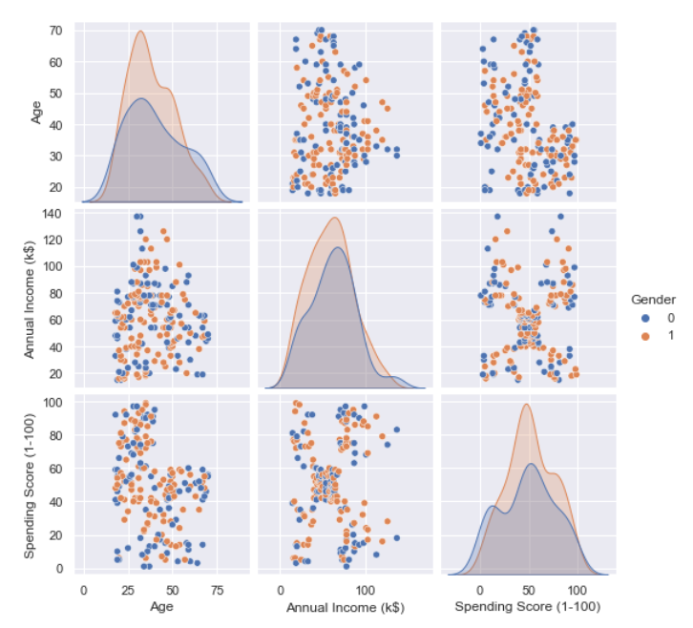
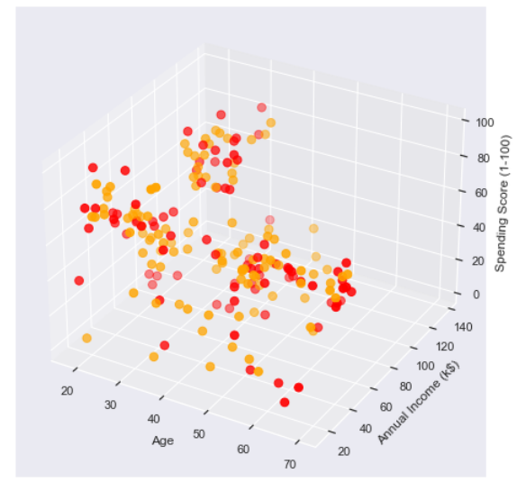
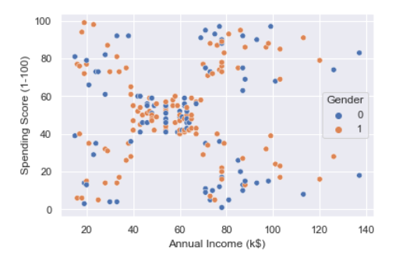
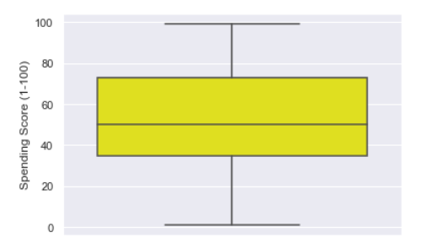
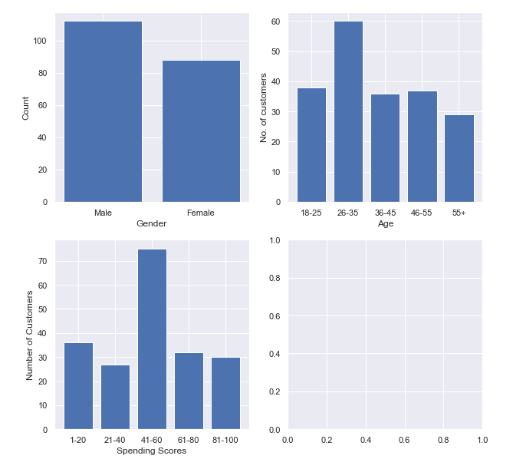
Data Visualization
Data visualization is an interdisciplinary field that deals with the graphic representation of data. It is a particularly efficient way of communicating when the data is numerous as for example a time series.
From an academic point of view, this representation can be considered as a mapping between the original data (usually numerical) and graphic elements (for example, lines or points in a chart). The mapping determines how the attributes of these elements vary according to the data. In this light, a bar chart is a mapping of the length of a bar to a magnitude of a variable. Since the graphic design of the mapping can adversely affect the readability of a chart, mapping is a core competency of Data visualization.

Slide 10
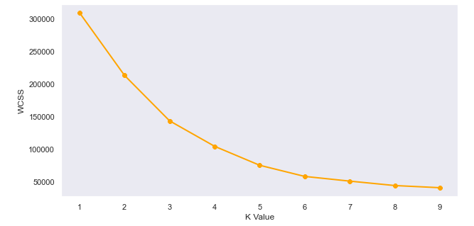
The Elbow Method
In cluster analysis, the elbow method is a heuristic used in determining the number of clusters in a data set. The method consists of plotting the explained variation as a function of the number of clusters, and picking the elbow of the curve as the number of clusters to use.
Calculate the Within Cluster Sum of Squared Errors (WSS) for different values of k, and choose the k for which WSS first starts to diminish. In the plot of WSS-versus k, this is visible as an elbow.
The steps can be summarized in the below steps:
Compute K-Means clustering for different values of K by varying K from 1 to 10 clusters.
For each K, calculate the total within-cluster sum of square (WCSS).
Plot the curve of WCSS vs the number of clusters K.
The location of a bend (knee) in the plot is generally considered as an indicator of the appropriate number of clusters.
The optimal K value is found to be 5 using the elbow method.
Finally I made a 3D plot to visualize the spending score of the customers with their annual income. The data points are separated into 5 classes which are represented in different colours as shown in the 3D plot.

Slide 11
Environment and tools
1
Scikit-learn (0.14.5)
2
Numpy(1.21.4)
3
Seaborn(0.11.2)
4
Matplotlib(3.4.3)
5
Pandas(1.3.4)

Slide 12
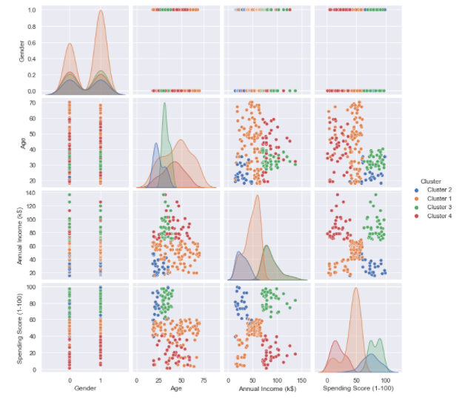
Results

Slide 13
Results
Cluster 1
Customers in this cluster buy fewer items because of their minimal annual income. Generally this cluster consists of people with age above 35.
Cluster 2
People in this group spend most of the money in buying things. They are not having good annual income and buy things with parent's money or others. Most of the youngsters without their own income constitutes this group.
Cluster 3
Customers in this cluster buy a lot in apparel. They purchase the most items, and have the highest spending per item. The cluster skews slightly female. This cluster consists of the most youngsters. They can be called as Spendthrifts.
Cluster 4
This is the most populated cluster. Customers in this cluster make small numbers of purchases and spend less on average. They are typically one time buyers.The people in this cluster can be called as The Compulsive Saver or Tightwads.

Slide 14
Conclusions
K-means clustering is one of the most popular clustering algorithms and usually the first thing practitioners apply when solving clustering tasks to get an idea of the structure of the dataset. The goal of K means is to group data points into distinct non-overlapping subgroups. One of the major application of K means clustering is segmentation of customers to get a better understanding of them which in turn could be used to increase the revenue of the company.
Principle of market segmentation is that the product and services needs of individual customers differ. Market segmentation involves the grouping of customers together with the aim of better satisfying their needs whilst
maintaining economies of scale. It consists of three stages and if properly executed should deliver more satisfied customers, few direct confrontations with competitors, and better designed marketing programmes. Segmentation depends the differentiation of market starategy and the achieve of goals that the main important thing with segment market don’t have achieve the target, market segmentation of different ways that the concludes are Segmentation to helps the market to pick up the market targets and that the differentaion of main thing is bases of segmentation they decided the all level of ages customer needs and wants.

Slide 15
THANK YOU

