Slide 1


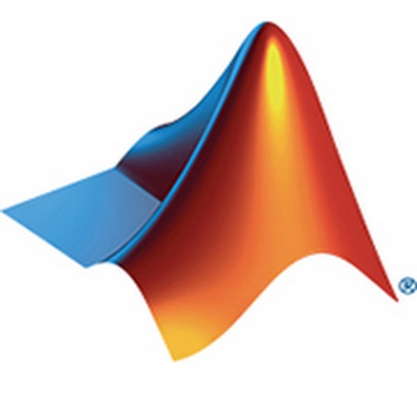
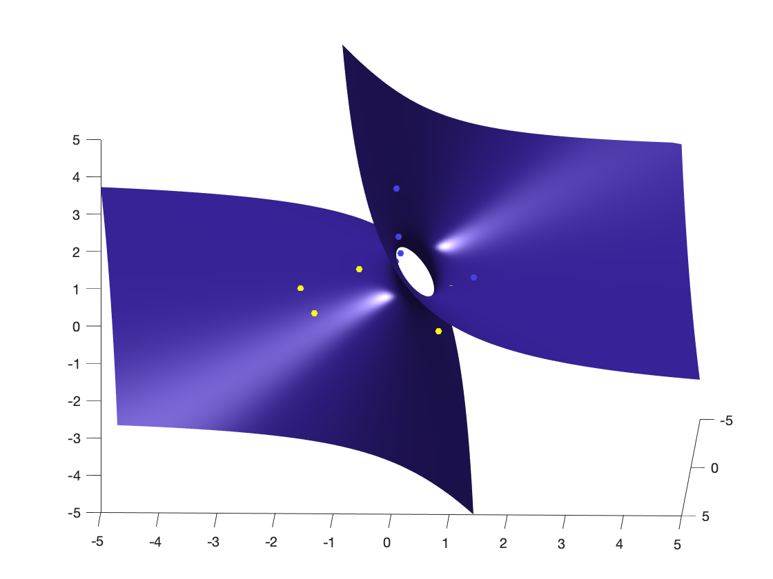
- CHETHAN M – PES2201800331 - S SREE KAUSTUB – PES2201800061 - KISHORE B R – PES2201800342 - G SAI CHARAN REDDY – PES22018000483
DIGITAL IMAGE PROCESSING USING MATLAB - PROJECT

Slide 2

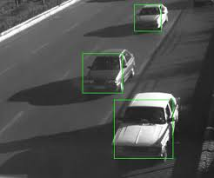
PROBLEM..!
DEVELOP A MATLAB CODE THAT CAN DETECT VEHICLES IN EACH FRAME OF A VIDEO AND GIVES THE VEHICLE COUNT OF THAT FRAME……
Notes:
When conducting research, it is easy to go to one source: Wikipedia. However, you need to include a variety of sources in your research. Consider the following sources:
Who can I interview to get more information on the topic?
Is the topic current and will it be relevant to my audience?
What articles, blogs, and magazines may have something related to my topic?
Is there a YouTube video on the topic? If so, what is it about?
What images can I find related to the topic?

Slide 3
Literature survey-1
Title: A survey on different background subtraction method for moving object detection
Year: October 2016
Authors :
1.Rajkumari Bidyalakshmi Devi
2.Yambem Jina Chanu
3.Khumanthem Manglem Singh
Notes:
When conducting research, it is easy to go to one source: Wikipedia. However, you need to include a variety of sources in your research. Consider the following sources:
Who can I interview to get more information on the topic?
Is the topic current and will it be relevant to my audience?
What articles, blogs, and magazines may have something related to my topic?
Is there a YouTube video on the topic? If so, what is it about?
What images can I find related to the topic?

Slide 4
Literature survey-1
ABSTRACT:
In computer vision application, detecting moving object in a video sequence is considered as a critical task as a moving object detection is very necessary for many video applications like video surveillance, traffic monitoring, object tracking etc. Many different methods have been proposed in recent years to differentiate the moving object and the background. One of the simplest method for detecting moving object from a video sequences is the background subtraction algorithm where the current frame is subtracted from the reference image or background model. In this paper, we review the different background subtraction algorithm developed in recent years.
Keywords
- Background Modelling
- Foreground Detection
- Moving Object Detection.
Notes:
When conducting research, it is easy to go to one source: Wikipedia. However, you need to include a variety of sources in your research. Consider the following sources:
Who can I interview to get more information on the topic?
Is the topic current and will it be relevant to my audience?
What articles, blogs, and magazines may have something related to my topic?
Is there a YouTube video on the topic? If so, what is it about?
What images can I find related to the topic?

Slide 5
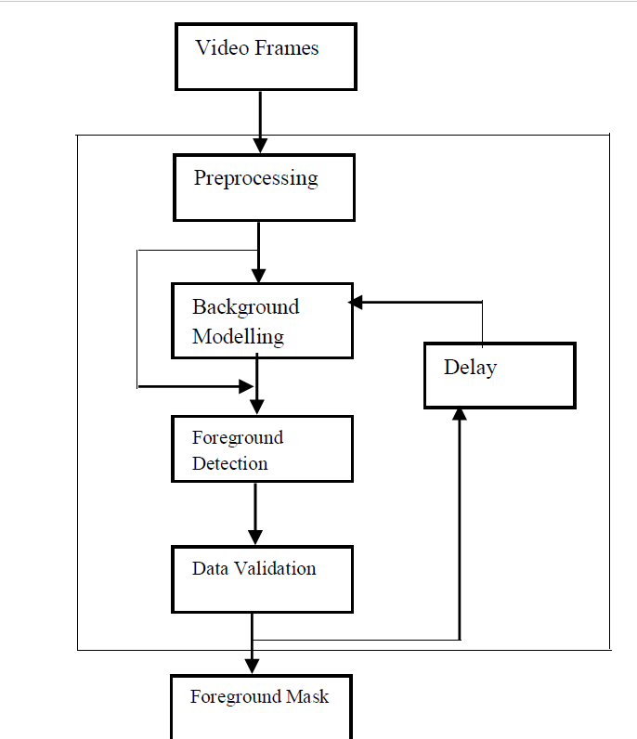
Literature survey-1
BACKGROUND SUBTRACTION ALGORITHM
-PREPROCESSING
-BACKGROUND MODELLING
-FOREGROUND DETECTION
-DATA VALIDATION
Notes:
When conducting research, it is easy to go to one source: Wikipedia. However, you need to include a variety of sources in your research. Consider the following sources:
Who can I interview to get more information on the topic?
Is the topic current and will it be relevant to my audience?
What articles, blogs, and magazines may have something related to my topic?
Is there a YouTube video on the topic? If so, what is it about?
What images can I find related to the topic?

Slide 6
Literature survey-2
Title: Literature survey on the various methods of object detection in video surveillance systems
Year: December 2016
Author:
Mrs.Poonam Khare
Notes:
When conducting research, it is easy to go to one source: Wikipedia. However, you need to include a variety of sources in your research. Consider the following sources:
Who can I interview to get more information on the topic?
Is the topic current and will it be relevant to my audience?
What articles, blogs, and magazines may have something related to my topic?
Is there a YouTube video on the topic? If so, what is it about?
What images can I find related to the topic?

Slide 7
Literature survey-2
ABSTRACT:
Video surveillance system is the most important dimension nowadays in order to maintain security and keep a track of events. It is used as a security system because it has the power to track and detect objects of interest. The importance of video surveillance system lies in the reality that it can be used in static and dynamic background as well. Static or stationary background examples are shopping mall, bank, school, colleges, ATMs etc and dynamic refers to vehicle tracking systems and traffic related areas. The most basic video surveillance systems undergoes many phases , after which it is able to detect the object of interest and makes necessary action like triggering of alarms .In this paper study of various phases of VSS is made and for each phase various alternative solutions with their advantages and disadvantages have been discussed
Notes:
When conducting research, it is easy to go to one source: Wikipedia. However, you need to include a variety of sources in your research. Consider the following sources:
Who can I interview to get more information on the topic?
Is the topic current and will it be relevant to my audience?
What articles, blogs, and magazines may have something related to my topic?
Is there a YouTube video on the topic? If so, what is it about?
What images can I find related to the topic?

Slide 8
Literature survey-2
Various phases in Video Surveillance systems(VSS):
-IMAGE ACQUISITION PHASE
-PREPROCESSING PHASE
-SEGEMENTATION PHASE
-DESCRIPTION/FEATURE SECTION
-RECOGNISION & INTERPRETATION
Notes:
When conducting research, it is easy to go to one source: Wikipedia. However, you need to include a variety of sources in your research. Consider the following sources:
Who can I interview to get more information on the topic?
Is the topic current and will it be relevant to my audience?
What articles, blogs, and magazines may have something related to my topic?
Is there a YouTube video on the topic? If so, what is it about?
What images can I find related to the topic?

Slide 9
Literature survey-3
Title: Real Time Vehicle Detection and Counting Method for Unsupervised Traffic Video on Highways
Year: August 2011
Author:
Mrs. P.M.Daigavane
Dr. P.R.Bajaj
Notes:
When conducting research, it is easy to go to one source: Wikipedia. However, you need to include a variety of sources in your research. Consider the following sources:
Who can I interview to get more information on the topic?
Is the topic current and will it be relevant to my audience?
What articles, blogs, and magazines may have something related to my topic?
Is there a YouTube video on the topic? If so, what is it about?
What images can I find related to the topic?

Slide 10
Literature survey-3
Summary
Automatic detecting and counting vehicles in unsupervised video on highways is a very challenging problem in computer vision with important practical applications such as to monitor activities at traffic intersections for detecting congestions, and then predict the traffic flow which assists in regulating traffic. Manually reviewing the large amount of data they generate is often impractical. The background subtraction and image segmentation based on morphological transformation for tracking and counting vehicles on highways is proposed. This algorithm uses erosion followed by dilation on various frames. Proposed algorithm segments the image by preserving important edges which improves the adaptive background mixture model and makes the system learn faster and more accurately, as well as adapt effectively to changing environments.
Notes:
When conducting research, it is easy to go to one source: Wikipedia. However, you need to include a variety of sources in your research. Consider the following sources:
Who can I interview to get more information on the topic?
Is the topic current and will it be relevant to my audience?
What articles, blogs, and magazines may have something related to my topic?
Is there a YouTube video on the topic? If so, what is it about?
What images can I find related to the topic?

Slide 11
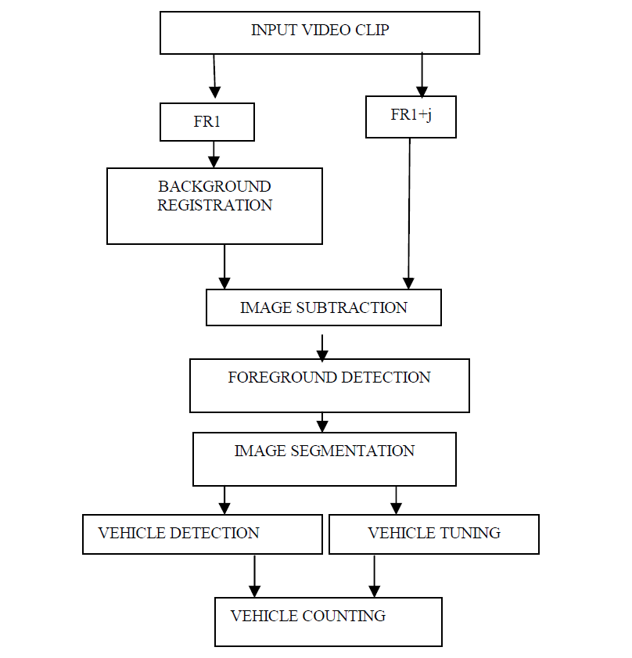
Literature survey-3
Notes:
When conducting research, it is easy to go to one source: Wikipedia. However, you need to include a variety of sources in your research. Consider the following sources:
Who can I interview to get more information on the topic?
Is the topic current and will it be relevant to my audience?
What articles, blogs, and magazines may have something related to my topic?
Is there a YouTube video on the topic? If so, what is it about?
What images can I find related to the topic?

Slide 12
The solution has 3 stages :
Develop the idea for a single frame
2
Extend the idea for collection of frames
3
Now introduce the car count feature
1
(i.e.) IMAGE PROCESSING
(i.e.) VIDEO PROCESSING
(i.e.) ADDED FEATURE
TRAIN
TEST
Notes:
When conducting research, it is easy to go to one source: Wikipedia. However, you need to include a variety of sources in your research. Consider the following sources:
Who can I interview to get more information on the topic?
Is the topic current and will it be relevant to my audience?
What articles, blogs, and magazines may have something related to my topic?
Is there a YouTube video on the topic? If so, what is it about?
What images can I find related to the topic?

Slide 13
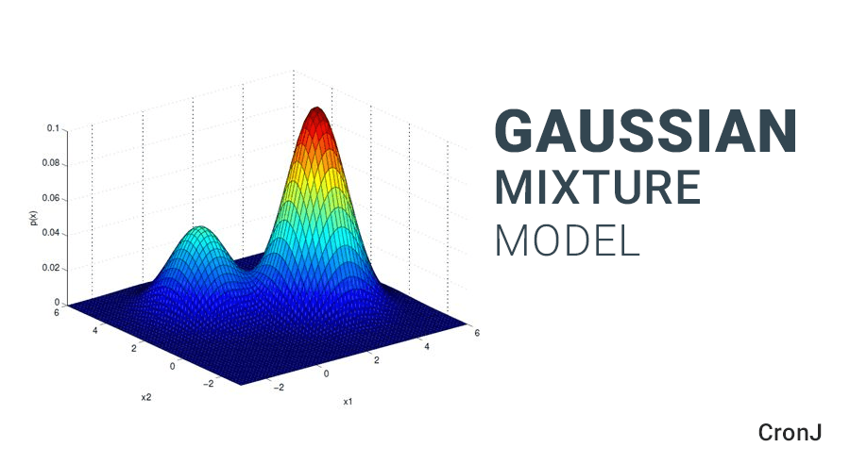
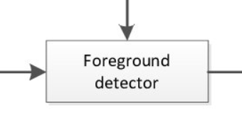
THE IDEA……
Notes:
You can use this slide as your opening or closing slide. Should you choose to use it as a closing, make sure you review the main points of your presentation. One creative way to do that is by adding animations to the various graphics on a slide. This slide has 4 different graphics, and, when you view the slideshow, you will see that you can click to reveal the next graphic. Similarly, as you review the main topics in your presentation, you may want each point to show up when you are addressing that topic.
Add animation to images and graphics:
Select your image or graphic.
Click on the Animations tab.
Choose from the options. The animation for this slide is “Split”. The drop-down menu in the Animation section gives even more animations you can use.
If you have multiple graphics or images, you will see a number appear next to it that notes the order of the animations.
Note: You will want to choose the animations carefully. You do not want to make your audience dizzy from your presentation.

Slide 14
Foreground detector
Gaussian mixture model
estimates the foreground pixels of the video sequence captured from a stationary camera
estimates the background using Gaussian Mixture Models and produces a foreground mask highlighting foreground objects; in this case, moving cars
a multivariate distribution that consists of multivariate Gaussian distribution components
Each component is defined by its mean and covariance.

Slide 15
PROJECT ASSUMPTIONS……
STATIONARY CAMERA
STATIC BACKGROUND
Notes:
You can use this slide as your opening or closing slide. Should you choose to use it as a closing, make sure you review the main points of your presentation. One creative way to do that is by adding animations to the various graphics on a slide. This slide has 4 different graphics, and, when you view the slideshow, you will see that you can click to reveal the next graphic. Similarly, as you review the main topics in your presentation, you may want each point to show up when you are addressing that topic.
Add animation to images and graphics:
Select your image or graphic.
Click on the Animations tab.
Choose from the options. The animation for this slide is “Split”. The drop-down menu in the Animation section gives even more animations you can use.
If you have multiple graphics or images, you will see a number appear next to it that notes the order of the animations.
Note: You will want to choose the animations carefully. You do not want to make your audience dizzy from your presentation.

Slide 16
CODE :
%initialize the foreground object
foregroundDetector = vision.ForegroundDetector('NumGaussians', 3, ...
'NumTrainingFrames', 50);
%read the image
frame = imread('saved.jpg');
foreground = step(foregroundDetector, frame);
%display the original image
figure; imshow(frame); title('IMAGE');
%display the Foreground image
figure; imshow(foreground); title('Foreground');
Notes:
Now, that you have narrowed your topic, you will want to organize your research in a structure that works. There are some common organizational patterns based on the kind of research you are doing.
Organizational Structures:
Cause and Effect- this kind of structure is great for explaining the causes and effects of a topic
Compare and Contrast- in this pattern you highlight the similarities and differences of the topic
Explain process- this structure is great for outlining a series of steps to follow;
Definition- if you want to make sure your audience understands what something is using illustrations, meanings, clarifying misconceptions, you may want to use this structure
Classification- a common organizational structure is grouping like topics or facts from the research together. For instance, in the internet safety about social media apps, you may organize the research where you look at each social media app one at a time

Slide 17
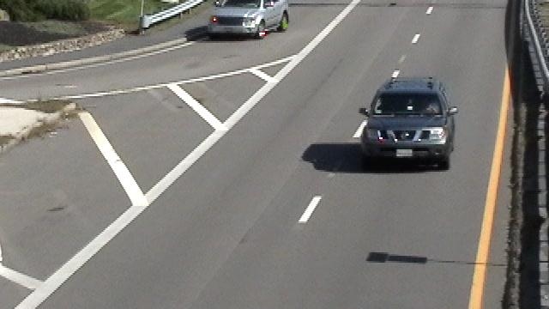
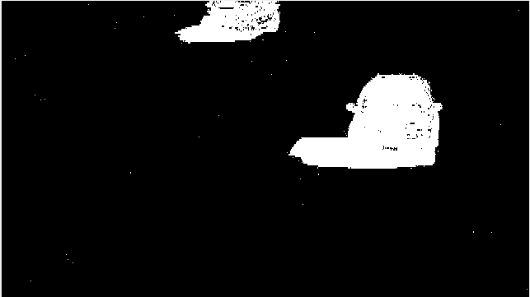
ORIGINAL IMAGE FOREGROUND IMAGE

Slide 18
%cleaning the Foreground image further
se = strel('square', 3);
filteredForeground = imopen(foreground, se);
%display the clean Foreground image
figure; imshow(filteredForeground); title('Clean Foreground');
Notes:
Now, that you have narrowed your topic, you will want to organize your research in a structure that works. There are some common organizational patterns based on the kind of research you are doing.
Organizational Structures:
Cause and Effect- this kind of structure is great for explaining the causes and effects of a topic
Compare and Contrast- in this pattern you highlight the similarities and differences of the topic
Explain process- this structure is great for outlining a series of steps to follow;
Definition- if you want to make sure your audience understands what something is using illustrations, meanings, clarifying misconceptions, you may want to use this structure
Classification- a common organizational structure is grouping like topics or facts from the research together. For instance, in the internet safety about social media apps, you may organize the research where you look at each social media app one at a time

Slide 19
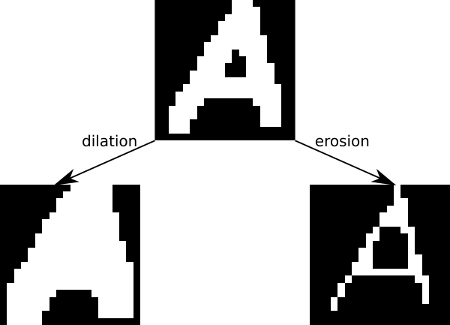

MORPHOLOGICAL IMAGE OPENING
- EROSION FOLLOWED BY DILATION
- RESULT IS A FILTERED FOREGROUND IMAGE
Image opening

Slide 20
%display the clean Foreground image
figure; imshow(filteredForeground); title('Clean Foreground');
%blob analysis
blobAnalysis = vision.BlobAnalysis('BoundingBoxOutputPort', true, ...
'AreaOutputPort', false, 'CentroidOutputPort', false, ...
'MinimumBlobArea', 150);
bbox = step(blobAnalysis, filteredForeground);
%insert rectangles on identified cars
result = insertShape(frame, 'Rectangle', bbox, 'Color', 'green');

Slide 21
%count the foreground images in the frame
numCars = size(bbox, 1);
%find the final result
result = insertText(result, [10 10], numCars, 'BoxOpacity', 1, ...
'FontSize', 14);
%display the final image with the cars detected
figure; imshow(result); title('Detected Cars');

Slide 22
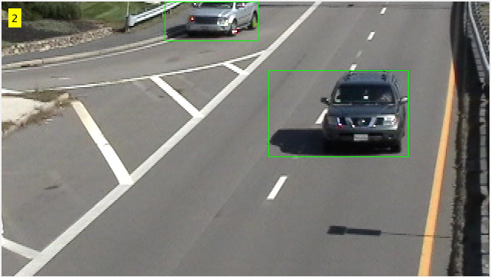
CLEAN FOREGROUND IMAGE DETECTED CARS

Slide 23




Project status:
Stage 1 – completed
Stage 2 – completed
Stage 3 – incomplete
Image processing - TRAIN
Video processing - TEST

Slide 24
THANK YOU

