Slide 1

TOPIC : EARTHQUAKES IN TURKEY
SOURCE:WWW.KAGGLE.COM
TEAM MEMBERS :
1.G Sai Charan Reddy – PES2201800483
2.Sagar S – PES2201800343
3.Chethan M – PES2201800331

Slide 2
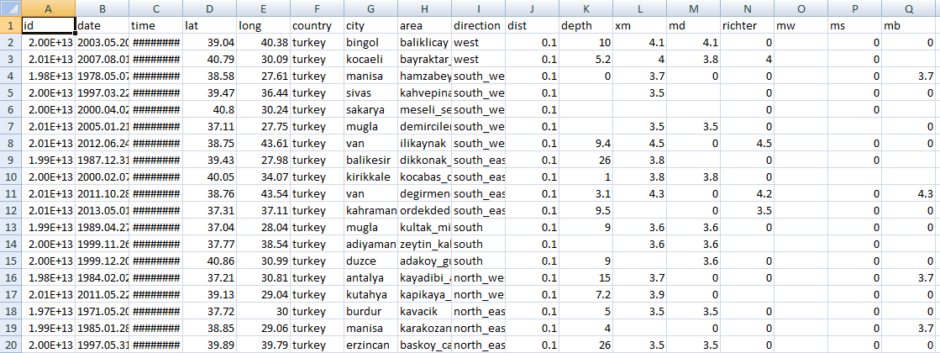
DATASET DESCRIPTION :
1.Number of Rows – 24007
2.Number of Columns – 17
3.Categorical Columns – 6
4.Numerical Columns – 11
5.Missing and NAN values – 3 % approx.

Slide 3
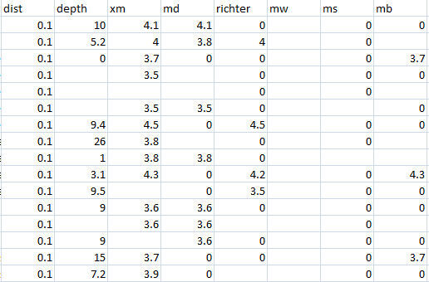
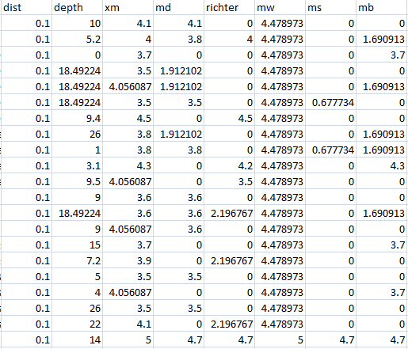
DATA CLEANING
BEFORE
AFTER

Slide 4
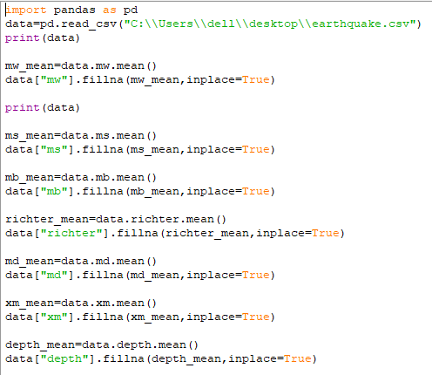

Slide 5
NORMALIZATION
AND
STANDARDIZATION
Why is it important ?
- Gives better results from ML models
- Scaling the spread to same range
How does it affect the dataset ?
- Makes the dataset flexible
- Eliminates the redundancy and inconsistency in dataset
- Improves Data dependence
- Improves Data integrity

Slide 6
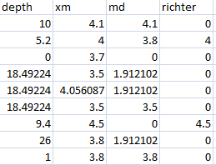
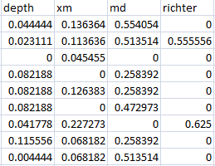
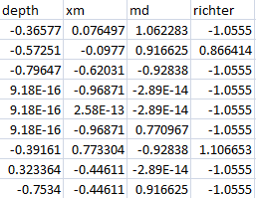
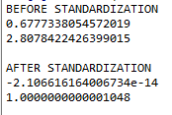
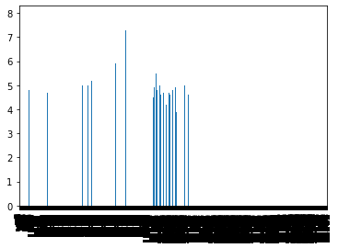
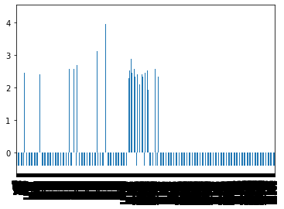
BEFORE
AFTER
BEFORE STANDARDISATION
AFTER STANDARDISATION

Slide 7
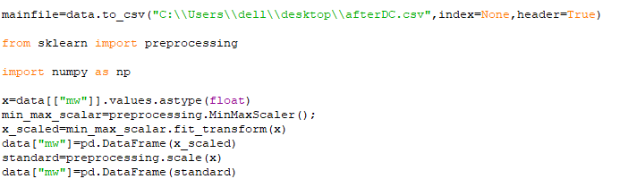
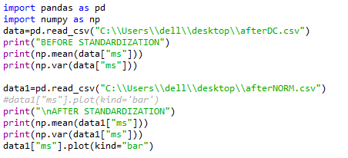

Slide 8
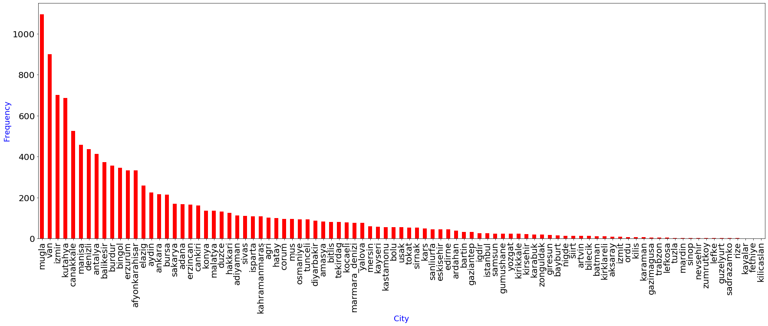
GRAPH-1
NUMBER OF EARTHQUAKES IN EACH CITY :
-Mugla city has recorded the highest number of earthquakes
-Almost zero earthquakes occurred in Fethiya, Kayalar and Kilicaslan

Slide 9
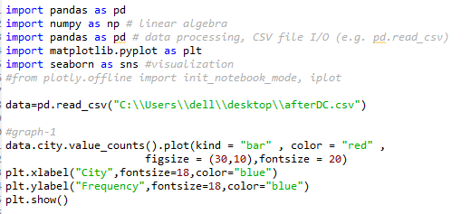

Slide 10
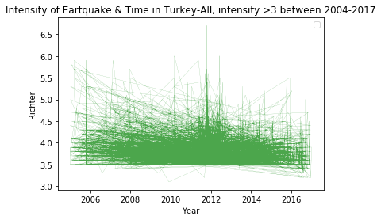
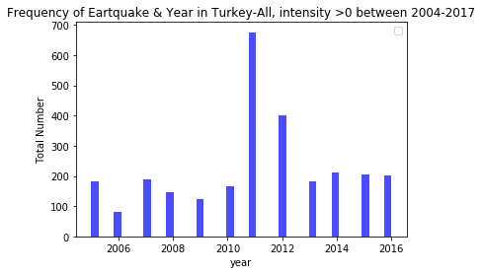
GRAPH-2 [Intensity and Frequency of EQ]
Year 2011 witnessed the
most number of earthquakes
and also high intensity
earthquakes.
-Year 2006 witnessed the least
number of earthquakes .
-Year 2016 witnessed low
intensity earthquakes.

Slide 11
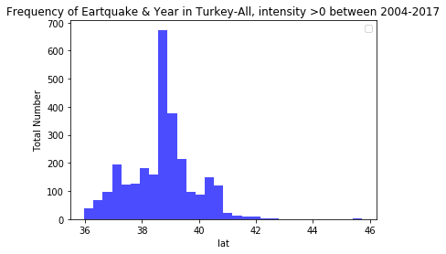



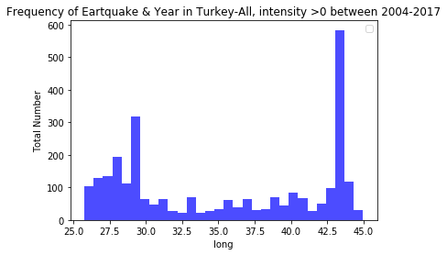
GRAPH-3 [Most affected Locations]
These places come under
The SILK-ROAD District in
Turkey

Slide 12
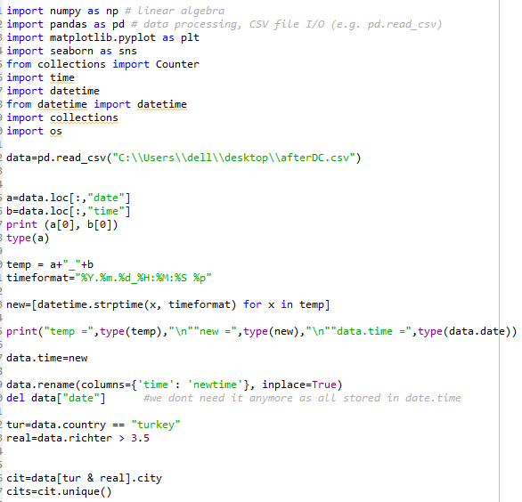
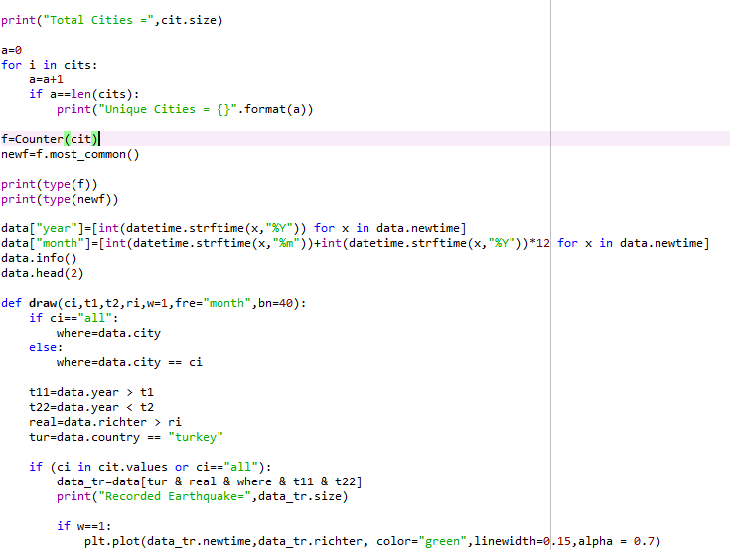

Slide 13
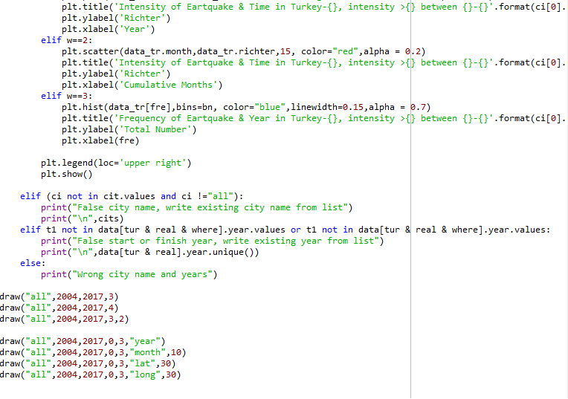

Slide 14
Hypothesis Testing
NULL HYPOTHESIS
There is no significant diff in the average Richter of north and south directed earthquakes - H0 :μX − μY = 0
ALTERNATE HYPOTHESIS
There is a significant diff in the average Richter of north and south directed earthquakes - H1 :μX − μY != 0
TEST
Large Sample test for difference b/w two means

Slide 15
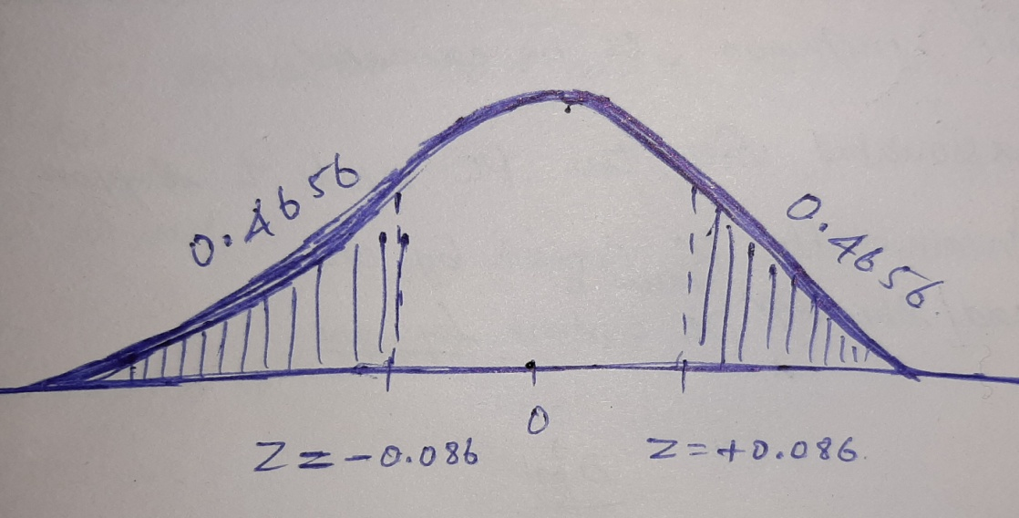
Hypothesis Testing
RESULT
Z-Value = -0.086
P-Value= 0.9313 > 0.05
Hence, we do not reject NULL Hypothesis.............

Slide 16
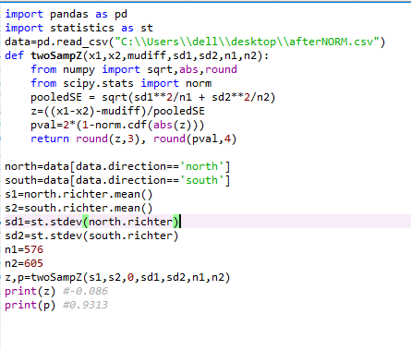

Slide 17
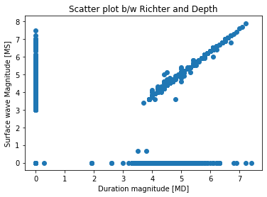


CORRELATION
-MS is the amplitude of a wave
in seismograph
-MD is the length of a wave in
seismograph
MS – size of an earthquake
MD – duration of an earthquake
Correlation value = 0.4612
M - MS
A - MW

Slide 18
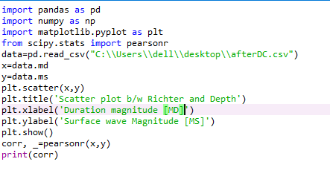

Slide 19
THANK YOU

