Slide 1

DATA ANALYTICS PROJECT India Literacy Analysis Using population data
CHETHAN M – PES2201800331
ANIRUDH R – PES2201800068
S SREE KAUSTUB – PES2201800061
G CHARAN REDDY – PES2201800483

Slide 2
Dataset : India Census 2011 (Latest census) https://www.kaggle.com/danofer/india-census
What to figure out ?
Various factors affecting literacy rate in India and how important each factors are in the literacy rate prediction.
Why this dataset?
- More than required features
- Huge no. of data samples
- Very less pre-processing required (almost zero NA columns)

Slide 3
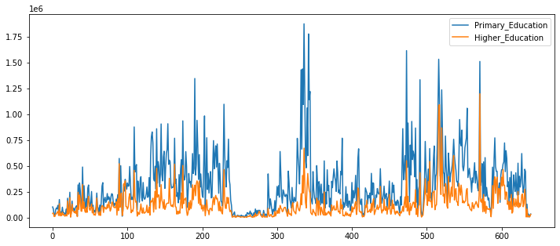
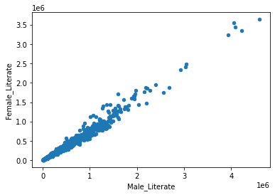
People stopping their education after primary classes
are marginally high. (Huge factor affecting the literacy rate
In India, when a minimum degree case is considered). But
it has been good since the 2001 census where people are
taking education and literacy in serious note.
Literacy rate:
2001 : 64.9052 %
2011 : 75.0021 %
Literacy rate:
2001:
MALE : 74.1004 %
FEMALE : 54.0076 %
2011:
MALE : 82.1096 %
FEMALE : 65.4897 %

Slide 4
Model Building
Model Used : Multiple Linear Regression
Target Variable : Literacy Rate
Independent Variables : Age group (0-29) & (30-50)
Households with car_jeep_van
Households with computer
Households with internet
Households with telephone_mobile

Slide 5
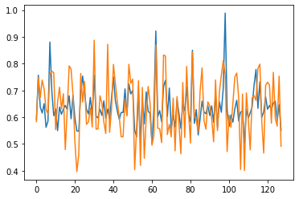
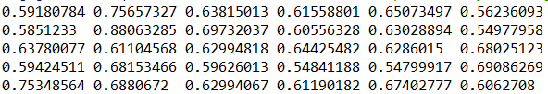
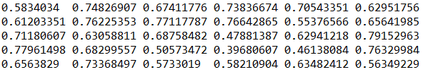
Prediction
Predicted values:
Original values:

Slide 6
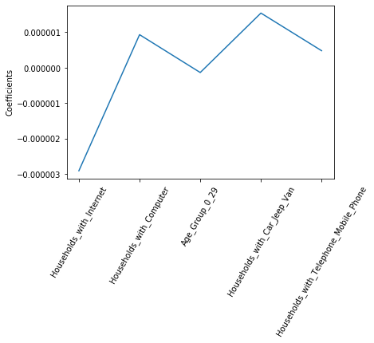
LASSO REGRESSION

Slide 7

Model Evaluation
Mean Squared Error:
Mean Absolute Error:

Slide 8
Conclusion and Inferences
People who are rich (categorized by owning a car, computer, mobiles etc.) tend to have high access to education resulting in high literacy rates in that particular district.
Districts having high male population tend to have literacy rates.
Districts having high permanent house-holds have high literacy rates.
Districts with high youth population (20-40) have marginally higher literacy rates.

Slide 9
Project Roles
CHETHAN M – MODEL BUILDING
ANIRUDH R – MODEL EVALUATION & INTERPRETATION
S SREE KAUSTUB – EDA + DATA-PREPROCESSING
G CHARAN REDDY – DATSETS COLLECTION AND RESEARCH PAPERS COLLECTION

