Slide 1
Oil pipeline accidents
Chethan M(PES2201800331)
Anirudh R(PES2201800068)

Slide 2
Linear Regression Model
Linear regression is used to predict the value of a continuous variable Y based on one or more input predictor variables X.
The aim of Linear Regression is to find a mathematical equation for a continuous response variable Y as a function of one or more X variable(s).
Y=aX+bY+....+intercept

Slide 3
Modelling
The dataset is split into 2 parts
80% data
20% data
op=read.csv("datasetmain.csv")
library(caTools)
split=sample.split(op,SplitRatio = 0.8)
train=subset(op,split="TRUE")
test=subset(op,split="FALSE")

Slide 4
Modelling
Linear Regression will be modelled on the dataset that contains 80% of values (train).
Predictions will be made on the dataset that contains 20% of values (test).
4 variables are used for modelling here :
Intentional oil loss
Unintentional oil loss
Oil recovery
Net loss

Slide 5

Creating the Model
net=train$Net.Loss..Barrels.
unint=train$Unintentional.Release..Barrels.
rec=train$Liquid.Recovery..Barrels.
int=train$Intentional.Release..Barrels.
model=lm(net~(unint+int+rec),data=train)
summary(model)

Slide 6

Significance of Model
P-Value =2.2e-16 < 0.05
Standard Error – measures the goodness of fit.
SE= 4.781e-12 (almost 0)
R squared – proportion of variation in dependent variables.
= 1 ( >0.70 )

Slide 7
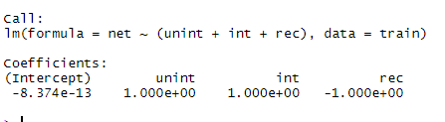
The model
Hence, the model is significant
Net = unint + int - rec – 8.374e-13

Slide 8

Prediction
pred=predict(model,test)
plot(test$Net.Loss..Barrels.,type="l",lty=1.8,col="red")
plot(pred,type="l",lty=1.8,col=“blue")
------------------The data-values are similar--------------------

Slide 9
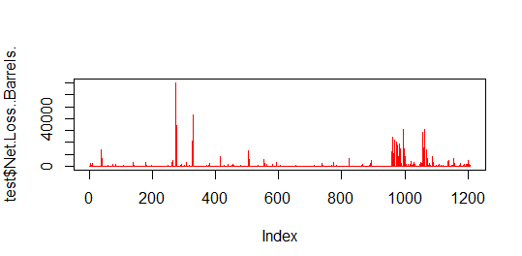
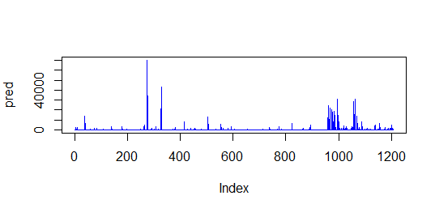
Prediction

Slide 10
Thank you

