Slide 1
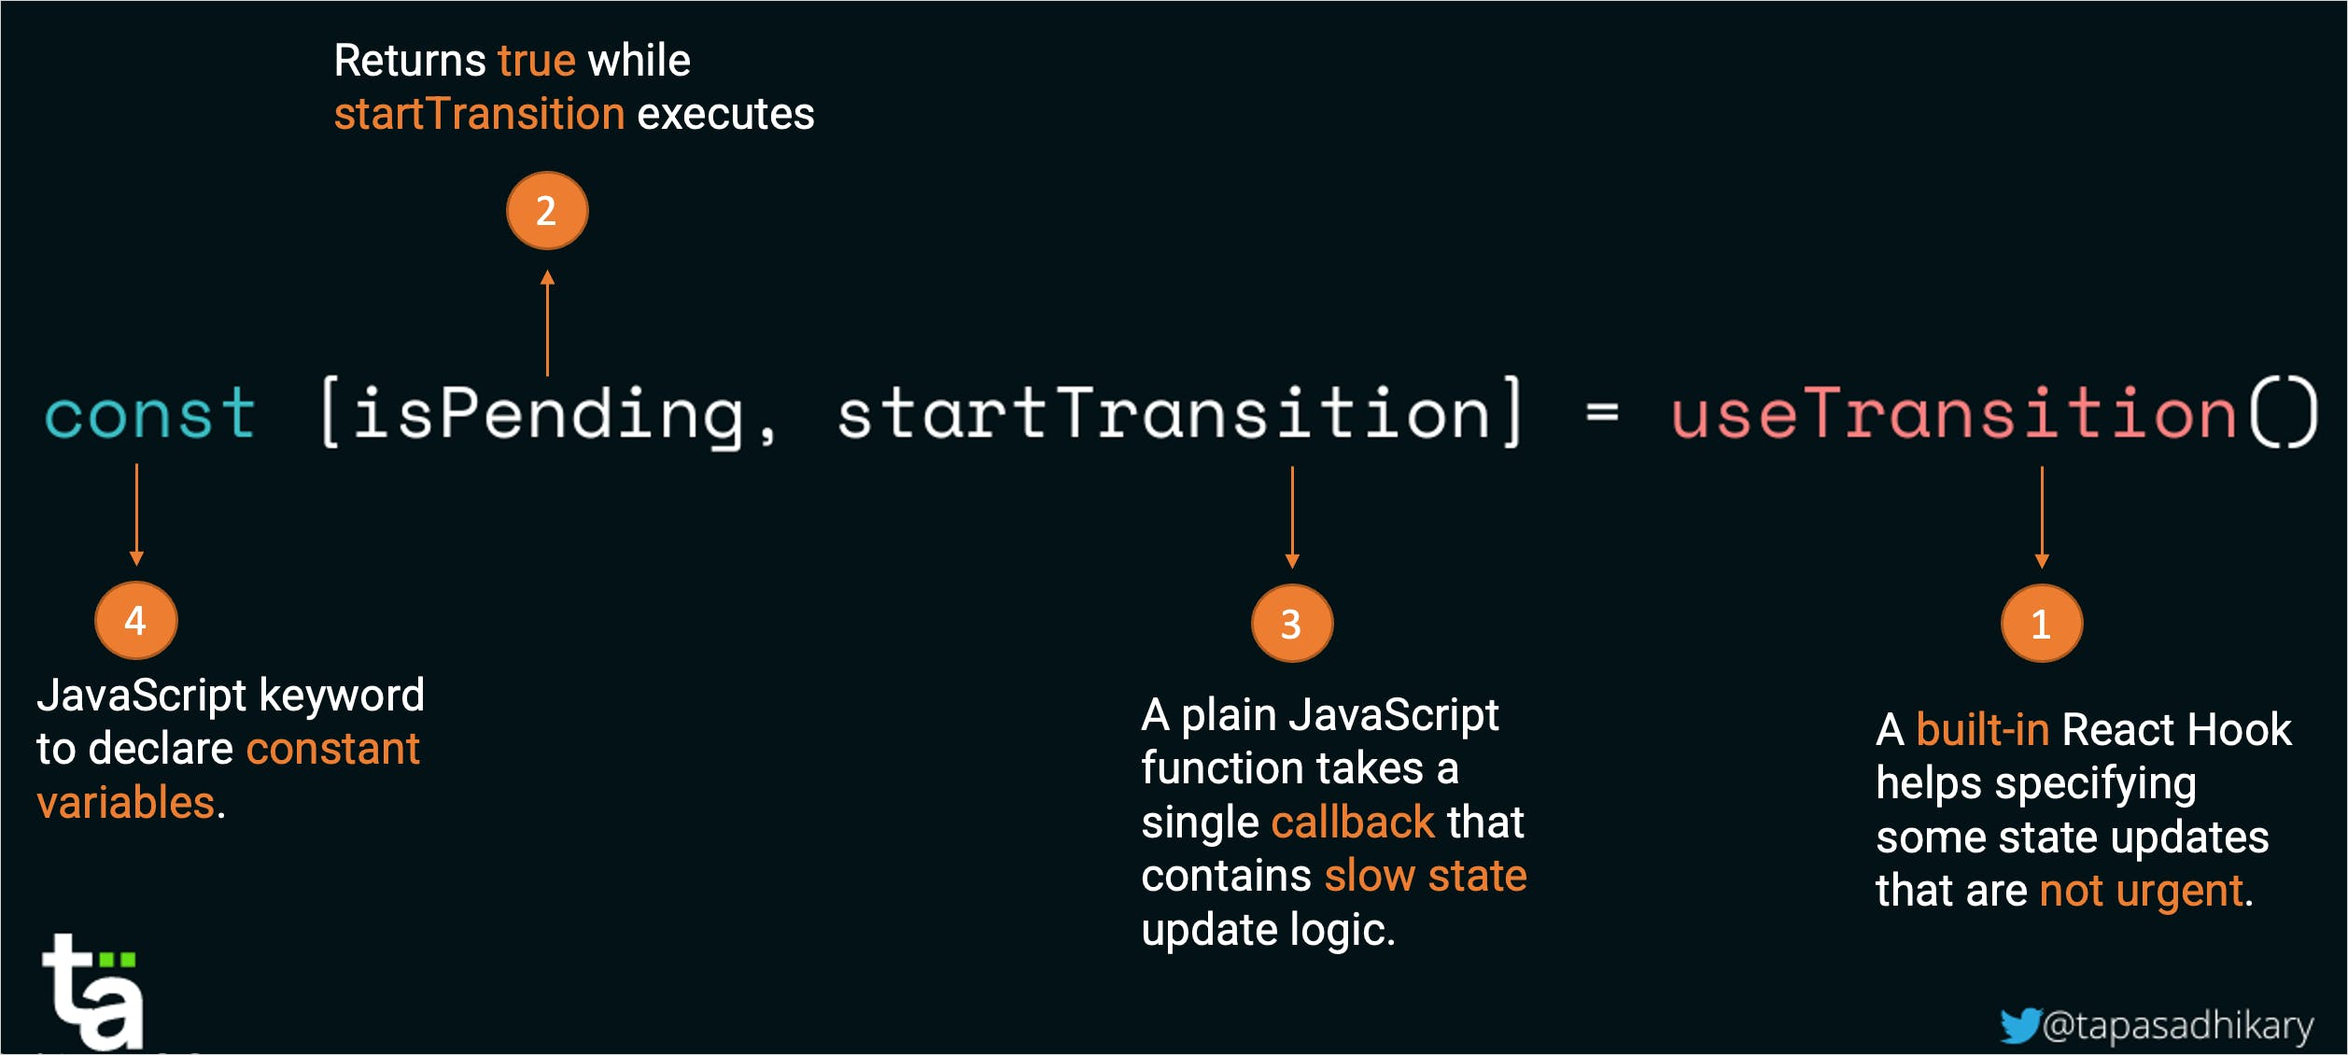
React 18 New features added.
1) New hook useTransition introduced.
This hook is used to improve the performance and responsiveness of the application. Mainly to improve the user experience.
This will work by making the urgent state transitions separated from not so important state transitions.
Code snippets are shown below.

Slide 2
Then the state variables has to be updated as shown below
const handleChange = ({ target: { value } }) => {
setSearchTerm(value);
startTransition(() => {
setFiltered(users.filter((item) => item.name.includes(value)));
});
};
Link : https://blog.greenroots.info/explain-react-18-usetransition-hook-with-examples
Github source code: https://github.com/atapas/youtube/tree/main/react/20-useTransition

