Slide 1






SafeRoute
– Women Safety & Emergency Assistance Platform
Team Name: DEBOT
Ch Stephy
SK Ruksana
D Chethana Laxmi
Reg. No: 241FA04087
Reg. No: 241FA04309
Reg. No: 241FA04A59
Notes:
Introduce the project, the team name DEBOT and the three team members.

Slide 2






Introduction & Problem Statement
Introduction
The Problem
SafeRoute is a web-based women safety and emergency assistance platform. It helps users access emergency support, share their location and find nearby emergency services.
Unsafe situations, slow access to help and scattered safety tools
Problem Statement
Women may face unsafe situations while travelling or in unfamiliar locations.
SafeRoute – One Platform
Accessing emergency contacts quickly can be difficult.
Sharing live location during emergencies can be challenging.
SOS emergency alert
Finding nearby police stations and hospitals may take time.
Live location sharing
Nearby hospitals & police
A centralized digital safety assistance platform is needed.
Notes:
Explain the problem women face in unsafe situations and how SafeRoute offers one place for emergency help.

Slide 3







Project Objectives
01
02
03
04
Provide quick access to emergency assistance
Enable SOS emergency alert functionality
Allow users to manage trusted emergency contacts
Support location sharing with trusted contacts
05
06
07
Help find routes and nearby emergency services
Provide an incident reporting facility
Develop a responsive, user-friendly web application
Your Safety, Our Priority.
Notes:
Walk through the seven objectives of the project.

Slide 4










Technologies & Tools Used
M
E
R
N
MongoDB
Express.js
React.js
Node.js
NoSQL database
Backend web framework
Frontend library
JavaScript runtime
Stores user details, emergency contacts, SOS alerts and reports.
Handles API requests and server-side operations.
Builds interactive and responsive user interfaces.
Executes backend application logic.
Additional Tools
HTML, CSS & JavaScript – web fundamentals
Axios – API communication
JWT & bcrypt – authentication and password security
Mongoose – MongoDB integration
Antigravity IDE – AI-assisted development
Git & GitHub – version control
Notes:
Explain each part of the MERN stack and the supporting tools used in the project.

Slide 5



System Architecture & Workflow
User
React.js Frontend
Axios API Requests
Node.js + Express.js Backend
MongoDB Database
Request Workflow
1
User registers or logs into SafeRoute.
2
React frontend sends requests to the backend.
3
Express APIs process the requests.
4
MongoDB stores and retrieves information.
5
Backend sends responses to the frontend.
6
User accesses the required safety features.
SOS Workflow
User
SOS Confirmation
Location Retrieval
Emergency Alert Processing
Contact Notification
Notes:
Show how data flows from the user to the database, then explain the SOS alert flow step by step.

Slide 6


Features & Functionalities
User Authentication
SOS Emergency Alert
Emergency Contacts
Live Location Sharing
Secure registration and login.
Allows users to initiate emergency alerts.
Add, view, update and delete trusted contacts.
Share location with authorized contacts.
Safe Route Finder
Nearby Emergency Services
Incident Reporting
Display routes between selected locations.
Locate nearby hospitals and police stations.
Submit and view safety-related reports.
Notes:
Cover the eight major features of SafeRoute briefly.

Slide 7
Database Design & API Integration
MongoDB Collections
REST API Endpoints
Users
Emergency Contacts
POST /api/auth/register
POST /api/auth/login
GET /api/contacts
POST /api/contacts
PUT /api/contacts/:id
DELETE /api/contacts/:id
POST /api/sos
GET /api/sos/history
POST /api/reports
GET /api/reports
User ID
Name
Email
Password (hashed)
Phone Number
Role
Contact ID
User ID
Contact Name
Phone Number
Relationship
SOS Alerts
Emergency Reports
Alert ID
User ID
Latitude
Longitude
Alert Status
Timestamp
Report ID
User ID
Title
Description
Category
Report Status
React + Axios
Express APIs
MongoDB via Mongoose
Notes:
Explain the four collections and how React talks to Express through REST APIs, and Express talks to MongoDB through Mongoose.

Slide 8
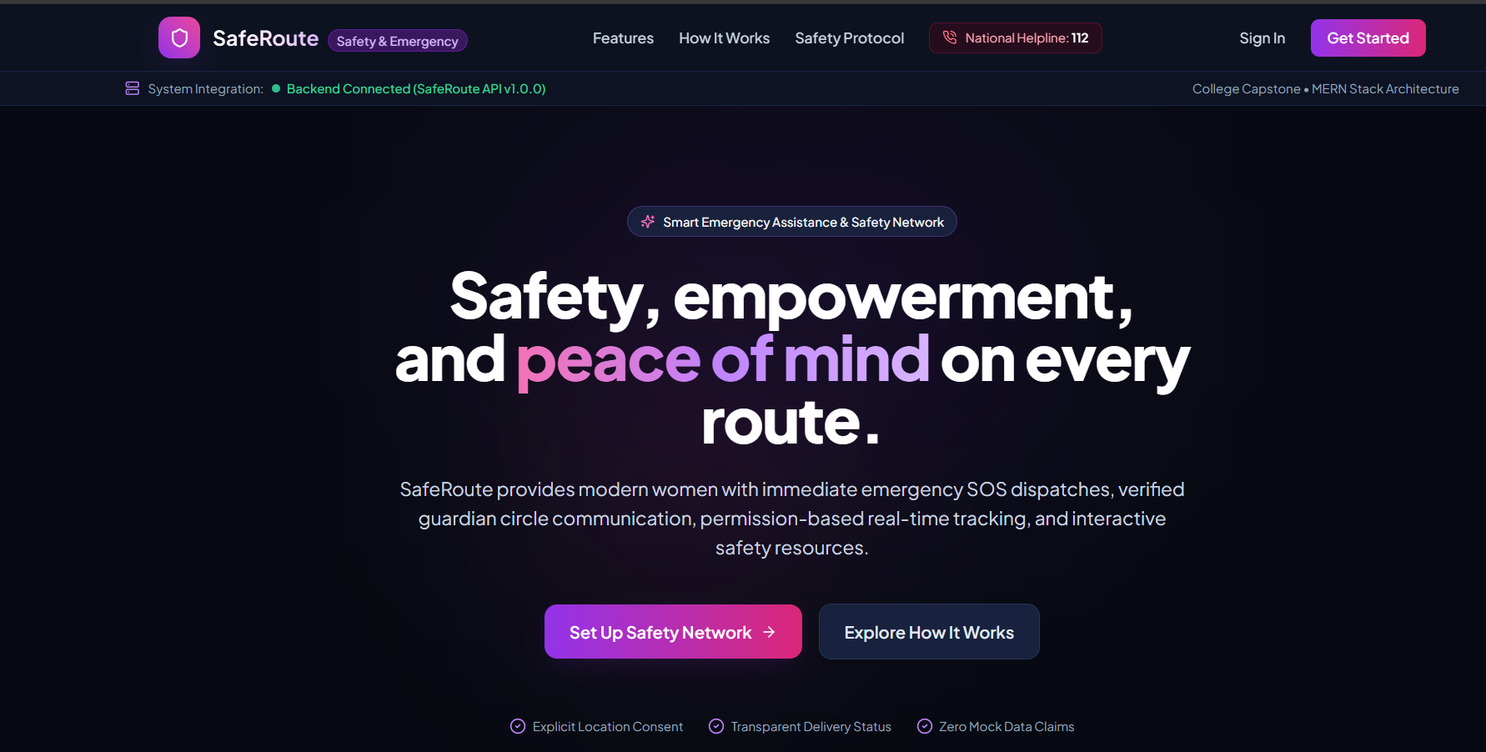
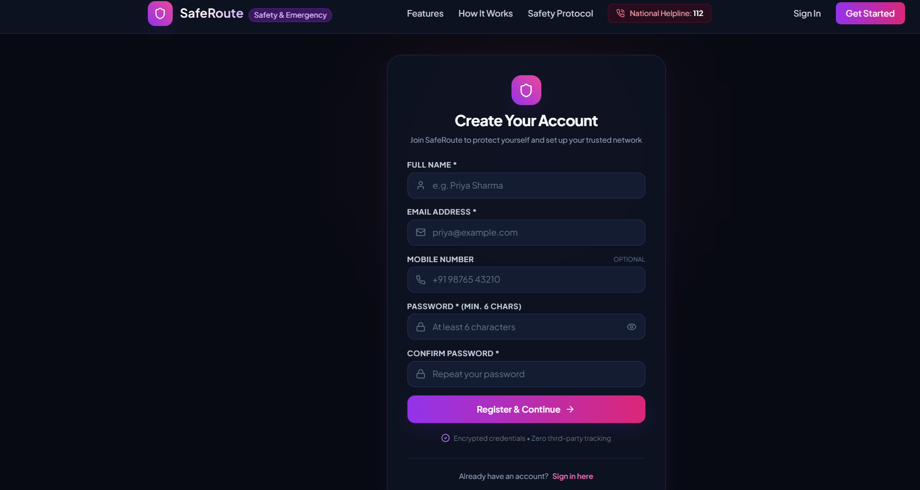
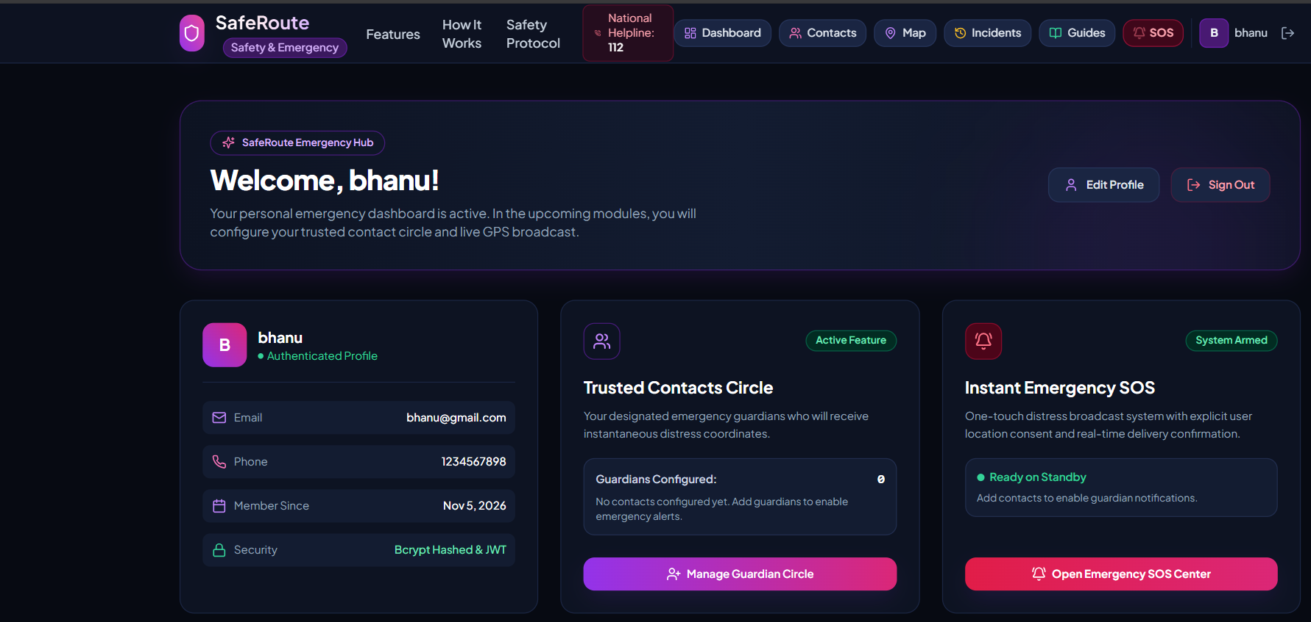

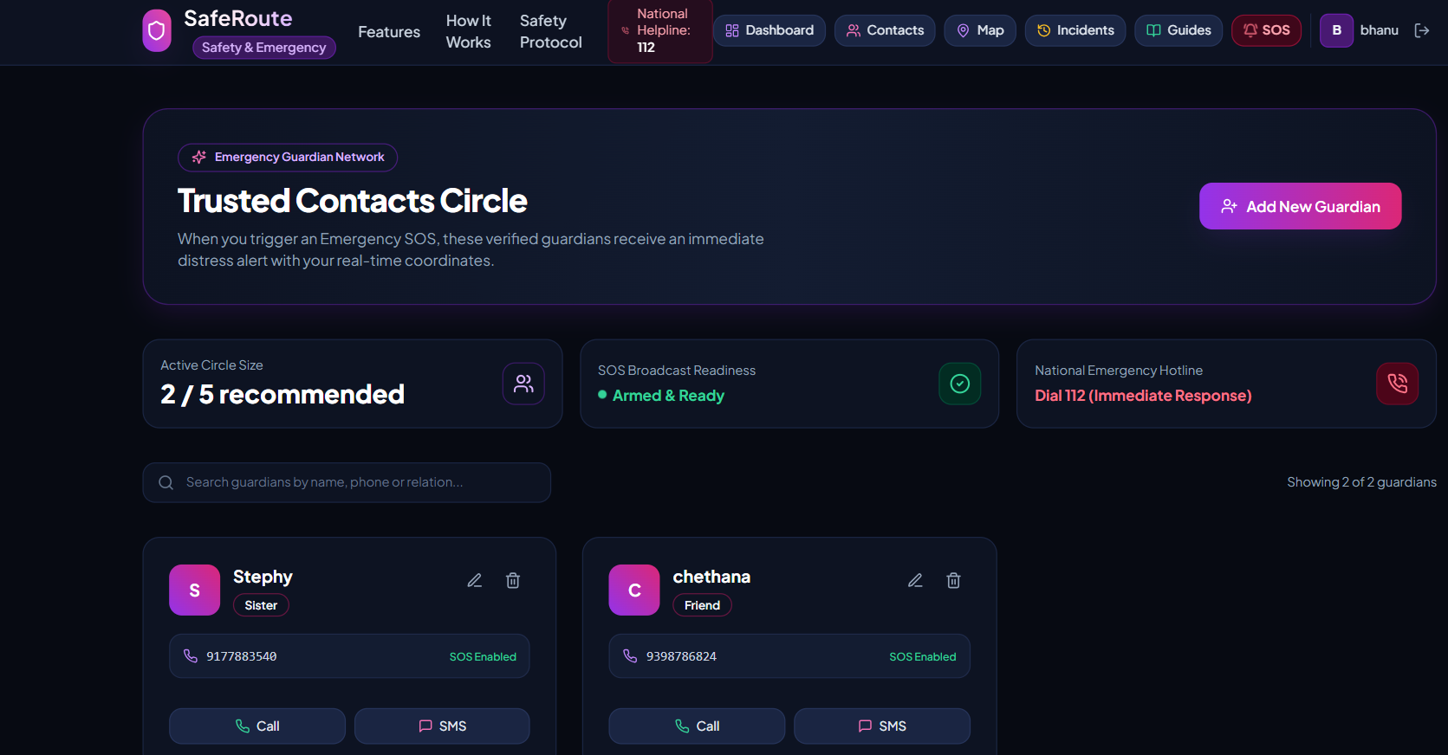
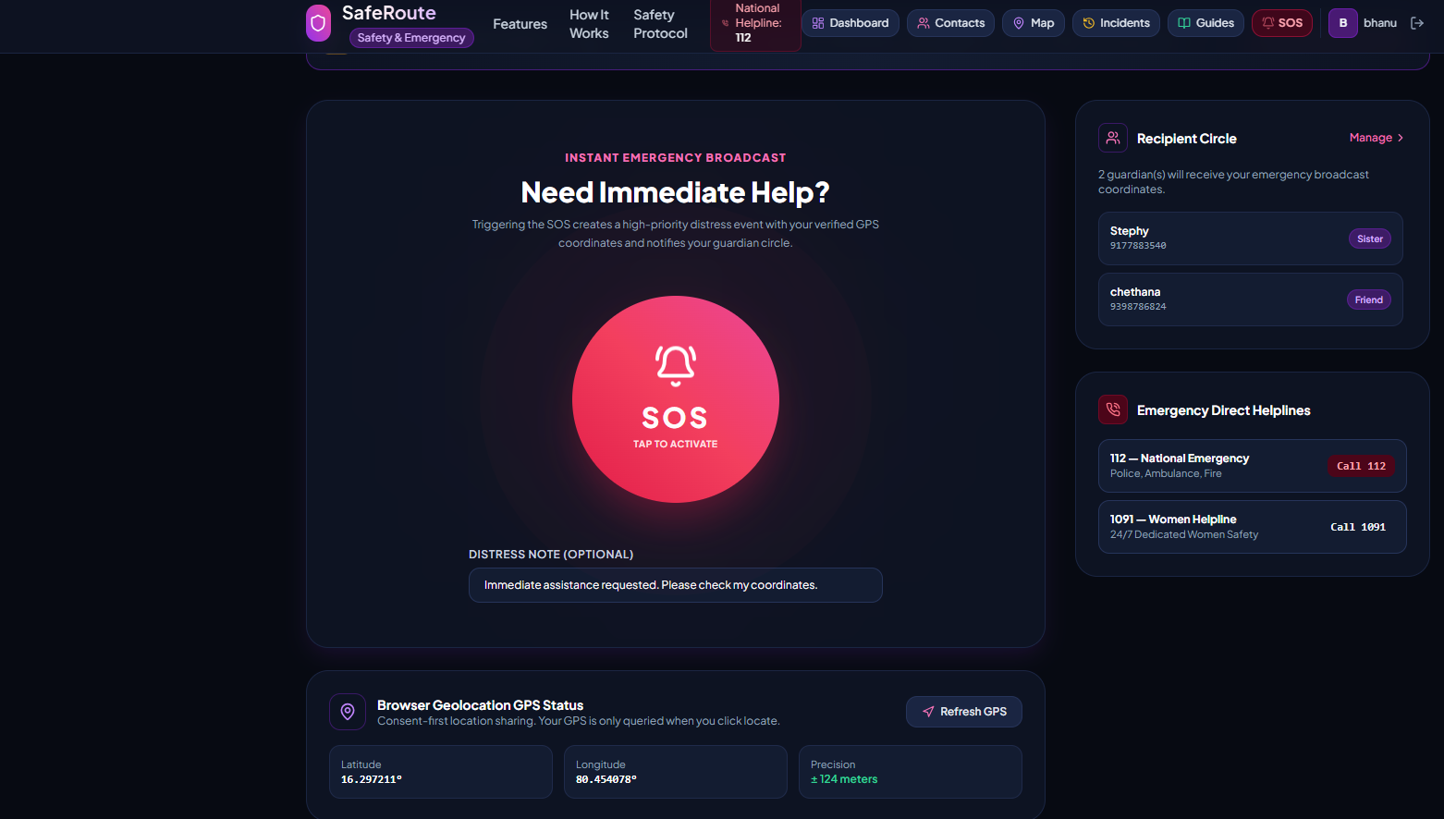
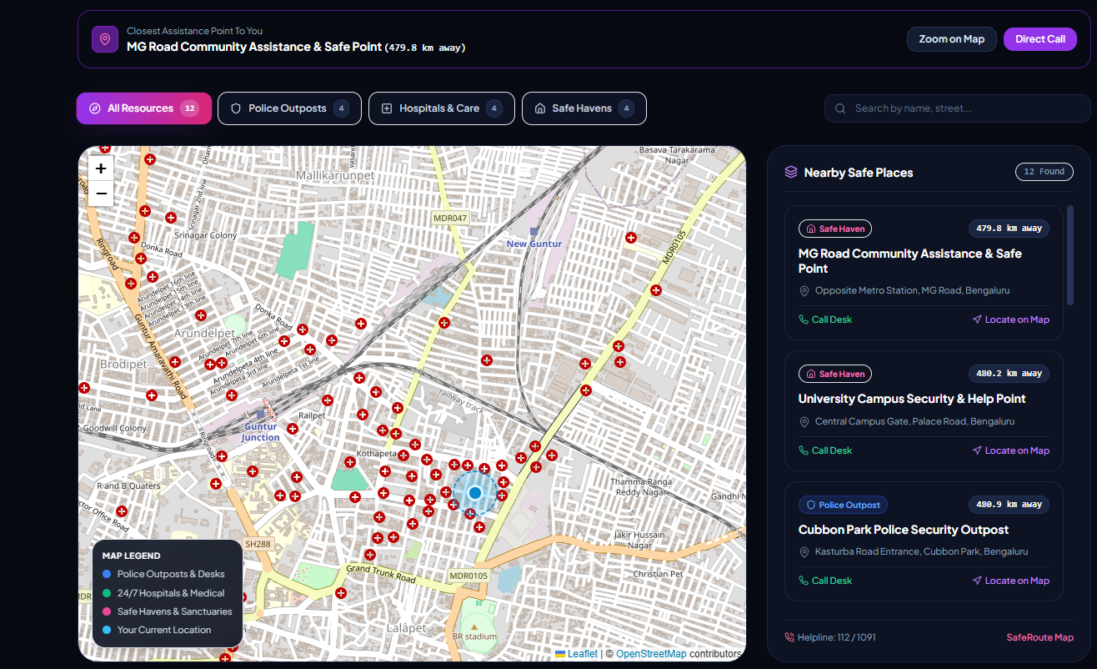
Project Screenshots
Home Page
Login & Registration Page
User Dashboard
Screenshot placeholder
Screenshot placeholder
Screenshot placeholder
Emergency Contacts Page
SOS Alert Interface
Safe Route Map
Screenshot placeholder
Notes:
These are labelled placeholders. Replace each one with a real screenshot of the finished page before presenting.

Slide 9








Challenges Faced & Future Scope
Challenges Faced
Future Scope
PLANNED – NOT YET IMPLEMENTED
Integrating frontend and backend
Mobile application development
Integration with reliable SMS and emergency notification services
Connecting MongoDB with Express
Real-time location tracking
Implementing secure authentication
Multilingual support
Handling browser location permissions
Voice-activated SOS functionality
Managing API errors and data validation
AI-based assistance and safety recommendations
Designing a responsive user interface
Integration with verified emergency service providers
Planned enhancements – not part of the current implementation.
Notes:
Mention the main challenges, then clearly say that the future scope items are plans, not finished features.

Slide 10

Conclusion
SafeRoute aims to provide a centralized digital platform for women safety and emergency assistance.
Quick access to emergency assistance
Your Safety, Our Priority.
Better emergency contact management
THANK YOU!
Location-sharing support
Access to nearby emergency services
Team DEBOT
Ch Stephy | SK Ruksana | D Chethana Laxmi
User-friendly and responsive MERN Stack architecture
Notes:
Summarise the key benefits, end with the tagline and thank the audience.

