Slide 1

GOVERNMENT ENGINEERING COLLEGE
MOSALEHOSAHALLI
Mobile Application Development
Project
Presentation On
“Music Player”
DEPARTMENT OF COMPUTER SCIENCE AND ENGINEERING
Presented By
CHETHANA B.V 4HG20CS004
ABHISHEK M 4HG21CS400
Under the Guidance
Miss.Madhuri
faculty, Dept.of CSE
GEC MH Halli

Slide 2
INTRODUCTION
The music player project is a software application designed to allow users to listen to their music collections on a computer or mobile device. The application will provide an interface for users to manage their music files, create playlists, and control playback. The interaction between the user and the media control so that the user can have a better experience to achieve real pressure relief.
It is worth mentioning that the music player has the audio trim function. Users can trim the best parts of the audio by setting the starting and ending points of the audio. Today everyone listens to music on their mobile devices, be it on the bus, while commuting to work, or while working out.

Slide 3
Scope of the project
The aim of a music player project is to create a software application or device that can play and manage digital audio files.
The primary goal of such a project is to provide a user-friendly interface for organizing and playing music, with features such as playlist creation.
The project may also involve designing and implementing algorithms for audio playback and processing. and ensuring smooth playback without skipping or buffering. Overall, the scope of the project of a music player project is to create a reliable and intuitive tool for listening to and enjoying music.

Slide 4
Objective
User-friendly interface: To create an intuitive and easy-to-use interface for organizing and playing music, with features such as playlist creation.
Audio playback and processing: To design and implement algorithms for audio playback and processing, such as decoding various audio file formats, applying audio effects, and ensuring smooth playback without skipping or buffering.
Compatibility and performance: To ensure that the music player can run on a variety of devices and operating systems, while meeting performance requirements such as fast load times and low resource usage.
Security and reliability: To ensure that the music player is secure, with features such reliable, with minimal crashes or errors. Overall, the objective of a music player project is to create a high-quality, reliable, and user-friendly tool for listening to and managing digital audio files.

Slide 5
System Configuration
HARDWARE CONFIGURATION
Processor : Intel core i5.
RAM : 4GB or Above.
Hard disk : 512 GB.
SOFTWARE CONFIGURATION
Operating System : Windows10 or ubuntu
Coding language : Java
Software : Android Studio

Slide 6
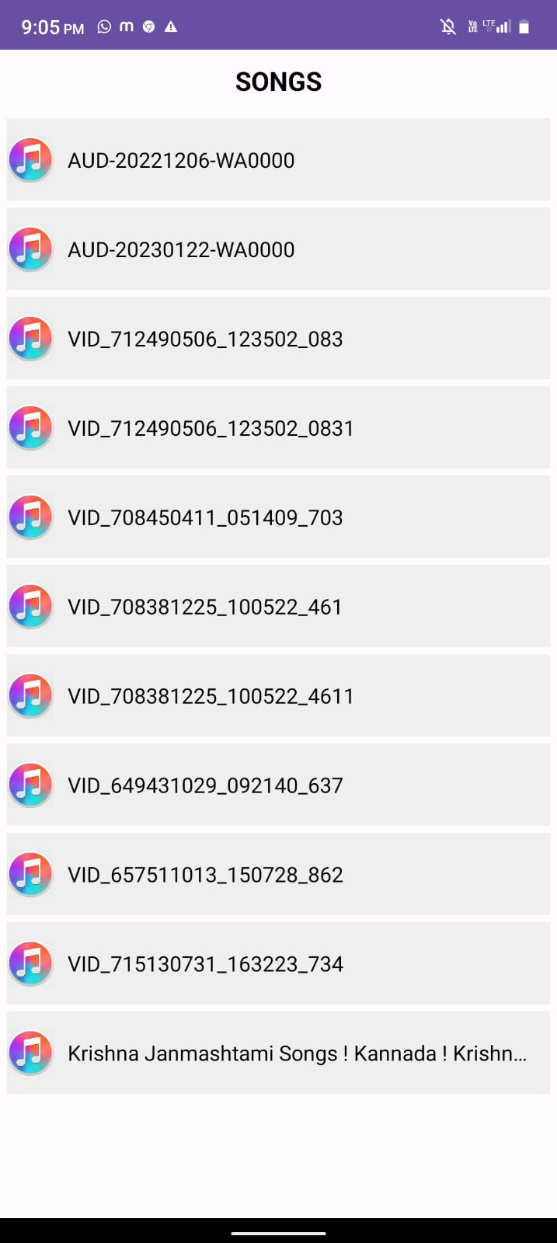
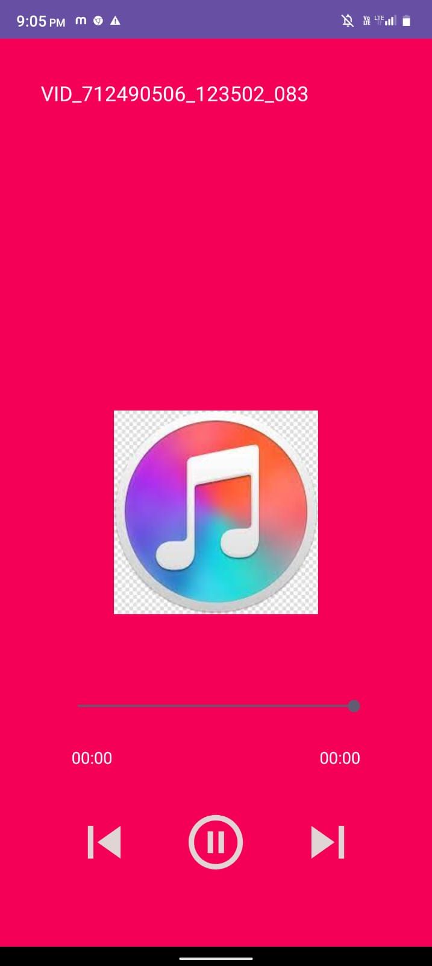
Snapshot

Slide 7
Module Description
This project, the agile development cycle will be used to guide the development process. The reason for using agile methods is that mobile applications have a short software life cycle and rapidly changing technologies, so users will constantly change their requirement and needs in response to technological changes.
The agile development cycle are more suitable for android application development because of iterative and flexible, so it can adapt effectively to changing customers. The agile development cycle contains phrase which is requirement analysis, planning, design, implementation or development, testing, and deployment.

Slide 8
Advantages
Personalized Music Experience: A music player app allows users to curate and personalize their music experience. They can create playlists, organize their favorite songs, and customize the app's settings to match their preferences
Enhanced Audio Features : Music player apps often come with advanced audio features to enhance the listening experience. Users can adjust equalizer settings, apply audio effects, create custom sound profiles, and control playback speed. These features allow users to fine-tune their audio preferences and enjoy their music the way they like it.
Offline Playback: Music player apps typically offer offline playback functionality, allowing users to download their favorite songs or playlists for offline listening. This feature is particularly useful in areas with limited internet connectivity or when users want to conserve their mobile data. Users can enjoy uninterrupted music even without an active internet connection.

Slide 9
Conclusion
Through the development of music player on Android platform, we get a clear understanding of overall process of the system. The core part of the music player is mainly composed of main interface, file browsing and song listing, Grasping the development of the music player has had the preliminary scale small features.
Music player system realized the basic function of player: play, pause, rewind and fast forward a, volume adjustment is performed through the Android System It self, play mode, song search, seek bar, This development implicated the popular mobile terminal development technology.

Slide 10
REFERENCES
Various open. Source materials from internet
https://www.Tutorialspoint.com
https://www.w3school.com
https://researchgate.net
www.openglforum.org

Slide 11


