Slide 1
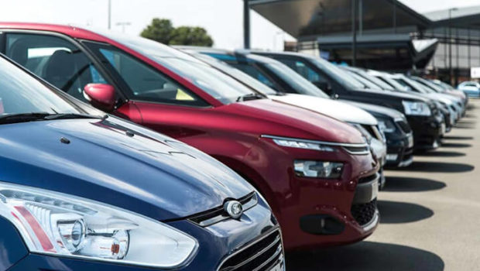

CAR PRICE PREDICTION PROJECT
Submitted to :
Mohd Kashif, Flip Robo Technologies
Submitted by:
CHETHANA M

Slide 2
Introduction
With the covid 19 impact in the market, we have seen lot of changes in the car market. Now some cars are in demand hence making them costly and some are not in demand hence cheaper. One of our clients works with small traders, who sell used cars. With the change in market due to covid 19 impact, our client is facing problems with their previous car price valuation machine learning models. So, they are looking for new machine learning models from new data. We have to make car price valuation model.
This project contains two phase :
Data Collection Phase : Here I have scraped 5,231 used cars data. Data of used cars is scraped the from Cars24 website. Using Selenium the data is scraped from the website for different locations like Bengaluru, Hyderabad, New Delhi, Noida, Gurgaon, Ahmedabad, Chennai and Mumbai. The number of columns for data is limited to be 10, it includes columns like Brand, model, variant, manufacturing year, driven kilometers, Automatic/Manual, fuel, number of owners, location and at last target variable Price of the car. Few Brands that are included in the data are Maruti, Hyundai, Nissan, Tata, Renault, Honda, Toyota, Kia, Mahindra, Skoda, Ford, Volkswagen, Mg, Datsun, Jeep, Mercedes Benz, Audi, Fiat, Bmw.
Model Building Phase : After collecting the data, machine learning model is built. Before model building all the data pre-processing steps are done. Different models with different hyper parameters are built and then the best model is selected. In the model building phase following steps are included - Data Cleaning, Exploratory Data Analysis, Data Pre-processing, Model Building, Model Evaluation, Selecting the best model.

Slide 3
Technical Goals
Which variables are important to predict the price of the used car?
How these variables are responsible to describe the price of the car?
Our main aim today is to make a model which can be used to predict the price of the used car based on other variables. We are going to use Linear Regression, Decision Tree Regressor, K Neighbors Regressor, SVR, Lasso and Ridge to build the different models for this dataset and see which model gives us a good accuracy.

Slide 4
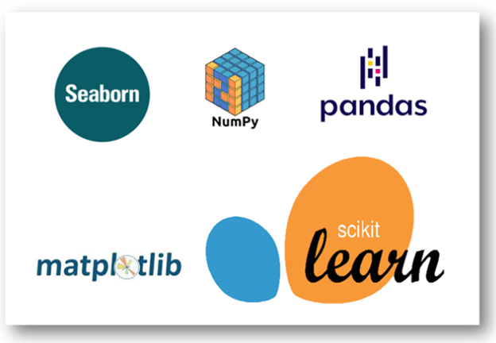
Software required
TOOLS USED
Jupyter Notebook
LIBRARY USED
Analysing : Numpy, Pandas, Sci-kit Learn
Visualization : Matplotlib, seaborn

Slide 5
Linear Regression
In this project we have used multiple algorithm to predict the price but ideally we will see what is Linear Regression.
In statistics, linear regression is a linear approach for modelling the relationship between a scalar response and one or more explanatory variables (also known as dependent and independent variables). The case of one explanatory variable is called simple linear regression, for more than one, the process is called multiple linear regression.
Apart from Linear Regression the other algorithms used in this project are :
Support vector Regressor
Decision Tree Regressor
KNeighbors Regressor
Ridge
Lasso

Slide 6
Implementation
Scraping the data from the websites
Preparing a csv file of scraped data
Importing the necessary libraries
Importing the dataset
Cleaning and analysing the dataset
Building the models
Cross Validation and Parameter tuning
Comparing the scores of the models and picking the best model
Saving the final model and making use of it for prediction

Slide 7
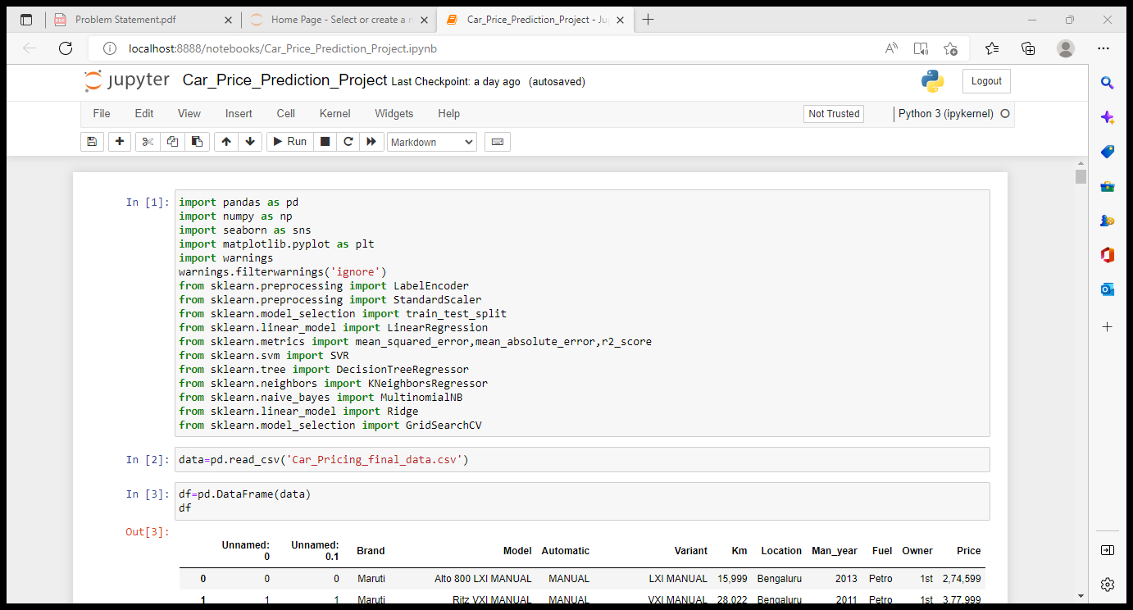
Importing the necessary libraries

Slide 8
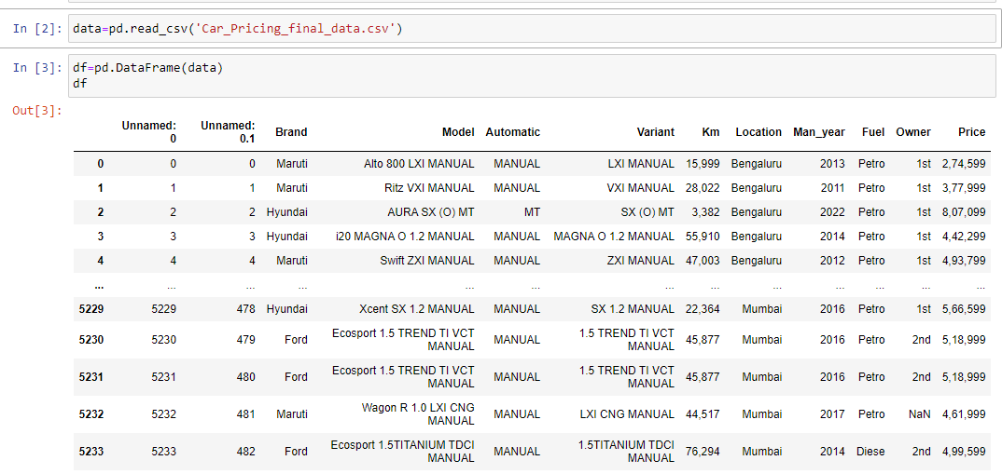
Read and explore the data
The dataset has 5234 rows and 10 columns

Slide 9
Cleaning and Analysing the data
There were some missing values in the dataset.
Outliers are present which will be removed using z-score method
Data is skewed which can be treated using Powertransformation (Yeo-Johnson) method.
Multicollinearity should be checked and drop the columns which were creating high multicollinearity in the dataset.

Slide 10
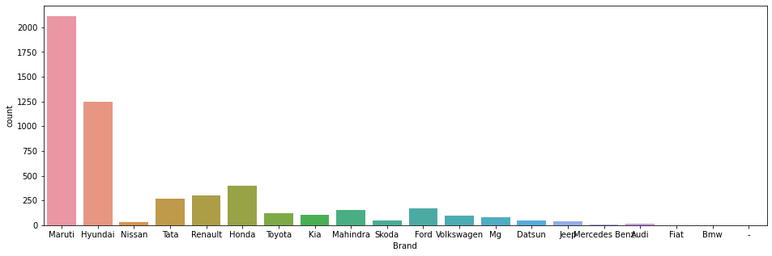
Data Visualization
Let us look into few example graphs to know about the characteristics of variables in the dataset.
From the plot above we can observe that Highest number of cars are from Maruthi and Hyundai brands.

Slide 11
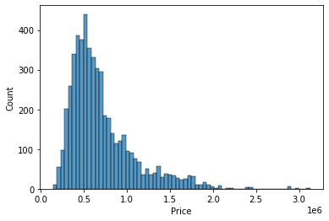
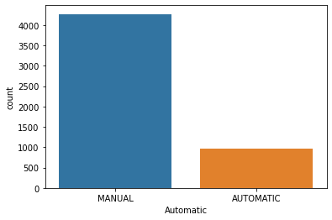
Above plot shows us the distribution of Price, it is understandable that most of the cars price ranges from 3 to 7 lakhs.
We can see from the above data that 4271 cars are of Manual operation and only 963 cars are Automatic.

Slide 12
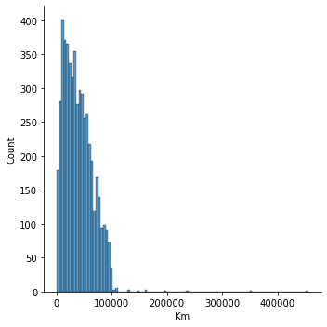
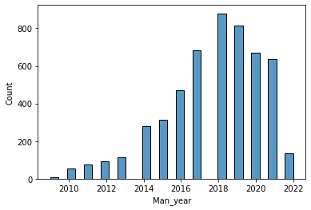
From the above plot it is clear that maximum number of cars driven Kms falls between 0 to 100000.
Most of the cars in the dataset are manufactured in the years 2017 to 2021 as we can observe in the above plot.

Slide 13
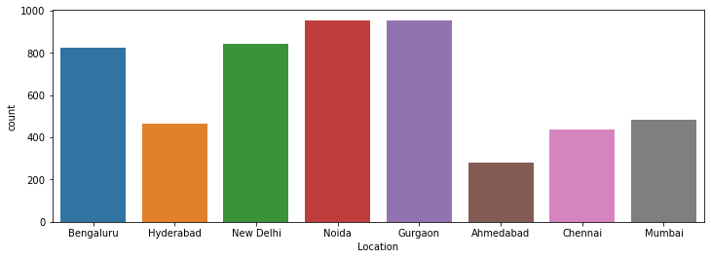
Data consists of 954 and 952 cars details which belongs to Gurgaon and Noida, 842 cars from New Delhi, 824 cars from Bengaluru, 483 cars from Mumbai, 465 cars from Hyderabad, 436 cars from Chennai and 278 cars from Ahmedabad

Slide 14
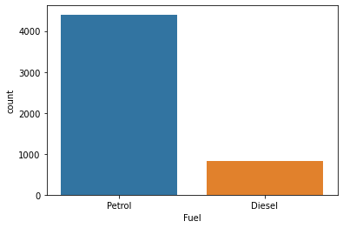
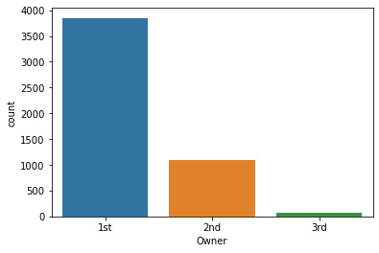
As we can observe from the above plot and data 4402 cars are Petrol cars and 832 are Diesel cars.
The data has 3851 cars from 1st owner, 1090 cars from 2nd and only 75 cars from 3rd owner.

Slide 15
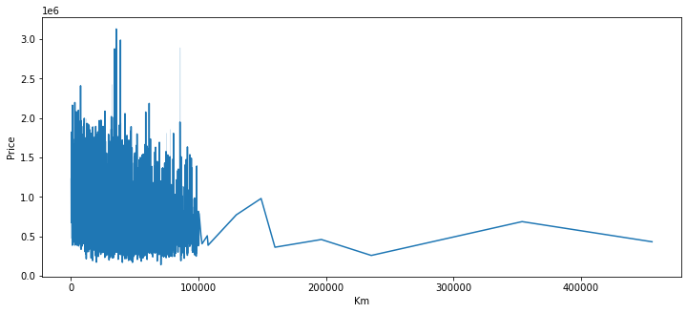
Bivariate analysis :
From the above plot we can observe that the price is high for those cars whose driven Km is less and as the driven Km increases the price decreases.

Slide 16
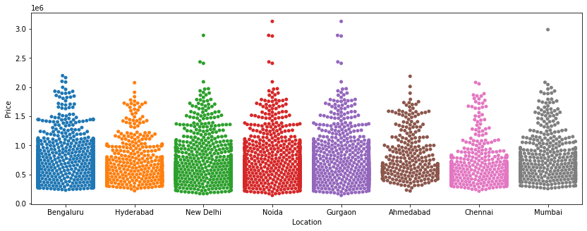
The price is reaching high for those cars in Noida and Gurgaon.

Slide 17
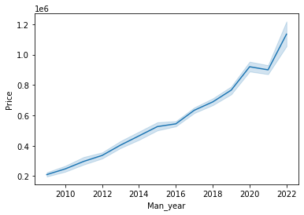
From the above plot we can observe that the price is increasing for the cars which are manufactured in the recent years, the older cars' price is lesser.

Slide 18
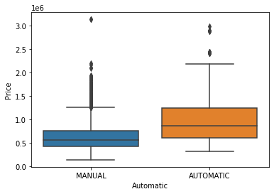
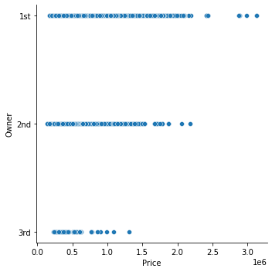
We can observe from the above plot that the price is higher for those cars which are sold from 1st owner than that of 2nd and owners.
We can see that the min and max price is higher for the cars which have automatic operations compared to manual cars.

Slide 19
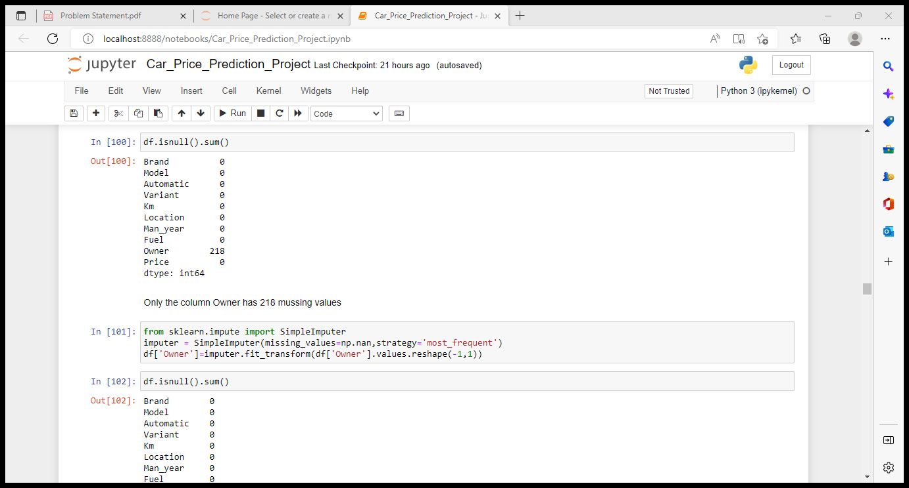
Treating missing data :
There are some missing values in the Owner column, we can now handle these missing values by simple imputer as shown above.

Slide 20
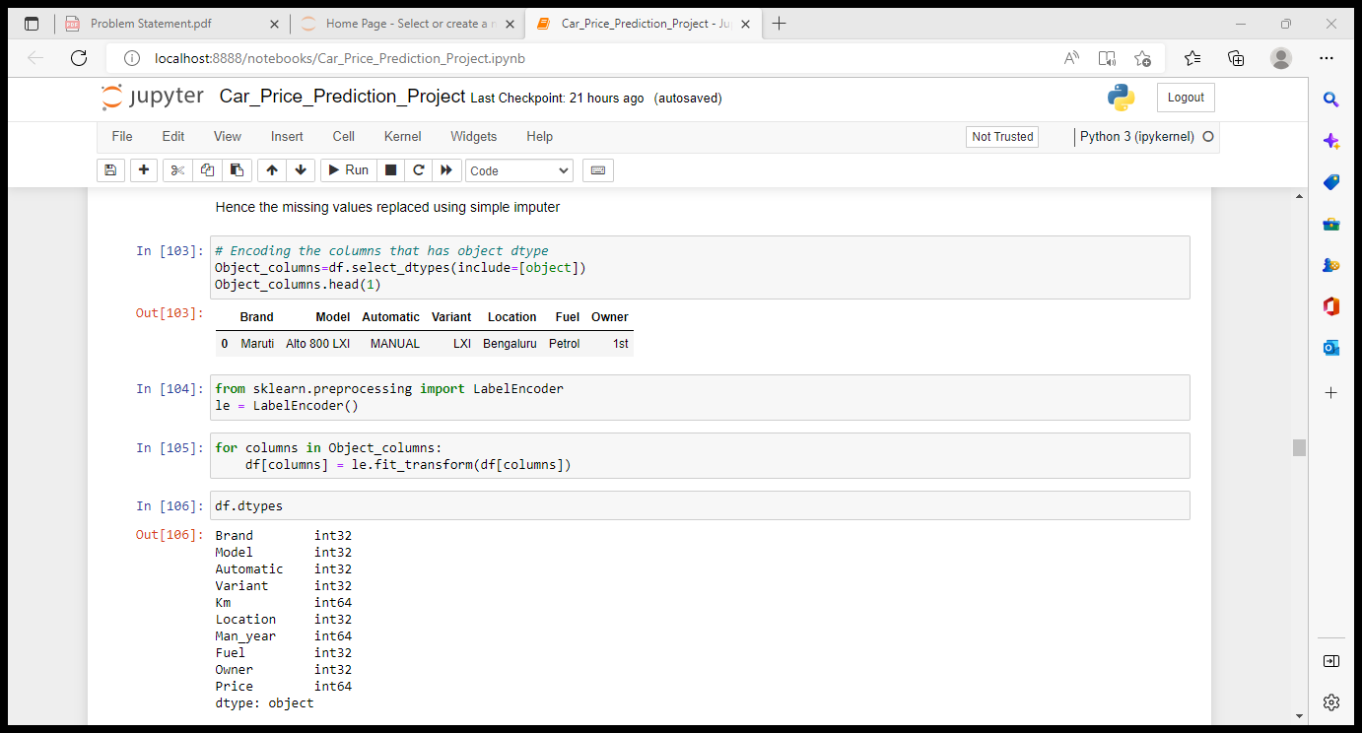
Treating Object type Data in the dataset
Hence all the data in dataset is encoded and we are left with integer type data in all the variables using Label encoder.

Slide 21
Key Observations :
Mean > median (50th percentile) in the columns Model, Km, Price hence the data in these columns are skewed
We can observe that there is a huge gap between 75th percentile and max in the columns Brand, Model, Variant, Km, Owner, Price and hence the data in these columns has outliers
In the columns Brand, Model, Variant, Km, Man_year, Price we can observe that there is a high gap between mean and std, hence the data is highly spreaded.
Price has a better correlation with Man_year, it have has a good correlation with Brand and Model
Price has least correlation with Fuel
Man_year has negative correlation with Km
Brand has a better correlation with Variant compared to others

Slide 22
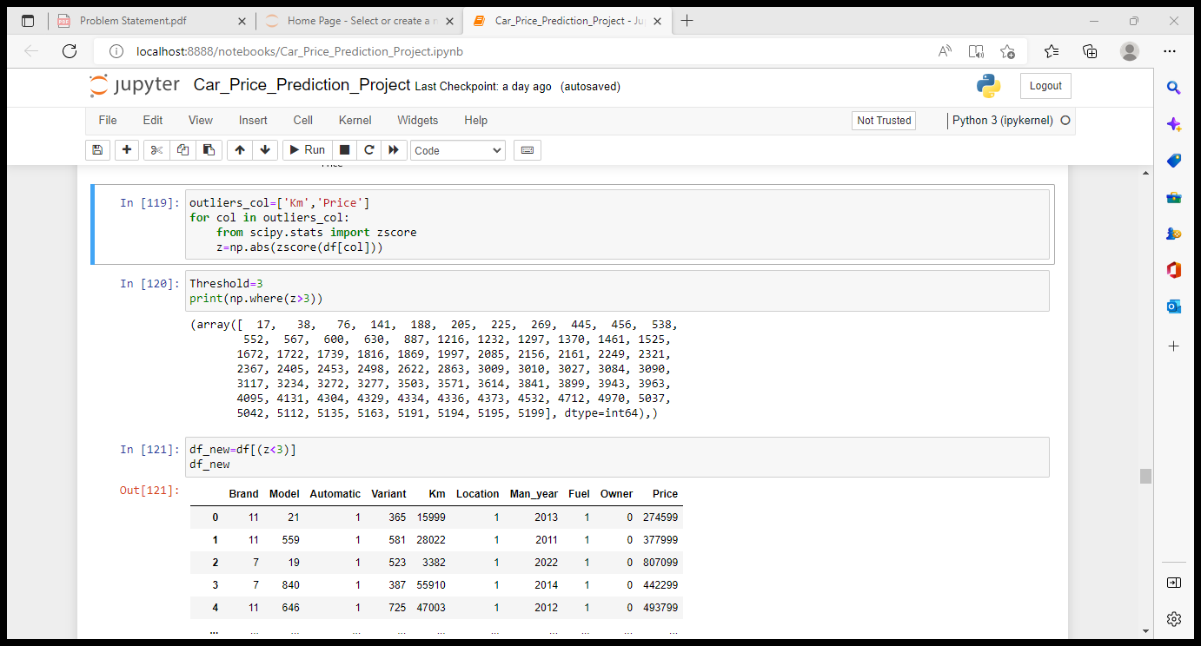
Removing Outliers
Hence the outliers are removed from the dataset using z-score method.
New dataset is created once after removing outliers, in the new dataset there are 5160 rows and 10 columns. The % of data lost while removing outliers is 1.4% which is less than 10% and tells that it is appropriate to remove the outliers using z-score method.

Slide 23
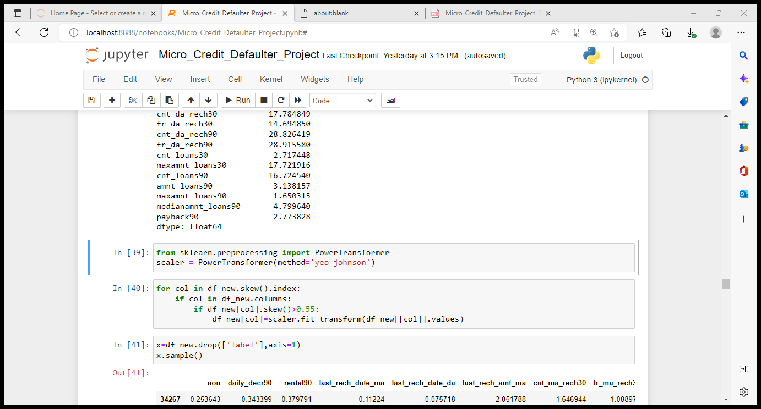
Removing skewness of the data
Hence the skewness is removed from the data using PowerTransformer (yeo-johnson) method.

Slide 24
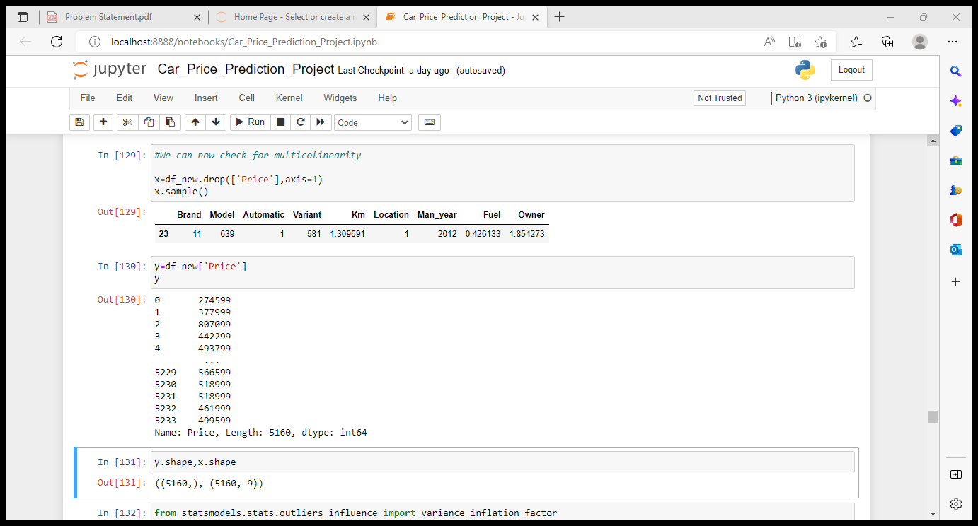
Splitting x and y variables

Slide 25
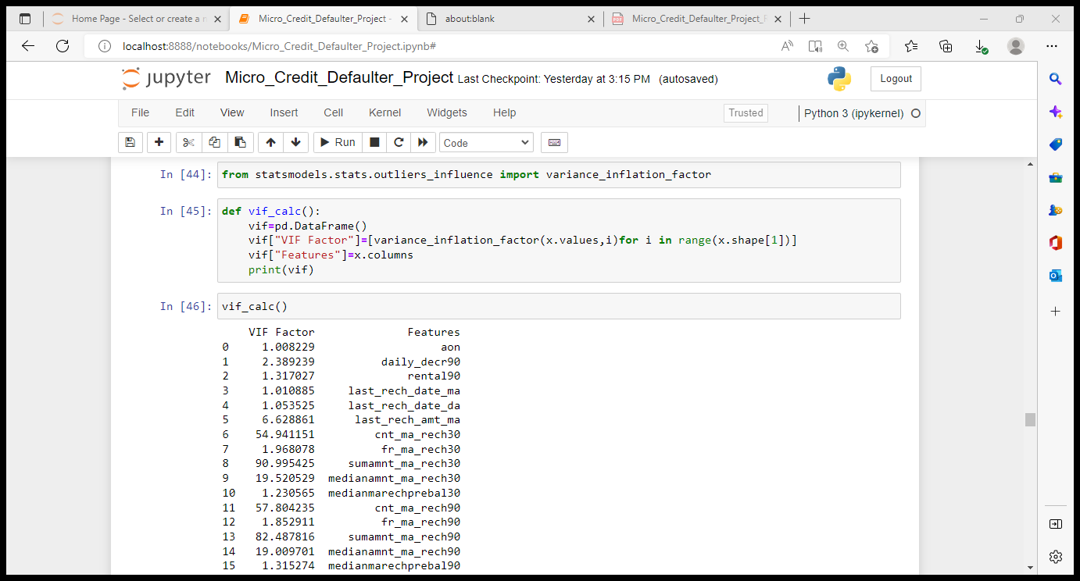
Checking multicollinearity in the data and dropping the variable which are creating multicollinearity
As we can observe from the above table Brand and Man_year are creating multicollinearity in the data, from the correlation data we can observe that Brand is giving lesser contribution to Price than Man_year hence we can drop off Brand at this stage.

Slide 26
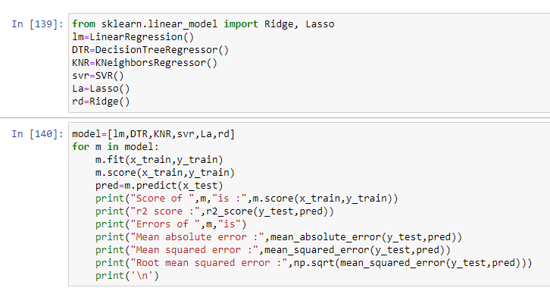
Building multiple models using the above mentioned algorithms
Linear Regression : 46.22%
Decision Tree Regressor : 100%
Kneighbors Regressor : 93.1%
Lasso : 46.22%
Ridge : 46.22%
SVR : -6%
From the above models we can consider that Decision tree regressor and KNeighbors regressor is giving us the best accuracy and r2 score.

Slide 27
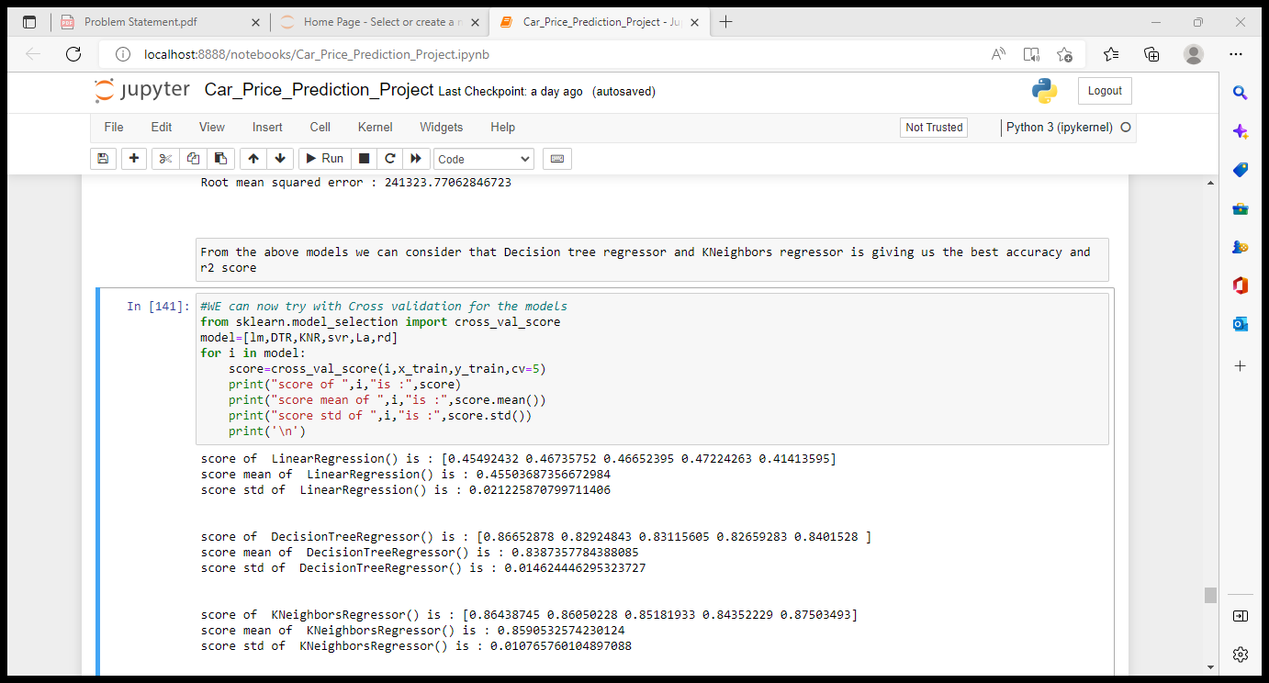
Cross Validation :
With CV we can see that KNeighbors is giving best mean score of 85.9%

Slide 28
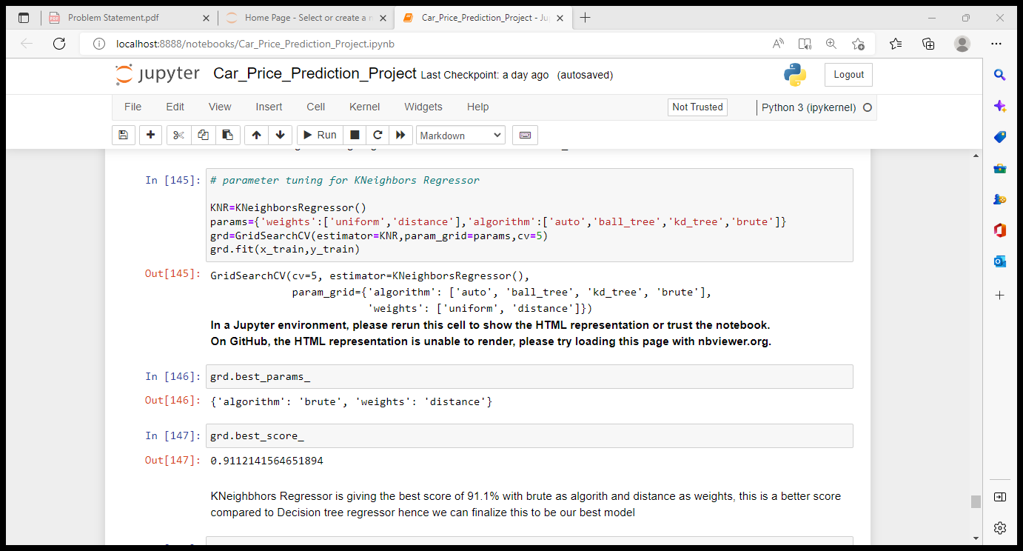
Parameter tuning for Kneighbors Regressor
KNeighbhors Regressor is giving the best score of 91.1% with brute as algorith and distance as weights, this is a better score compared to Decision tree regressor hence we can finalize this to be our best model.

Slide 29
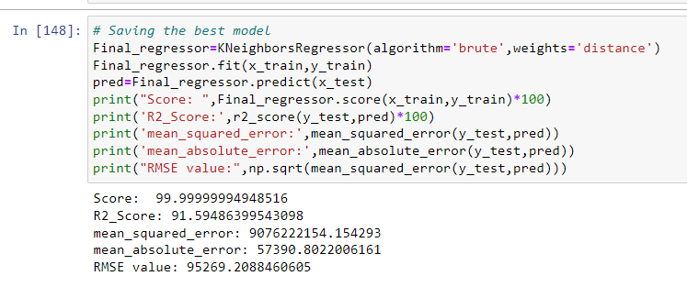
Picking the Final model
We can finalize the Kneighbors Regressor as the final model which is giving 99.99% accuracy and 91.5 r2 score with algorithm = brute and weights = distance.

Slide 30
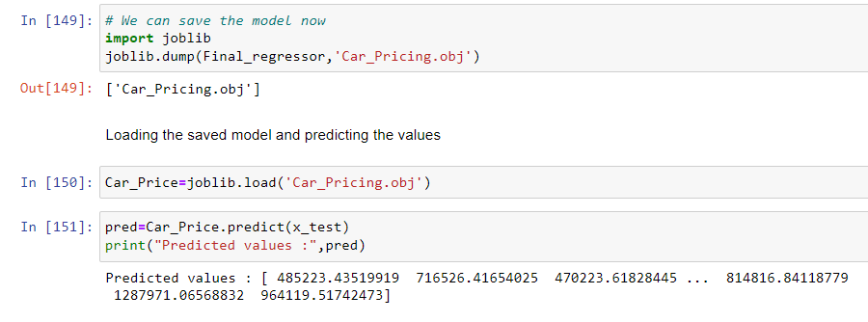
Saving the final model

Slide 31
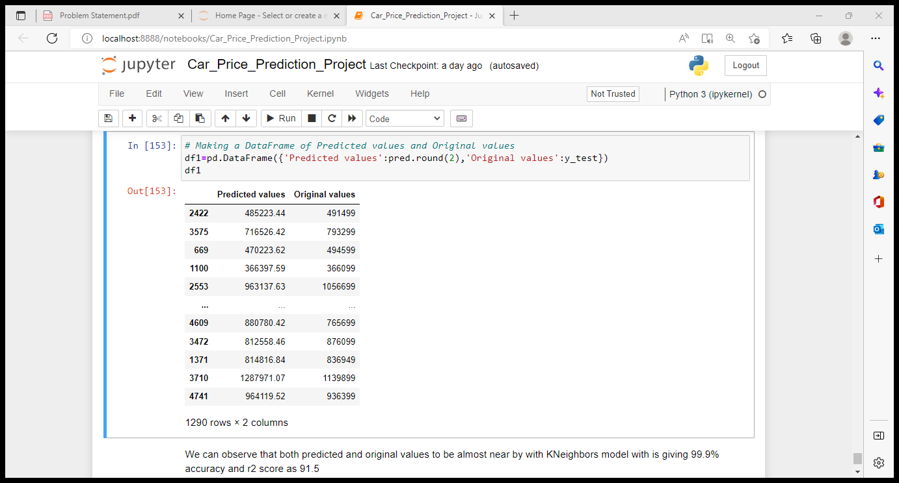
Making prediction

Slide 32
Conclusion
From the Exploratory Data Analysis, we could generate insight from the data. How each of the features relates to the target. Also, while training the model we could observe that KNeighbors Regressor was performing well with the accuracy 99.99%.
From the EDA we could also observe that target variable was highly dependent on Number or owners, fuel, manufactured year
Few variables like Location, Km had poor correlation with target variable.
Cleaning of the data included few techniques like removing outliers, treating skewed data, dropping the variables which were creating multicollinearity
While building the model we could observe that it is always good to build 4 to 5 models for the same train test data and compare the scores of the models then pick the best model instead of sticking onto single model.
As of now we could finalize KNeighbors Regressor with algorithm = brute and weights = distance as the best model which is giving 99.99% accuracy score and 91.5 r2 score which was best compared to other models.

Slide 33
THANK YOU ☺

