Slide 1
Customer Retention Project
E-retail factors for customer activation and retention: A case study from Indian e-commerce customers

Slide 2
Case study
Customer satisfaction has emerged as one of the most important factors that guarantee the success of online store; it has been posited as a key stimulant of purchase, repurchase intentions and customer loyalty. A comprehensive review of the literature, theories and models have been carried out to propose the models for customer activation and customer retention. Five major factors that contributed to the success of an e-commerce store have been identified as: service quality, system quality, information quality, trust and net benefit. The research furthermore investigated the factors that influence the online customers repeat purchase intention. The combination of both utilitarian value and hedonistic values are needed to affect the repeat purchase intention (loyalty) positively. The data is collected from the Indian online shoppers. Results indicate the e-retail success factors, which are very much critical for customer satisfaction.

Slide 3
Basic details of datasets
The data set has 2 different files
1. original data file
2. Coded data file
Both the files have same data shape of 269 rows and 71 columns.
The coded data file is emerged out of original data file while the first 47 columns are coded.
The 71 columns in datasets consists of five major factors that contributed to the success of an e-commerce store have been identified as: service quality, system quality, information quality, trust and net benefit.
All the columns in set dataset are categorical data and none has continuous values where every column carries data about customers reviews and feedbacks on different aspects of e-shopping.

Slide 4
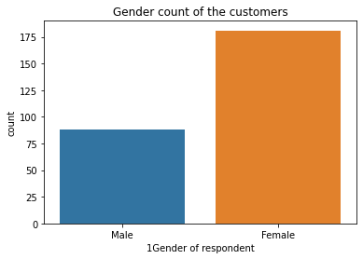
We can explore that data in each column by doing visualization on each.
Column 1 : The column ‘Gender of respondent’ tells us about the gender of the customers, the below count plot tells us that out of 269 customers 181 are females and 88 are males who shop online. In the similar way we can study each column in the dataset.

Slide 5
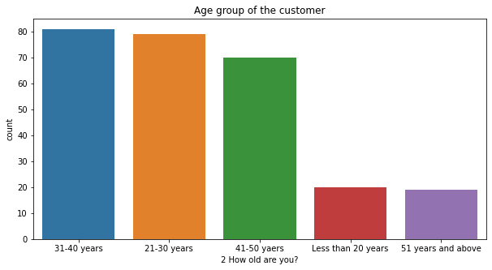
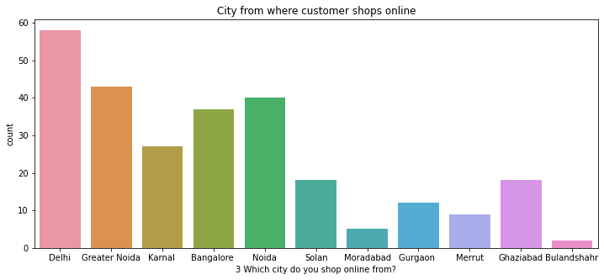
Column 2 : This column tells us about to which age group customers belong to, from the plot below we can observe that most of the customers fall under the category 21-30 years and 31-40 years
Column 3 : The column 'Which city do you shop online from?' gives us details about from which city the customer is doing online shopping, there are 11 different cities in the column from where customers shop.
From the below plot we can also observe that highest number of customers are in Delhi, Greater Noida and Noida, Least number of customers are in Bulandshahr

Slide 6
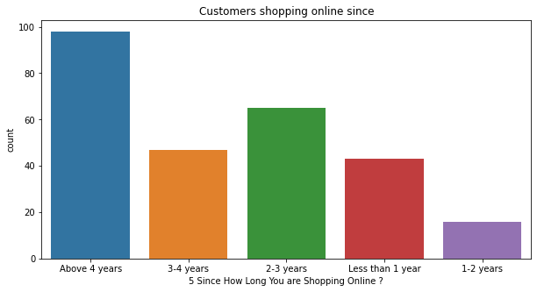
Column 4 :
The column '4 What is the Pin Code of where you shop online from?' gives us details about the pincodes of the locations from where the customers are shopping online, it has 39 unique pincodes and value count of each pincode.
Column 5 :
The column '5 Since How Long You are Shopping Online ?' gives us the details about since how long the customer is doing online shopping, the data in this column has 5 categories.
We can also observe that the maximum number of customers fall in the category 'Above 4 years', which tells that most of customers are doing online shopping for more than 4 years

Slide 7
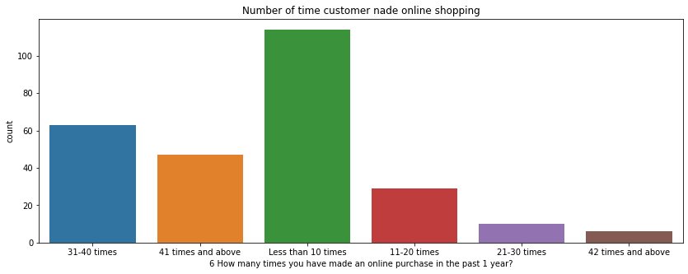
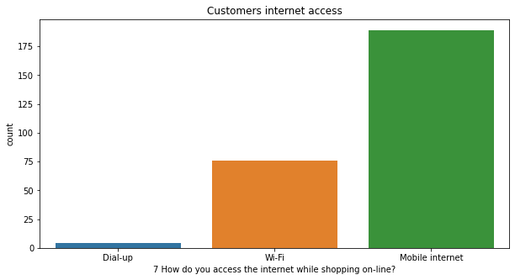
Column 6 :
In the column '6 How many times you have made an online purchase in the past 1 year?' we can observe that the data gives us details about how many time each customer did online shopping, that data in this column is catogorized into 6 categories.
Also we can observe that maximum number of customers (114 members) did online shopping less than 10 times and minimum number of customers (6 members) did 42 times or above times.
Column 7 :
Now from the '7 How do you access the internet while shopping on-line?' column we can see the details of how the customers accessed internet while doing the online shopping, again the data here is categories into 3 different categories.
Maximum number of customers (189 members) accessed internet through Mobile internet while doing online shopping and minimum number of customer accessed through Dial-up and shopped online

Slide 8
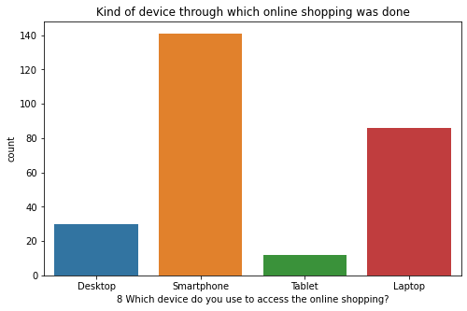
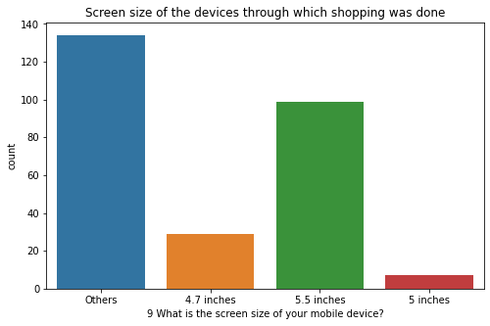
Column 8 :
The column '8 Which device do you use to access the online shopping?' tell us details about through which kind of device the customer made online shopping, the data in this column is categorized into 4 different categories.
Below count plot we can observe that maximum number of customers (141) shopped through Smartphones and minimum number of customers (12) shopped through Tablet.
Column 9 :
The column '9 What is the screen size of your mobile device?' gives us the details about the size of the screens of devices through which customers did online shopping, the data in this is categorized into 4 different categories as 4.7, 5.5, 5 inches and other sizes falls under 'Others' category.
From the above count plot we can observe that Most of the customers fall under 'Other' category and least number of customers shopped from the device whose screen size is 5 inches

Slide 9
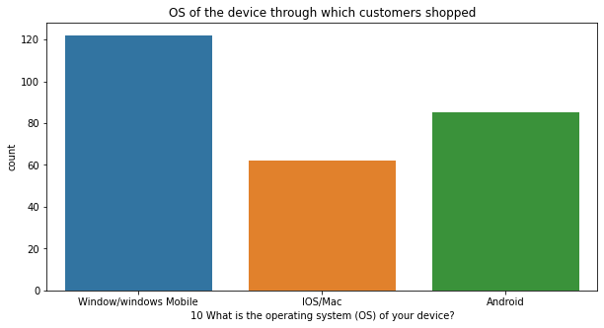
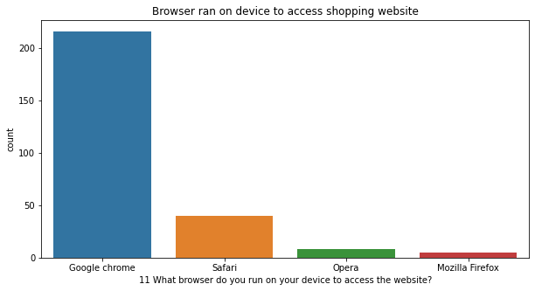
Column 10 :
The column '10 What is the operating system (OS) of your device?' tell us the details about OS of the devices through which customers did online shopping, the data in this is categorized into 3 different categories.
From the above count plot we can observe that maximum number of customers (122) shopped from Window/windows Mobile and least (62) shopped from IOS/Mac.
Column 11 :
The column '11 What browser do you run on your device to access the website?' tell us details about which browser customers used in their device to access the shopping website, the data in this is categorized into 4 categories.
From the above table and countplot we can observe that maximum number of customers (216) accessed the website through Google chrome and minimum number of customers (5) accessed from Mozilla Firefox

Slide 10
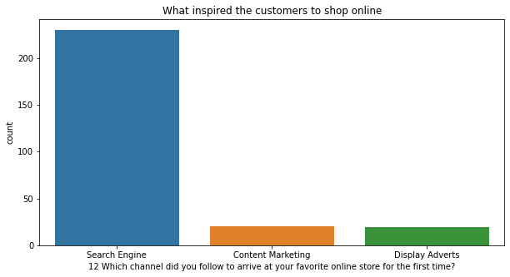
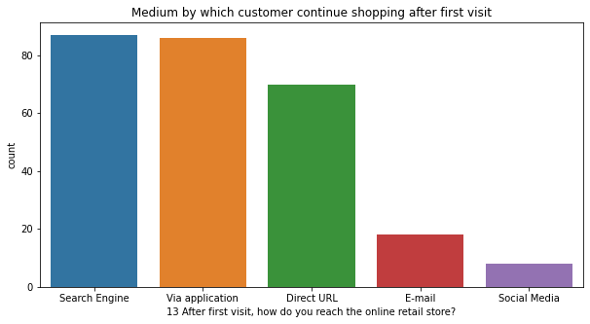
Column 12 :
The column '12 Which channel did you follow to arrive at your favorite online store for the first time?' tells us details about what inspired the customer to do online shopping for the first time, the data data here is categorized into 3 categories.
From the above count plot we can observe that maximum number od customers (230) shopped online for the first time through 'search Engine' and least (19) shopped online for the first time getting inspired by 'Display Advertises'
Column 13 :
The column '13 After first visit, how do you reach the online retail store?' tells us details about how the customers continued shopping after visiting the website first, this data is categorized into 5 different categories.
From the above count plot we can observe that maximum number of customers continued their shopping through Search engine (87) and Application (86) and least number of customers shopped through Social media(8)

Slide 11
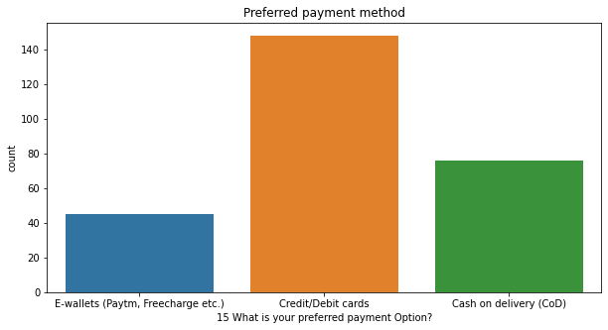
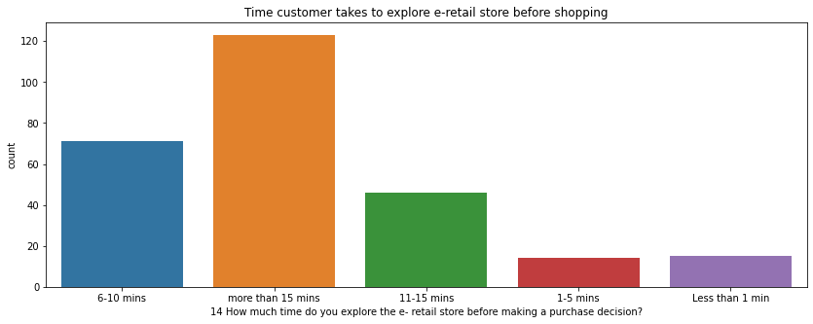
Column 14 :
The column '14 How much time do you explore the e- retail store before making a purchase decision?' tells us details about how much time each customer spends on e-retail store before making a decission of shopping any online product, the data in this column is categorized into 5 different categories.
From the below count plot we can observe that maximum number customers (123) spend more than 15 minutes on the e-retail store before making a choise of shopping online and minimum number of customers fall in the category of spending 1-5 min (14) or less than 1 min (15)
Column 15 :
The column '15 What is your preferred payment Option?' tells us details about what method customers use for doing payment, the data in this is categorized into 3 different categories.
From the above countplot we can observe that maximum number of customers (148) do their payments through Credit/Debit cards and where as minimum number of customers (45) do payments using E-wallets (Paytm, Freecharge etc.) and COD is done by 76 customers

Slide 12
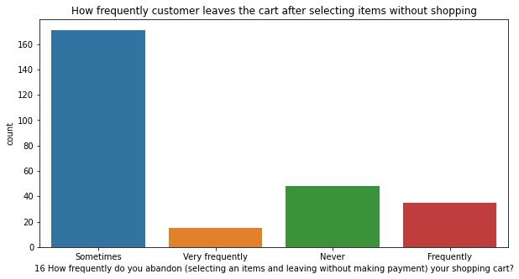
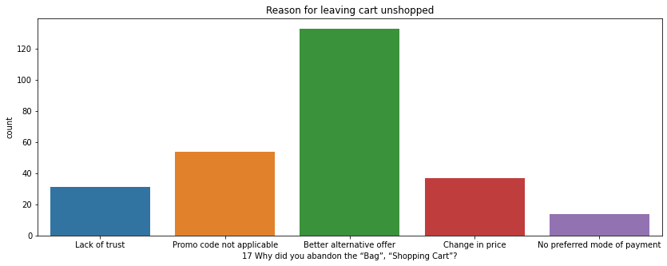
Column 16 :
The column '16 How frequently do you abandon (selecting an items and leaving without making payment) your shopping cart?' tells us details about how frequently customer leaves the cart without shopping after adding items in, the data in this is categorized in 4 categories.
From the above countplot we can observe that the maximum number of customers (171) leave the cart unshopped sometimes and least number of customers (35) leave the cart unshopped after adding items to cart very frequently.
Column 17 :
The column '17 Why did you abandon the “Bag”, “Shopping Cart”?' tells us details about the reasons why customer is leaving the cart without shopping after adding items to cart
From the below countplot we can observe that 133 customers give reason that they got better alternative offer on the item for their abondness, 14 customers give reason that they had no preferred mode of payment for them to abandon.

Slide 13
Column 16 :
The column '16 How frequently do you abandon (selecting an items and leaving without making payment) your shopping cart?' tells us details about how frequently customer leaves the cart without shopping after adding items in, the data in this is categorized in 4 categories.
From the above countplot we can observe that the maximum number of customers (171) leave the cart unshopped sometimes and least number of customers (35) leave the cart unshopped after adding items to cart very frequently.
Column 17 :
The column '17 Why did you abandon the “Bag”, “Shopping Cart”?' tells us details about the reasons why customer is leaving the cart without shopping after adding items to cart
From the below countplot we can observe that 133 customers give reason that they got better alternative offer on the item for their abondness, 14 customers give reason that they had no preferred mode of payment for them to abandon.

Slide 14
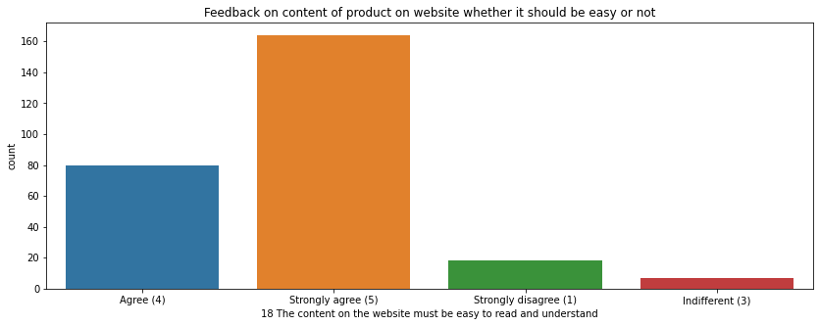
In the similar way the columns from 19 to 47 gives us details about customers feedbacks on different parameters, we can see the feedback response of each parameter by plotting countplot.
Column 18 :
The column '18 The content on the website must be easy to read and understand' tells us about customers opinion about content on website which tells them about the product. this data is categorised into 4 categories as show below
1. Strongly agree (5) - 164
2. Agree (4) - 80
3. Strongly disagree (1) - 18
4. Indifferent (3) - 7
From the above count plot we can observe that 164 customers strongly agree that the product details on the website should be easy to read and understand
In the similar way the columns from 19 to 47 gives us details about customers feedbacks on different parameters, we can see the feedback response of each parameter by plotting pie chart all together instead of studying them one by one

Slide 15
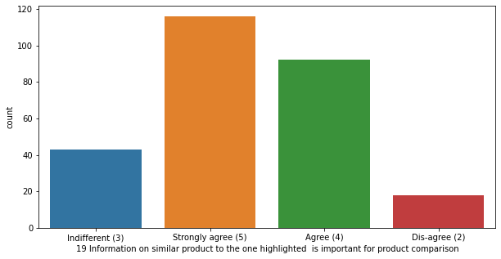
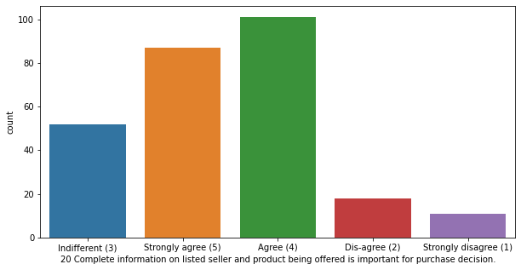
Column 19 :
This column tells us about how satisfied customers are with the information on similar product which would be helpful for comparision, Most of the customers strongly agree with importance of information on similar products
Column 20 :
This column tells us about how strongly customers agree that the information on listed seller and product being offered is important for purchase decision, here most of the customers strongly agree that complete information of product is important to make decision for purchase

Slide 16
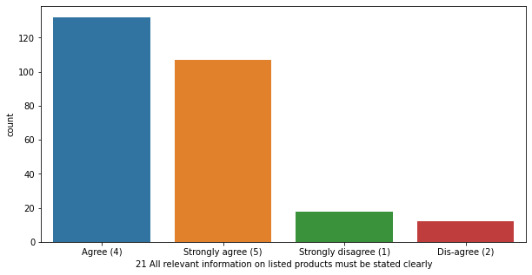
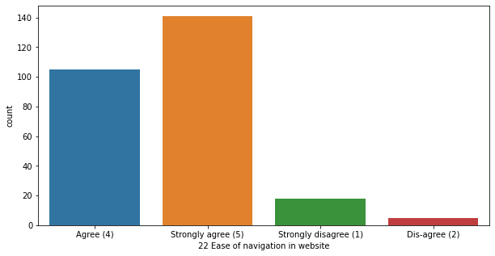
Column 21 :
This column tells us about how important it is to give relevant information on listed products must be stated clearly, in this most of the customers agree for the aspect.
Column 22 :
This column tells us about how friendly the website is for the customers to navigate, Maximum number of customers strongly agree that the websites are easy to navigate.

Slide 17
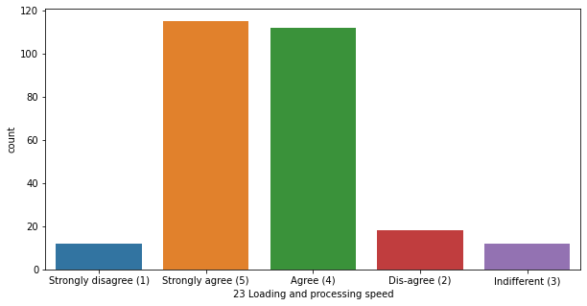
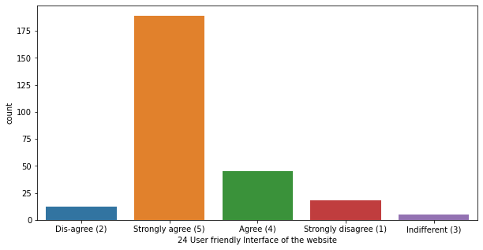
Column 23 :
This column tells us about how satisfied the customers are with loading and processing speed, Maximum customers Strongly agree and agree with that loading and processing speed is good in the websites
Column 24 :
This column tells us about how satisfied the customers are with user friendly interface of the website, Maximum number of customers strongly agree with this aspect

Slide 18
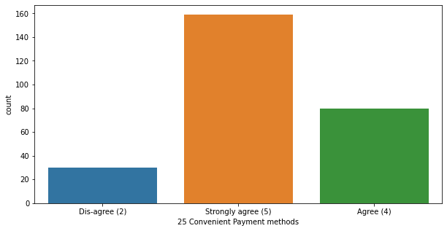
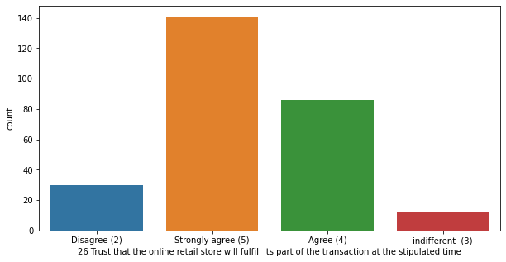
Column 25 :
This column tells us about the convenience of payment methods, Maximum number of customers strongly agree that the payment methods are convenient enough
Column 26 :
This column tells us about whether the transactions are made at the stipulated time or not, Maximum number of customers strongly agree that the transactions ate made at the stipulated time

Slide 19
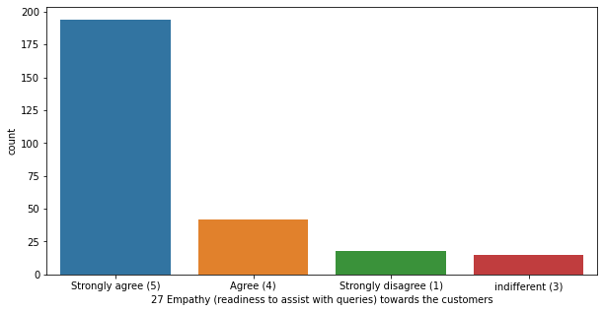
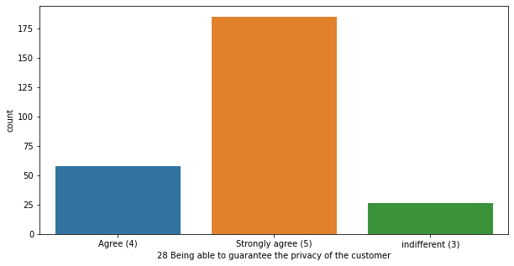
Column 27 :
This column tells us about how empathetically the customers were treated and assisted with their queries, maximum number of customers strongly agree that they were treated empathically and assisted with their queries
Column 28 :
This column tells us about how satisfied the customers are with the privacy of their data, maximum number of customers strongly agree that their information was kept confidential

Slide 20
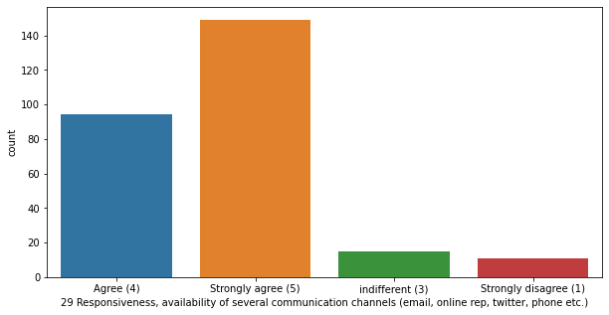
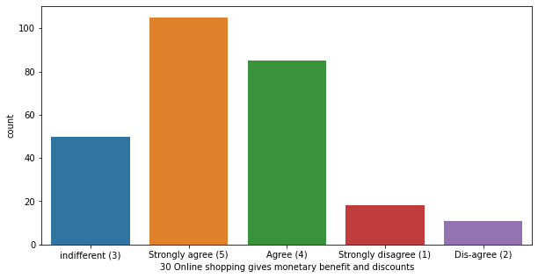
Column 29 :
This column tells us about how satisfied the customers are with responsiveness, availability of several communication channels(email, online rep, teitter, phone etc.), maximum number of customers strongly agree that communication channels are responsive and available
Column 30 :
This column tells us about how satisfied customers are with monetary benefits and discounts on online shopping, maximum number of customers strongly agree that they get good monetary benefits discounts on online shopping

Slide 21
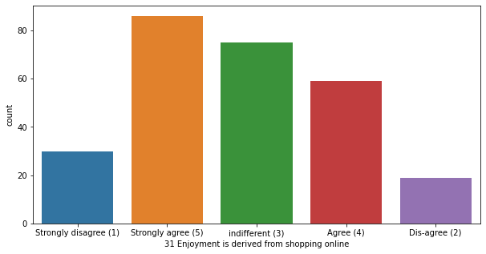
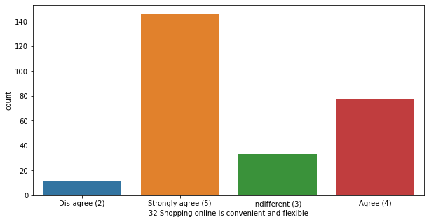
Column 31 :
This column tells us about how enjoyable the online shopping is for customers, maximum number of customers strongly agree that they the enjoyment is derived from online shopping
Column 32 :
This column tells us about how convenient and flexible online shopping is, maximum number of customers strongly agree that shopping online is convenient and flexible

Slide 22
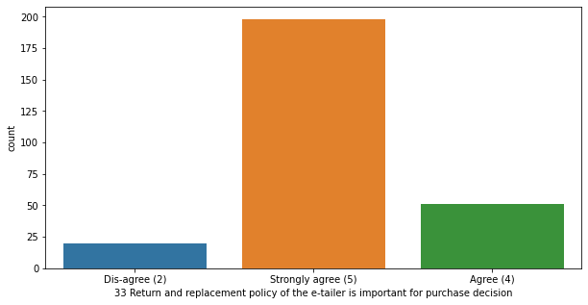
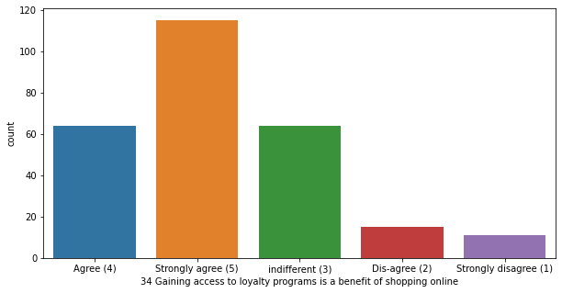
Column 33 :
This column tells us about how important return and replacement policy is to make a purchase decision, maximum number of customers strongly agree that return and replacement policy is important to make purchase decision
Column 34 :
This column tells us about how important it is to gain access to loyalty programs that benefit online shopping, maximum number of customers strongly agree with this aspect

Slide 23
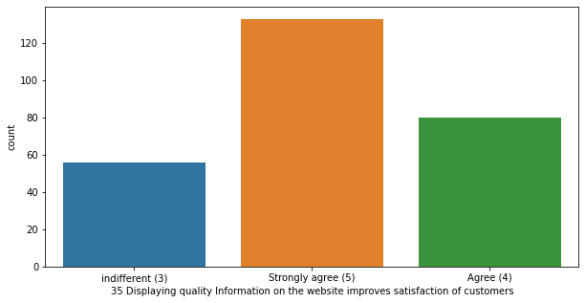
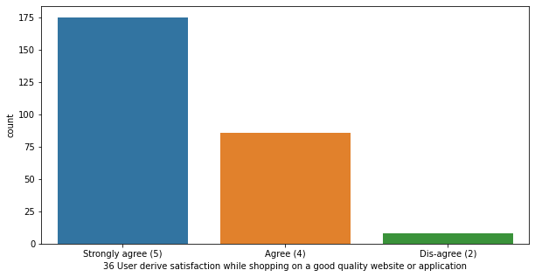
Column 35 :
This column tells us about how important it is to display quality information on the website to improve satisfaction of customers, maximum number of customers strongly agree that it is important to display quality information on website improves satisfaction of customers
Column 36 :
This column tells us about how important it is to have a good quality website or application to satisfy users while shopping online, maximum number of customers strongly agree that it is important to have a good quality website and application to satisfy users while shopping online

Slide 24
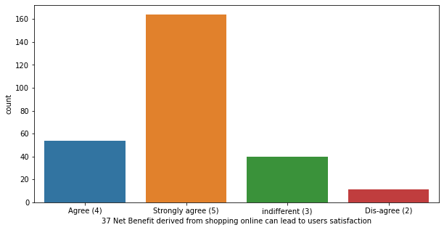
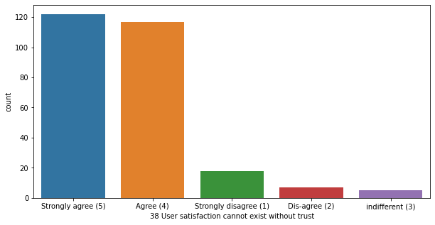
Column 37 :
This column tells us about how important it is to create net benefit from shopping online which leads to user satisfaction, maximum number of customers strongly agree that net benefit derived from online shopping leads to user satisfaction
Column 38 :
This column tells us about how important trust is to create user satisfaction, maximum number of customers strongly agree that trust is important to create user satisfaction in customers

Slide 25
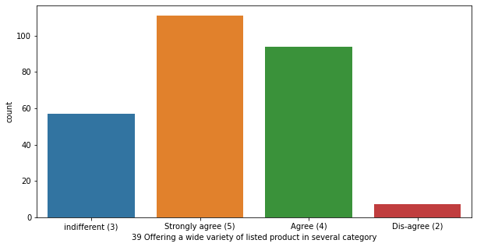
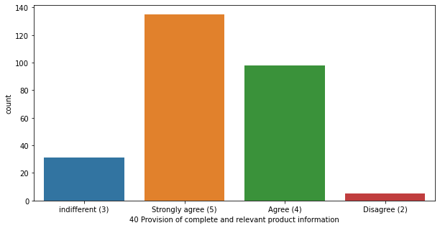
Column 39 :
This column tells us about how important it is to provide a wide variety of products in different categories, maximum customers strongly agree that it is important to provide wide variety of listed products in all categories to attract customers
Column 40 :
This column tells us about how important it is to provide provision of complete and relevant product information, maximum number of customers strongly agree that provision of complete and relevant product information is important

Slide 26
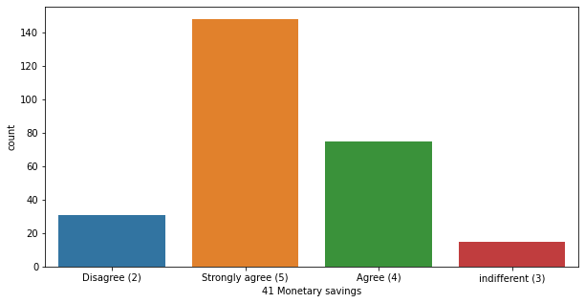
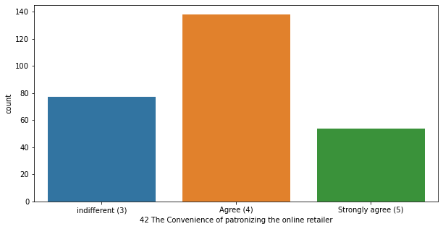
Column 41 :
This column tells us about Monetary savings done by online shopping, maximum number of customers strongly agree that monetary saving is done by shopping online
Column 42 :
This column tells us about the convenience in patronizing the online retailer, maximum number of customers strongly agree with the patronizing the online retailer is important for user satisfaction

Slide 27
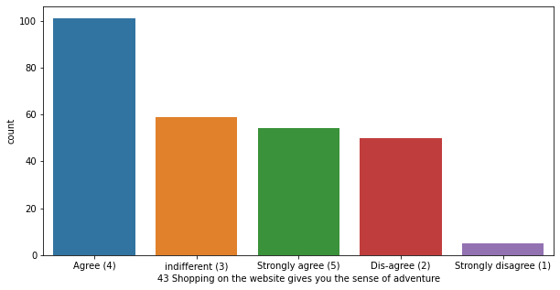
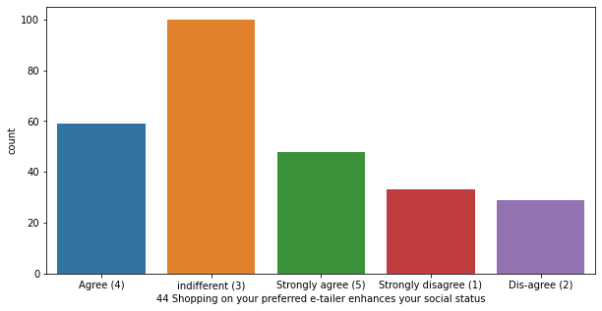
Column 43 :
This column tells us about how adventurous it is to shop online, maximum number of customers agree that it is adventurous to shop online
Column 44 :
This column tells us about if customers social status is enhanced by shopping on preferred e-retail store, maximum number of customers tell that it is indifferent to this aspect

Slide 28
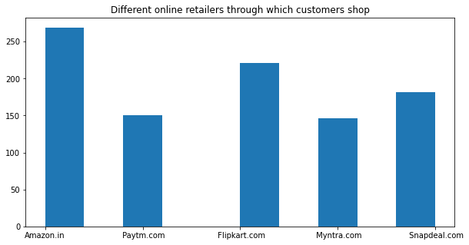
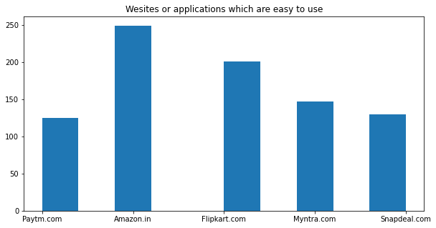
Understanding further 24 columns and what details they explain
Column 48 : The column 'From the following, tick any (or all) of the online retailers you have shopped from;' tell us details about which online retails customers use for shopping online, and from the above plot we can observe that most pf the customers shop from Amazon and Flipkart
Counter({'Amazon.in': 269, ' Flipkart.com': 221, ' Snapdeal.com': 182, ' Paytm.com': 150, ' Myntra.com': 146})
Column 49 : The column 'Easy to use website or application' tells us about customers' opinion on which application or website is easy to use, Customers gave maximum vote for amazon and flipkart.com.
Counter({'Amazon.in': 249, ' Flipkart.com': 193, ' Myntra.com': 147, ' Snapdeal.com': 130, ' Paytm.com': 113, 'Paytm.com': 12, 'Flipkart.com': 8})

Slide 29
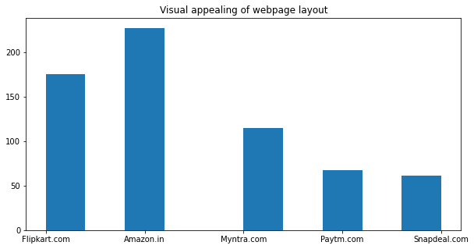
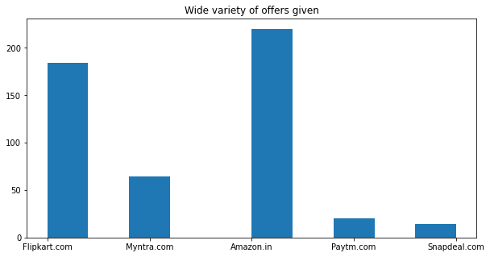
Column 50 : The column 'Visual appealing web-page layout' gives us details about which online shopping site gives us a better visual appearance, from the above plot we can analyse that maximum votes is given for Amazon and least votes are given for Snapdeal.com
Counter({'Amazon.in': 227, ' Flipkart.com': 148, ' Myntra.com': 100, ' Paytm.com': 67, ' Snapdeal.com': 61, 'Flipkart.com': 27, 'Myntra.com': 15})
Column 51 : The column 'Wild variety of product on offer' tells us details about which e-retail site gives wide variety of offers on the products, Customers have shared their opinion that Amazon gives the best offers on the products and least voting is given for snapdeal.com
Counter({'Amazon.in': 220, 'Flipkart.com': 184, 'Myntra.com': 64, 'Paytm.com': 20, 'Snapdeal.com': 14})

Slide 30
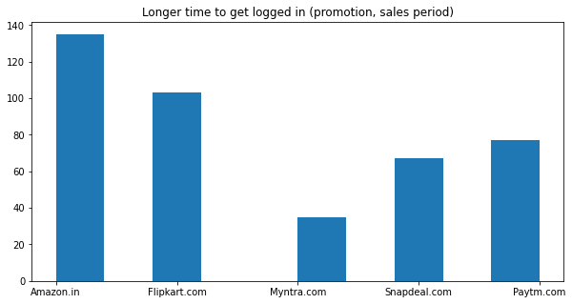
In the similar way we can study each column and conclude the observations
The upcoming columns is to discuss about the negative characteristics of the e-retail store's website or Application¶
Column 61 : The column 'Longer time to get logged in (promotion, sales period)' tells us about customers opinion on which e-retails' app or website takes longer time to get logged in, Customers have voted that Amazon.in (135) takes longer time to login due to promotions, sales period etc. least votes are given for Myntra.com (35)
Counter({'Amazon.in': 135, 'Flipkart.com': 103, 'Paytm.com': 77, 'Snapdeal.com': 67, 'Myntra.com': 35})

Slide 31
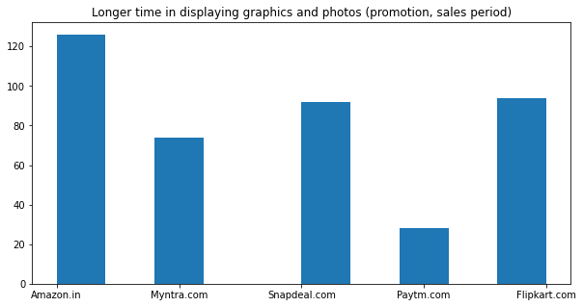
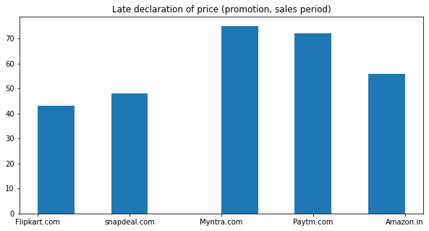
Column 62 : The column 'Longer time in displaying graphics and photos (promotion, sales period)' tells us about opinion of customers on which app or website takes longer time to display the graphics and photos, From the above plot we can observe that maximum number of customers have voted that Amazon.in (126) takes longer time to display the graphics and photos, next stands Flipkart.com (94) and Snapdeal.com (92), the least votes are given for Paytm.com(28)
Counter({'Amazon.in': 126, 'Flipkart.com': 94, 'Snapdeal.com': 92, 'Myntra.com': 74, 'Paytm.com': 28})
Column 63 : The column 'Late declaration of price (promotion, sales period)' tells us about customers opinion on which r-retail's app or website declares the price lately, customers have voted that Myntra.com (75) delays in declaring the price, least votes are given for Flipkart.com (43).
Counter({'Myntra.com': 75, 'Paytm.com': 72, 'Amazon.in': 56, 'snapdeal.com': 48, 'Flipkart.com': 43})

Slide 32

We can do further EDA considering Coded data
Checking for missing values in the data :
From the heat map we can observe that there are no missing values in the dataset.

Slide 33

Discussing on details description on the data :
Key Observations :
1. We can see that mean is greater than median (50th percentile) in the columns
• 4 What is the Pin Code of where you shop online from?
• 8 Which device do you use to access the online shopping?
• 11 What browser do you run on your device to access the website?
• 12 Which channel did you follow to arrive at your favorite online store for the first time?
• 15 What is your preferred payment Option?
• 17 Why did you abandon the “Bag”, “Shopping Cart”?
Hence right skewness is present in these columns, The same we can observe from the below data as well

Slide 34

We can observe that mean is less than median (50th percentile) in the columns
• 1Gender of respondent
• 5 Since How Long You are Shopping Online ?
• 9 What is the screen size of your mobile device?
• 14 How much time do you explore the e- retail store before making a purchase decision?
• 18 The content on the website must be easy to read and understand
• 19 Information on similar product to the one highlighted is important for product comparison
• 20 Complete information on listed seller and product being offered is important for purchase decision.
• 21 All relevant information on listed products must be stated clearly
• 22 Ease of navigation in website
• 23 Loading and processing speed
• 24 User friendly Interface of the website
• 25 Convenient Payment methods
• 26 Trust that the online retail store will fulfill its part of the transaction at the stipulated time
• 27 Empathy (readiness to assist with queries) towards the customers
• 28 Being able to guarantee the privacy of the customer
• 29 Responsiveness, availability of several communication channels (email, online rep, twitter, phone etc.)
• 30 Online shopping gives monetary benefit and discounts
• 31 Enjoyment is derived from shopping online
• 32 Shopping online is convenient and flexible
• 33 Return and replacement policy of the e-tailer is important for purchase decision
• 34 Gaining access to loyalty programs is a benefit of shopping online
• 35 Displaying quality Information on the website improves satisfaction of customers
• 36 User derive satisfaction while shopping on a good quality website or application
• 37 Net Benefit derived from shopping online can lead to users satisfaction
• 38 User satisfaction cannot exist without trust
• 39 Offering a wide variety of listed product in several category
• 40 Provision of complete and relevant product information
• 41 Monetary savings
• 46 Shopping on the website helps you fulfill certain roles
Hence we there is left skewness present in these respective columns

Slide 35


2. We can observe that there is a huge gap between 75th percentile and max in the columns
• 4 What is the Pin Code of where you shop online from?
• 8 Which device do you use to access the online shopping?
• 11 What browser do you run on your device to access the website?
• 12 Which channel did you follow to arrive at your favorite online store for the first time?
• 16 How 4 do you abandon (selecting an items and leaving without making payment) your shopping cart?
Hence there are outliers present in those columns data, the same we can observe from the below plots as well

Slide 36

Checking for Correlation of columns by plotting correlation heat map :
From the above heat map we can observe that :
'Convenient payment method' has a good correlation with 'user friendly interface of the website', 'Loading and processing speed' and 'The content on the website must be easy to read and understand'
'21 All relevant information on listed products must be stated clearly' has good correlation with '18 The content on the website must be easy to read and understand'

Slide 37

From the above heatmap we can observe that :
'28 Being able to guarantee the privacy of the customer' has good correlation with '26 Trust that the online retail store will fulfil its part of the transaction at the stipulated time' and '27 Empathy (readiness to assist with queries) towards the customers'
'27 Empathy (readiness to assist with queries) towards the customers' has a good correlation with '38 User satisfaction cannot exist without trust'

Slide 38
Conclusion
Conclusion :
1. From the graphs we have plotted in the file we can observe that we have 3 different categories of data.
First set of data gives clarity on customers’ device and the mode of operations they use in case of online shopping.
Second set of data gives clarity on customers’ view on why the parameter is been implemented in the app or website
Thirst set of data gives us details about e-retails stores operations and which app or site operates well according to them, it also tells us about which app e-retails store gives wide range of collections, offers, monetary rewards, speedy delivery, assistance on any issues. This also includes data on some negative aspects which app or website take longer time to load the pages, visual display, adds on more promotions etc.
2. From all things mentioned above we can observe that Amazon.com stands as top
3. performer and next stands Flipkart. Least votes are given by the customers to Myntra, Paytm and Snapdeal.
Over all Customers are happy to recommend Amzon.in to their friends to shop online.

