Slide 1
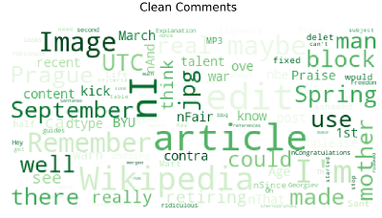

MALIGNANT COMMENTS CLASSIFIER PROJECT
Submitted to :
Mohd Kashif, Flip Robo Technologies
Submitted by:
CHETHANA M

Slide 2
Introduction
Online hate, described as abusive language, aggression, cyberbullying, hatefulness and many others has been identified as a major threat on online social media platforms. Social media platforms are the most prominent grounds for such toxic behaviour
There has been a remarkable increase in the cases of cyberbullying and trolls on various social media platforms. Which is leading users to depression, mental illness, self-hatred and suicidal thoughts.
Our goal is to build a prototype of online hate and abuse comment classifier which can used to classify hate and offensive comments so that it can be controlled and restricted from spreading hatred and cyberbullying.

Slide 3
Goals and Objective
Given a number of comments, sentences or paragraphs being used as a comment by a user, our task is to identify the comment as whether it is a malignant comment or not. After that, when we have a collection of all the malignant comments, our main task is to classify the comments into one or more of the following categories
– Malignant, Highly Malignant, Rude, Threat, Abuse or Loathe. This problem thus comes under the category of multi-label classification problem.

Slide 4
Software required
TOOLS USED
Jupyter Notebook
LIBRARY USED
Analysing : Numpy, Pandas, Sci-kit Learn, stop-words, nltk, scikit-multilearn
Visualization : Matplotlib, seaborn

Slide 5
Implementation
1. Calling the required libraries
2. Import necessary files
3. Read the train.csv file
4. EDA
5. Separate the comment field data and outcome labels
6. Data Visualizations
7. Remove excessive length comments
8. Preprocessing
9. Removing Punctuations and other special characters
• Splitting the comments into individual words
• Removing Stop Words
• Stemming and Lemmatising
• Applying Count Vectoriser
10. Similar process done on test data and preparing train and test data
11. Building the model

Slide 6
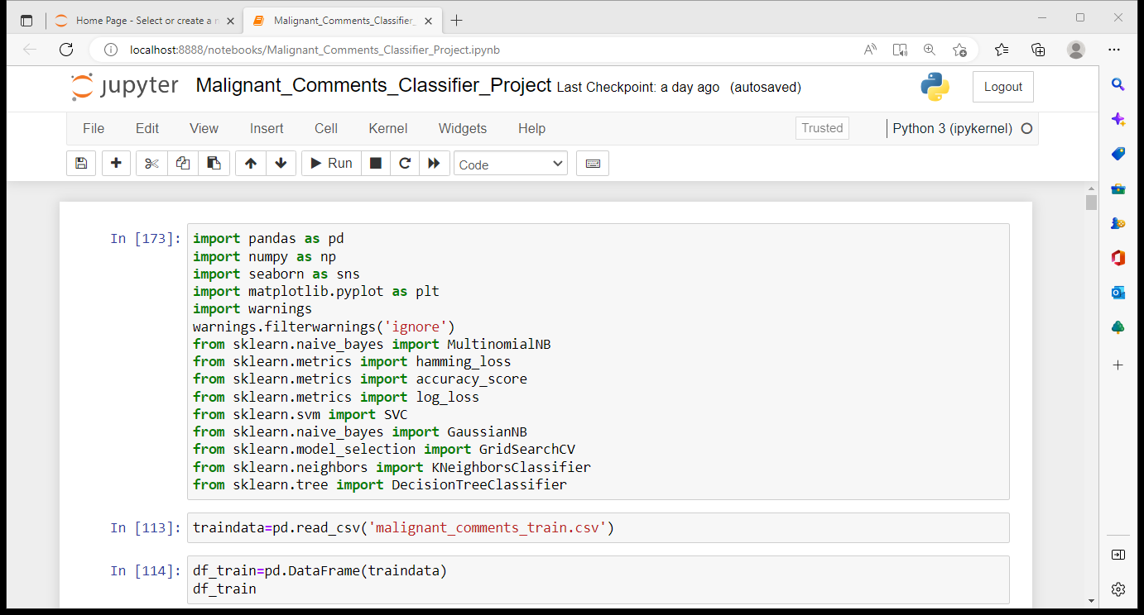
Importing the necessary libraries

Slide 7
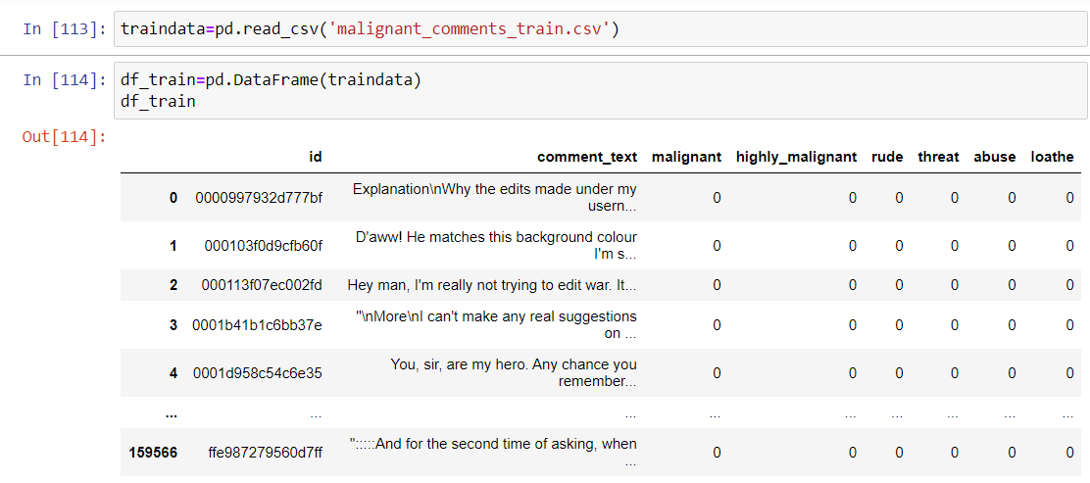
Read and explore the data
The data is split into train and test data, train data has 159571 rows and 8 columns, test data has 153164 rows and 2 columns

Slide 8
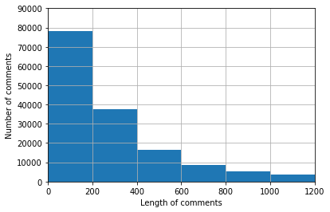
Data Visualization
From the first visualization we can observe that comments have varying lengths from within 200 up to 1200. The majority of comments have length up to 200, and as we move towards greater lengths, the number of comments keep on falling. Since including very long length comments for training will increase the number of words manifold, it is important to set a threshold value for optimum results.

Slide 9
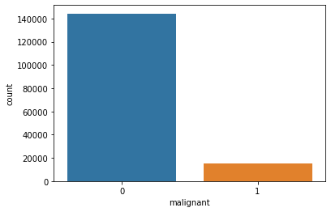
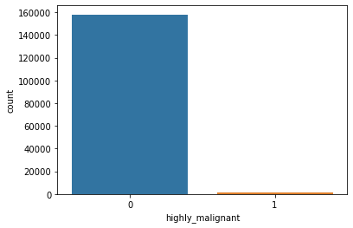
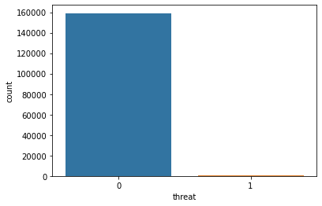
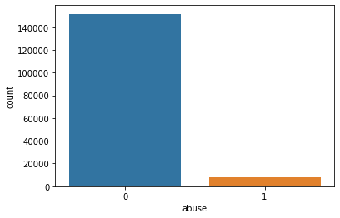

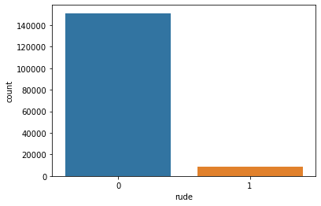
Data Visualization

Slide 10
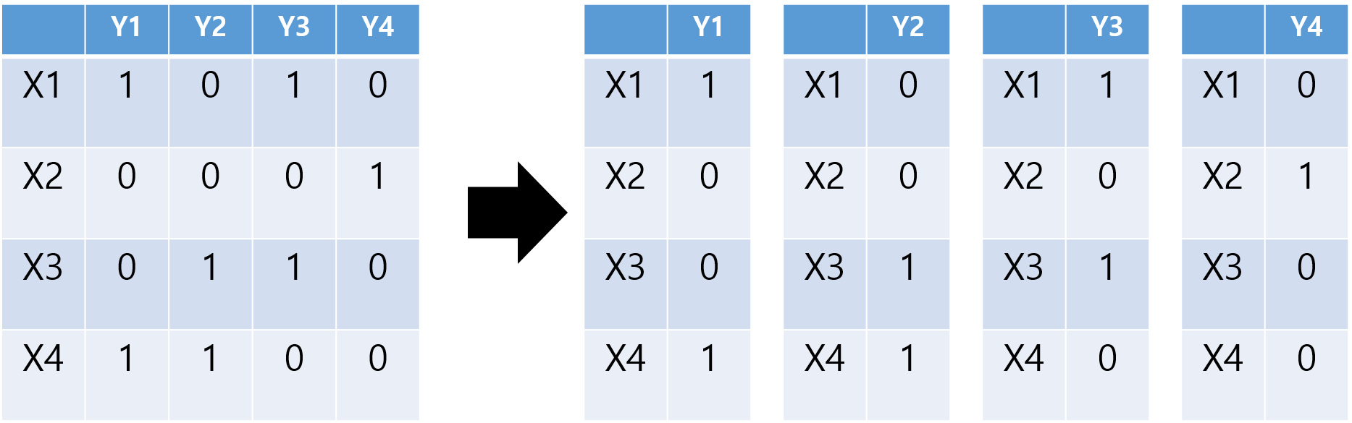
Algorithm and techniques
Binary Relevance Method: This method does not take into account the interdependence of labels. Each label is solved separately like a single label classification problem. This is the simplest approach to be applied.

Slide 11
Data Preprocessing :
A string without all punctuations to be prepared:
The string library contains punctuation characters. This is imported and all numbers
are appended to this string. Our comment_text field contains strings such as won't,
didn't, etc. which contain apostrophe character('). To prevent these words from
being converted to wont or didn't, the character ' represented as \' in escape
sequence notation is replaced by empty character in the punctuation string.
Make_trans( intab, outtab) function is used. It returns a translation table that maps
each character in the intab into the character at the same position in the outtab
string.

Slide 12
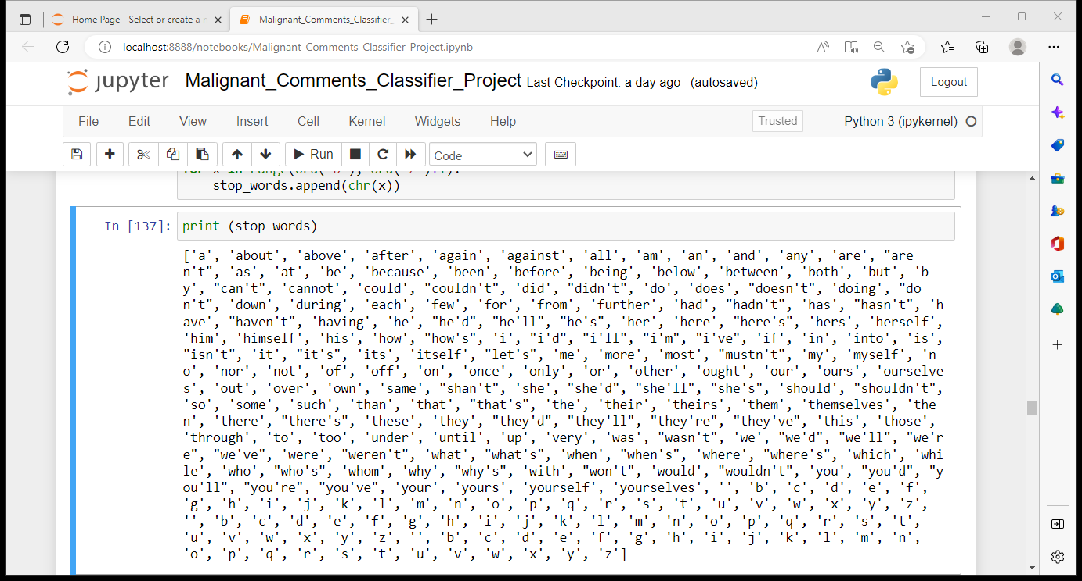
Updating the list of stop words:
Stop words are those words that are frequently used in both written and verbal communication and thereby do not have either a positive or negative impact on our statement like “is, this, us, etc.”.
Single letter words if existing or created due to any preprocessing step do not convey any useful meaning and so they can be directly removed. Hence letters from b to z, will be added to the list of stop words imported directly.

Slide 13
Stemming and Lemmatizing:
The process of converting inflected/derived words to their word stem or the root form is called stemming. Many similar origin words are converted to the same word e.g. words like "stems", "stemmer", "stemming", "stemmed" as based on "stem".
Lemmatizing is the process of grouping together the inflected forms of a word so they can be analyzed as a single item. This is quite similar to stemming in its working but differs since it depends on correctly identifying the intended part of speech and meaning of a word in a sentence, as well as within the larger context surrounding that sentence, such as neighboring sentences or even an entire document.
The wordnet library in nltk will be used for this purpose. Stemmer and Lemmatizer are also imported from nltk.

Slide 14
Applying Count Vectorizer and Splitting dataset into Training and Testing:
To convert a string of words into a matrix of words with column headers represented by words and their values signifying the frequency of occurrence of the word Count Vectorizer is used.
Stop words were accepted, convert to lowercase, and regular expression as its parameters. Here, we will be supplying our custom list of stop words created earlier and using lowercase option. Regular expression will have its default value.
Since we have our train and test data separated we can perform the above mentioned processes separately on train and test data and then form the train and test sets.

Slide 15
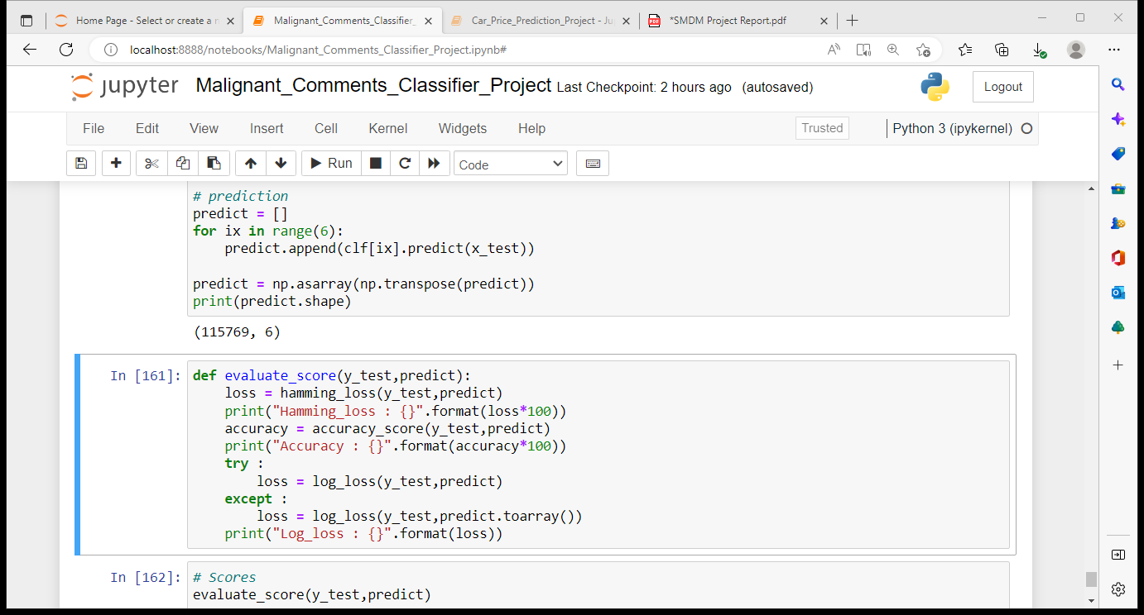
Implementation :
We will be defining function evaluate_score for printing all evaluation metrics: Some implementations return a sparse matrix for the predictions and others return a dense matrix. So, a try except block were used to handle it.

Slide 16
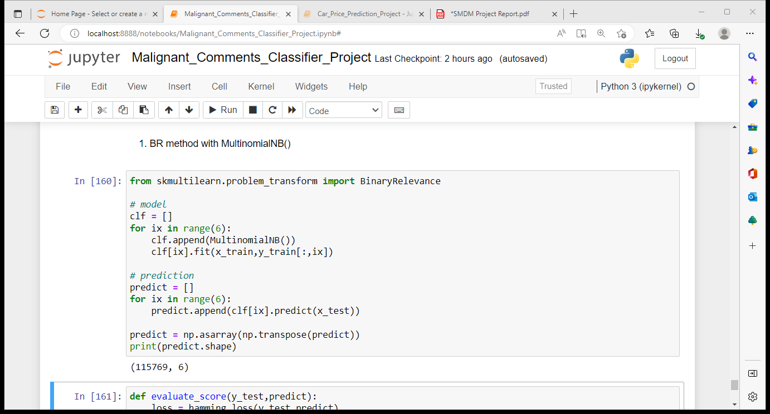
Binary relevance method :
Binary Relevance method were implemented from scratch. It does not consider the interdependence of labels and basically creates a separate classifier for each of the labels. The code is as shown above

Slide 17
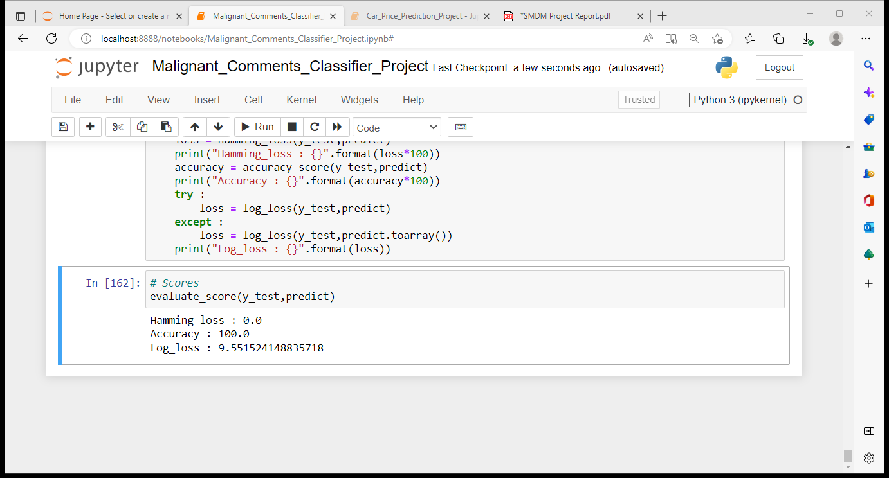
Results :
Our model was the Binary Relevance method using MultinomialNB classifier. It led to the following results:

Slide 18
Conclusion
To summarize this project, the first step involved studying the train and test data.
The second major step was performing cleaning of data including punctuation removal, stop word removal, stemming and lemmatizing: This step was also crucial since the occurrence of similar origin words but having different spellings will intend to give similar classification, but computer cannot recognize this on its own. Hence, this step helped to a large extent in both removing and modifying existing words.
The third step was to build model Binary Relevance method with MultinomialNB()
Finally checking for the evaluation metrics: The two major evaluation metrics I planned to check on were hamming-loss and log-loss. Hence the performance of the model was verified on the basis of the combination of both these losses.
Although we have we have built a model which is giving us accuracy of 100%, it is always good to build 4 to 5 models for the same test and train data.

Slide 19
THANK YOU ☺

