Slide 1


MICRO CREDIT DEFAULTER PROJECT
Submitted to :
Mohd Kashif, Flip Robo Technologies
Submitted by:
CHETHANA M

Slide 2
Introduction
A Microfinance Institution (MFI) is an organization that offers financial services to low income populations. The Microfinance services (MFS) provided by MFI are Group Loans, Agricultural Loans, Individual Business Loans and so on.
Today, microfinance is widely accepted as a poverty-reduction tool, representing $70 billion in outstanding loans and a global outreach of 200 million clients.
We are working with one such client that is in Telecom Industry. They are a fixed wireless telecommunications network provider. They have launched various products and have developed its business and organization based on the budget operator model, offering better products at Lower Prices to all value conscious customers through a strategy of disruptive innovation that focuses on the subscriber.
They are collaborating with an MFI to provide micro-credit on mobile balances to be paid back in 5 days. The Consumer is believed to be defaulter if he deviates from the path of paying back the loaned amount within the time duration of 5 days.
The sample data is provided to us from our client database. It is hereby given to you for this exercise. In order to improve the selection of customers for the credit, the client wants some predictions that could help them in further investment and improvement in selection of customers.

Slide 3
Technical Goals
Our goal is to build a model using Machine Learning in order to predict the actual value of the prospective properties and decide whether to invest in them or not. For this company wants to know:
• Which variables are important to predict the price of variable?
• How do these variables describe the price of the house?

Slide 4
Goals and Objective
The purpose of this project is to document the process I went through to create my predictions on whether the customer will pay back the loan In the given period of time or not.
The Objective of this projective is to build a model that could successfully determine whether the customer will pay back the loan amount with the given dataset.

Slide 5
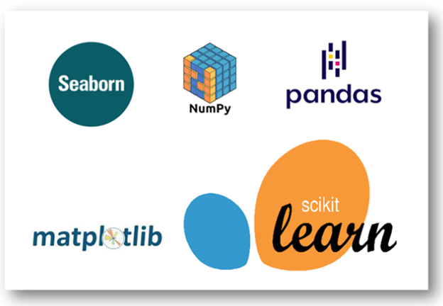
Software required
TOOLS USED
Jupyter Notebook
LIBRARY USED
Analysing : Numpy, Pandas, Sci-kit Learn
Visualization : Matplotlib, seaborn

Slide 6
Logistic Regression
In this project we have used multiple algorithm to predict if the customer pays the loan or not but ideally we will see what is Logistic Regression.
In statistics, the logistic model is a statistical model that models the probability of an event taking place by having the log-odds for the event be a linear combination of one or more independent variables. In regression analysis, logistic regression is estimating the parameters of a logistic model. Formally, in binary logistic regression there is a single binary dependent variable, coded by an indicator variable, where the two values are labeled ‘0’ and ‘1’, while the independent variables can each be a binary variable or a continuous variable.
Apart from Linear Regression the other algorithms used in this project are :
Decision Tree Classifier
KNeighbors Classifier
Random Forest Classifier

Slide 7
Implementation
Importing the necessary libraries
Importing the dataset
Cleaning and analysing the dataset
Building the models
Cross Validation and Parameter tuning
Comparing the scores of the models and picking the best model
Saving the final model and making use of it for prediction

Slide 8
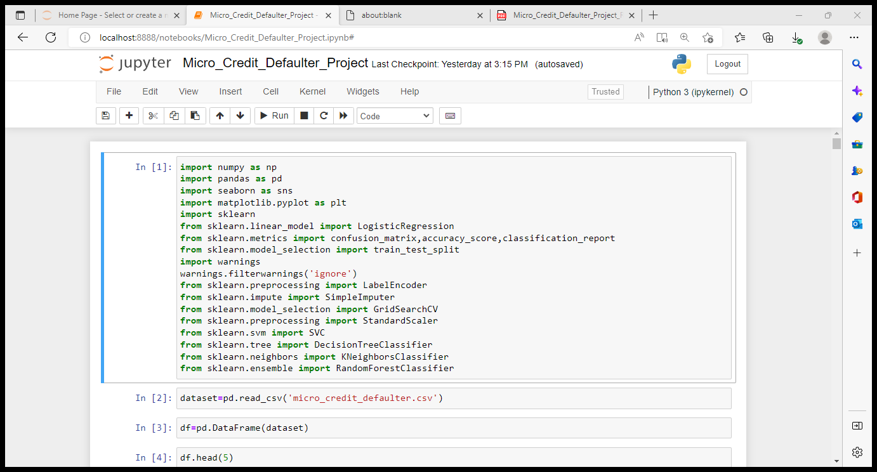
Importing the necessary libraries

Slide 9
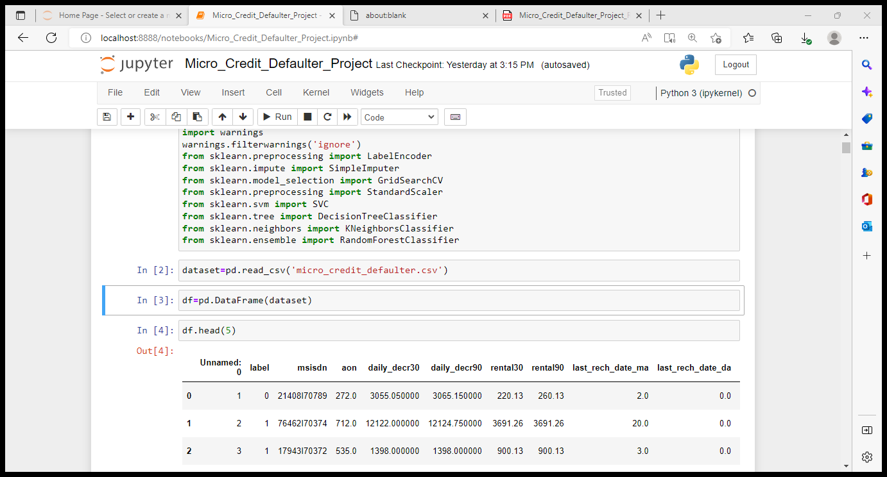
Read and explore the data
The dataset has 209593 rows and 36 columns

Slide 10
Cleaning and Analysing the data
There was no missing values in the dataset
Outliers are present which will be removed using z-score method
Data is skewed which can be treated using Powertransformation (Yeo-Johnson) method.
Multicollinearity should be checked and drop the columns which were creating high multicollinearity in the dataset.
Scaling the data

Slide 11
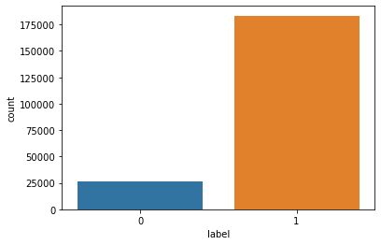
Data Visualization
Let us look into few example graphs to know about the characteristics of variables in the dataset.
The dataset is imbalanced. Label '1' has approximately 87.5% records, while, label '0' has approximately 12.5% records.

Slide 12
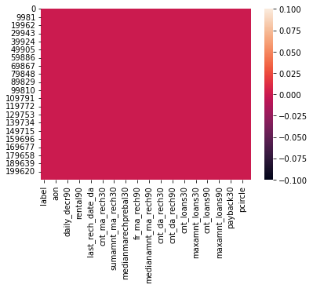
Checking for missing values in the dataset :
From the above plot we can observe that there are no missing values in the dataset.

Slide 13
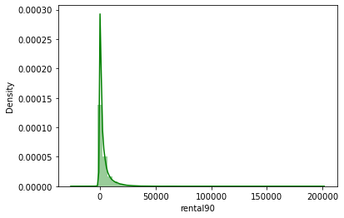
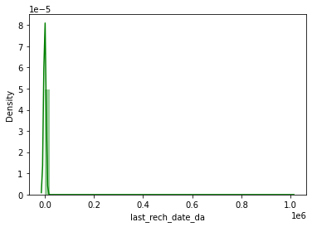
The above plot is about Average main account balance over last 30 days, The data has right skew.
The above plot tells us about Number of days till last recharge of main account.

Slide 14
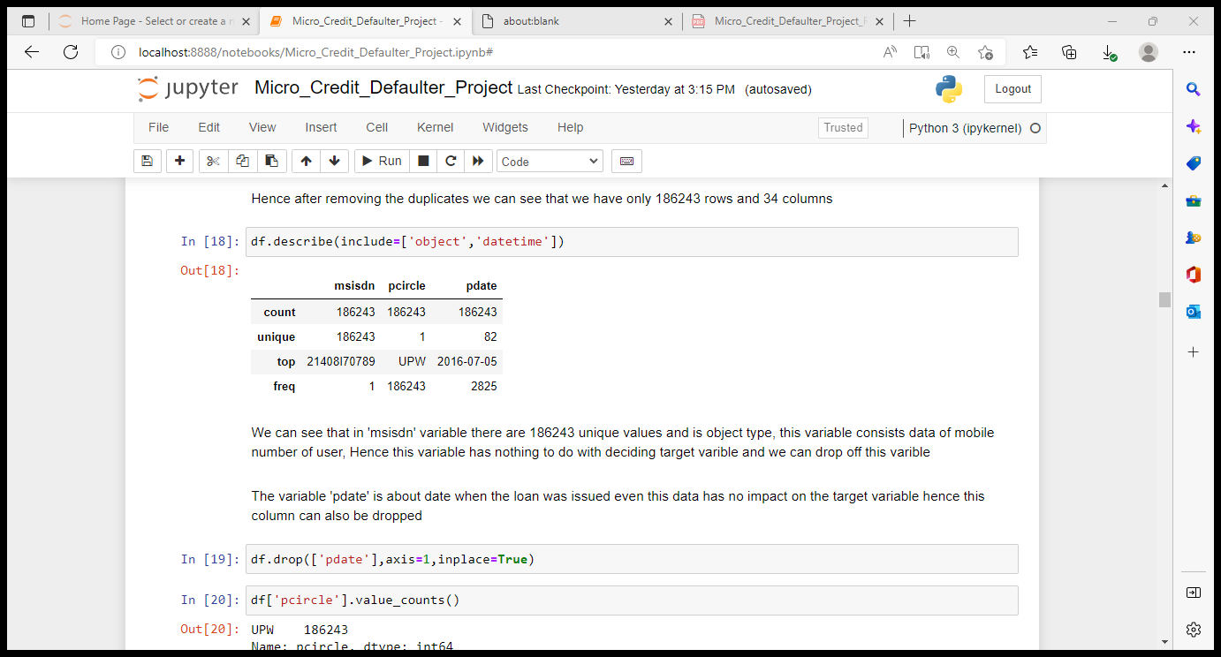
Object dtype Data in the dataset
We can see that in 'msisdn' variable there are 186243 unique values and is object type, this variable consists data of mobile number of user, Hence this variable has nothing to do with deciding target variable and we can drop off this variable.
The variable 'pdate' is about date when the loan was issued even this data has no impact on the target variable hence this column can also be dropped.
The variable ‘pcircle’ has only 1 unique value which doesn’t make any impact on target variable, hence this variable can also be dropped.

Slide 15
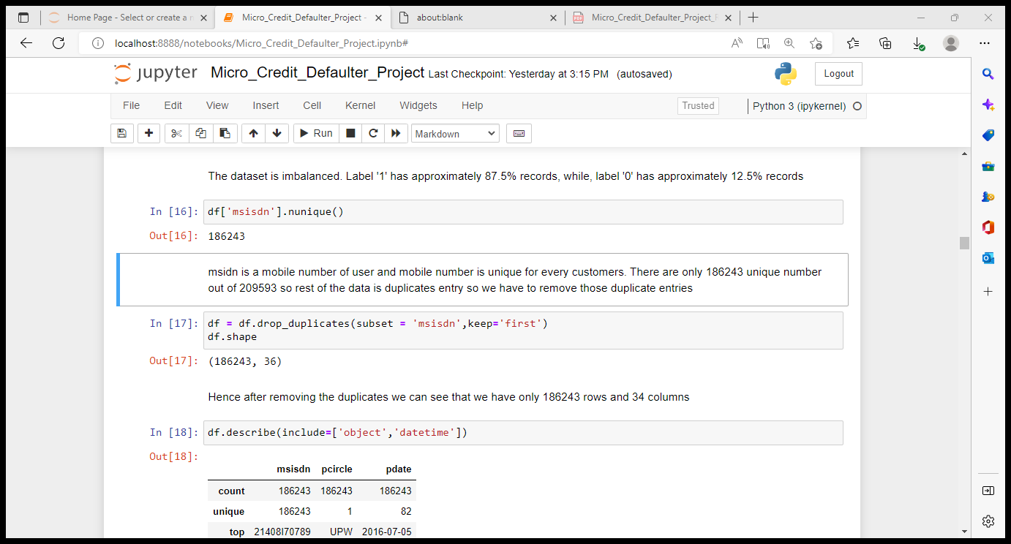
Identifying the duplicates and removing duplicated
Hence after removing the duplicates we can see that we have only 186243 rows and 36 columns.

Slide 16
Key Observations :
mean > median (50th percentile) almost in all the columns, hence the data has right skewness in it.
We can see that the difference between 75% percentile and max is high is case of all the variables, hence outliers are present in the data.
daily_decr30 and daily_decr90 are having good correlation to each others.
In the similar way cnt_loans30 and amnt_loans30, payback30 and payback90 have good correlations.
label has a better correlation with daily_decr30, amnt_loans90, cnt_loans30, cnt_ma_rech90 compared to other variables.
Label has very poor correlation with few variables like cnt_loans90, fr_da_rech90, medianmarechprebal30 etc. as we can observe in the above table and map.

Slide 17
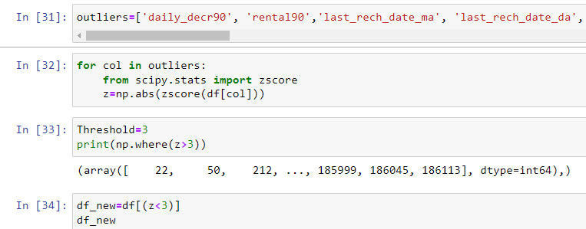
Removing Outliers
Hence the outliers are removed from the dataset using z-score method.
New dataset is created once after removing outliers, in the new dataset there are 182937 rows and 33 columns. The % of data lost while removing outliers is 1.8% which is less than 10% and tells that it is appropriate to remove the outliers using z-score method.

Slide 18
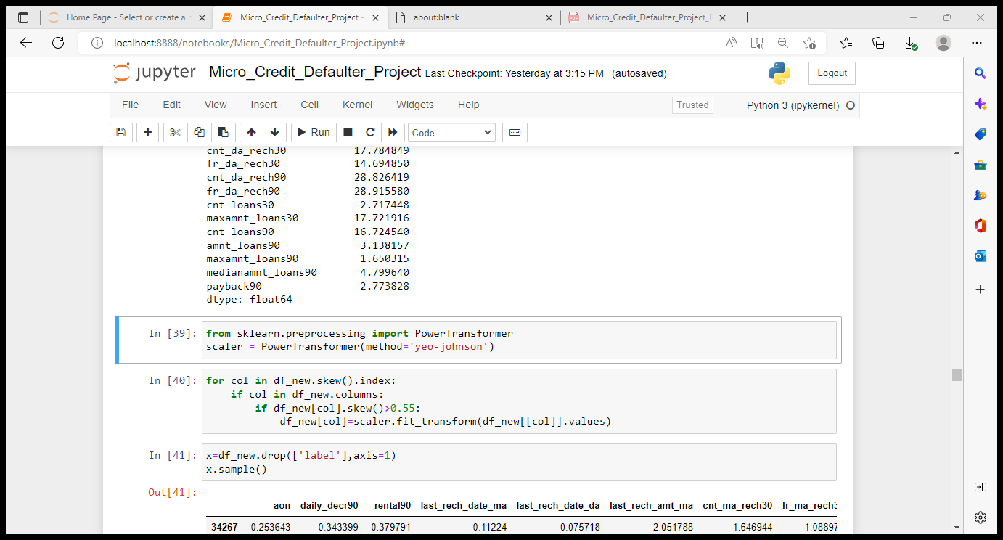
Removing skewness of the data
Hence the skewness is removed from the data using PowerTransformer (yeo-johnson) method.

Slide 19
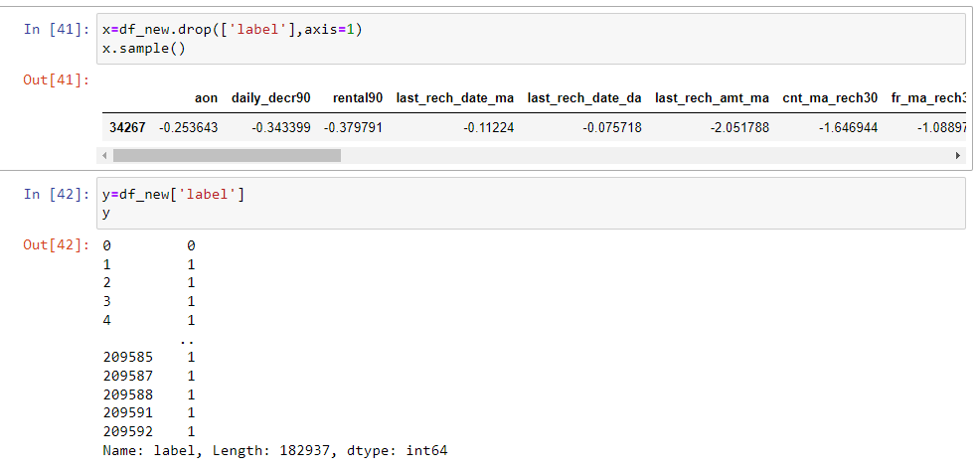
Splitting x and y variables

Slide 20
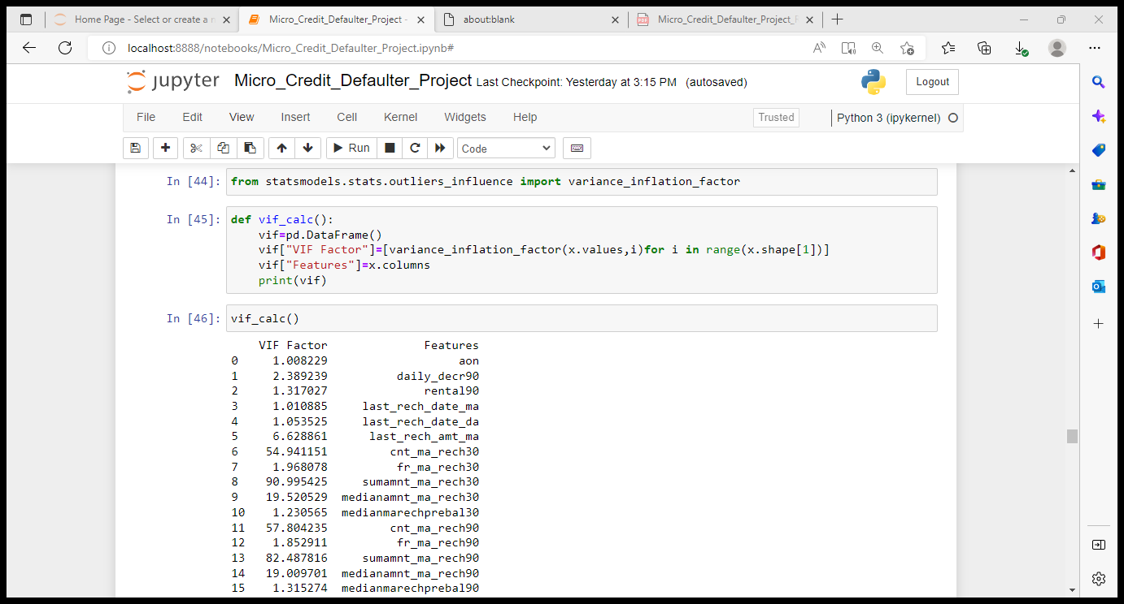
Checking multicollinearity in the data and dropping the variable which are creating multicollinearity
Once we check the multicollinearity in the data, we can see which are the variables that are causing multicollinearity and by observing the correlation table we can decide on which variable is creating least impact on Label and drop them.
In the same format we have dropped few variables like sumamnt_ma_rech30, amnt_loans90, sumamnt_ma_rech90, cnt_ma_rech30, daily_decr30, rental30, amnt_loans30, medianamnt_loans30, payback30. So once after all these process we can see that the dataset we have is 24 columns and 182937 rows.

Slide 21
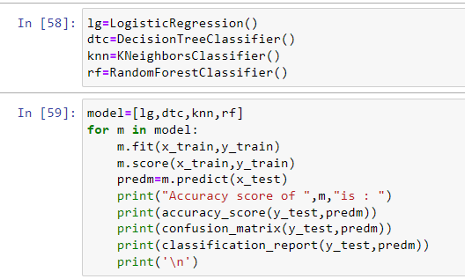
Building multiple models using the above mentioned algorithms
Logistic Regression : 87.46%
Decision Tree Classifier : 85.19%
Kneighbors Classifier : 88.84%
Random Forest Classifier : 90.35%
From the above models we can see that Random Forest Classifier is giving the best score of 90.35%, hence we can consider this model to be the best as of now.

Slide 22
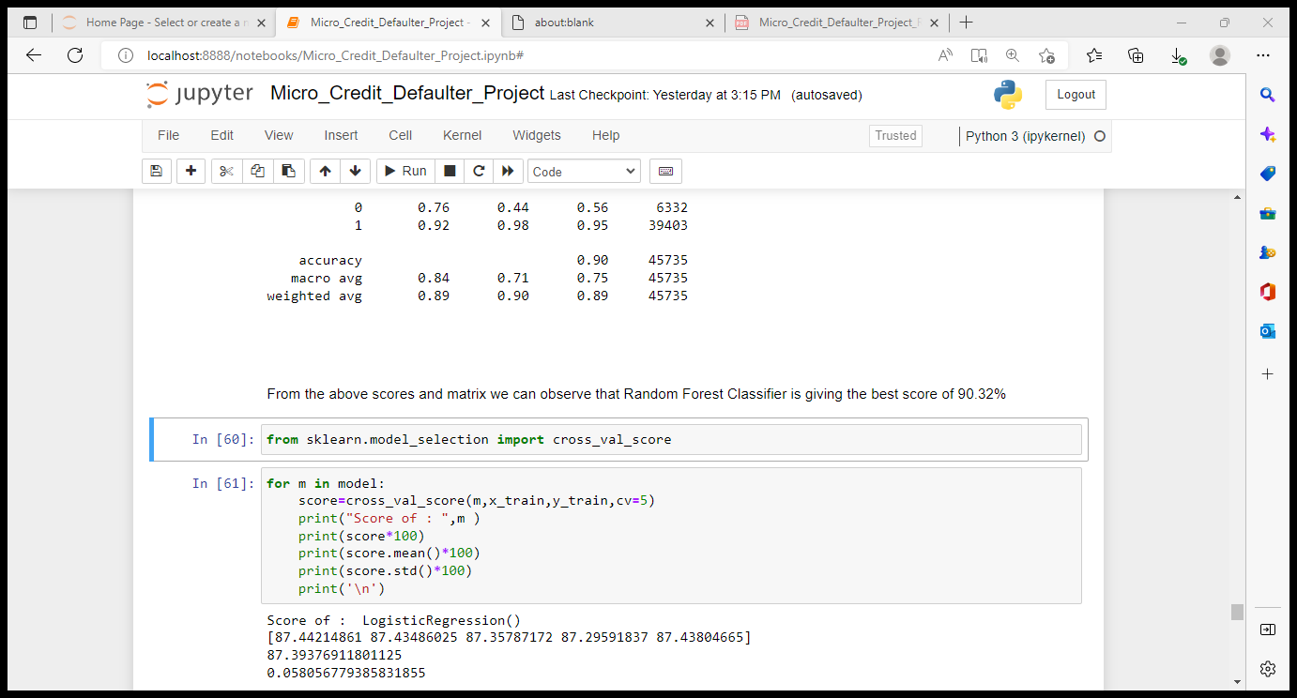
Cross Validation :
Evening with cross validation we can observe that mean score is good for Random Forest Classifier model.

Slide 23
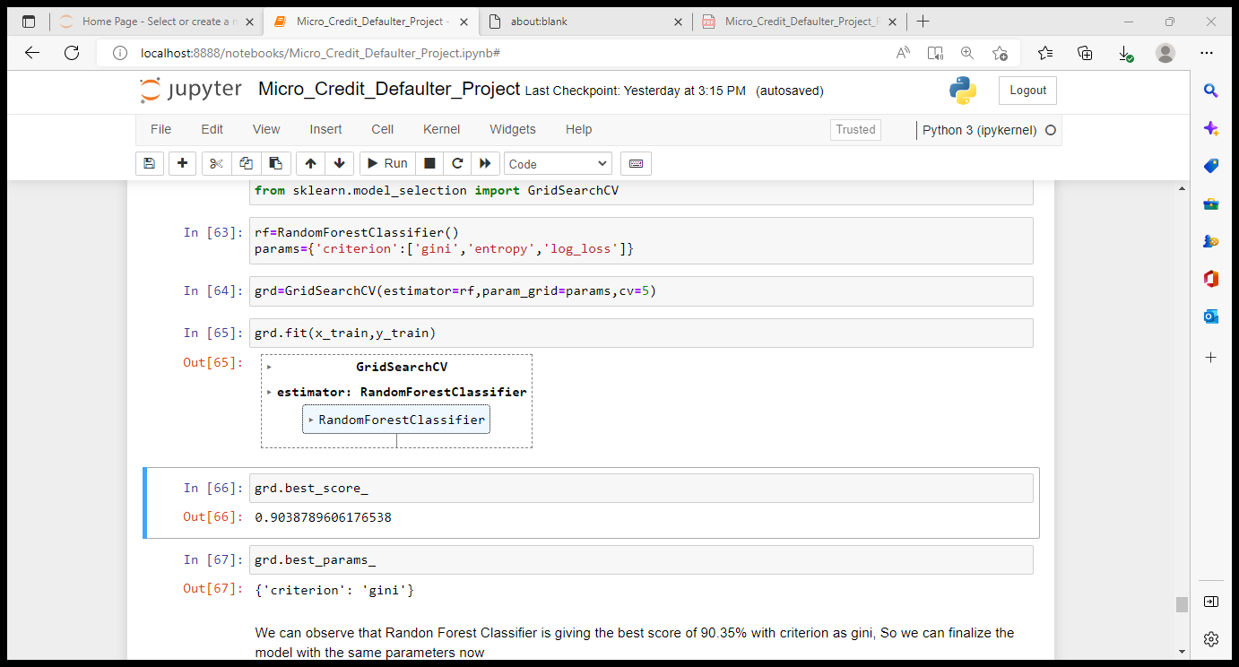
Parameter tuning on Random Forest Classifier
We can observe that Random Forest Classifier is giving the best score of 90.35% with criterion as gini, So we can finalize the model with the same parameters now.

Slide 24
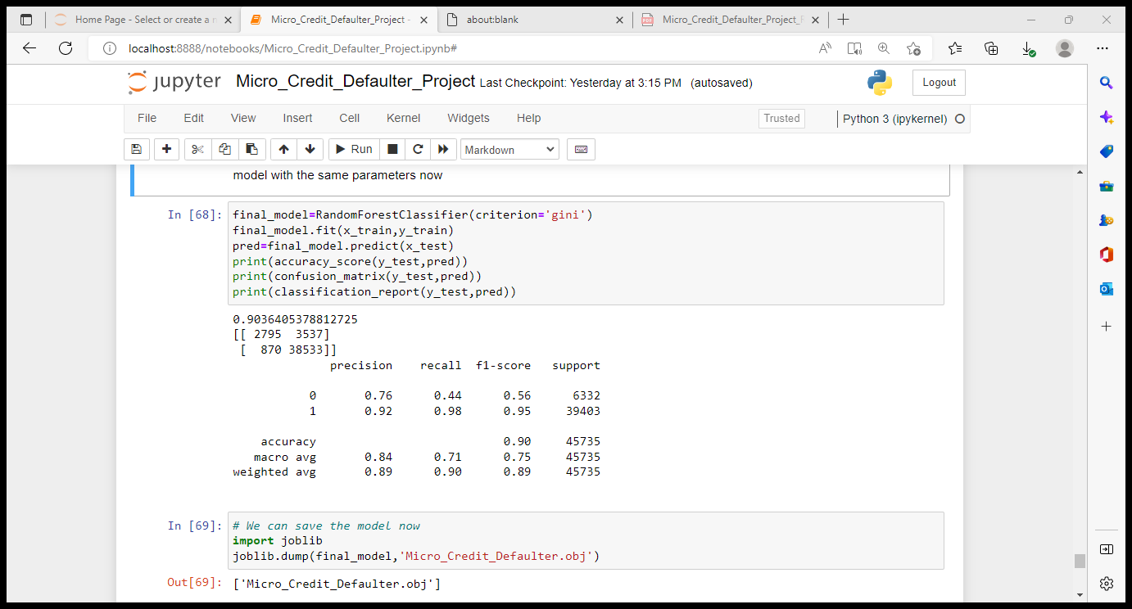
Picking the Final model
We can finalize the Random Forest Classifier as the final model which is giving 90.36% accuracy with criterion = gini.

Slide 25
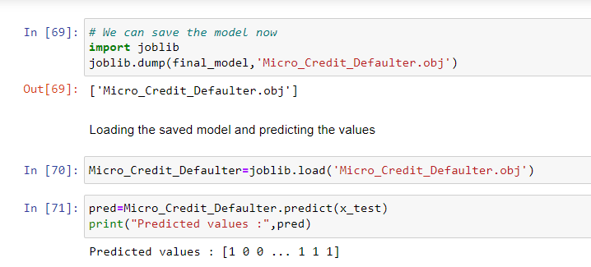
Saving the final model

Slide 26
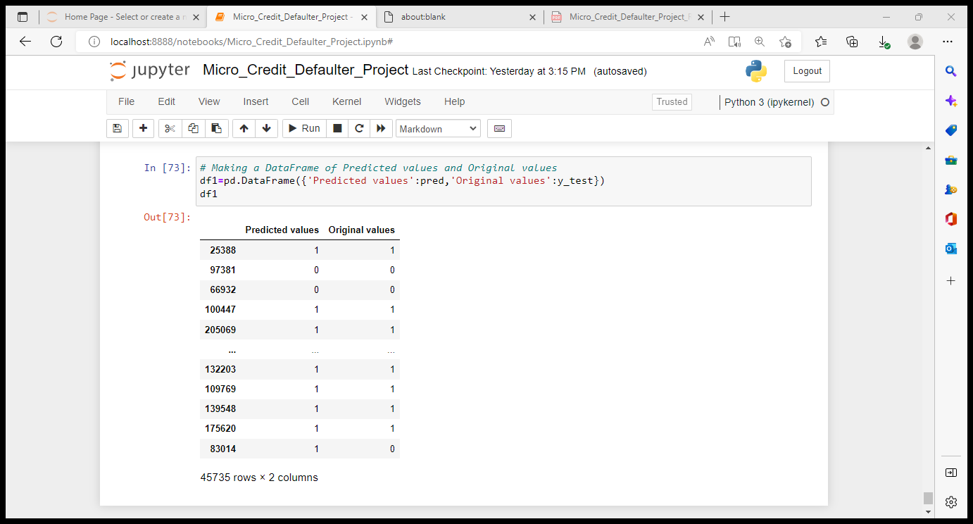
Making prediction

Slide 27
Conclusion
From the Exploratory Data Analysis, we could generate insight from the data. How each of the features relates to the target. Also, while training the model we could observe that Random Forest Classifier was performing well with the accuracy 90.35%.
From the EDA we could also observe that there were some duplicates present in the dataset which had to be removed, Label had better correlation with few variables like daily_decr30, amnt_loans90, cnt_loans30, cnt_ma_rech90 compared to other variables.
Few variables like cnt_loans90, fr_da_rech90, medianmarechprebal30 had poor correlation with target variable.
Cleaning of the data included few techniques like removing outliers, treating skewed data, dropping the variables which were creating multicollinearity and finally the data was scaled.
While building the model we could observe that it is always good to build 4 to 5 models for the same train test data and compare the scores of the models then pick the best model instead of sticking onto single model.
To make the model more accurate I think it is good to use SMOTE and PCA techniques if applicable. As of now we could finalize Random Forest Classifier with gini as the criterion as the best model which was giving 90.35% accuracy score which was best compared to other models.

Slide 28
THANK YOU ☺

