Slide 1


FAKE NEWS CLASSIFIER PROJECT
Submitted to :
Mohd Kashif, Flip Robo Technologies
Submitted by:
CHETHANA M

Slide 2
Introduction
Fake news has become one of the biggest problems of our age. It has serious impact on our online as well as offline discourse. One can even go as far as saying that, to date, fake news poses a clear and present danger to western democracy and stability of the society.
Fake news on different platforms is spreading widely and is a matter of serious concern, as it causes social wars and permanent breakage of the bonds established among people. A lot of research is already going on focused on the classification of fake news.
Here we will try to solve this issue with the help of machine learning in Python.

Slide 3
Technical Goals
As time flows, the amount of data, especially text data increases exponentially. Along with the data, our understanding of AI also increases and the computing power enables us to train very complex and large models faster. Fake news has been gathering a lot of attention worldwide recently. The effects can be political, economic, organizational, or even personal. This project discusses the approach of natural language processing and machine learning in order to solve this problem. Use of bag-of-words, count vectorizer has been made, TF-IDF, and trained the data on five classifiers to investigate which of them works well for this specific dataset of labelled news statements. The precision, recall and f1 scores help us determine which model works best.

Slide 4
Goals and Objective
The purpose of this project is to document the process I went through to create classification on whether the given news title is fake or true.
The Objective of this project is to build a model that could successfully classify the news titles into fake and true with the given dataset.

Slide 5
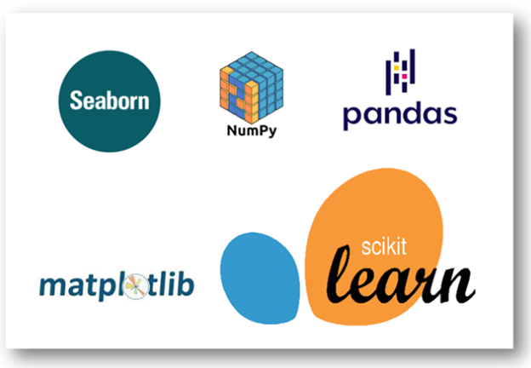
Software required
TOOLS USED
Jupyter Notebook
LIBRARY USED
Analysing : Numpy, Pandas, Sci-kit Learn
Visualization : Matplotlib, seaborn

Slide 6
Algorithms used :
MultinomialNB, this model provides an ability to classify data, that cannot be represented numerically. Its main advantage is the significantly reduced complexity. It provides an ability to perform the classification, using small training sets, not requiring to be continuously re-trained.
Logistic Regression, this statistical model (also known as logit model) is often used for classification and predictive analytics. Logistic regression estimates the probability of an event occurring, such as voted or didn’t vote, based on a given dataset of independent variables. Since the outcome is a probability, the dependent variable is bounded between 0 and 1. In logistic regression, a logit transformation is applied on the odds—that is, the probability of success divided by the probability of failure. This is also commonly known as the log odds, or the natural logarithm of odds.
Kneighbors Classifier, this is a non-parametric and lazy learning algorithm. Non-parametric means there is no assumption for underlying data distribution. In other words, the model structure determined from the dataset. This will be very helpful in practice where most of the real world datasets do not follow mathematical theoretical assumptions. Lazy algorithm means it does not need any training data points for model generation. All training data used in the testing phase. This makes training faster and testing phase slower and costlier. Costly testing phase means time and memory. In the worst case, KNN needs more time to scan all data points and scanning all data points will require more memory for storing training data.

Slide 7
Algorithms used :
4. DecisionTreeClassifier, is a Supervised Machine Learning Algorithm that uses a set of rules to make decisions, similarly to how humans make decisions. One way to think of a Machine Learning classification algorithm is that it is built to make decisions.
5. RandomForestClassifier, is a Supervised Machine Learning Algorithm that is used widely in Classification and Regression problems. It builds decision trees on different samples and takes their majority vote for classification and average in case of regression. One of the most important features of the Random Forest Algorithm is that it can handle the data set containing continuous variables as in the case of regression and categorical variables as in the case of classification. It performs better results for classification problems.

Slide 8
Implementation
Calling the required libraries
Import necessary files
Adding labels, concating the datasets and shuffling
Separating input and target variables
Applying Countvectorizer
Splitting data for training and testing
Building the model
Cross validation
Parameter tuning
Saving the final model

Slide 9
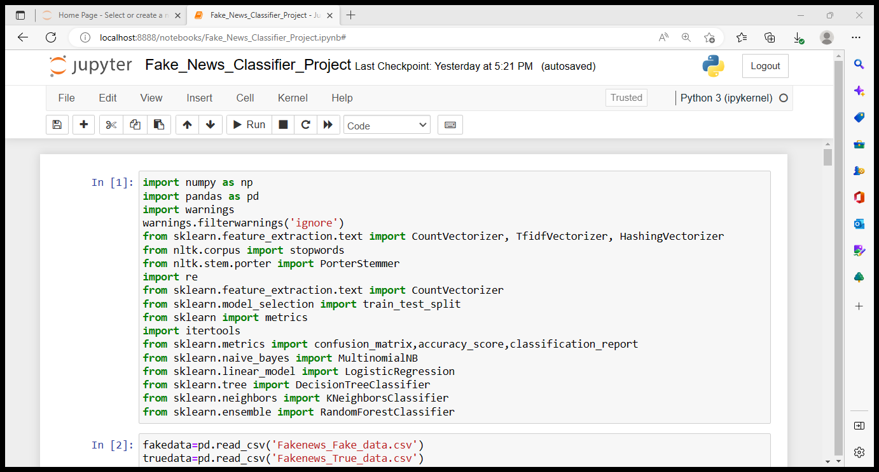
Importing the necessary libraries

Slide 10
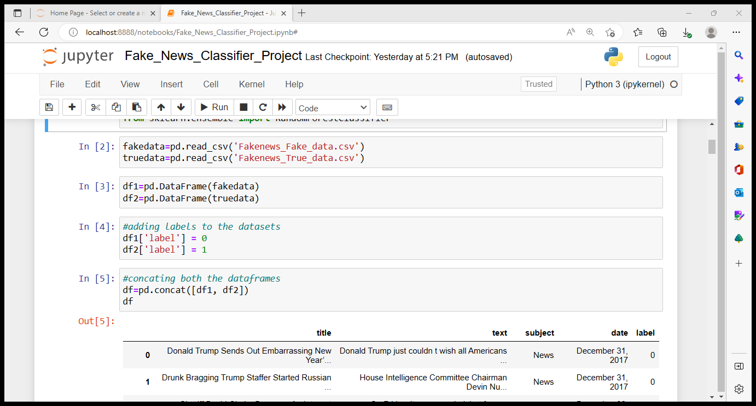
Importing the files, adding labels, concating the datasets and shuffling it

Slide 11
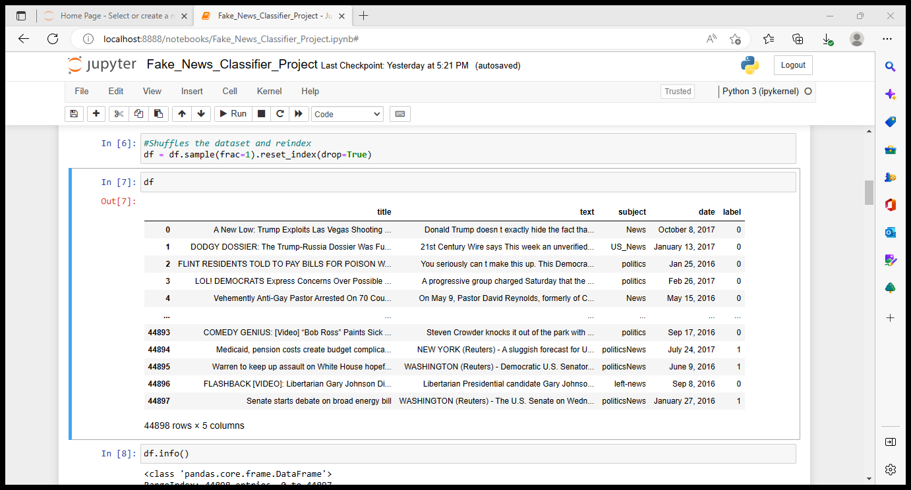
Final Dataset
The final dataset has 44898 rows, 5 columns which includes news title, description, subject, published date and label.

Slide 12
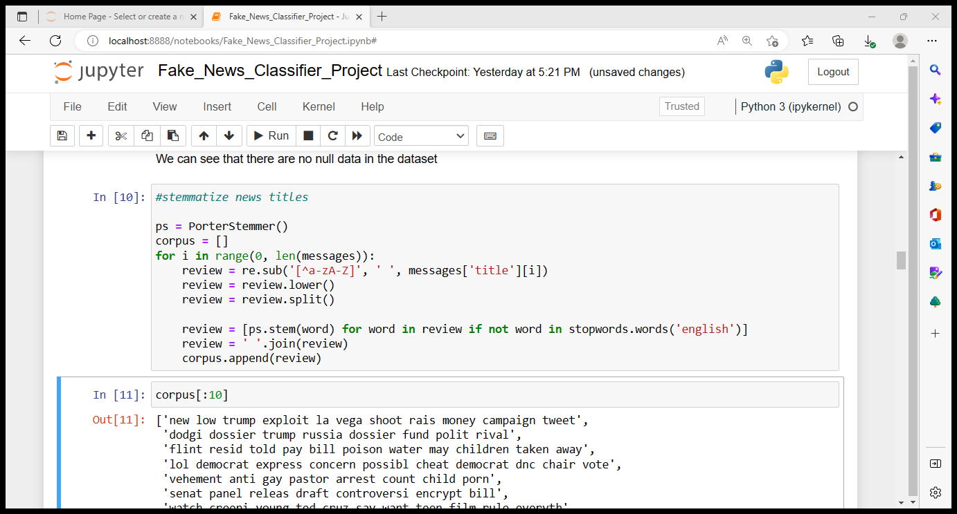
Stemmatize news titles
Text normalization is the process of simplifying multiple variations or tenses of the same word. Stemming and lemmatization are two methods of text normalization, the former being the simpler of the two. To stem a word, we simply remove the suffix of a word to reduce it to its root.
As an example, “jumping”, “jumps”, and “jumped” all are stemmed to “jump.”
Stemming is not without its faults, however. We can run into the issue of overstemming. Overstemming is when words with different meanings are stemmed to the same root - a false positive.

Slide 13
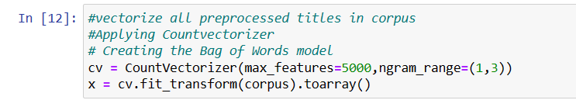
vectorize all preprocessed titles in corpus, Applying Countvectorizer and Creating the Bag of Words model.
The CountVectorizer provides a simple way to both tokenize a collection of text documents and build a vocabulary of known words, but also to encode new documents using that vocabulary.
We can use it as follows:
Create an instance of the CountVectorizer class.
Call the fit() function in order to learn a vocabulary from one or more documents.
Call the transform() function on one or more documents as needed to encode each as a vector.
An encoded vector is returned with a length of the entire vocabulary and an integer count for the number of times each word appeared in the document.
In our project we are using count vectorizer to vectorize all the titles in corpus by applying CountVectorizer then create a bag of words model.

Slide 14
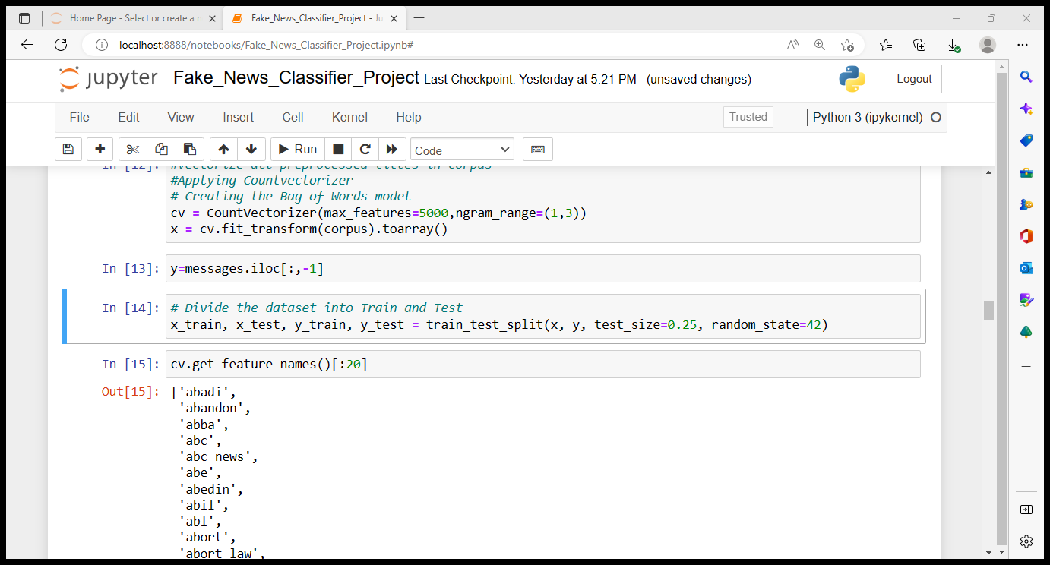
Splitting train-test data :
To split the data into our two datasets, we’ll use scikit-learn’s train_test_split() method.
Let’s say we have 100 records in the loaded dataset. If we specify the test dataset is 25 percent, we’ll split 75 records for training and use the remaining 25 records for testing.

Slide 15
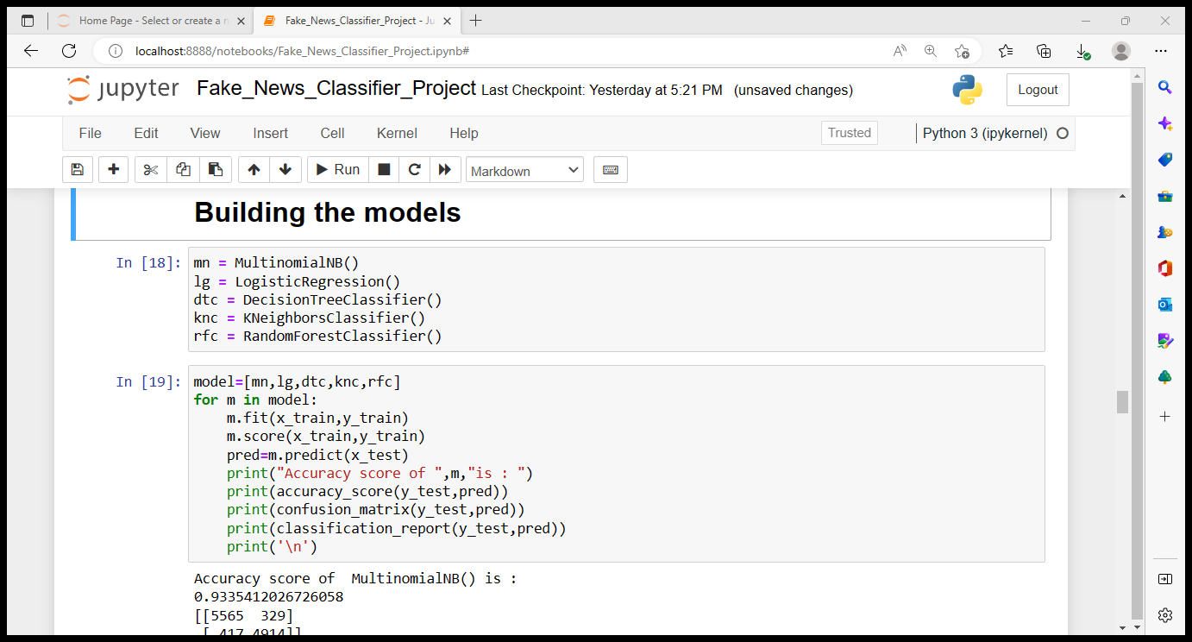
Building the models :
Firstly we will be calling all the algorithms required and the start building the models for the same train and test datasets. We are here using MultinomialNB, LogisticRegression, DecisionTreeClassifier, KneighborsClassifier and RandomForestClassifier.
The reason behind why we are building 5 models simultaneously for the same train and test data is that to check for the performance of the models and conclude the final model which gives the best score. The same is done by running the code as shown above.

Slide 16
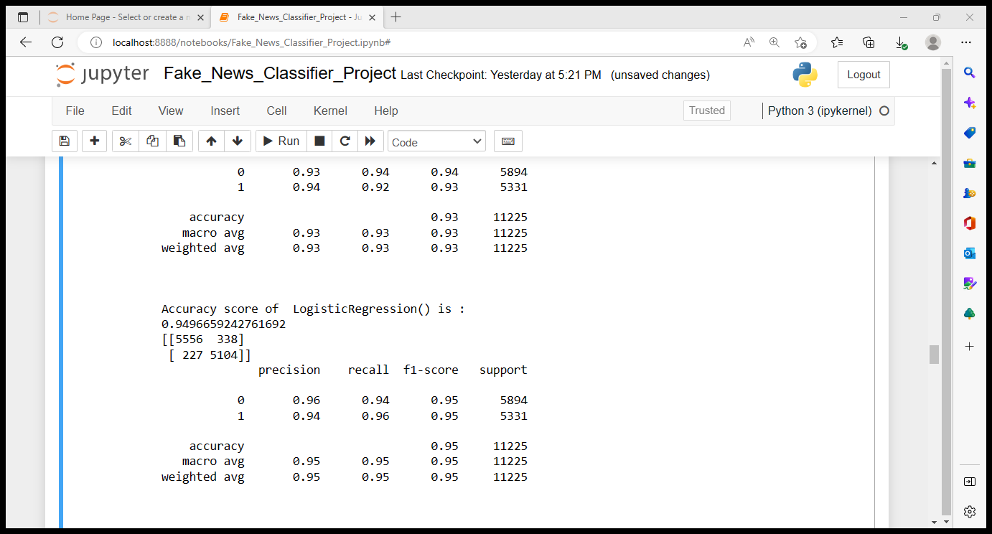
Scores of the best performing model :
By running the above codes we were able see the performance of each model and by comparing the score and matrix we can tell that LogisticRegression is giving the best result whose accuracy score and matrix is as below.

Slide 17
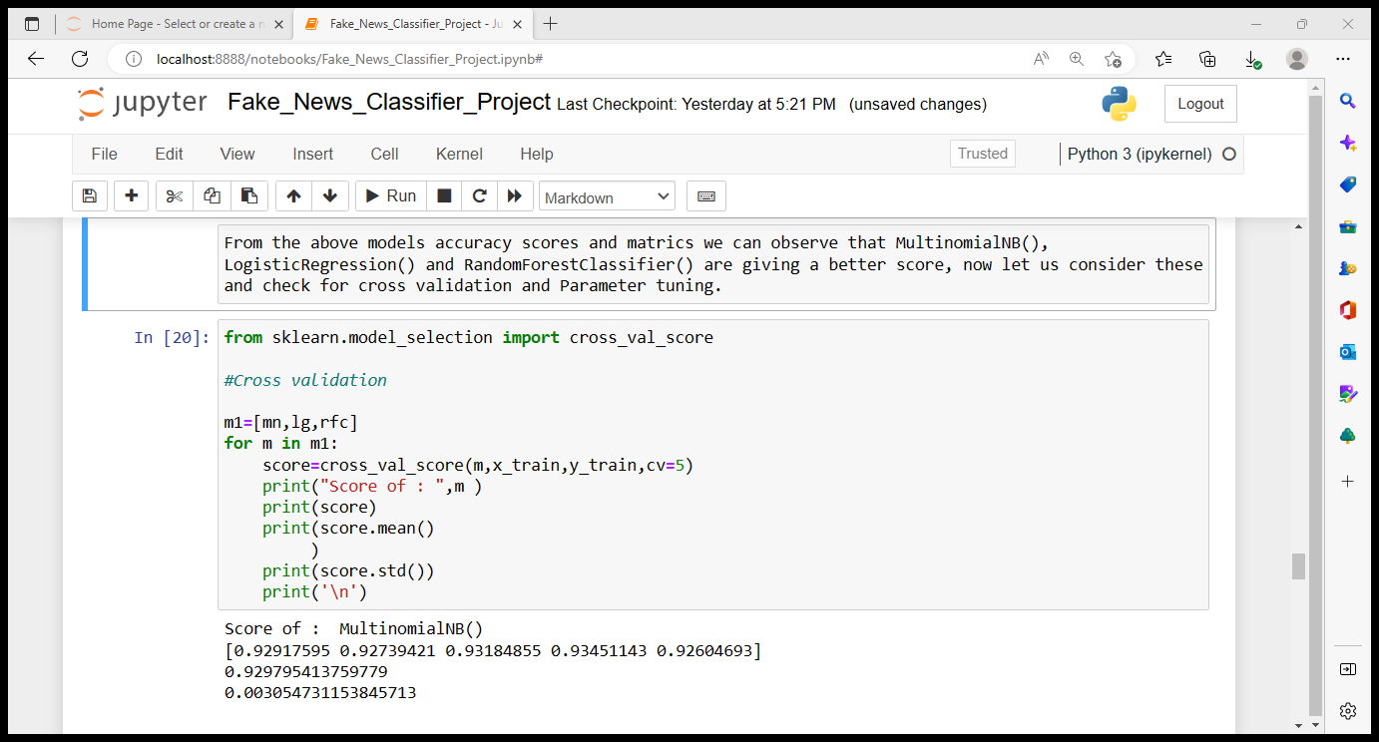
Cross Validation :
Going further we will be performing cross validation on the algorithm which are giving us the better scores comparatively. This can be performed by running the codes as shown above.

Slide 18
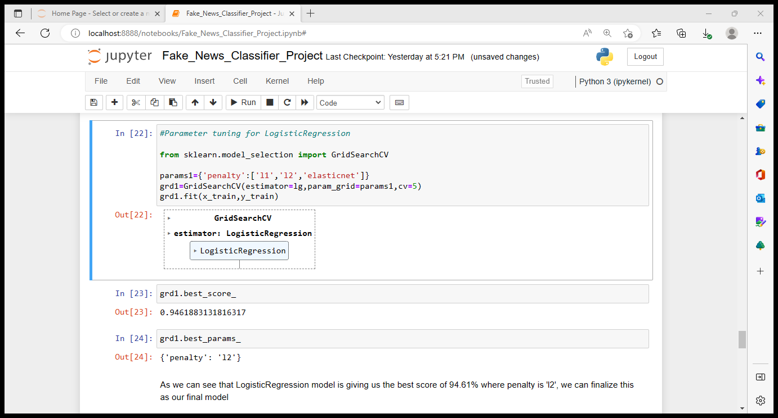
Parameter tuning
As we can observe that Logistic regression is the best model so far, to check if we can further improve the performance of the model by using parameter tuning method.
So now we can observe that Logistic regression model is working better with the parameter where penalty is ‘l2’ by giving us the accuracy score of 94.61%.
We can now finalize LogisticRegression with penalty as ‘l2’ model as our final classifier.

Slide 19
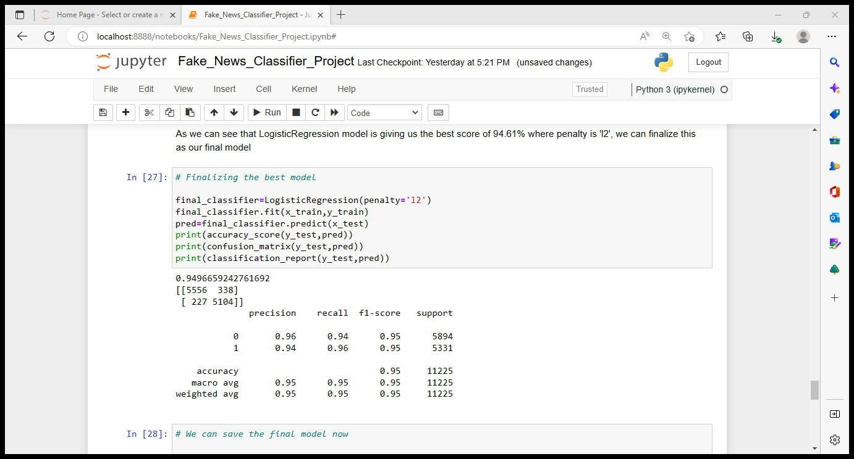
Finalizing the best model :

Slide 20
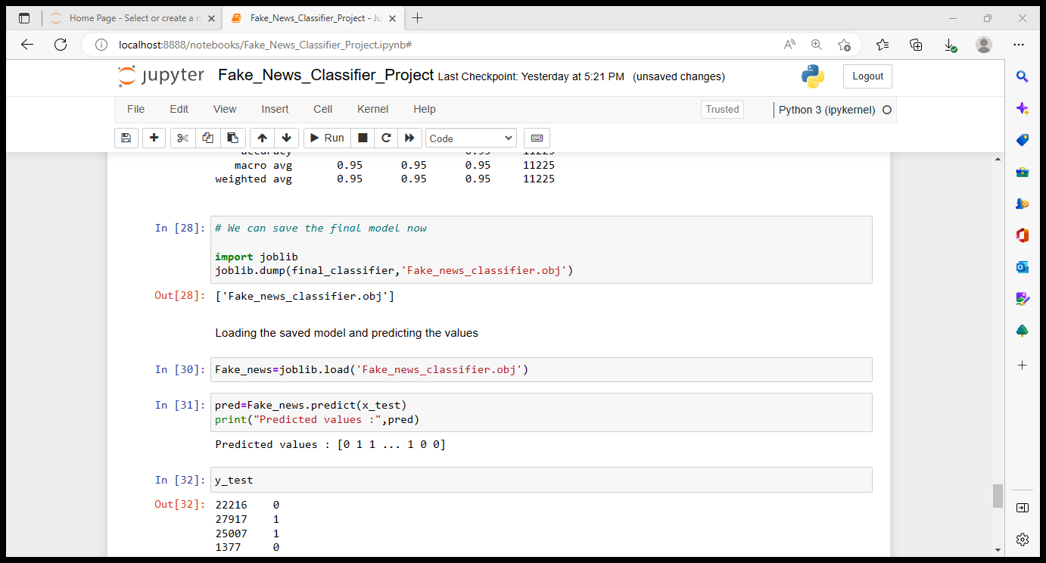
Saving the final model and checking for the predicted values

Slide 21
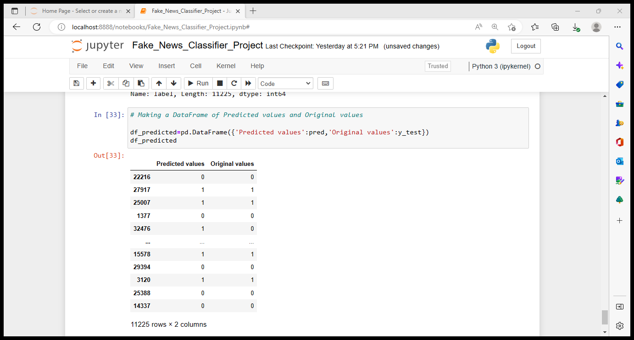
Now we can create a dataframe with the predicted values and original values and do the comparisons between both values.

Slide 22
Conclusion
To summarize this project, the first step involved studying the dataset.
The second major step was to separate input and target variables, stemmatizing the titles, applying Countvectorizer, Splitting data for training and testing.
The third step was to build models MultinomialNB, LogisticRegression, DecisionTreeClassifier, KneighborsClassifier and RandomForestClassifier and check for the best performing model comparing their accuracy scores, precision, recall and f1 scores.
Finally parameter tuning is done on LogisticRegression model as it was performing better compared to other 4 models and chose the best model with best parameter where penalty = l2, which was giving the best score of 94.96%.
Although we have built a model which is giving us accuracy of 94.9%, it is always good to build maximum number of models for the same test and train data to check if other model perform better than the current one.

Slide 23
THANK YOU ☺

