Slide 1


EMAIL SPAM CLASSIFIER PROJECT
Submitted to :
Mohd Kashif, Flip Robo Technologies
Submitted by:
CHETHANA M

Slide 2
Introduction
Spam Detector is used to detect unwanted, malicious and virus infected texts and helps to separate them from the nonspam texts. It uses a binary type of classification containing the labels such as ‘ham’ (nonspam) and spam. Application of this can be seen in Google Mail (GMAIL) where it segregates the spam emails in order to prevent them from getting into the user’s inbox.
In this tutorial, we’ll use Python to build an email spam detector. Then, we’ll use machine learning to train our spam detector to recognize and classify emails into spam and non-spam.

Slide 3
Technical Goals
Our goal is to build models using Machine Learning in order to classify the emails as spam or ham.
Choose the best model that gives best score comparatively.

Slide 4
Goals and Objective
The purpose of this project is to document the process I went through to create classification on whether the email is spam or ham based on the given list of emails.
The Objective of this projective is to build a model that could successfully classify the emails into spam and ham with the given dataset.

Slide 5
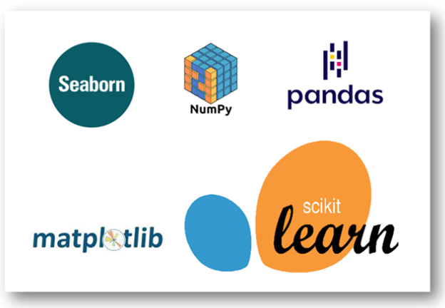
Software required
TOOLS USED
Jupyter Notebook
LIBRARY USED
Analysing : Numpy, Pandas, Sci-kit Learn
Visualization : Matplotlib, seaborn

Slide 6
Algorithms used :
SVM, the support vector machine algorithm, is a linear model for classification and regression. The idea of SVM is simple, the algorithm creates a line, or a hyperplane, which separates the data into classes. SVM can solve both linear and non-linear problems
DecisionTreeClassifier, is a Supervised Machine Learning Algorithm that uses a set of rules to make decisions, similarly to how humans make decisions. One way to think of a Machine Learning classification algorithm is that it is built to make decisions.
RandomForestClassifier, is a Supervised Machine Learning Algorithm that is used widely in Classification and Regression problems. It builds decision trees on different samples and takes their majority vote for classification and average in case of regression. One of the most important features of the Random Forest Algorithm is that it can handle the data set containing continuous variables as in the case of regression and categorical variables as in the case of classification. It performs better results for classification problems.

Slide 7
Implementation
Calling the required libraries
Import necessary files
EDA
Separating input and target variables
Applying Countvectorizer
Splitting data for training and testing
Building the model
Parameter tuning
Saving the final model

Slide 8
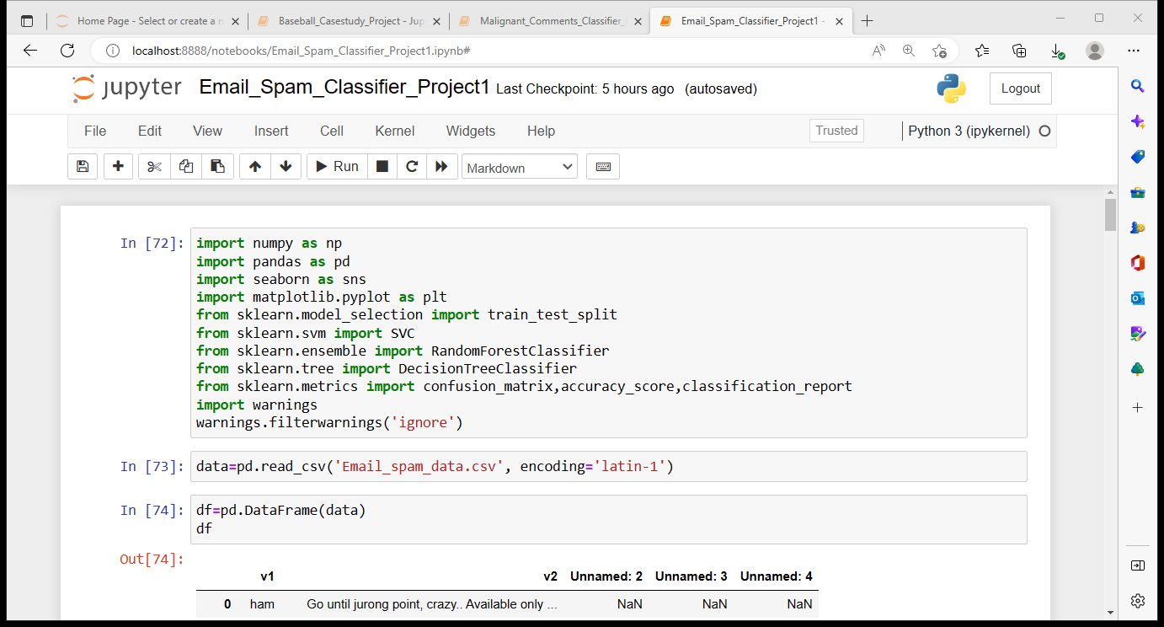
Importing the necessary libraries

Slide 9
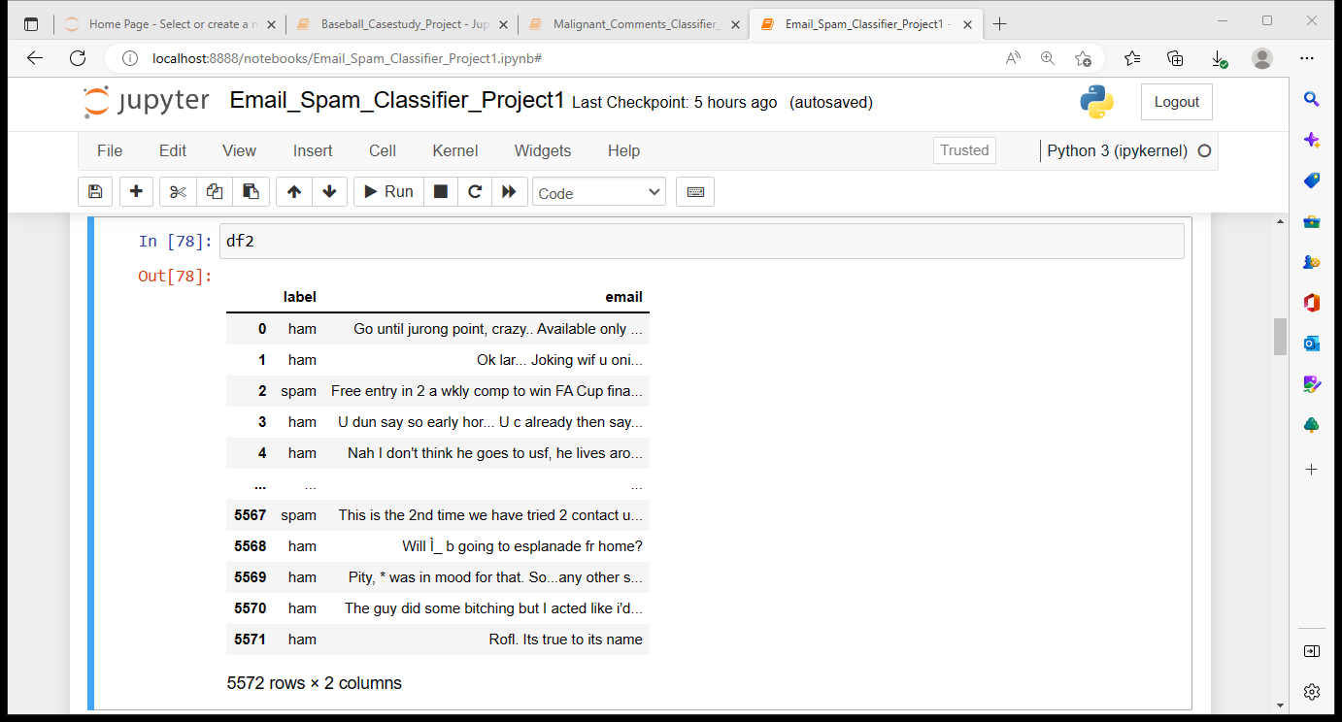
Read and explore the data
The dataset has 5572 rows and 2 columns after we remove the unwanted variables from the dataset

Slide 10
Cleaning and Analysing the data
There were no missing data in the dataset
There were 3 unnamed columns which had no useful data, hence we had dropped the columns
The data which we used as input and target variables were named as v1 and v2, hence changed them as email and label for the better understanding.

Slide 11
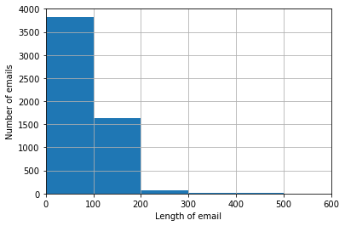
Data Visualization
From the above visualization we can observe that emails have varying lengths from within 0 up to 500. The majority of emails have length up to 200, and as we move towards greater lengths, the number of emails keep on falling.

Slide 12
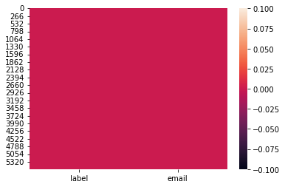
Checking for missing values in the dataset :
From the above plot we can observe that there are no missing values in the dataset.

Slide 13
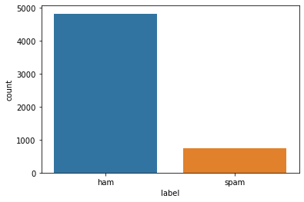
The above plot tells us about the target variable, it has 4825 ham mails and 747 spam mails

Slide 14
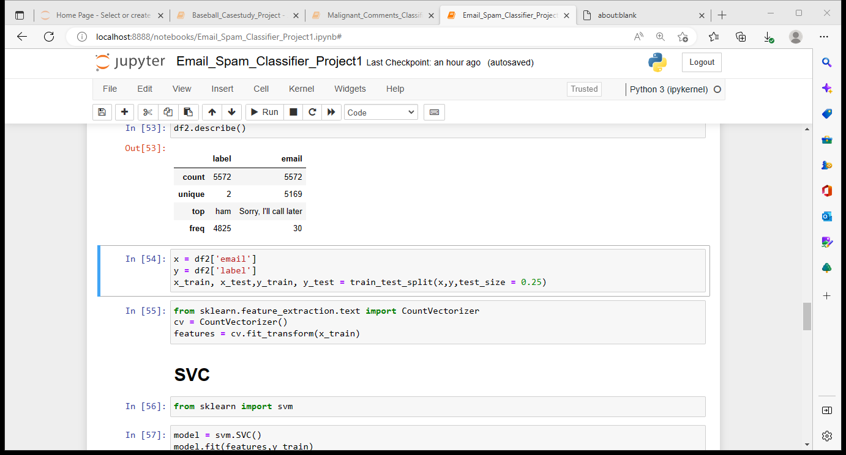
Algorithm & Techniques :
We’ll use a train-test split method to train our email spam detector to recognize and categorize spam emails. The train-test split is a technique for evaluating the performance of a machine learning algorithm. We can use it for either classification or regression of any supervised learning algorithm.
The procedure involves taking a dataset and dividing it into two separate datasets. The first dataset is used to fit the model and is referred to as the training dataset. For the second dataset, the test dataset, we provide the input element to the model. Finally, we make predictions, comparing them against the actual output.
Train dataset: used to fit the machine learning model
Test dataset: used to evaluate the fit of the machine learning model

Slide 15
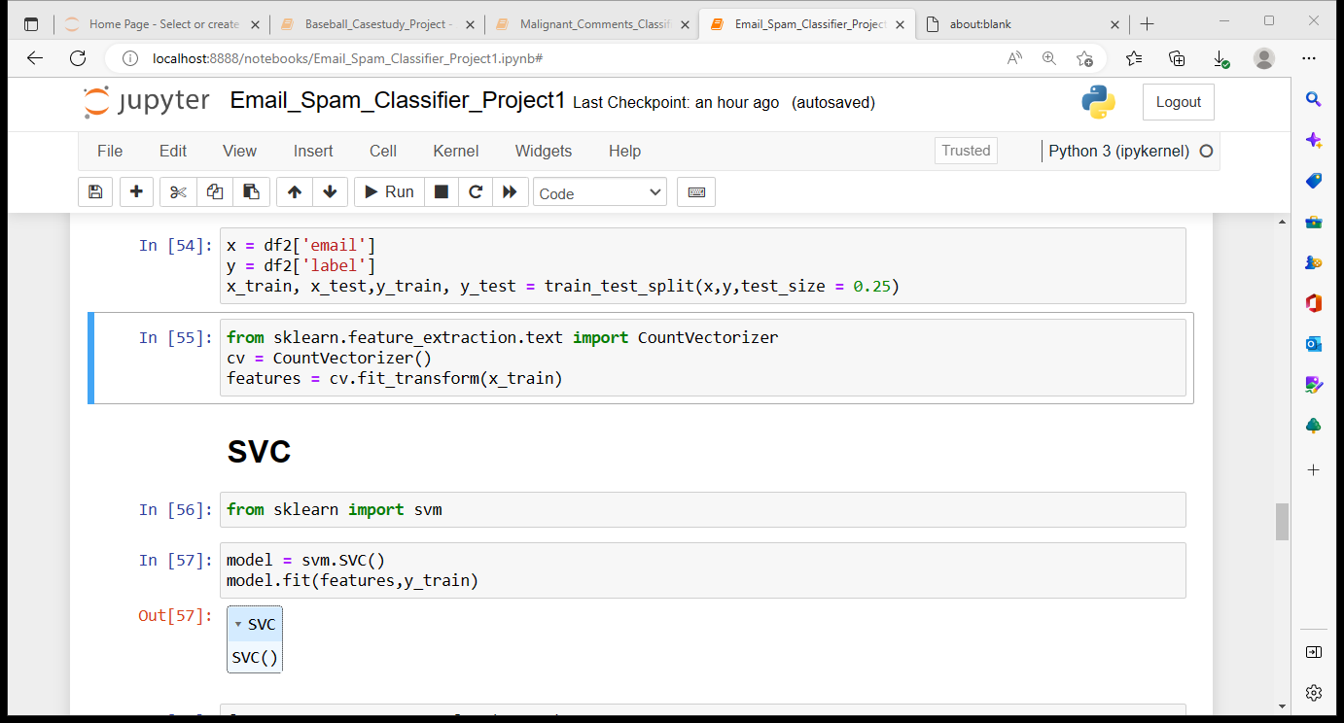
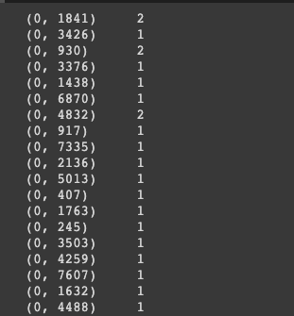
Applying Countvectorizer
In cv= CountVectorizer(), CountVectorizer() randomly assigns a number to each word in a process called tokenizing. Then, it counts the number of occurrences of words and saves it to cv. At this point, we’ve only assigned a method to cv.
features = cv.fit_transform(x_train) randomly assigns a number to each word. It counts the number of occurrences of each word, then saves it to cv. In the image below, 0 represents the index of the email. The number sequences in the middle column represent a word recognized by our function, and the numbers on the right indicate the number of times that word was counted:

Slide 16
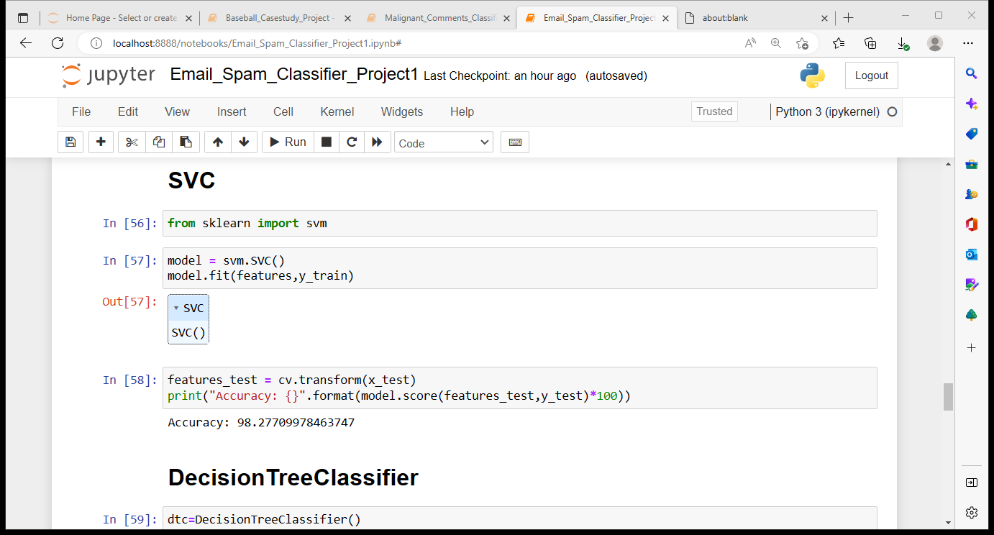
Building the models : SVC

Slide 17
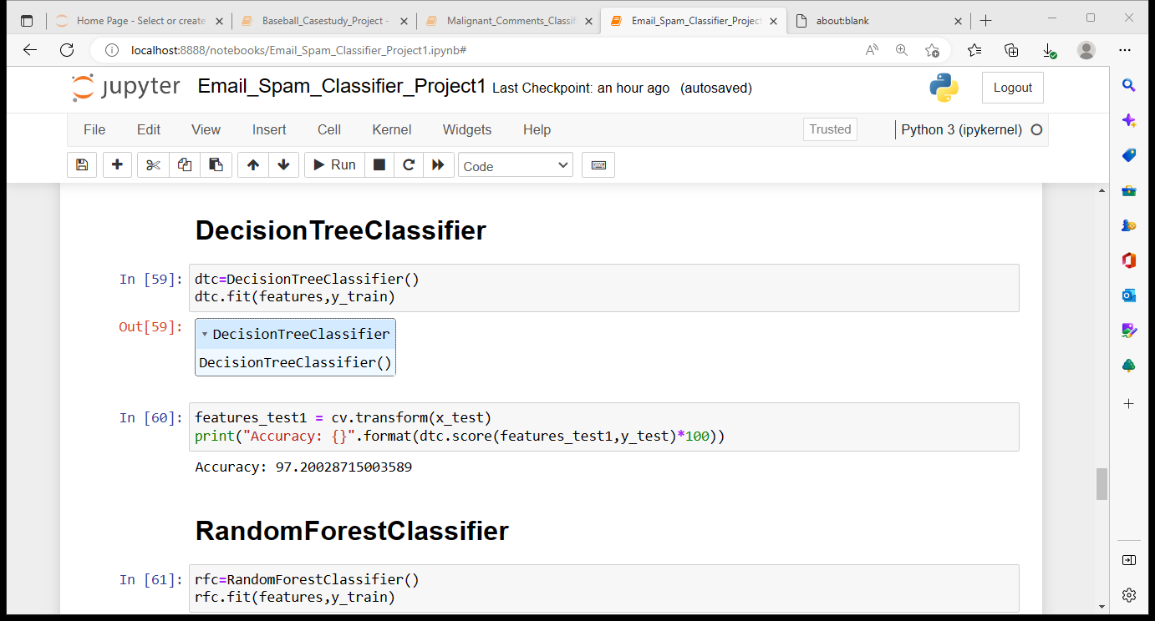
Building the models : DecisionTreeClassifier

Slide 18
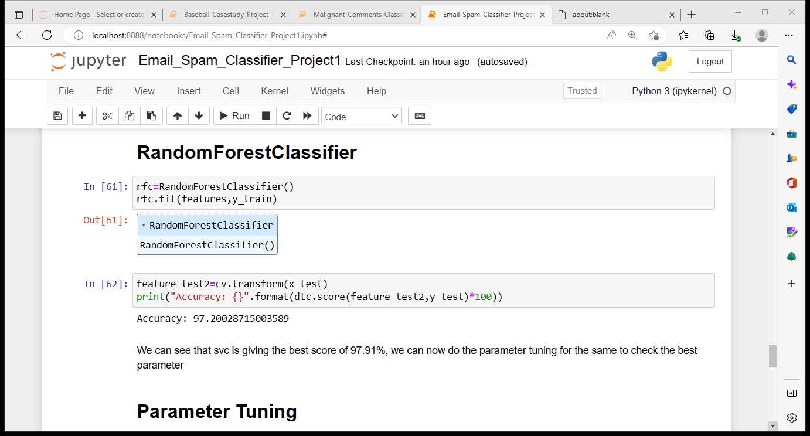
Building the models : RandomForestClassifier

Slide 19
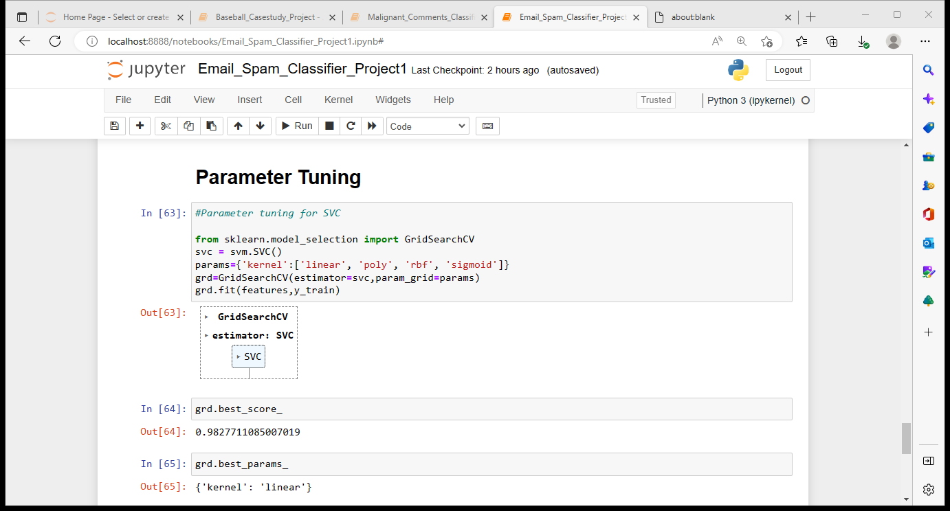
Parameter Tuning :
From the above 3 models, we can observe that SVC is giving the best score of 98.2%, hence we can do the parameter tuning on the same model and finalize the model with the best parameters. Parameter tuning on SVC can be done using the code as shown above.

Slide 20
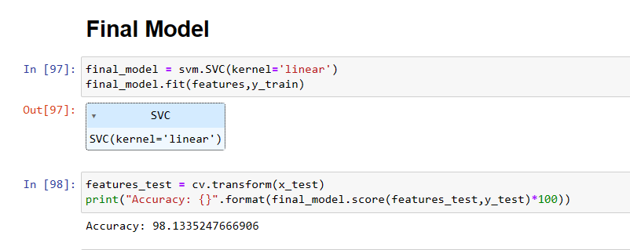
Finalizing the best model :
From the above results we can see that SVC is giving the best result of 98.2% where the best parameter for kernel is chosen to be ‘linear’. Now we can finalize the model for the same parameters as shown below.

Slide 21
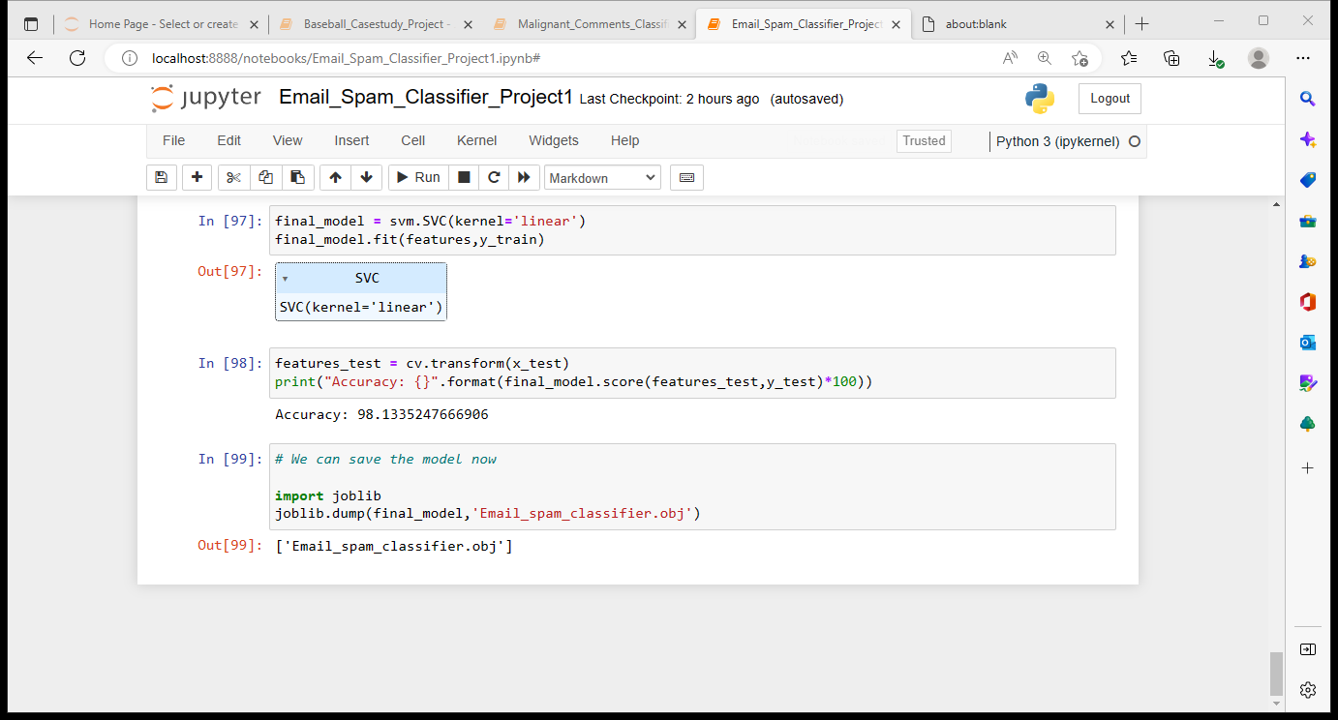
Saving the final model

Slide 22
Conclusion
To summarize this project, the first step involved studying the dataset.
The second major step was to separate the input and target variables, followed by that splitting was done for training and testing the model. Applied Countvectorizer where it randomly assigns a number to each word in a process called tokenizing. Then, it counts the number of occurrences of words.
The third step was to build models SVC, DecisionTreeClassifier and RandomForestClassifier and check for the best performing model comparing their accuracy scores.
Finally parameter tuning is done on SVC as it was performing better compared to other 2 models and chose the best model with best parameter where kernel = linear, which was giving the best score of 98.2%.
Although we have built a model which is giving us accuracy of 98.2%, it is always good to build 4 to 5 models for the same test and train data to check if other model perform better than the current one.

Slide 23
THANK YOU ☺

