Slide 1
BRATS Project
Varun Kumar M
S Chethana Vaisali

Slide 2
Problem statement & Dataset
Segment brain image into background(black), tumour core(64), whole tumour (128) and enhancing tumour (255).
20 samples of patients.
16 patients are in train dataset, 4 in validation dataset.
375 images in train dataset, 90 images are in validation dataset.

Slide 3

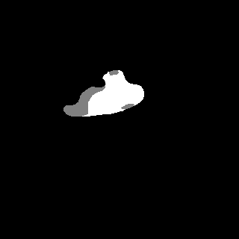
DeepLabV3_Plus
The contours aren’t detected properly.
Ran 80 epochs

Slide 4
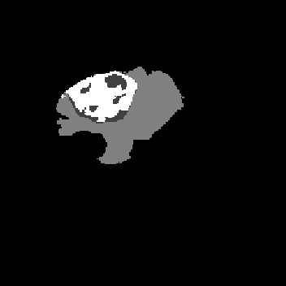
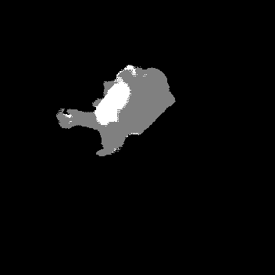
Mobile U-Net
Mobile U-Net with 2 layers.
Validation Mean IOU = 76.3%
Few predictions are false positives!!

Slide 5
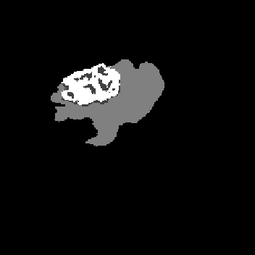
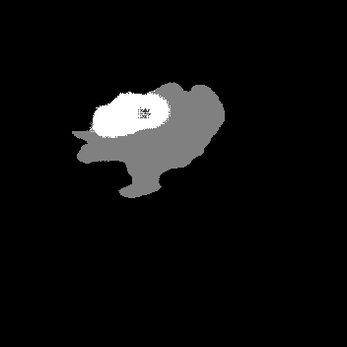
Mobile U-Net
Mobile U-Net with 3 layers.
Able to segment the whole tumour but fails to segment the TC and ET properly. Validation Mean IOU = 78.2%

Slide 6
Problems with the dataset
Training data is too small.
There are more pixels belonging to background class than the other classes.
There are more negative frames.

Slide 7
THANK YOU

