Slide 1
MODULE - 2

Slide 2
DIGITAL-TO-DIGITAL CONVERSION
Digital data can be represented by using digital signals. The conversion involves three techniques:
line coding, block coding, and scrambling.
Line coding is always needed; block coding and scrambling may or may not be needed.

Slide 3
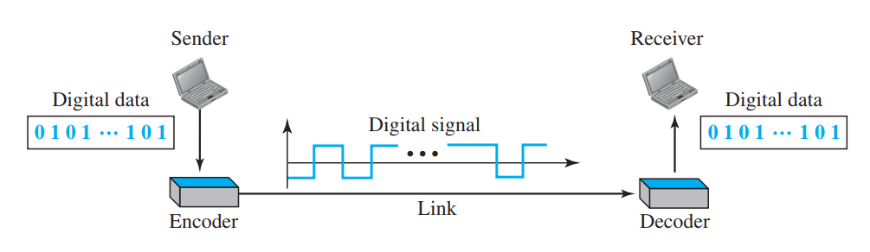
Line Coding
Line coding is the process of converting digital data to digital signals. We assume that data, in the form of text, numbers, graphical images, audio, or video, are stored in computer memory as sequences of bits.
Line coding converts a sequence of bits to a digital signal. At the sender, digital data are encoded into a digital signal; at the receiver, the digital data are recreated by decoding the digital signal .

Slide 4
Characteristics
Signal Element Versus Data Element
A data element is the smallest entity that can represent a piece of information: this is the bit.
In digital data communications, a signal element carries data elements.
data elements are what we need to send; signal elements are what we can send. Data elements are being carried; signal elements are the carriers.
We define a ratio r which is the number of data elements carried by each signal element.

Slide 5
Characteristics cont
Data Rate Versus Signal Rate
The data rate defines the number of data elements (bits) sent in 1s.
The signal rate is the number of signal elements sent in 1s.
The data rate is sometimes called the bit rate; the signal rate is sometimes called the pulse rate, the modulation rate.
One goal in data communications is to increase the data rate while decreasing the signal rate. Increasing the data rate increases the speed of transmission; decreasing the signal rate decreases the bandwidth requirement.
The relationship between data rate (N) and signal rate (S)
S=N/r in which r number of data elements per signal element..

Slide 6

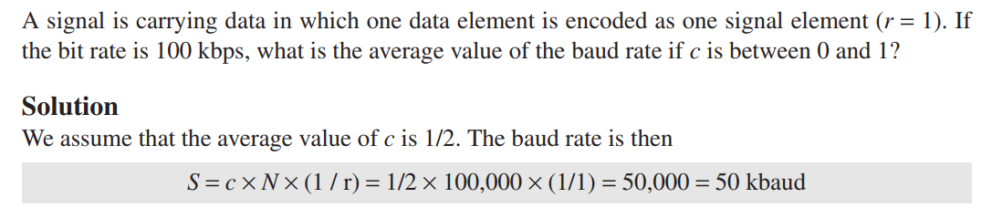
To derive a formula for the relationship, we need to define three cases: the worst, best, and average. The worst case is when we need the maximum signal rate; the best case is when we need the minimum. In data communications, Consider the average case.
formulate the relationship between data rate and signal rate as

Slide 7
Bandwidth The bandwidth is theoretically infinite. The effective bandwidth is finite.
Although the actual bandwidth of a digital signal is infinite, the effective bandwidth is finite.
Bit Rate and Baud rate
Bit Rate (bps): Number of bits transmitted per second.
Baud Rate (baud / symbols per second): Number of signal changes (symbols) per second.
Bandwidth is directly tied to how often the signal changes, not how many bits are carried. That’s why baud rate determines required bandwidth, not bit rate.

Slide 8

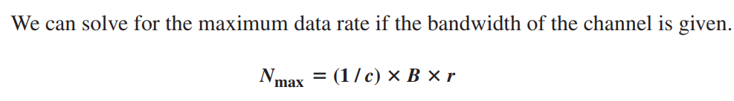
The minimum bandwidth can be given as

Slide 9
Baseline Wandering
In decoding a digital signal, the receiver calculates a running average of the received signal power. This average is called the baseline.
The incoming signal power is evaluated against this baseline to determine the value of the data element.
A long string of 0s or 1s can cause a drift in the baseline (baseline wandering) and make it difficult for the receiver to decode correctly

Slide 10
DC Components
When the voltage level in a digital signal is constant for a while, the spectrum creates very low frequencies.
These frequencies around zero is called DC (direct-current) components. This present problems for a system that cannot pass low frequencies .
For example, a telephone line cannot pass frequencies below 200 Hz.
For these systems, we need a scheme with no DC component.

Slide 11
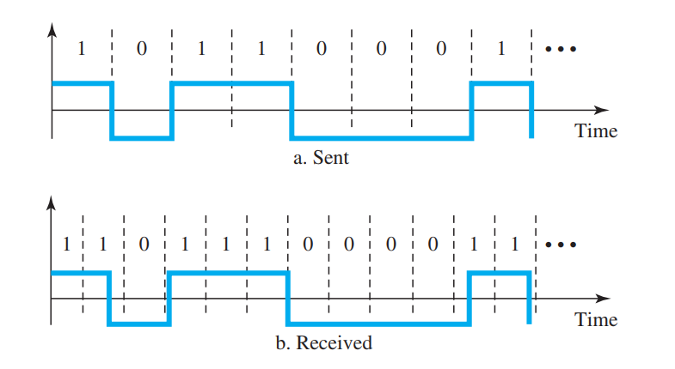
Self-synchronization
To correctly interpret the signals received from the sender, the receiver’s bit intervals must correspond exactly to the sender’s bit intervals.
If the receiver clock is faster or slower, the bit intervals are not matched and the receiver might misinterpret the signals.
A self-synchronizing digital signal includes timing information in the data being transmitted.

Slide 12
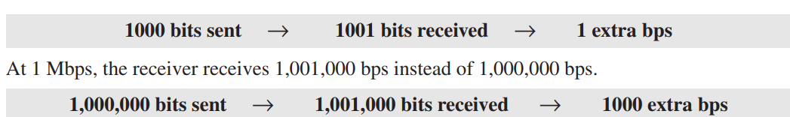
Problem
In a digital transmission, the receiver clock is 0.1 percent faster than the sender clock. How many extra bits per second does the receiver receive if the data rate is 1 kbps? How many if the data rate is 1 Mbps? Solution
At 1 kbps, the receiver receives 1001 bps instead of 1000 bps

Slide 13
Built-in Error Detection
It is desirable to have a built-in error-detecting capability in the generated code to detect some or all of the errors that occurred during transmission .
Immunity to noise and interference means how well a system can resist these unwanted signals and still correctly receive the original data.
Complexity
A complex scheme is more costly to implement than a simple one. For example, a scheme that uses four signal levels is more difficult to interpret than one that uses only two levels.

Slide 14
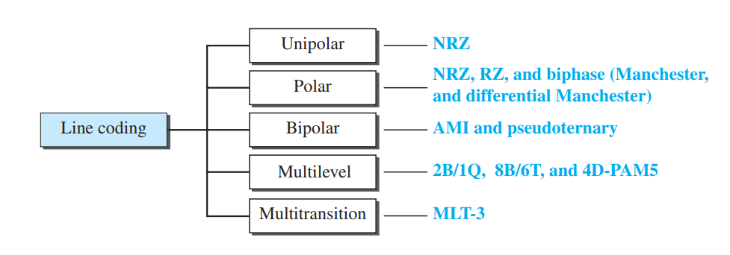
Line Coding Schemes
.
We can roughly divide line coding schemes into five broad categories.
Line coding is the process of converting digital data (0s and 1s) into a digital signal (waveform) that can be transmitted over a communication channel.
Different line coding methods are used to solve problems like DC component, synchronization, and noise immunity

Slide 15
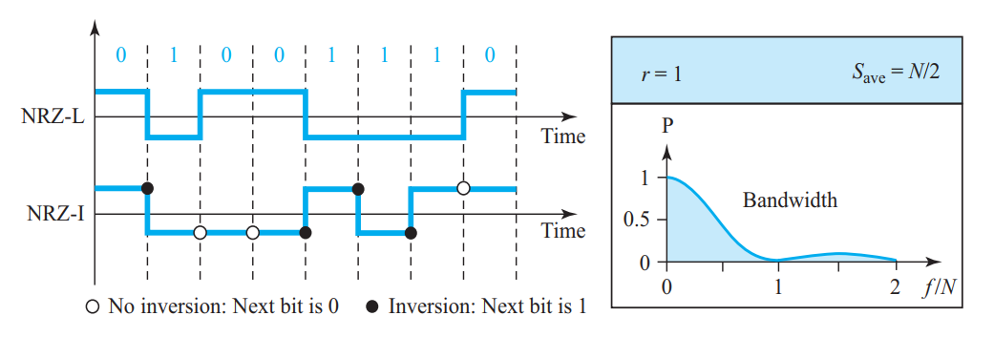
Polar Schemes
In polar schemes, the voltages are on both sides of the time axis.
For example, the voltage level for 0 can be positive and the voltage level for 1 can be negative.
Non-Return-to-Zero (NRZ)
In polar NRZ encoding, we use two levels of voltage amplitude
two versions of polar NRZ: NRZ-L and NRZ-I

Slide 16
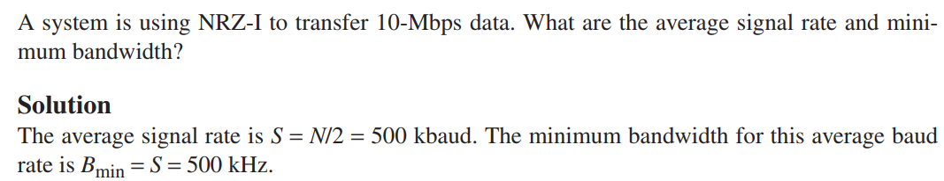
In the first variation, NRZ-L (NRZ-Level), the level of the voltage determines the value of the bit.
In the second variation, NRZ-I (NRZ-Invert), the change or lack of change in the level of the voltage determines the value of the bit.
If there is no change, the bit is 0; if there is a change, the bit is 1.
PROBLEM

Slide 17
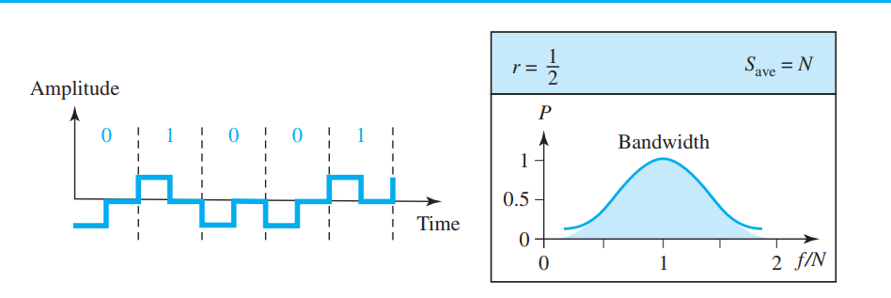
Return-to-Zero (RZ)
The main problem with NRZ encoding occurs when the sender and receiver clocks are not synchronized.
One solution is the return-to-zero (RZ) scheme,
it uses three values: positive, negative, and zero.
In RZ, the signal changes not between bits but during the bit.
Here the signal goes to 0 in the middle of each bit. It remains there until the beginning of the next bit.

Slide 18
Return-to-Zero (RZ)
RZ encoding is that it requires two signal changes to encode a bit and therefore occupies greater bandwidth.
no DC component problem.
Problem is the complexity: RZ uses three levels of voltage, which is more complex to create and discern. As a result of all these deficiencies, the scheme is not used today. Instead, it has been replaced by the better-performing Manchester and differential Manchester schemes

Slide 19
Biphase: Manchester and Differential Manchester
To Solve the problems like baseline wandering ,synchronization, and sometimes DC component issues. we have
Manchester
Differential Manchester
Manchester Encoding
The idea of RZ (transition at the middle of the bit) and the idea of NRZ-L are combined into the Manchester scheme the duration of the bit is divided into two halves.
The voltage remains at one level during the first half and moves to the other level in the second half.
The transition at the middle of the bit provides synchronization.

Slide 20
0 → High in first half, Low in second half.
1 → Low in first half, High in second half.
Advantages:
No DC component (because positive and negative parts balance out).
Easy to synchronize (because every bit has a mid-transition).
No baseline wandering.

Slide 21
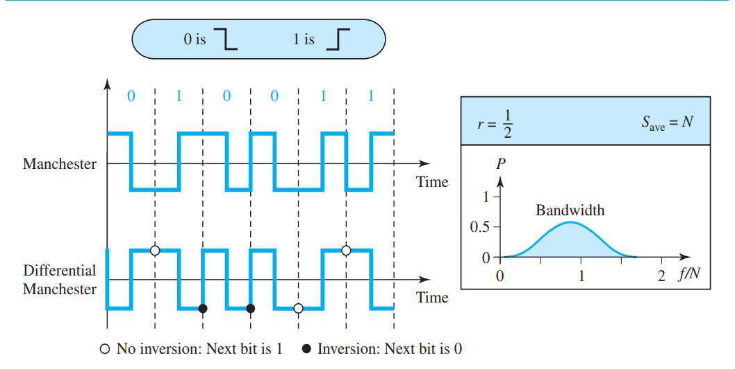
Differential Manchester
Combines the ideas of RZ and NRZ-I.
There is a transition at the middle of the bit, but the bit values are determined at the beginning of the bit.
If the bit is 0 → A transition at the beginning of the bit.
If the bit is 1 → No transition at the beginning.

Slide 22
The Manchester and differential Manchester schemes are also called biphase schemes.
Disadvantage:
The signal rate is double

Slide 23
Bipolar Schemes
In bipolar encoding (also called multilevel binary), there are three voltage levels: positive, negative, and zero.
The voltage level for one data element is at zero, while the voltage level for the other element alternates between positive and negative.
Two popular bipolar schemes are:
AMI (Alternate Mark Inversion)
Pseudoternary
AMI (Alternate Mark Inversion)
A common bipolar encoding scheme is called bipolar alternate mark inversion (AMI) .Here the word mark indicates 1. So AMI means alternate 1 inversion. A neutral zero voltage represents binary 0. Binary 1s are represented by alternating positive and negative voltages.
0 → 0 voltage (neutral).
1 → a+ve and -ve voltages.

Slide 24
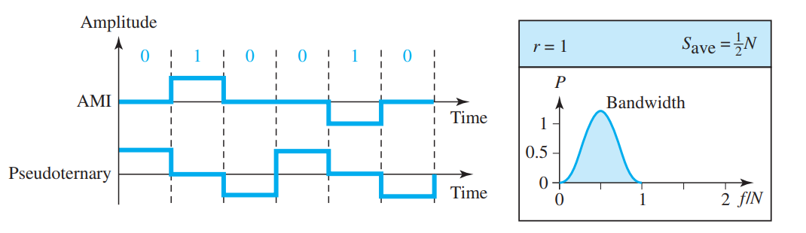
Pseudoternary
A variation of AMI encoding is called pseudoternary in which the 1 bit is encoded as a zero voltage and the 0 bit is encoded as alternating positive and negative voltages.
1 → 0 voltage (neutral).
0 → a+ve and -ve voltages.
The bipolar scheme was developed as an alternative to NRZ. The bipolar scheme has the same signal rate as NRZ, but there is no DC component because If we have a long sequence of 1s, the voltage level alternates between positive and negative; it is not constant. Therefore, there is no DC component. For a long sequence of 0s, the voltage remains constant, but its amplitude is zero, which is the same as having no DC component.

Slide 25
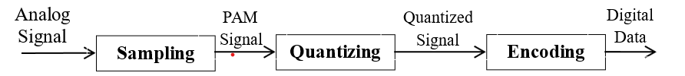
Analog-To-Digital Conversion
• An analog-signal may created by a microphone or camera.
• To change an analog-signal to digital-data, we use PCM (pulse code modulation).
• After the digital-data are created (digitization), then we convert the digital-data to a digital-signal.
Pulse Code Modulation (PCM)
• PCM is a technique used to change an analog signal to digital data (digitization).
• PCM has encoder at the sender and decoder at the receiver.
• The encoder has 3 processes (Figure 4.21):
1) Sampling
2) Quantization
3) Encoding.

Slide 26
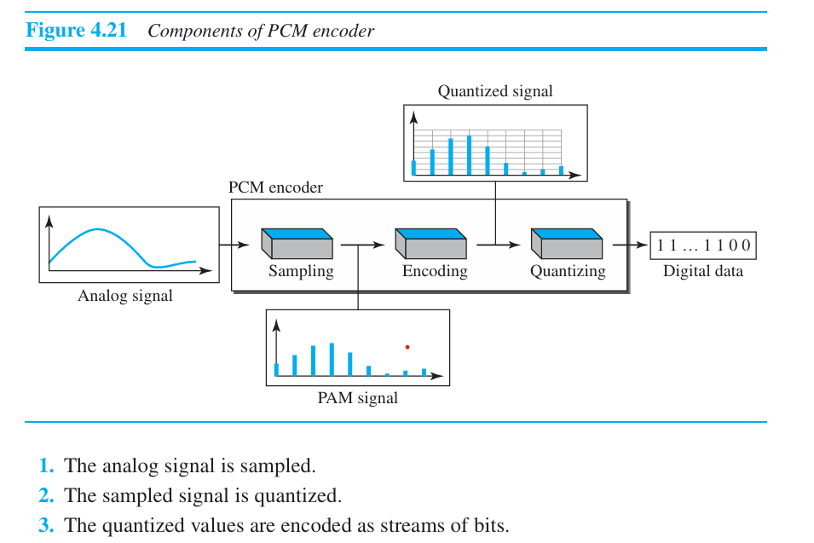

Slide 27
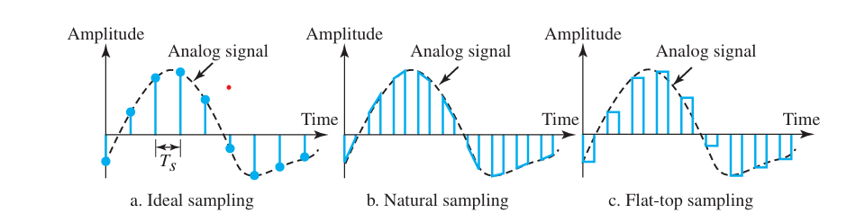
Sampling:
The first step in PCM is sampling. The analog signal is sampled every Ts s, where Ts is the sample interval or period.
The inverse of the sampling interval is called the sampling rate or sampling frequency and denoted by fs, where fs = 1/Ts.
There are three sampling methods- ideal, natural, and flat-top.
1) Ideal Sampling : This method is difficult to implement. Pulses from the analog signal are sampled.
2) Natural Sampling : A high-speed switch is turned ON for only the small period of time when the sampling occurs. The result is a sequence of samples that retains the shape of the analog-signal.
3) Flat Top Sampling : The most common sampling method is sample and hold. Sample and hold method creates flat-top samples. This method is sometimes referred to as PAM (pulse amplitude modulation).

Slide 28
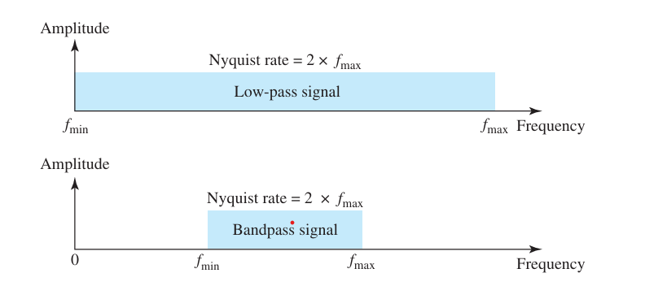
Sampling Rate
• According to Nyquist theorem,
“The sampling-rate must be at least 2 times the highest frequency, not the bandwidth“.
i) If the analog-signal is low-pass, the bandwidth and the highest frequency are the same value (Figure 4.23a).
ii) If the analog-signal is bandpass, the bandwidth value is lower than the value of the maximum frequency (Figure 4.23b).

Slide 29

2.1.2 Quantization
• The sampled-signal is quantized.
• Result of sampling is a set of pulses with amplitude-values b/w max & min amplitudes of the signal.
• Four steps in quantization:
1) We assume that the original analog-signal has amplitudes between Vmin & Vmax.
2) We divide the range into L zones, each of height Δ(delta).
where L = number of levels.
3) We assign quantized values of 0 to (L-1) to the midpoint of each zone.
4) We approximate the value of the sample amplitude to the quantized values.
• For example: Let Vmin=-20 Vmax =+20 V L=8 Therefore , Δ = [+20-(-20)]/8= 5 V
• In the chart (Figure 4.26),
1) First row is normalized-PAM-value for each sample.
2) Second row is normalized-quantized-value for each sample.
3) Third row is normalized error (which is diff. b/w normalized PAM value & quantized values).
4) Fourth row is quantization code for each sample.
5) Fifth row is the encoded words (which are the final products of the conversion).

Slide 30
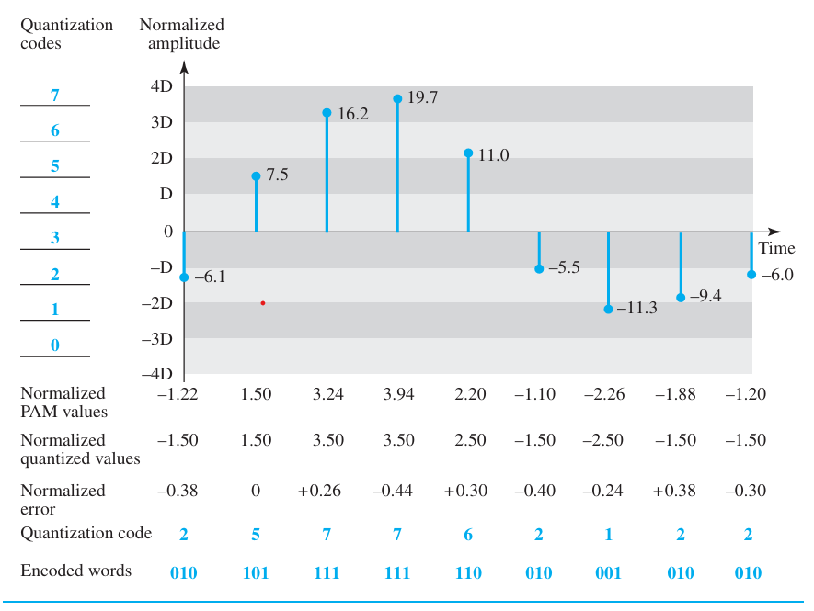


Slide 31
Quantization Level
• Let L = number of levels.
• The choice of L depends on
→ range of the amplitudes of the analog-signal and
→ how accurately we need to recover the signal.
• If the signal has only 2 amplitude values, we need only 2 quantization-levels.
If the signal (like voice) has many amplitude values, we need more quantization-levels.
• In audio digitizing, L is normally chosen to be 256.
In video digitizing, L is normally thousands.
• Choosing lower values of L increases the quantization-error.
Quantization Error
• Quantization-error is the difference b/w normalized PAM value & quantized values
• Quantization is an approximation process.
• The input values to the quantizer are the real values.
The output values from the quantizer are the approximated values.
• The output values are chosen to be the middle value in the zone.
• If the input value is also at the middle of the zone,
Then, there is no error.
Otherwise, there is an error.
• In the previous example,
The normalized amplitude of the third sample is 3.24, but the normalized quantized value is
3.50. This means that there is an error of +0.26.

Slide 32
Uniform vs. Non Uniform Quantization
• Non-uniform quantization can be done by using a process called companding and expanding.
1) The signal is companded at the sender before conversion.
2) The signal is expanded at the receiver after conversion.
Companding means reducing the instantaneous voltage amplitude for large values.
Expanding means increasing the instantaneous voltage amplitude for small values.
• It has been proved that non-uniform quantization effectively reduces the SNRdB of quantization.
2.1.3 Encoding
• The quantized values are encoded as n-bit code word.
• In the previous example,
A quantized value 2 is encoded as 010.
A quantized value 5 is encoded as 101.
• Relationship between number of quantization-levels (L) & number of bits (n) is given by
n=log2L or 2n=L
• The bit-rate is given by:

Slide 33
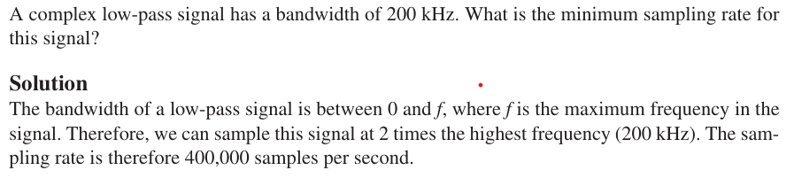
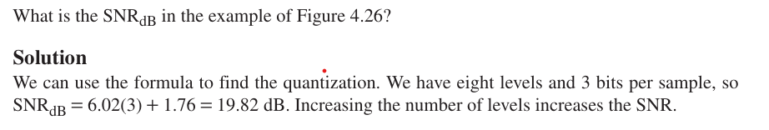
Example 2.1
Example 2.2

Slide 34
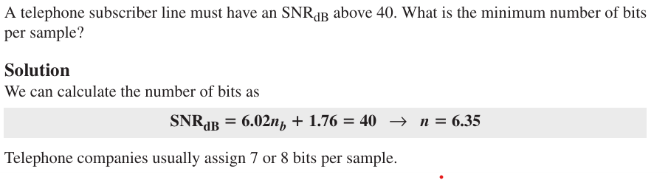
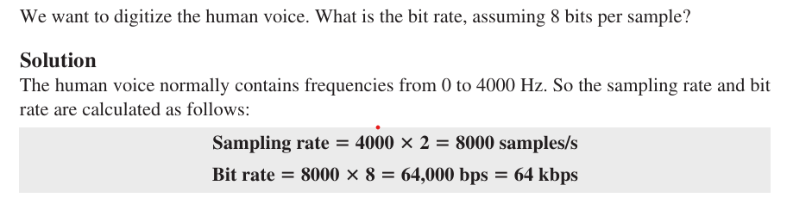
Example 2.3
Example 2.4

Slide 35
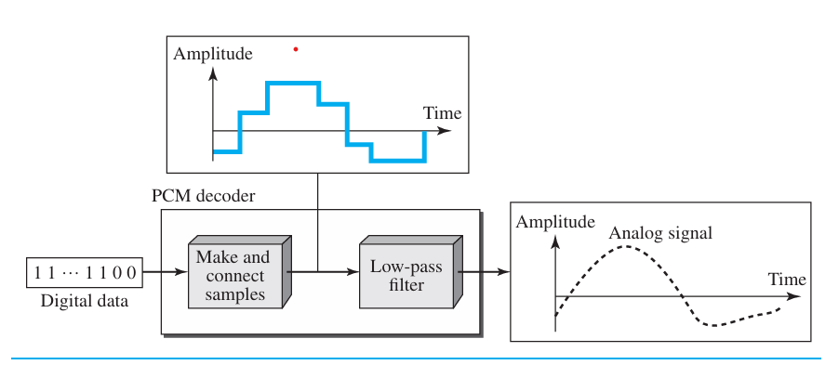
Original Signal Recovery
• PCM decoder is used for recovery of the original signal.
• Here is how it works (Figure 4.27):
1) The decoder first uses circuitry to convert the code words into a pulse that holds the amplitude until the next pulse.
2) Next, the staircase-signal is passed through a low-pass filter to smooth the staircase signal into an analog-signal.
• The filter has the same cut-off frequency as the original signal at the sender.
• If the signal is sampled at the Nyquist sampling-rate, then the original signal will be re-created.
• The maximum and minimum values of the original signal can be achieved by using amplification.

Slide 36
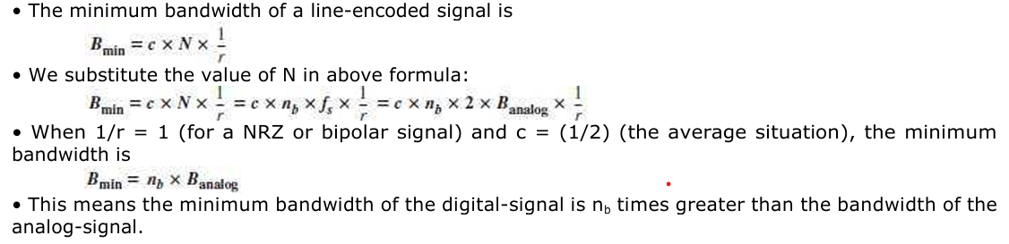
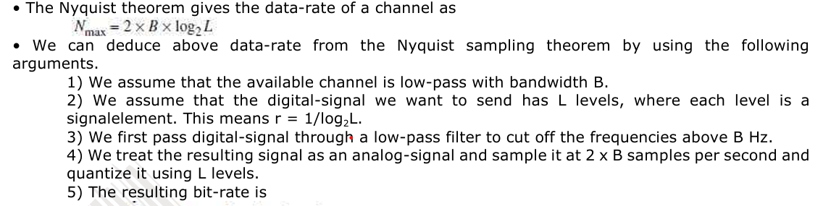


PCM Bandwidth
Maximum Data Rate of a Channel
This is the maximum bandwidth

Slide 37

Minimum Required Bandwidth
• The previous argument can give us the minimum bandwidth if the data-rate and the number of signal-levels are fixed.
We can say

Slide 38
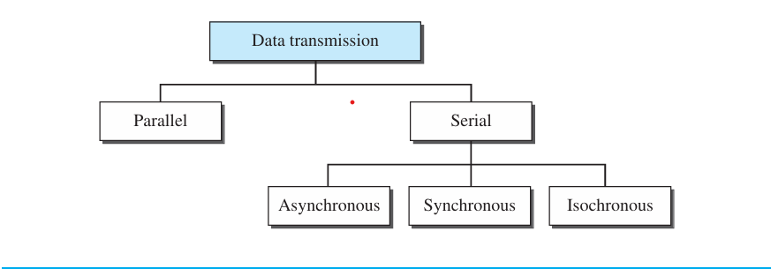
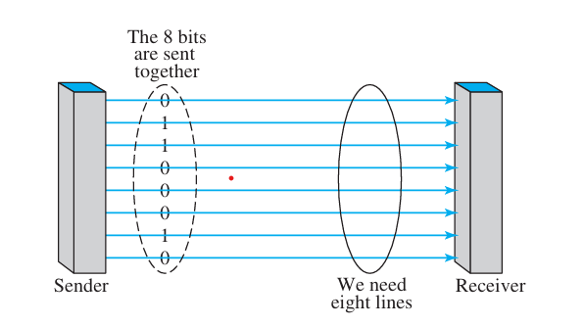
TRANSMISSION MODES
• Two ways of transmitting data over a link (Figure 4.31): 1) Parallel mode & 2) Serial mode.
PARALLEL TRANSMISSION
• Multiple bits are sent with each clock-tick (Figure 4.32).
• “n‟ bits in a group are sent simultaneously.
• “n‟ wires are used to send “n‟ bits at one time.
• Each bit has its own wire.
• Typically, the 8 wires are bundled in a cable with a connector at each end.

Slide 39
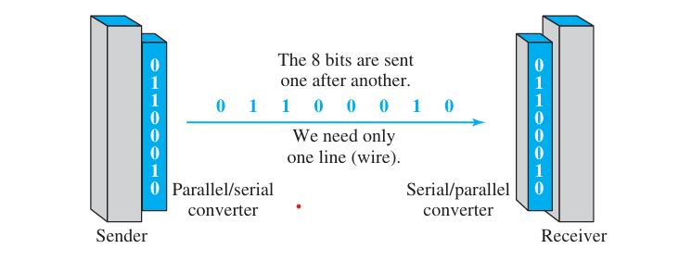
• Advantage:
Speed: Parallel transmission can increase the transfer speed by a factor of n over serial transmission.
• Disadvantage:
Cost: Parallel transmission requires n communication lines just to transmit the data-stream. Because this is expensive, parallel transmission is usually limited to short distances.
Limited to short distance
SERIAL TRANSMISSION
• One bit is sent with each clock-tick using only a single link (Figure 4.33).
Figure 4.33 Serial transmission
• Advantage:
1) Cost: Serial transmission reduces cost of transmission over parallel by a factor of n.
• Disadvantage:
1) Since communication within devices is parallel, following 2 converters are required at interface:
i) Parallel-to-serial converter
ii) Serial-to-parallel converter

Slide 40
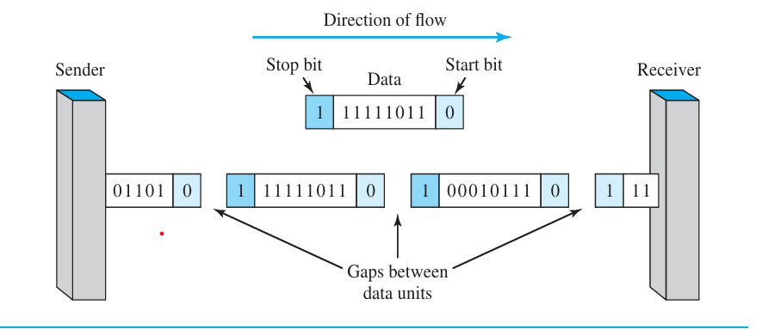
• Three types of serial transmission: asynchronous, synchronous, and isochronous.
Asynchronous Transmission
• Asynchronous transmission is so named because the timing of a signal is not important (Figure 4.34).
• Prior to data transfer, both sender & receiver agree on pattern of information to be exchanged.
• Normally, patterns are based on grouping the bit-stream into bytes.
• The sender transmits each group to the link without regard to a timer.
• As long as those patterns are followed, the receiver can retrieve the info. without regard to a timer.
• There may be a gap between bytes.
• We send
→ 1 start bit (0) at the beginning of each byte →
1 stop bit (1) at the end of each byte.
• Start bit alerts the receiver to the arrival of a new group.
Stop bit lets the receiver know that the byte is finished.
• Here, the term asynchronous means “asynchronous at the byte level”.
However, the bits are still synchronized & bit-durations are the same.

Slide 41
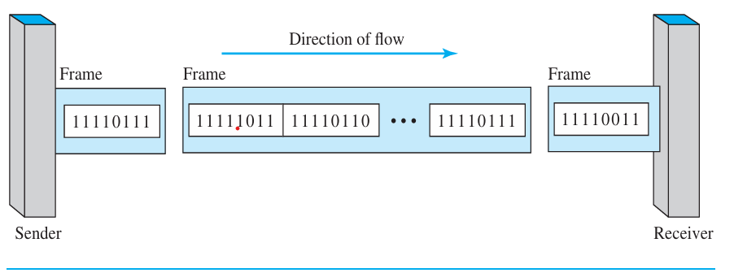
• Disadvantage:
1) Slower than synchronous transmission. (Because of stop bit, start bit and gaps)
• Advantages:
1) Cheap & effective.
2) Useful for low-speed communication.
Synchronous Transmission
• The receiver is responsible for grouping the bits.
• We send bits one after another without start or stop bits or gaps (Figure 4.35).
• The bit-stream is combined into longer "frames," which may contain multiple bytes.
• If the sender wants to send data in separate bursts, the gaps b/w bursts must be filled with a special
sequence of 0s & 1s (that means idle).

Slide 42
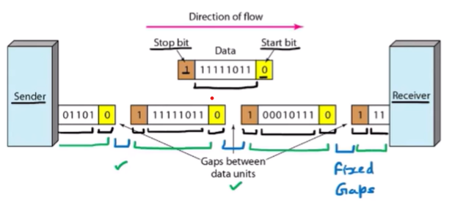
• Advantages:
1) Speed: Faster than asynchronous transmission. (no stop bit, start bit and gaps).
2) Useful for high-speed applications such as transmission of data from one computer to another.
Isochronous
• Synchronization between characters is not enough; the entire stream of bits must be synchronized.
• The isochronous transmission guarantees that the data arrive at a fixed rate.
• In real-time audio/video, jitter is not acceptable. Therefore, synchronous transmission fails.
• For example: TV images are broadcast at the rate of 30 images per second. The images must be
viewed at the same rate.

Slide 43
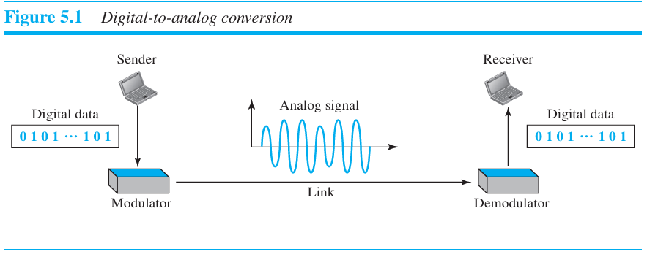
ANALOG TRANSMISSION
DIGITAL TO ANALOG CONVERSION
• Digital-to-analog conversion is the process of changing one of the characteristics of an analog-signal
based on the information in digital-data. Fig below shows the relationship between the digital information, the digital-to-analog modulating process, and the resultant analog signal.

Slide 44
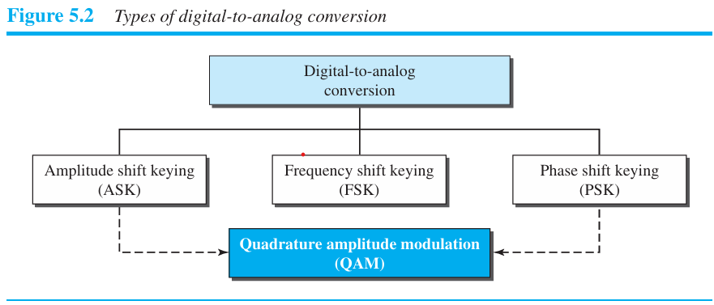
• A sine wave can be defined by 3 attributes:
1) Amplitude
2) Frequency
3) Phase.
• When anyone of the 3 attributes of a wave is varied, a different version of the wave will be created.
• So, by changing one attribute of an analog signal, we can use it to represent digital-data.
• Four methods of digital to analog conversion (Figure 5.2):
1) Amplitude shift keying (ASK)
2) Frequency shift keying (FSK)
3) Phase shift keying (PSK)
4) Quadrature amplitude modulation (QAM).
• QAM is a combination of ASK and PSK i.e. QAM combines changing both the amplitude and phase.
QAM is the most efficient of these 4 methods.
QAM is the method commonly used today.

Slide 45
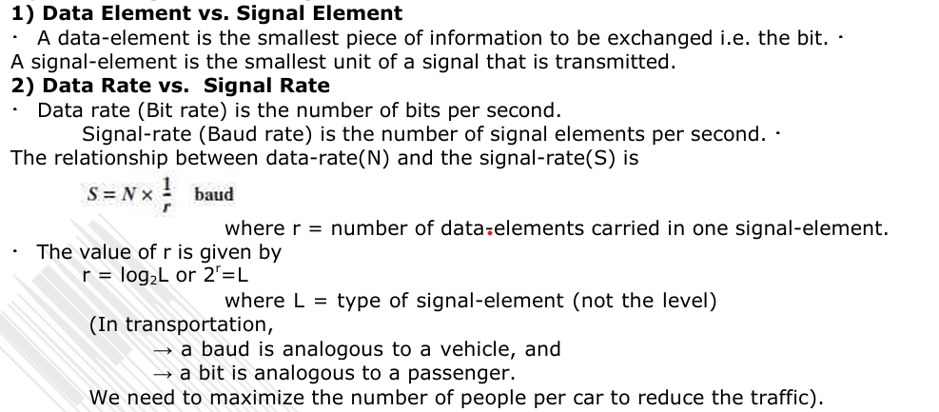
Aspects of Digital-to-Analog Conversion

Slide 46
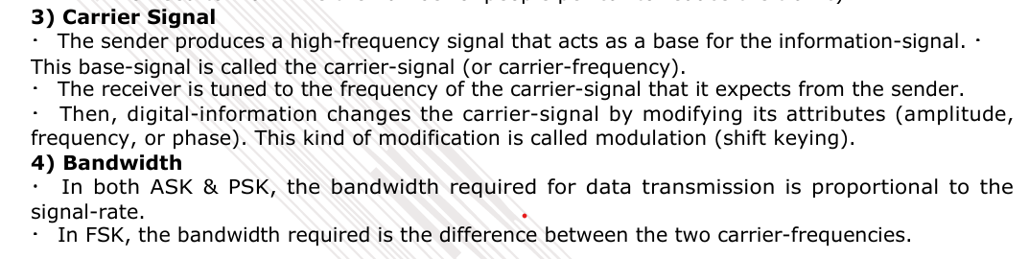
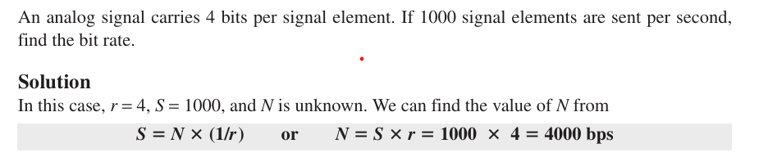
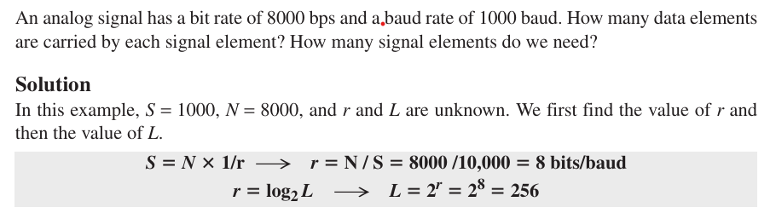
Example
Example

Slide 47
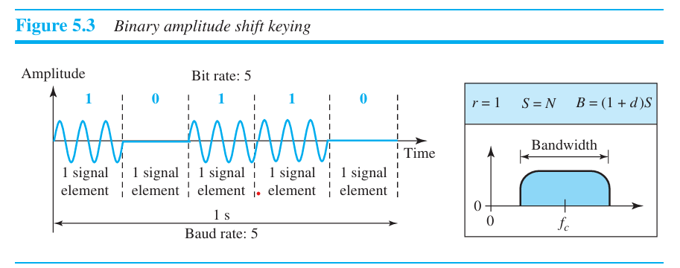
Amplitude Shift Keying (ASK)
•The amplitude of the carrier-signal is varied to represent different signal-elements.
• Both frequency and phase remain constant for all signal-elements.
Binary ASK (BASK)
• BASK is implemented using only 2 levels. (Figure 5.3)
• This is also referred to as OOK (On-Off Keying).

Slide 48
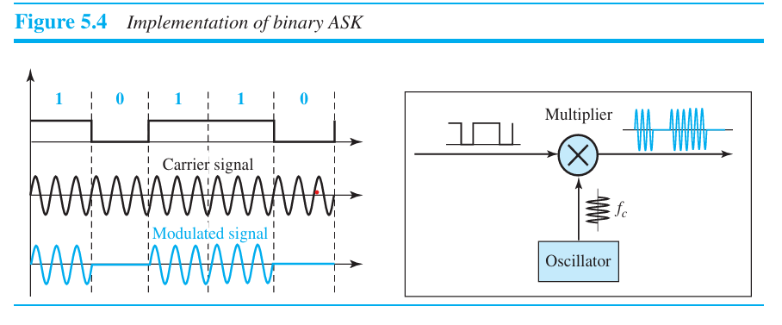
Implementation of BASK
• Here, line coding method used = unipolar NRZ (Figure 5.4).
• The unipolar NRZ signal is multiplied by the carrier-frequency coming from an oscillator.
1) When amplitude of the NRZ signal = 0, amplitude of the carrier-signal = 0.
2) When amplitude of the NRZ signal = 1, the amplitude of the carrier-signal is held.

Slide 49

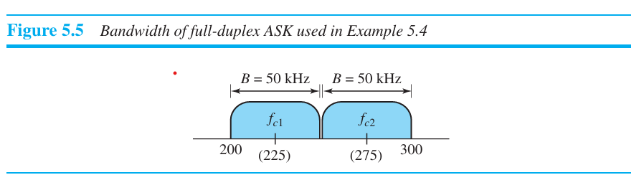
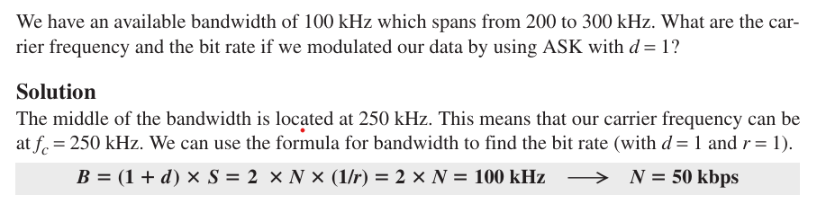
Bandwidth for ASK
• The bandwidth is proportional to the signal-rate (S) (Figure 5.5)
•The bandwidth is given by
where d(0<d<1)= this factor depends on modulation and filtering-process.
Example

Slide 50
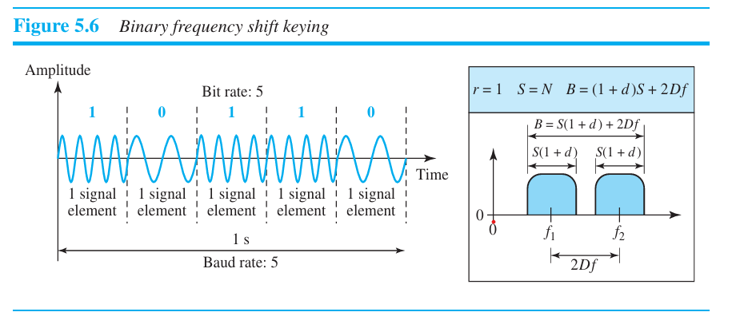
Frequency Shift Keying (FSK)
• The frequency of the carrier-signal is varied to represent different signal-elements.
• The frequency of the modulated-signal is constant for the duration of one signal-element, but
changes for the next signal-element if the data-element changes.
• Both amplitude and phase remain constant for all signal-elements.
Binary FSK (BFSK)
• This uses 2 carrier-frequencies: f1 and f2. (Figure 5.6)
1) When data-element = 1, first carrier frequency(f1) is used.
2) When data-element = 0, second carrier frequency(f2) is used.

Slide 51
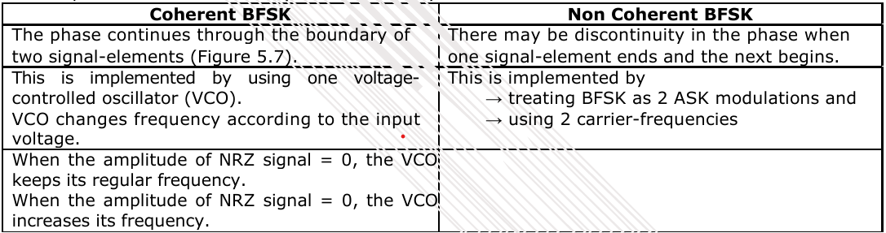
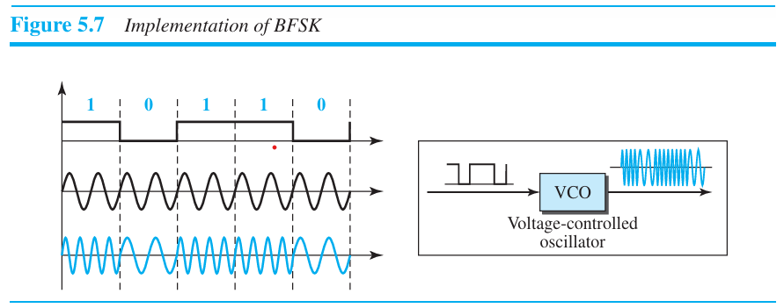
Implementation
• Here, line coding method used = unipolar NRZ.
• Two implementations of BFSK: i) Coherent and ii) Non-Coherent.

Slide 52

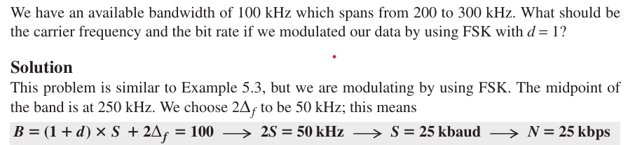
Bandwidth for BFSK
• FSK has two ASK signals, each with its own carrier-frequency f1 or f2. (Figure 5.6)
• The bandwidth is given by
where 2∆f is the difference between f1 and f2,
Example

Slide 53
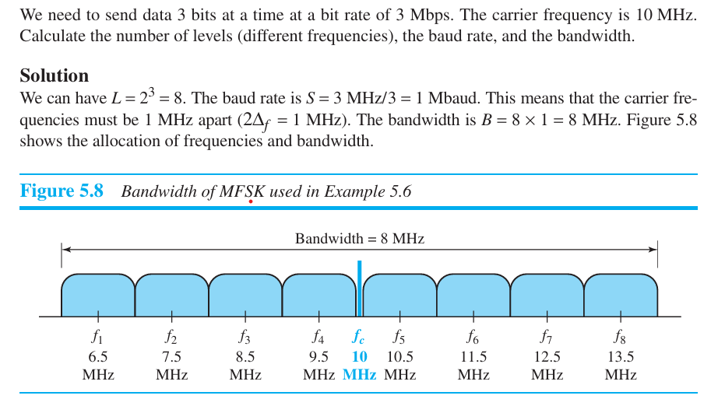
Example

Slide 54
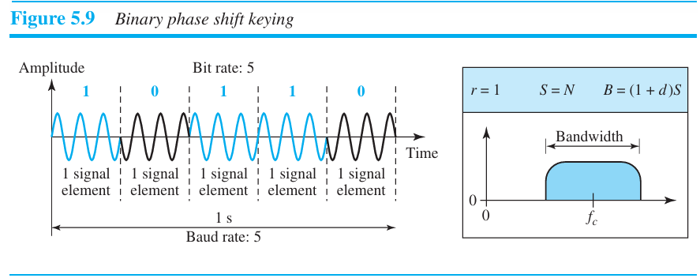
Phase Shift Keying (PSK)
• The phase of the carrier-signal is varied to represent different signal-elements.
• Both amplitude and frequency remain constant for all signal-elements.
Binary PSK (BPSK)
• We have only two signal-elements:
1) First signal-element with a phase of 0°.
2) Second signal-element with a phase of 180° (Figure 5.9).
• ASK vs. PSK
In ASK, the criterion for bit detection is the amplitude of the signal. ➢
In PSK, the criterion for bit detection is the phase.
• Advantages:
1) PSK is less susceptible to noise than ASK.
2) PSK is superior to FSK because we do not need 2 carrier-frequencies.
• Disadvantage:
1) PSK is limited by the ability of the equipment to distinguish small differences in phase.

Slide 55
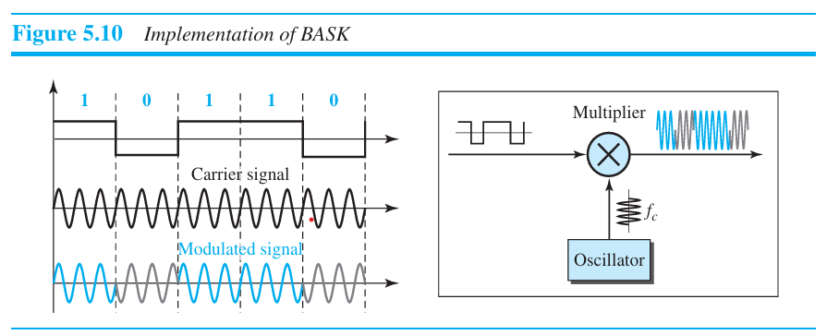
Implementation
• The implementation of BPSK is as simple as that for ASK. (Figure 5.10).
phase 0°.
• Here, line coding method used: polar NRZ.
• The signal-element with phase 180° can be seen as the complement of the signal-element with
• The polar NRZ signal is multiplied by the carrier-frequency coming from an oscillator.
1) When data-element = 1, the phase starts at 0°.
2) When data-element = 0, the phase starts at 180°.

Slide 56
Bandwidth for BPSK
• The bandwidth is the same as that for BASK, but less than that for BFSK. (Figure 5.9b)
• No bandwidth is wasted for separating 2 carrier-signals.
Quadrature PSK (QPSK)
• The scheme is called QPSK because it uses 2 separate BPSK modulations (Figure 5.11):
1) First modulation is in-phase,
2) Second modulation is quadrature (out-of-phase).
• A serial-to-parallel converter
→ accepts the incoming bits
→ sends first bit to first modulator and
→ sends second bit to second modulator.
• The bit to each BPSK signal has one-half the frequency of the original signal.
• Advantages:
1) Decreases the baud rate.
2) Decreases the required bandwidth.

Slide 57
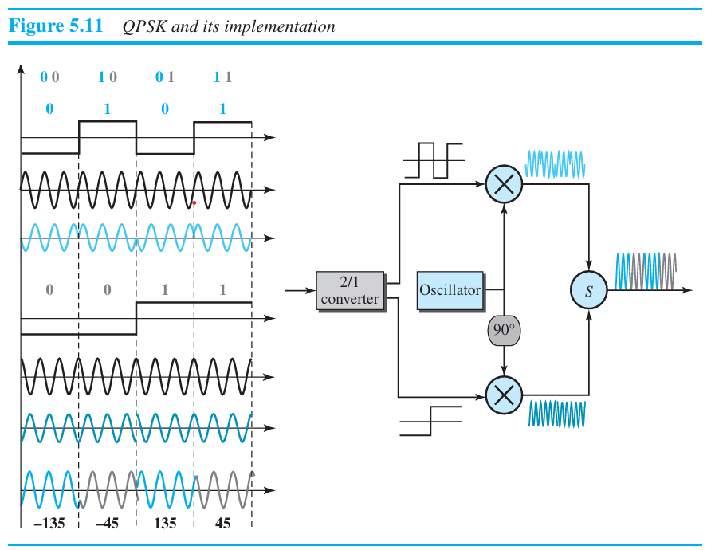
• As shown in Figure 5.11, the 2 composite-signals created by each multiplier are 2 sine waves with the
same frequency, but different phases.
• When the 2 sine waves are added, the result is another sine wave, with 4 possible phases: 45°, -45°,
135°, and -135°.
• There are 4 kinds of signal-elements in the output signal (L=4), so we can send 2 bits per signal element (r=2).

Slide 58
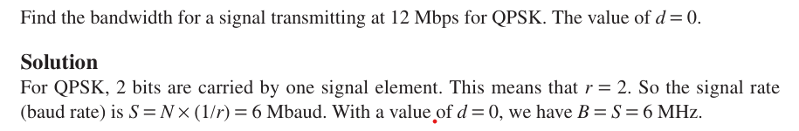
Constellation Diagram
• A constellation diagram can be used to define the amplitude and phase of a signal-element.
• This diagram is particularly useful
→ when 2 carriers (one in-phase and one quadrature) are used.
→ when dealing with multilevel ASK, PSK, or QAM.
• In a constellation diagram, a signal-element type is represented as a dot.
• The diagram has 2 axes (Figure 5.12):
1) The horizontal X axis is related to the in-phase carrier.
2) The vertical Y axis is related to the quadrature carrier.
• For each point on the diagram, 4 pieces of information can be deduced.
1) The projection of point on the X axis defines the peak amplitude of the in-phase component.
2) The projection of point on Y axis defines peak amplitude of the quadrature component.
3) The length of the line that connects the point to the origin is the peak amplitude of the
signal-element (combination of the X and Y components);
4) The angle the line makes with the X axis is the phase of the signal-element.

Slide 59
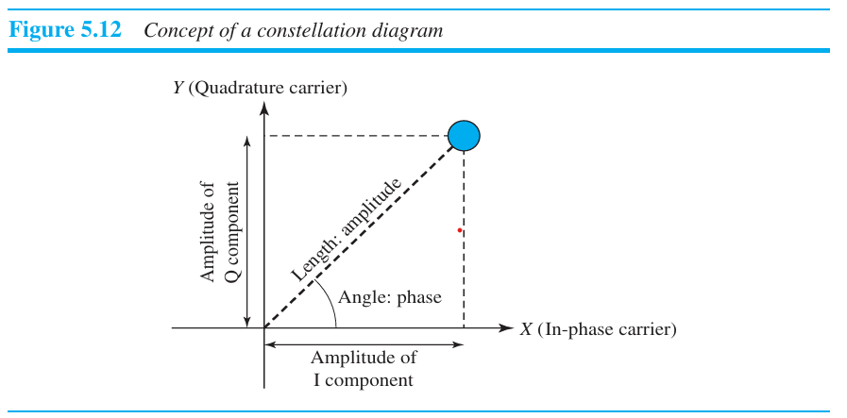

Slide 60
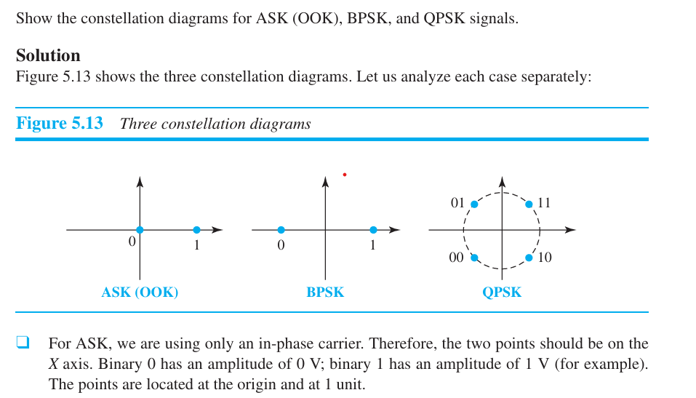

Slide 61

Quadrature Amplitude Modulation (QAM)
• This is a combination of ASK and PSK.
• Main idea: Using 2 carriers, one in-phase and the other quadrature, with different amplitude levels for
each carrier.
• There are many variations of QAM (Figure 5.14).
A) Figure 5.14a shows the 4-QAM scheme using a unipolar NRZ signal. This is same as BASK.
B) Figure 5.14b shows another QAM using polar NRZ. This is the same as QPSK.
C) Figure 5.14c shows another 4-QAM in which we used a signal with 2 positive levels to
modulate each of the 2 carriers.
D) Figure 5.14d shows a 16-QAM constellation of a signal with 8 levels, 4 positive & 4 negative.

Slide 62
Bandwidth for QAM
• The bandwidth is same as in ASK and PSK transmission.
• QAM has the same advantages as PSK over ASK.

