Slide 1
Mini Project Presentation Review – 02
UNVEILING THE ECONOMIC AND ADDICTIVE TRAPS OF MANIPULATED ODDS IN INDIA'S ONLINE BETTING LANDSCAPE
Presented By
Mr. Aditya P karchi USN: 1BY23AI010
Mr. B Sudharshan USN: 1BY23AI025
Mr. C R Tarun USN: 1BY23AI034
Mr. Chethan S L USN: 1BY23AI037
Under the guidance of
Dr. Manoj H M
Associate Professor
15-11-2025
1

Slide 2
Content
Introduction
Problem Statement
Objectives
Existing System :Literature Survey
System Architecture:
Methodology :
Tools and Technologies System Requirement Specifications
Results/Outcome of the project
Applications of the Project
Conclusion
References : (IEEE format)
15-11-2025
2

Slide 3
Introduction
The online betting industry in India is growing rapidly. However, it is difficult to determine the exact size and value of the market for 2025 because a large portion of it operates illegally with worth over ₹3 trillion (about $40 billion) each year. The growth in online gaming has been significant over the past ten years, driven by digital access, smartphone use, and the fun of gaming. The COVID-19 pandemic also led to an increase in online betting, as more people were online and aware of these plat-forms.
The core problem this presentation addresses is how betting companies can manipulate odds and design unfair platforms, creating a significant disadvantage for users and leading to inflated profits for the companies. This investigation aims to unveil these manipulative practices to better protect consumers in a global market that is projected to grow to over $57 billion.
15-11-2025
3

Slide 4
Problem Statement
The main problem this project looks at is how betting companies can manipulate odds and design their platforms in ways that are unfair to users, that can lead to bigger profits for the companies and put consumers at a disadvantage.
15-11-2025
4

Slide 5
Objectives
To build an informational website or platform that educates the public on the mechanics of betting odds, the risks of the unregulated market, and how data can reveal unfair practices.
Establish a "True Odds" Baseline: To use the validated prediction model to generate unbiased, data-driven probabilities for race outcomes, establishing a "true odds" benchmark for fair betting.
To develop and validate a high-accuracy machine learning framework capable of predicting horse racing outcomes, and to leverage this model to systematically identify and expose manipulated odds and unfair practices within the online betting market, thereby promoting consumer protection.
15-11-2025
5

Slide 6
Existing System :Literature Survey
Ref | Project Title | Author(s) | Year | Technologies / Methods Used | Limitations & Gaps
[1] | Fair and easy: the effect of perceived fairness, effort expectancy and user experience on online slot machine gambling intention | J. Konietzny, A. Caruana | 2018 | Survey-based analysis, statistical modeling | Focused only on slot machines; lacks AI or digital intervention studies.
[2] | The structural characteristics of online sports betting | J. Torrance | 2024 | Behavioral analysis, gambling psychology frameworks | Descriptive only; no predictive or AI/ML models applied.
15-11-2025
6

Slide 7
[3] | Identifying online sports betting motivations associated with betting intention | H. Song, K. K. Byon, P. M. Pedersen | 2024 (pre-pub online 2025) | Quantitative surveys, regression analysis | Links motivations with intentions but lacks long-term or tech-driven insights.
[4] | AI-based betting anomaly detection system to ensure ... | C. Kim et al. | 2024 | Artificial Intelligence, anomaly detection, machine learning | Technical focus; limited to anomaly detection; fairness/ethics not addressed.
[5] | Youth Sports Betting and Problem Gambling | F. M. Daniel | 2024 | Literature review, global data synthesis | Review-only; lacks new experimental or AI-driven interventions.

Slide 8
[6] | Auditing Fairness by Betting | B. Chugg | 2023 | Statistical auditing, fairness in ML | Theoretical; not tested on large-scale real betting platforms.
[7] | How structural changes in online gambling are shaping the ... | N. Hing et al. | 2022 | Policy review, structural gambling analysis | Focuses on market/regulatory aspects; lacks technical prevention measures.
[8] | Favorite-longshot bias | Wikipedia | 2024 (accessed 2025) | General reference, statistical gambling bias | Informational only; no new empirical research.

Slide 9
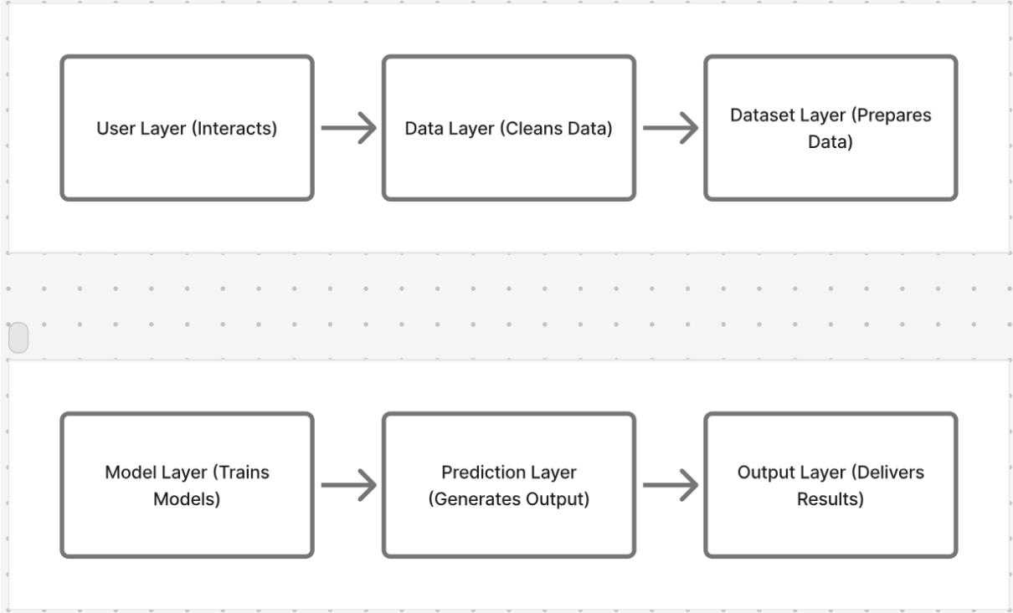
System Architecture:
15-11-2025
9

Slide 10
Methodology :
Our solution is a unified framework that uses machine learning to bring transparency to the online betting market. It establishes a "fair odds" benchmark to historically analyze market manipulation and assess platform fairness.
1. Data & Preprocessing Engine :
Function: Processes and cleans the existing dataset of over 14,700 races.
Key Technology: Utilizes the SMOTE technique to correct data imbalance, ensuring unbiased analysis.
2. Predictive Modeling Core :
Function: Calculates the true, unbiased probability of winning for each horse from the historical data.
Key Technology: Powered by a Random Forest algorithm with accuracy.
Output: Generates a data-driven "Fair Odds" baseline for every race in the dataset.
3. Historical Market Odds Engine :
Function: Compiles and analyzes the historical betting odds that were offered for the races in our dataset.
Output: Creates a comparative database of the "Market Odds" that were presented to consumers.
15-11-2025
10

Slide 11
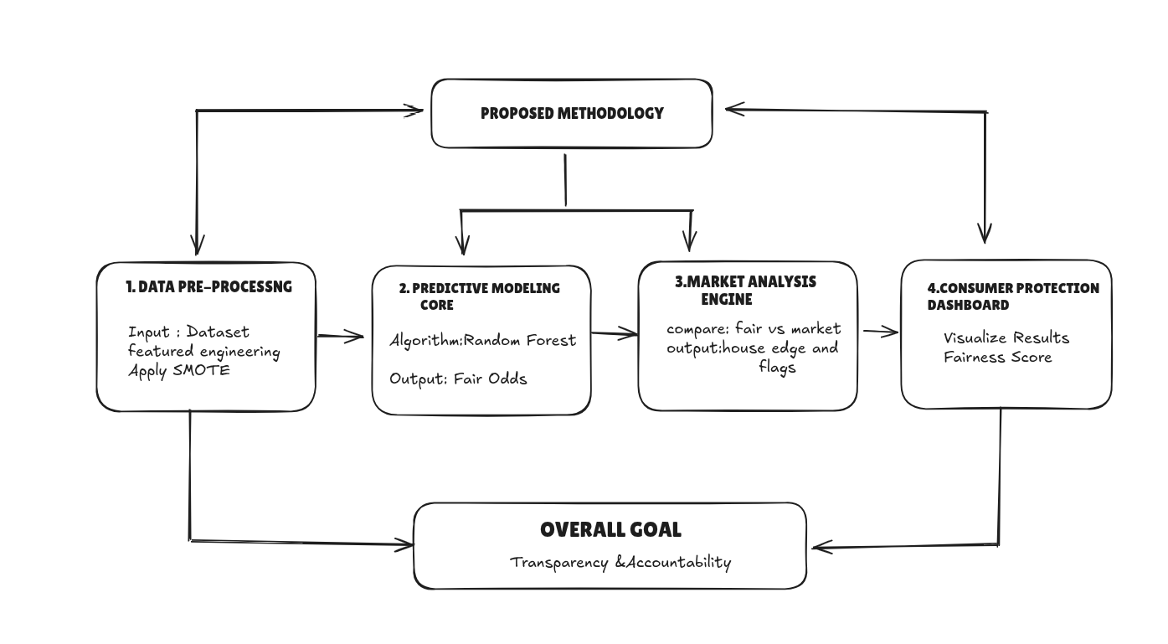
4. Platform Fairness Dashboard
Function: A web-based analytical tool that visualizes the historical data.
Key Features:
Directly compares our calculated "Fair Odds" vs. historical "Market Odds".
Generates a historical "Fairness Score" for different betting sites.
15-11-2025
11

Slide 12
Tools and Technologies
Programming Language: Python: 3.8+ The most common and powerful language for data science, used to implement the entire TSNY ML pipeline (data ingestion, feature engineering, modeling, evaluation, and deployment).
Core Machine Learning & Data Science Libraries:
LightGBM: Primary gradient-boosting framework used for Winner and Placed prediction (fast, memory-efficient, handles categorical features).
Scikit-learn: Fundamental utilities for preprocessing, model evaluation, scaling, label encoding, and metrics (accuracy, precision, recall, AUC).
Random Forest (baseline): Ensemble tree-based model used as a baseline comparison for robustness checks.
Imbalanced-learn: Tools (e.g., SMOTE, resampling) to handle class imbalance in winner/placed labels.
15-11-2025
12

Slide 13
Pandas: Essential for loading, cleaning, joining, and structuring race and runner datasets.
NumPy: High-performance numerical operations and array manipulations used throughout feature engineering and model input pipelines.
Joblib / Pickle: Efficient model serialization and loading for production inference.
PyTables / h5py (HDF5): Storage library used for fast, compressed intermediate datasets (train/test HDF5 files).
Matplotlib & Seaborn: Plotting libraries for performance charts, feature importance visuals, and EDA.
3. Development Environment:
Jupyter Notebook / JupyterLab / VS Code: An interactive environment ideal for data exploration, model development, and visualizing results step-by-step.
15-11-2025
13

Slide 14
System Requirement Specifications
Hardware Requirements (Functional):
CPU: Multi-core processor (e.g., Intel Core i5 / AMD Ryzen 5 or better) to efficiently handle data preprocessing, model execution, and feature engineering.
RAM: 8 GB minimum, 16 GB recommended for smooth dataset processing, LightGBM training, and handling HDF5 files without lag.
Storage: 256 GB SSD recommended for faster dataset loading, model saving, and intermediate file operations.
Graphics (Optional): A basic NVIDIA CUDA-enabled GPU can accelerate model training but is not mandatory.
15-11-2025
14

Slide 15
Software Requirements (Non-Functional):
Operating System: Windows 10/11, macOS, or any modern Linux distribution (e.g., Ubuntu 20.04+).
Core Software:
Python (Version 3.8 or newer) – Required for all scripts and ML workflows.
Anaconda Distribution – Highly recommended for managing environments and installing libraries like Pandas, NumPy, Scikit-learn, LightGBM, Imbalanced-learn, and h5py.
Required Python Libraries: (Installed automatically via Anaconda/pip)
Pandas
NumPy
Scikit-learn
LightGBM
Imbalanced-learn
Matplotlib / Seaborn
h5py / PyTables
Joblib / Pickle
15-11-2025
15

Slide 16
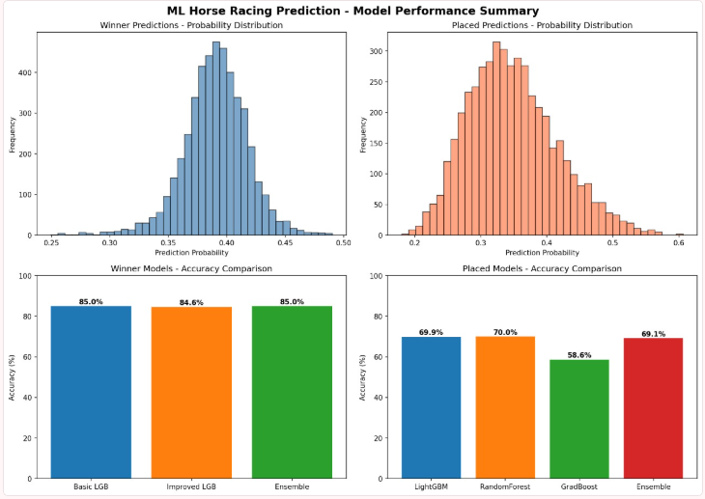
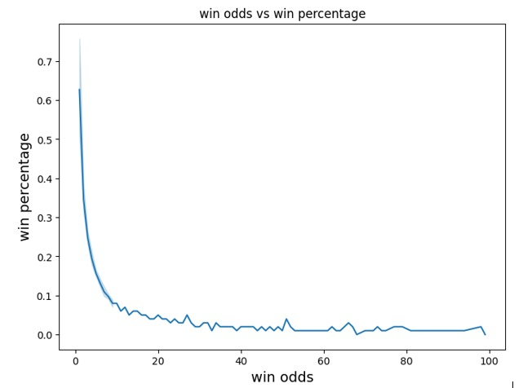
Outcome of the project
The Prediction Module is the final functional part of the system, where fairness reports, user-risk simulations, and awareness visualizations are generated. It uses the trained Random Forest model to predict fair win probabilities and to demonstrate the effects of manipulated odds over continuous betting.
15-11-2025
16

Slide 17
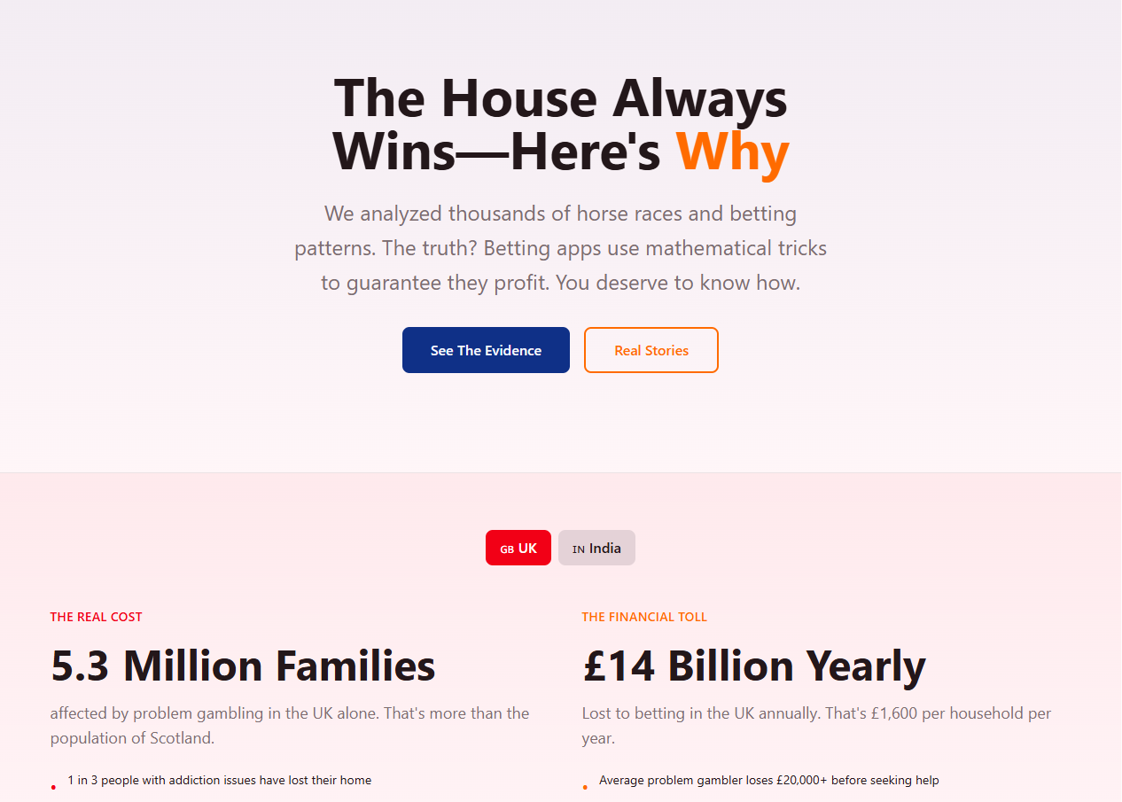
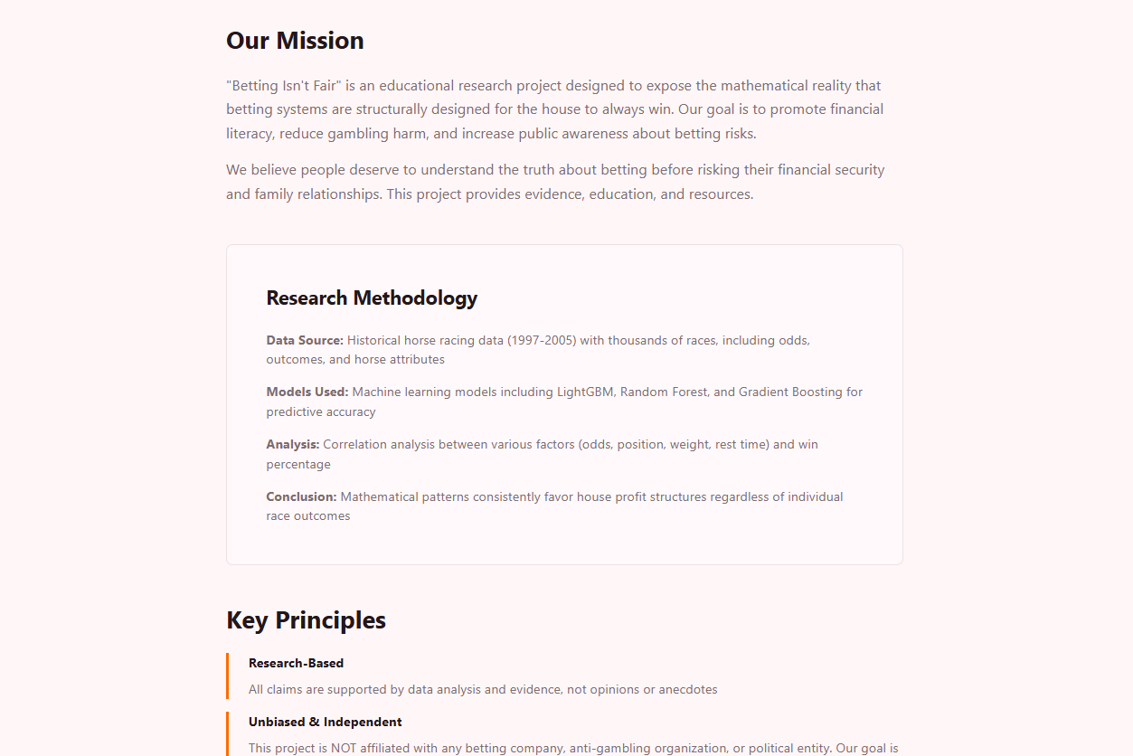
An informational website or platform that educates the public on the mechanics of betting odds, the risks of the unregulated market, and how data can reveal unfair practices
Home Page
About Page

Slide 18
Applications of the Project
Market Fairness Analysis:
Provides a clear, data-driven method to study and determine if betting apps are fair or biased.
Consumer Awareness & Education:
Clearly demonstrates to users the long-term financial risks, even when games appear fair initially.
Creates public awareness about the dangers of online betting and promotes responsible choices.
Academic & Research Support:
Offers a valuable resource for researchers, educators, and students in fields like gambling studies, psychology, and consumer protection.
Policy & Regulation Support:
Delivers crucial insights for policymakers to help them draft effective laws and regulations to protect users from unfair digital betting systems.
Future Scope & Development:
Establishes a foundation that can be expanded with more advanced machine learning to detect even deeper, hidden patterns in odds and betting behavior.

Slide 19
CONCLUSION
Betting apps in India show users the dream of winning money, but in reality, they are designed in a way that the company always earns profit. Most people do not know about this hidden bias and end up losing more than they win. In this project, we collected odds, compared them with real chances, and showed through simulations how users are at a disadvantage. The system makes it simple to understand that betting apps are not fair and that awareness is very important to avoid financial and social problems. The study is small, but it can grow into bigger research and also help in making fair rules for online betting in India.

Slide 20
References
[1] H. Kim, S.-W. Park, and J.-G. Lee, "An Anomaly Detection Framework for Match-Fixing in Sports Betting Using Machine Learning," IEEE Access, vol. 12, pp. 15034–15048, 2024.
[2] G. Elaad, "Essays on Dynamic Efficiency in a Betting Market," Ph.D. dissertation, School of Econ., Social and Political Sciences, Univ. of Southampton, Southampton, U.K., 2020.
[3] N. Bhanot and R. Sharma, "Mapping the Emotional and Psychological Dimensions of Fantasy Sports Betting: A Bibliometric Analysis," Journal of Gambling Issues, vol. 56, pp. 1–30, Jul. 2025.
[4] O. Prakash, A. Kumar, and S. Singh, "A study on online gambling addiction and risk behaviors among college students in Kerala, India," Industrial Psychiatry Journal, vol. 33, no. 1, pp. 120–127, 2024.
[5] E. A. Avenyo, J. O. A. Agyapong, and G. K. A. Asempapa, "Online sports betting among university students in Ghana: its impact on academic work and social life," Journal of Gambling Studies, vol. 40, no. 1, pp. 291–311, 2024.
[6] S. Gupta and P. Singh, "Performance evaluation of machine learning classifiers for predicting horse racing results," International Journal of Information Technology, vol. 15, pp. 3021–3030, 2023.
[7] M. Rockloff, N. L. L. Su, A. Russell, E. J. K. L. Yeo, and J. C. K. Lee, "Incentives in Wagering: A Behavioural Economic Analysis of Inducements to Bet on Long Odds," Journal of Gambling Studies, vol. 36, no. 3, pp. 897–912, 2020.
[8] D. Forrest and I. G. McHale, "Screening frameworks for match-fixing in sports betting," in Statistical Methods in Sports, London, UK: IntechOpen, 2019.
[9] R. Gupta, "The Rise of Online Gambling in India: A Study of Marketing Strategies of Gamiﬁed Platforms," Journal of Content, Community & Communication, vol. 15, pp. 178–190, Jun. 2022.
[10] A. S. Panicker and A. Kumar, "Regulatory Models for Online Gambling: A Comparative Study of India, UK, and Australia," Journal of Legal Studies and Research, vol. 8, no. 3, pp. 123–139, 2022.

Slide 21
[11] J. T. Holden, A. S. C. L. E. F. K. Rodenberg, and R. A. Pielke, "Tech features in betting: A review of in-play betting and cash-out," International Gambling Studies, vol. 20, no. 3, pp. 372–392, 2020.
[12] M. D. Griffiths, "Internet gambling: Issues, concerns, and recommendations," CyberPsychology & Behavior, vol. 9, no. 5, pp. 557–568, 2006.
[13] S. M. Gainsbury, "Online Gambling Addiction: The Relationship Between Internet Gambling and Disordered Gambling," Current Addiction Reports, vol. 2, no. 2, pp. 185–193, 2015.
[14] S. Monaghan, B. C. P. C. Derevensky, and L. Sklar, "The impact of gambling advertising on children and young people: A review of the evidence," Journal of Gambling Issues, no. 22, pp. 202–225, 2008.
[15] Yale SOM, [Title related to "Mobile sportsbook policy"], ..., 2025.(Note: This entry could not be located. It may be an unpublished working paper, a future publication, or an internal institutional report.)
[16] S. Yong-wook, "A Study on the Rules for Detecting Match-Fixing in Tennis Games," Journal of the Korea Society of Computer and Information, vol. 23, no. 11, pp. 129–135, 2018.
[17] G. Sinclair, J. L. S. G. P. H. Harris, and A. B. C. D. E. F. G. Russell, "Cashing-out in-play: A profile of sports bettors who use cash-out," Journal of Gambling Studies, vol. 40, pp. 313–333, 2024.

