Slide 1
Speech Emotion Recognition Using Machine Learning
Shri Shankaracharya Institute of Professional Management & Technology, Raipur
Minor Project Report on
CSE 7th Semester
Department of Computer Science and Engineering,
Batch 2018-2022
Session July – Dec 2021
Presentation Date: 5-10-2021
Project Group Members:
Shweta Shrivas
Chetna Arya
Project Guide
Mr. Abhishek Kumar Saw
(Assistant Professor, CSE)

Slide 2
INDEX
Introduction
Application Area
Project Overview
Project Requirements (Developer)
Project Requirements (End User)
Back End Details
Database Details
Front End Details
Project Flow Diagram
Data Flow Diagram
Result & Conclusion
References

Slide 3
INTRODUCTION
Emotion plays a significant role in daily interpersonal human interactions. This is essential to our rational as well as intelligent decisions. It helps us to match and understand the feelings of others by conveying our feelings and giving feedback to others. Research has revealed the powerful role that emotion play in shaping human social interaction
We choose this project to understand the different dynamics that play in speech and how can a program can accurately interpreter emotion.

Slide 4
Application Area
SER aims to recognize the underlying emotional state of a speaker from her voice. There are many applications of detecting the emotion of the persons like in the interface with robots, audio surveillance, web-based E-learning, commercial applications, clinical studies, entertainment, banking, call centers, cardboard systems, computer games, etc.
End users may differ according to usage of fields. If it is used in E- Learning platform then end users are teachers. If it is used in call centers then end user are employees.

Slide 5
Project Overview
Speech Emotion Recognition will help us to recognize the emotional state of a person in 6 categories which are anger, disgust, fear, happiness, sadness, and surprise. This project uses modulation spectral features and mel-frequency cepstrum coefficients (MFCC),,to extract the emotional features of a speech.
Mel-frequency cepstrum coefficient (MFCC) is the most used representation of the spectral property of voice signals. These are the best for speech recognition as it takes human perception sensitivity with respect to frequencies into consideration.
Modulation spectral features (MSFs) The spectral contents of the modulation signals are referred to as modulation spectra, and the proposed features are thereby named modulation spectral features (MSFs)

Slide 6
Project Requirements (Developer)
Software’s Required
Technology - Machine Learning
Language – Python (3.8.3)
Operating System – Windows/Linux
Pycharm or Jupyter Lab
Hardware Required
System : 64 bits OS, x64-based processor
RAM -2 GB (min)
SSD 256 GB
Hard Disk 1 TB

Slide 7
Project Requirements (End User)
Software’s Required
Operating System – Windows X/7/8 or Linux
Hardware Required
Intel Pentinum core i4/i5/i3
RAM -2 GB
SSD 256 GB
Hard Disk 1 TB

Slide 8
Back End Details
Back End - Python
Database required
1. Dataset_collection
2. Emotions data
Tables Required –
1. Dataset
2. Feature_Extraction
3. Method_applied
4. Emotions_datatable
5. emotion_recognise

Slide 9
Database Details
Database Name
1. Dataset_collection
2. Emotions data
Tables Required –
1. Dataset – [ S.no , audio_name]
2. Feature_Extraction [ S.no , MCFF , MSF , Method]
3. Emotions_datatable [S.no, anger, disgust, fear, happiness, sadness, surprise, average , std_deviation]
4. Emotion_recognise [ S.no , audio_name , average , std_deviation, Emotion]

Slide 10
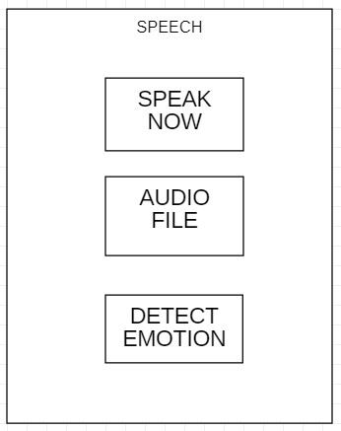
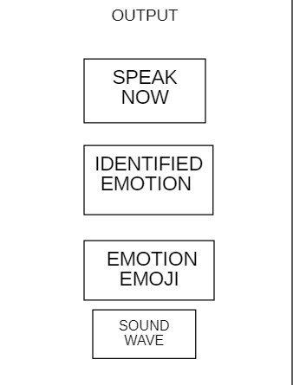
Front End Details
Front End – Python (Tkinter/Kivy)
2 interface in front end.

Slide 11
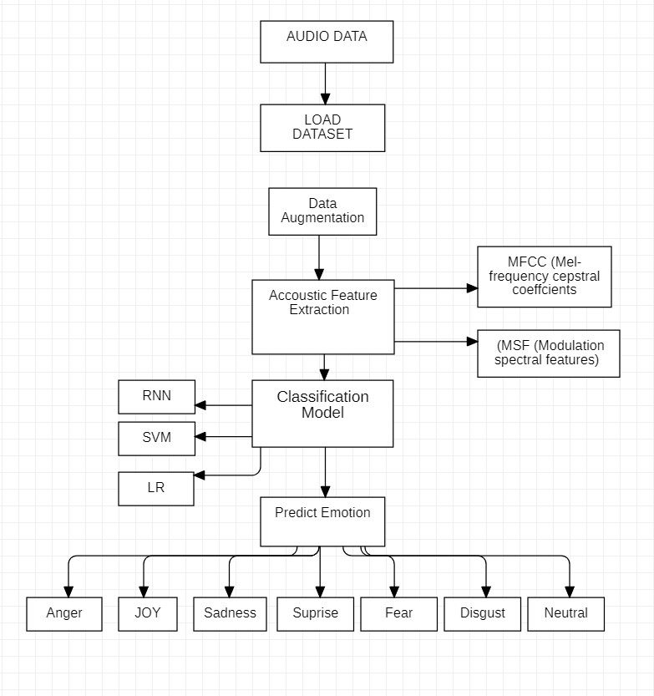
Project Flow Diagram

Slide 12
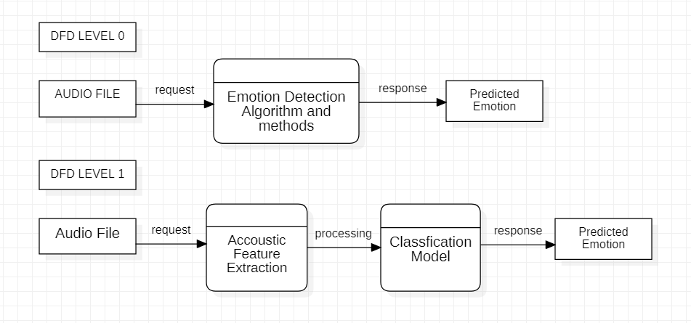
Data Flow Diagram

Slide 13
Result & Conclusion
The project can be used to find distress signs in other people through their speech. It can be used in different fields like education, hospital , commercial applications, clinical studies, entertainment, banking, call centers, cardboard systems, computer games, etc.

Slide 14
References
Text Book
Machine Learning – “Tom M. Mitchell”
Pattern Recognition and Machine Learning – “Christopher M. Bishop”
Web Resources
https://www.intechopen.com/chapters/65993
https://ijcrt.org/papers/IJCRT2106108
https://moizalimoomin.medium.com/how-to-build-speech-emotion-recognition-using-dnn-in-9steps-3bd3a21af375

