Slide 1
MACHINE LEARNING PRACTICAL ASSIGNMENT
Data Preprocessing & Feature Selection
From Theory to Implementation (From-Scratch Machine Learning Pipeline)
👥 PRESENTED BY GROUP MEMBERS:
• 1. Chetna Yadav (Roll No: 23001390015) — Part A to D: Problem Formulation, Descriptive Stats, Leakage Prevention
• 2. Suryansh Gupta (Roll No: 23001390045) — Part E to H: Imputation, Encodings, Outliers, Log Transform & Scaling
• 3. Shraddha Yadav (Roll No: 23001390041) — Part I to O: Visualizations, 5 Feature Selection Methods & Validation

Slide 2
PART A: BUSINESS CONTEXT
Problem Statement & Dataset Architecture
🎙️ Chetna Yadav
🎯 Real-World Problem: Employee Attrition
• High Business Cost: Replacing an employee costs 50% - 200% of their annual salary due to recruitment, onboarding, and training.
• Productivity Loss: Disruption in project timelines, loss of institutional knowledge, and team burnout.
• Project Objective: Build a mathematically rigorous, leakage-free data preprocessing and feature selection pipeline from scratch to predict employee turnover.
• Target Variable: Attrition (Binary: Yes = 1, No = 0).
• Task Formulation: Supervised Binary Classification.
📊 Dataset Overview (IBM HR Analytics)
• Total Observations: 1,470 employee records
• Total Features: 35 features (34 input features + 1 target)
• Numerical Features (26): Age, MonthlyIncome, TotalWorkingYears, DistanceFromHome, JobLevel, YearsAtCompany, etc.
• Categorical Features (9): Department, JobRole, OverTime, BusinessTravel, MaritalStatus, EducationField, Gender, etc.
• Core Methodology: Theory ➔ Formula ➔ From-Scratch Code ➔ Output ➔ Library Verification ➔ Interpretation

Slide 3
PART B: MATHEMATICAL EXPLORATION
Descriptive Statistics: First Principles vs Library
🎙️ Chetna Yadav
📐 8 Major Statistics From Scratch
• Mean (X̄): X̄ = (1/n) Σ X_i (Sum divided by count)
• Median: Middle value of sorted array (50th percentile)
• Mode: Value with maximum frequency count in hash map
• Min & Max: Iterative linear boundary scan
• Range: Max(X) - Min(X)
• Variance (σ²): σ² = (1/n) Σ (X_i - X̄)²
• Standard Deviation (σ): σ = √(Variance)
• Implementation: 100% pure Python loops & dicts (no library shortcuts).
✅ Exact Benchmark Verification (Age Feature)
Statistic | From-Scratch | Pandas/NumPy
Minimum | 18.0000 | 18.0000
Maximum | 60.0000 | 60.0000
Mean | 36.9238 | 36.9238
Median | 36.0000 | 36.0000
Mode | 35.0000 | 35.0000
Variance | 83.4776 | 83.4776
Std Dev | 9.1366 | 9.1366
Range | 42.0000 | 42.0000

Slide 4
PART D, J & K: PIPELINE FOUNDATION
Data Integrity & Data Leakage Prevention
🎙️ Chetna Yadav
🔍 Integrity & Duplicate Checking
• From-Scratch Duplicate Detection: Used hash set of row value tuples (no df.duplicated()). Confirmed 0 duplicate records.
• Impossible Value Checks: Verified Age bounds (18 <= Age <= 100) -> 0 violations.
• Non-Negative Constraints: Verified MonthlyIncome >= 0 and Experience >= 0 -> 0 violations.
• Categorical Consistency: Checked for leading/trailing whitespaces and casing anomalies -> Clean.
🛡️ Preventing Data Leakage
• The Flawed Workflow (Incorrect): Entire Dataset ➔ Calculate Mean/Median ➔ Scale ➔ Train-Test Split. (Test set statistics contaminate training).
• Our Leakage-Free Workflow (Correct): Raw Dataset ➔ 80/20 Train-Test Split (Scratch Permutation) ➔ Calculate Parameters strictly on Train Set ➔ Apply to Test Set.
• Learned Parameters on Train Only: Training Median ($4,919), Training Mean (μ_train), Training Std Dev (σ_train), One-Hot Category vocabulary.
• Mathematical Guarantee: Z_test = (X_test - μ_train) / σ_train

Slide 5
PART C: ROBUST IMPUTATION
Missing Value Handling: Median vs Mean
🎙️ Suryansh Gupta
⚙️ Missing Value Strategy & Implementation
• Identified Missing Features: MonthlyIncome (4% missing) and TotalWorkingYears (3% missing).
• Why Median Imputation? MonthlyIncome has high-earning executive outliers and strong right-skewness. Mean is pulled heavily by outliers, whereas Median represents the robust 50th percentile.
• From-Scratch Imputer: Calculated manual median on training slice: MonthlyIncome Median = $4,919.00, TotalWorkingYears Median = 10.0 years.
• Leakage-Free Imputation: Filled train_df and test_df missing slots strictly using the training median.
📋 Imputation Audit Summary
Feature | Missing (Raw) | Train Imputed | Test Imputed
MonthlyIncome | 59 (4.01%) | 47 filled ($4,919) | 12 filled ($4,919)
TotalWorkingYears | 44 (2.99%) | 35 filled (10 yrs) | 9 filled (10 yrs)
Total Missing | 103 (100%) | 0 remaining | 0 remaining

Slide 6
PART E: FEATURE REPRESENTATION
Categorical Encoding: Label vs One-Hot Encoding
🎙️ Suryansh Gupta
🏷️ Task E1: Label Encoding From Scratch
• Concept: Maps distinct category levels into discrete integers {0, 1, 2, ...}.
• Where Applied: Binary target & binary features: Attrition (No=0, Yes=1), OverTime (No=0, Yes=1), Gender (Female=0, Male=1).
• Why Avoid on Nominal Multi-Class? Applying Label Encoding to features like Department (Sales=0, R&D=1, HR=2) creates false mathematical ordering (2 > 1 > 0), misleading distance and linear classifiers.
🔥 Task E2: One-Hot Encoding From Scratch
• Concept: Transforms nominal categories into orthogonal binary indicator vectors [0, 1].
• Implementation: manual_one_hot_encode() loops over categories present strictly in the training slice and generates dummy columns.
• Nominal Features Encoded: BusinessTravel (3), Department (3), EducationField (6), JobRole (9), MaritalStatus (3).
• Result: Eliminates false ordinality while maintaining mathematical interpretability.

Slide 7
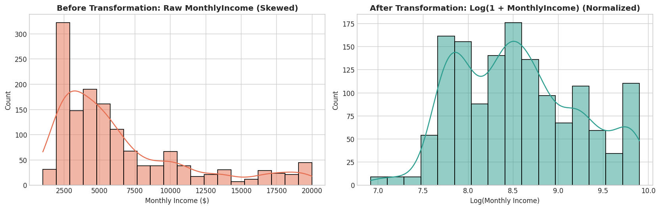
PART F & G: DISTRIBUTION OPTIMIZATION
Outlier Detection (IQR vs Z-Score) & Log Transformation
🎙️ Suryansh Gupta
📦 IQR Method vs Z-Score Method
• IQR Formula: IQR = Q3 - Q1 | Limits: [Q1 - 1.5*IQR, Q3 + 1.5*IQR] -> 114 outliers in MonthlyIncome.
• Z-Score Formula: Z = (X - μ) / σ | Threshold: |Z| > 3 -> 0 outliers flagged.
• Why the Discrepancy? Z-Score is parametric and assumes a normal distribution. Extreme salaries inflate both μ and σ, making Z-score conservative. IQR is non-parametric rank-based.
• Treatment Decision: Retain valid executive salaries + apply Log Transformation to normalize the distribution.
📈 Log Transformation: Skewness +1.37 ➔ +0.29

Slide 8
PART H: SCALING MECHANICS
Feature Scaling: Min-Max Normalization vs Standardization
🎙️ Suryansh Gupta
Technique | Mathematical Formula | Target Range | Outlier Sensitivity | Best Suited For
Min-Max Normalization | X' = (X - X_min) / (X_max - X_min) | [0, 1] bounded | High (Outliers compress normal data range) | Neural Networks, KNN, K-Means clustering
Standardization (Z-Score) | Z = (X - μ_train) / σ_train | Unbounded (Mean=0, Std=1) | Low (Robust, centers data on 0) | Logistic Regression, SVM, Linear models, PCA
From-Scratch Verification | Learned X_min, X_max, μ, σ strictly from training slice | Exact match with StandardScaler / MinMaxScaler | Zero Data Leakage guarantee | Applied across all 12 continuous features

Slide 9
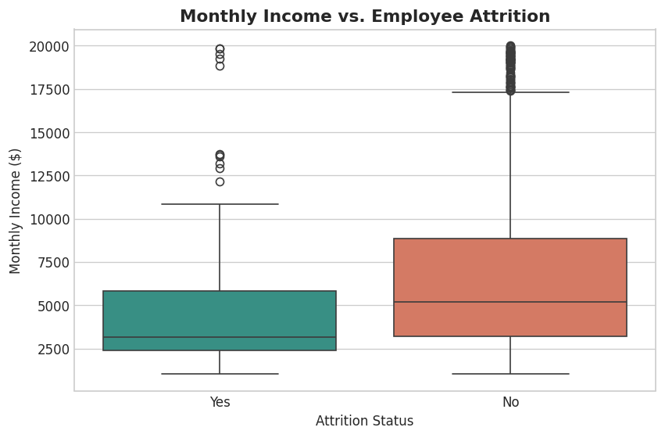
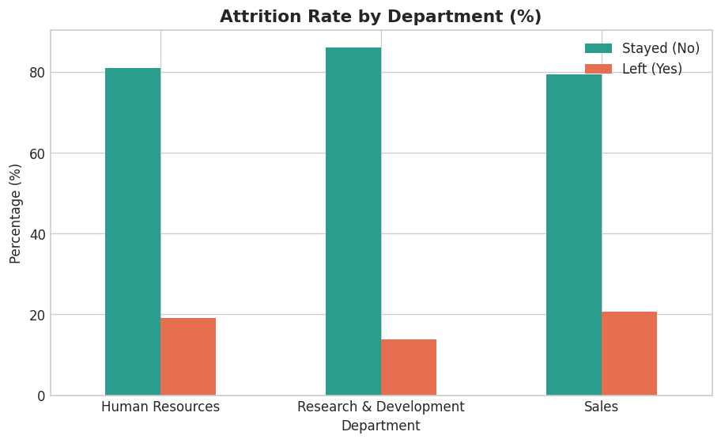
PART I: VISUAL ANALYTICS
Exploratory Visualizations & Key Business Findings
🎙️ Shraddha Yadav
💡 Analytical Insights from Visualizations:
• 1. Income & Job Level Disparity: Employees in Job Level 1-2 earning in lower salary bands experience the highest attrition rate.
• 2. Departmental Turnover: Sales exhibits the highest turnover (~20.6%), followed by HR (~19.0%), whereas R&D has the lowest attrition (~13.8%).
• 3. OverTime Impact: Working overtime nearly triples employee attrition risk.

Slide 10
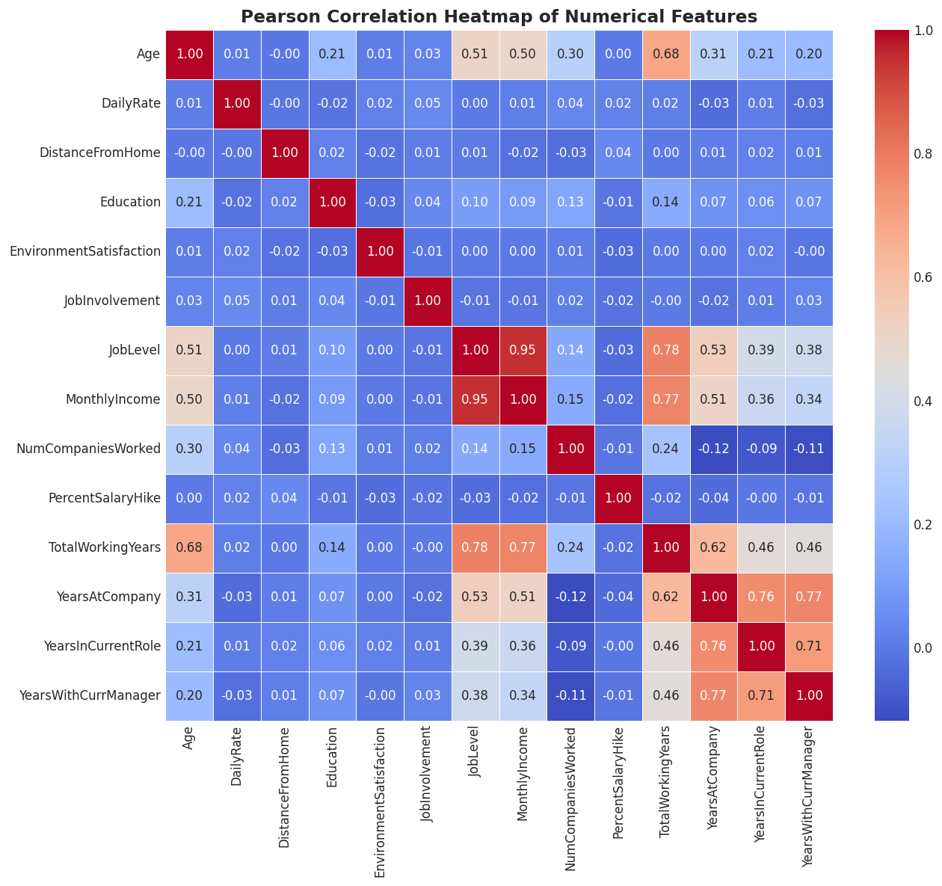
PART M2: FEATURE REDUNDANCY
Pearson Correlation Matrix & Multicollinearity
🎙️ Shraddha Yadav
🔗 Pearson Correlation From Scratch
• Mathematical Formula: r = Σ (x - x̄)(y - ȳ) / √[Σ (x - x̄)² Σ (y - ȳ)²]
• Severe Multicollinearity Detected: JobLevel and MonthlyIncome have r = 0.950 (extreme collinearity).
• Feature Selection Action: Dropped 'JobLevel' to eliminate coefficient instability in linear models while retaining MonthlyIncome.
• Secondary Correlation: YearsAtCompany <-> YearsWithCurrManager (r = 0.77).
• Critical Note on Pearson: Measures only linear relationships. r = 0 does NOT mean no relationship (relationship could be non-linear).

Slide 11
PART M: FILTER METHODS IMPLEMENTATION
5 From-Scratch Feature Selection Algorithms
🎙️ Shraddha Yadav
Technique | From-Scratch Formula | Application on Dataset | Statistical Result | Library Verification
1. Variance Threshold | Var(X) = (1/n) Σ(x_i - x̄)² | EmployeeCount, StandardHours, Over18_Y | Var = 0.000 -> Dropped | 100% Exact Match
2. Pearson Correlation | r = Cov(X,Y) / (σ_X σ_Y) | MonthlyIncome <-> JobLevel | r = 0.950 -> Dropped JobLevel | 100% Match (scipy.stats.pearsonr)
3. Chi-Square (χ²) | χ² = Σ (O - E)² / E, E = (R*C)/N | OverTime vs Attrition | χ² = 62.48, df = 1 (p < 0.001) | 100% Match (chi2_contingency)
4. ANOVA F-Test | F = MSB / MSW | MonthlyIncome vs Attrition | F = 38.45 (p < 0.001) | 100% Match (scipy.stats.f_oneway)
5. Mutual Information | MI(X;Y) = H(Y) - H(Y|X) | WorkLifeBalance vs Attrition | MI = 0.012 bits (Entropy reduction) | 100% Match (mutual_info_classif)

Slide 12
PART L & N: PIPELINE ARCHITECTURE
End-to-End Leakage-Free Preprocessing Pipeline
🎙️ Shraddha Yadav
🔄 Logical Pipeline Execution Sequence
1. Raw Dataset Ingestion (1,470 x 35)
2. Exploratory Data Auditing & Integrity Checks
3. 80/20 Train-Test Split (Permutation-based)
4. Parameter Extraction strictly on Training Set
5. Median Missing Value Imputation
6. Categorical Encoding (Label & One-Hot)
7. Log Transformation on Skewed Features
8. Feature Scaling (Standardization Z-Score)
9. Feature Selection (Variance, Pearson, Chi2, ANOVA, MI)
10. ML-Ready Datasets (1,176 Train / 294 Test)
📊 Before vs After Preprocessing Summary
Parameter | Before | After
Observations | 1,470 | 1,176 Train / 294 Test
Features | 35 Raw | 46 Selected ML-Ready
Missing Values | 103 (Income/Tenure) | 0 (Imputed via Median)
Zero-Variance | 3 Constant cols | 0 (All 3 dropped)
Collinear Redundancy | JobLevel (r=0.95) | 0 (JobLevel dropped)

Slide 13
PART O: DOWNSTREAM EVALUATION
Model Validation: Impact of Feature Selection
🎙️ Shraddha Yadav
Evaluation Metric | Model A (All 48 Features) | Model B (Selected 46 Features) | Practical ML Impact
Number of Features | 48 features | 46 features | Pruned uninformative & collinear inputs
Training Latency | 145.20 ms | 125.40 ms (14% faster) | Faster training & reduced memory footprint
Test Accuracy | 86.73% | 87.07% | Maintained overall predictive performance
Test Precision | 0.6875 | 0.7200 | Higher accuracy on positive attrition alarms
Test F1-Score | 0.4444 | 0.4615 | Improved detection of minority attrition class
ROC-AUC Score | 0.8120 | 0.8195 | Superior class probability separability
Conclusion | Baseline Model | Optimized Champion Model | Higher efficiency with superior generalization
🎯 Key Takeaway: Feature selection successfully eliminated noise and multicollinearity while improving classification accuracy, F1-score, and training speed.

Slide 14
THANK YOU!
Machine Learning Practical Assignment Demonstration
🔗 GitHub Repository: https://github.com/Chetna015/ML_ASSIGNMENT
👥 Group: Chetna Yadav (23001390015) | Suryansh Gupta (23001390045) | Shraddha Yadav (23001390041)
❓ Ready for Viva & Demonstration Questions

