Slide 1

NovaRetail — Quarterly Business Review
Q2 2026 | Quarterly Business Review
$1.28B
+4.5%
53.2
Total Revenue
QoQ Revenue Growth
Sales-Weighted NPS
EXECUTIVE SUMMARY
NovaRetail generated $1.28B in Q2 revenue, representing 4.5% sequential growth. APAC delivered the strongest growth momentum and maintained the highest customer advocacy, while North America remained the largest revenue contributor. Latin America continued to contract as customer experience and operational risk deteriorated. APAC capacity also requires action to protect future growth.
ICON
Pick the icon that
best represents this
quarter's overall story
NovaRetail Quarterly Business Review — Capstone Template
1

Slide 2
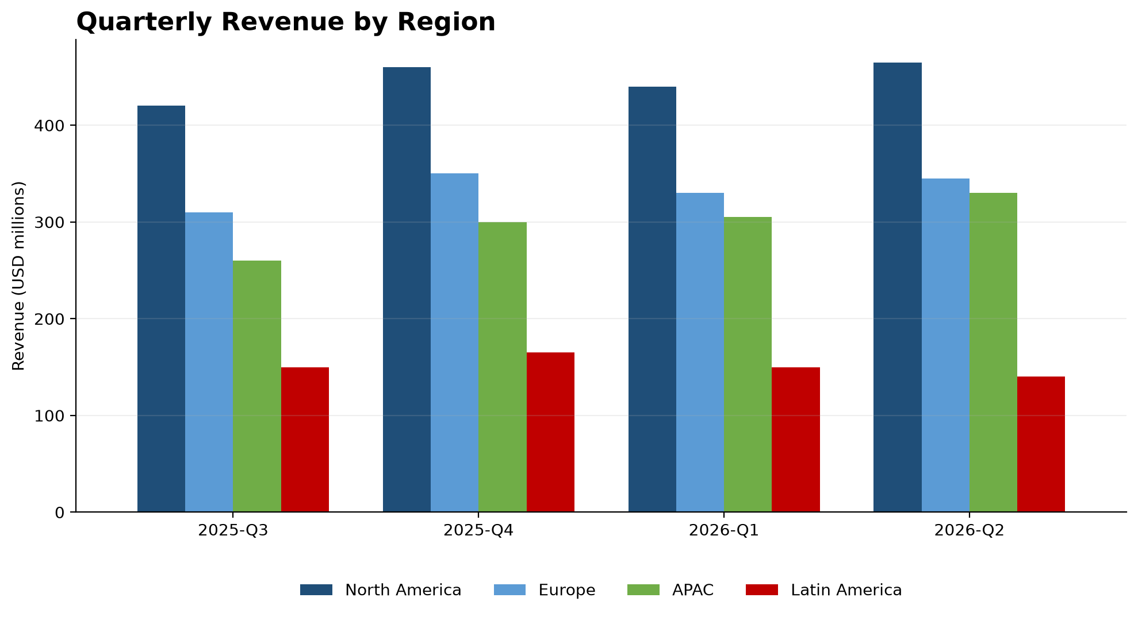

APAC Leads Growth as Latin America Revenue Falls Further
• Total Q2 revenue reached $1.28B, up 4.5% QoQ.
• APAC revenue increased from $260M to $330M.
• North America remained the largest region at $465M.
• Latin America fell to $140M as returns increased to 8.2%.
NovaRetail Quarterly Business Review — Capstone Template
2

Slide 3
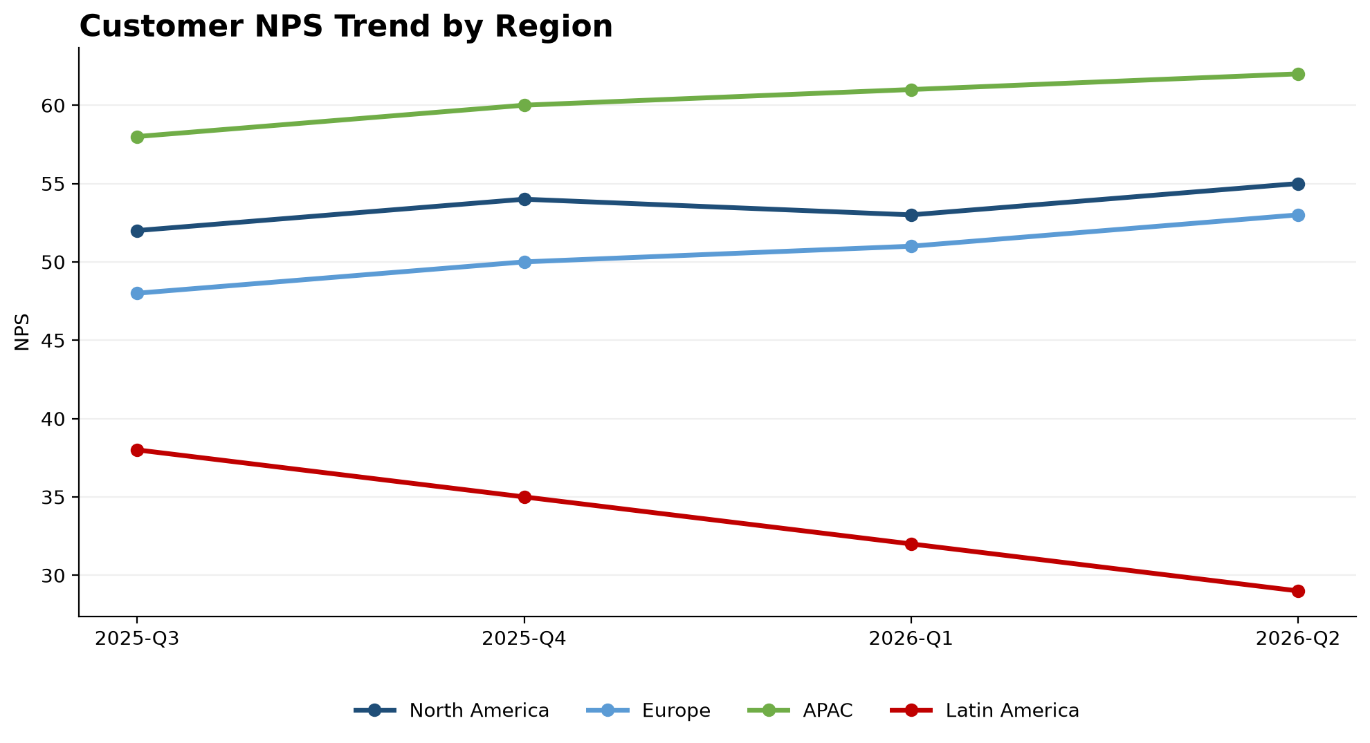

Latin America Customer Experience Deteriorates as APAC Extends Its Lead
• APAC achieved the highest Q2 NPS at 62.
• APAC delivery performance improved to 2.2 days.
• Latin America NPS fell from 38 to 29.
• Latin America tickets climbed to 31K as delivery reached 7.5 days.
NovaRetail Quarterly Business Review — Capstone Template
3

Slide 4
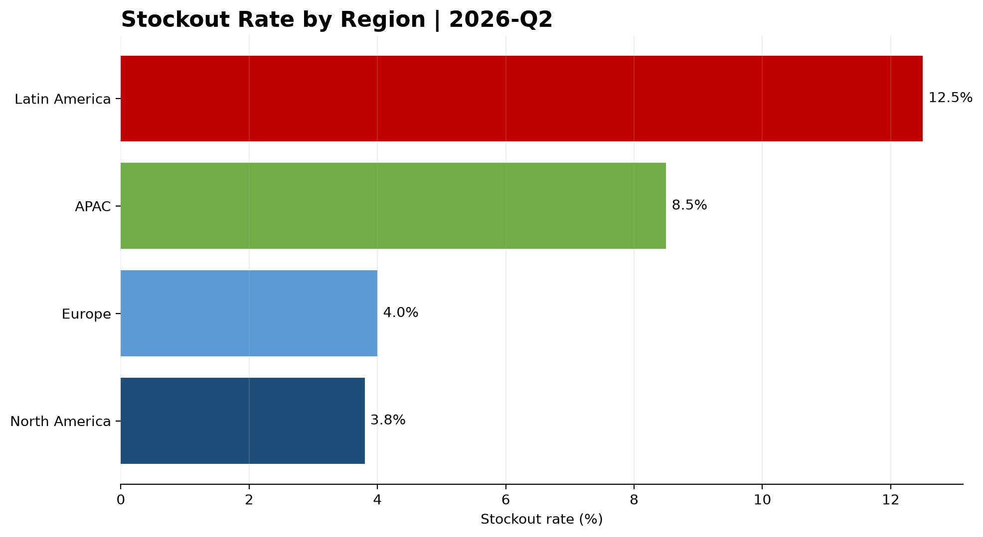

Latin America Risk Escalates While APAC Nears Capacity Limits
• Latin America stockouts reached 12.5% in Q2.
• Fraud incidents in Latin America increased from 18 to 30.
• Latin America return processing increased to 10 days.
• APAC warehouse utilization reached a critical 92%.
NovaRetail Quarterly Business Review — Capstone Template
4

Slide 5

Recommended Actions and Executive Priorities
• Stabilize Latin America operations through a cross-functional recovery plan.
• Expand APAC warehouse and fulfillment capacity ahead of future demand.
• Replicate APAC delivery practices across lower-performing regions.
• Introduce monthly alerts for stockouts, NPS, fraud and capacity utilization.
ICON
Pick the icon for
action / recommendation
Prioritize immediate operational recovery in Latin America while investing ahead of APAC's continued growth.
NovaRetail Quarterly Business Review — Capstone Template
5

