Slide 1

Predicting bakery sales
Team 8
Chetna Lourembam
Joao Vicente de Camargo
Vaishali Vinod

Slide 2
Data overview
Daily sales for multiple product groups
Weather data and Kieler Woche sales
Seasonality & routine effects

Slide 3
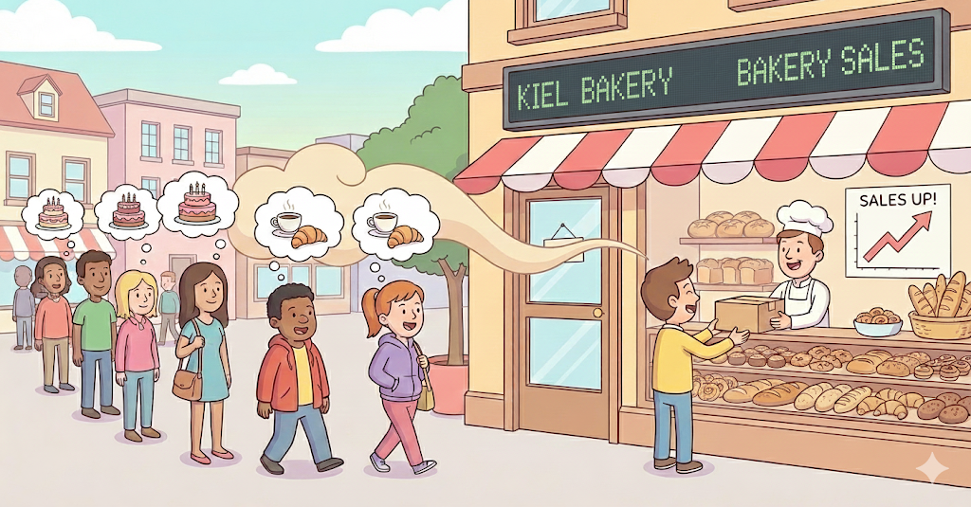
What we focused on
Sales momentum – lags & rolling averages
Cyclical routines – weekday patterns encoded
Product-group-specific behavior
Best vs worst prediction cases

Slide 4
Handling missing values
📊 Weather variables: median imputation
📊 Weather codes: mode imputation
⛵️ Event flags: filled with 0
📈 Recent Sales Momentum: dropped initial rows

Slide 5
Self-created variables
Variable | Description
lag_7 | Captures weekly demand memory
rolling_7 | Smooths short-term noise
dow_sin/cos | Encodes routines cyclically
is_weekend | Behavioral shift

Slide 6
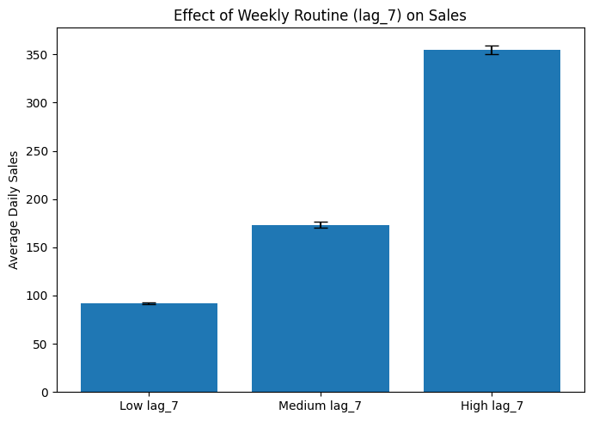
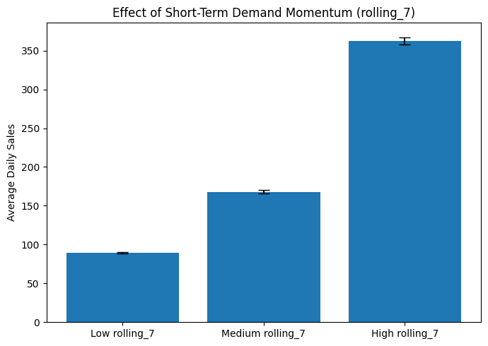
Effect of self-created variables on sales

Slide 7
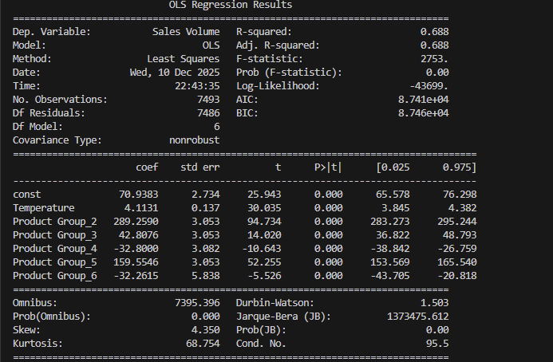
Variables linear Prediction
From all parameters tested, the one with the most relevant effect was only temperature/ product group. All other possible variables tested, included holidays, days of the week, precipitation (using data from Holtenau-Kiel weather station). The test was run variable/ product group, or temperature/ extra variable/ product group , all variables/product group.
Parameters : features = ["Temperature", "Product Group"]

Slide 8
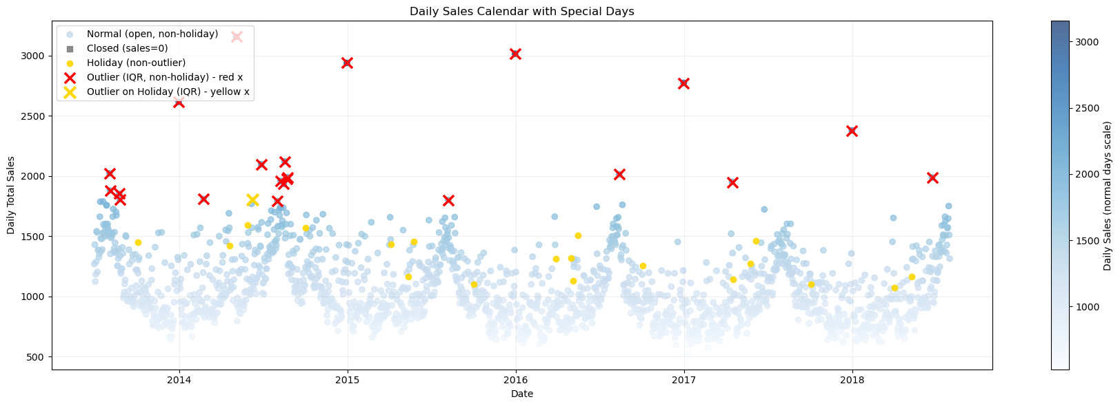
Outliers analysis

Slide 9
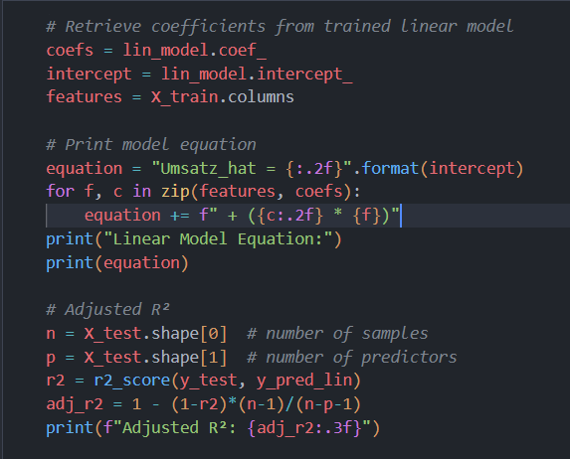
Linear Model Optimization
Linear Model Equation:
Umsatz_hat = 207.47 + (-0.56 * Temperatur) + (-2.01 * Bewoelkung) + (0.03 * Windgeschwindigkeit) + (-0.70 * Wettercode) + (2.77 * KielerWoche) + (19.00 * is_weekend) + (-1.95 * dow_sin) + (-2.05 * dow_cos) + (0.87 * doy_sin) + (-0.66 * doy_cos) + (14.32 * lag_1) + (17.08 * lag_7) + (99.93 * rolling_7) + (4.09 * Warengruppe_2) + (0.19 * Warengruppe_3) + (-0.69 * Warengruppe_4) + (2.54 * Warengruppe_5) + (-0.42 * Warengruppe_6)
Adjusted R²: 0.879

Slide 10
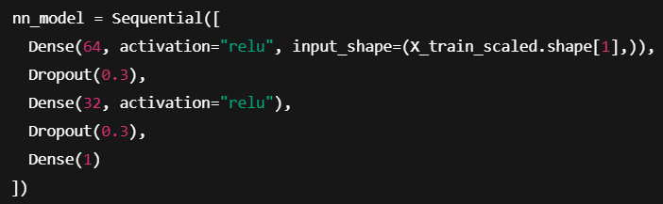
Neural Network Optimization

Slide 11
TRAINING AND VALIDATION PERFORMANCE
MODEL | RMSE | MAE | R2
0 Baseline (Weather Only) | 129.14 | 104.27 | 0.048
1Linear Regression (Engineered) | 44.75 | 31.64 | 0.880
2Neural Net (Engineered) | 39.77 | 26.29 | 0.906

Slide 12
Model Performance (MAPE) for different product groups
Overall NN MAPE = 16.0%
Product | MAPE
Bread | 19.4%
Rolls | 9.2%
Croissant | 14.0%
Confectionery | 21.1%
Cake | 15.0%

Slide 13
Best Improvement VS Worst Fail
1. Best Improvement Case
Sales follow stable weekly patterns and short-term momentum.
Lag and rolling features align well with observed patterns.
Linear model: underestimates the interaction.
Neural network: captures both routine and momentum → significantly lower prediction error.
Takeaway: Neural networks excel when patterns are consistent and predictable.
2. Worst Failure Case
Sales deviate sharply from weekly patterns and rolling averages.
Often caused by irregular events or sudden demand shifts.
Both linear and neural models struggle → high prediction error.
Takeaway: Time-based features alone cannot handle unexpected or irregular events.

Slide 14
Other models: Ridge, XG BOOST, rANDOM FOREST, LIGHT GM, ENSEMBLE
Feature Engineering:
Temporal: Day of week, day of year, weekend indicator
Cyclical: Weekly & yearly patterns (sin/cos transformations)
Lagged & Rolling: Past 1 & 7 days’ sales, 7-day rolling average
Models:
Ridge Regression: Handles correlated features
Random Forest: Captures non-linear patterns
XGBoost & LightGBM: Gradient boosting, efficient on large datasets
Ensemble: Averages predictions for higher accuracy

Slide 15
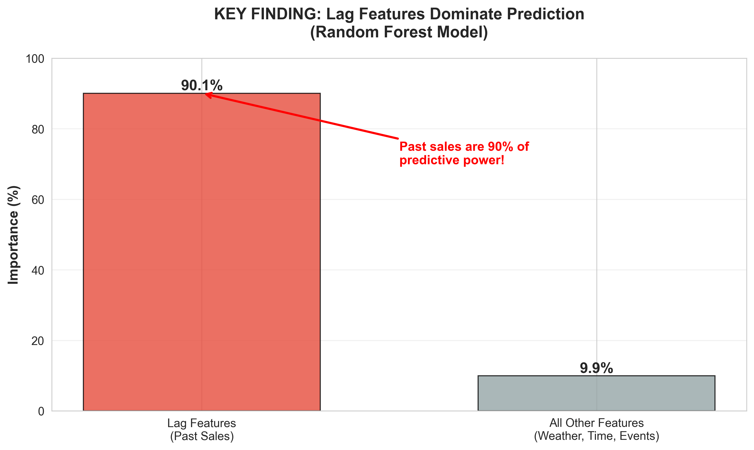
Past sales dominate: Lag features contribute ~90% of predictive power
Weather, events, and temporal features improve accuracy but are less critical
Ensemble predictions are more stable than individual models

Slide 16
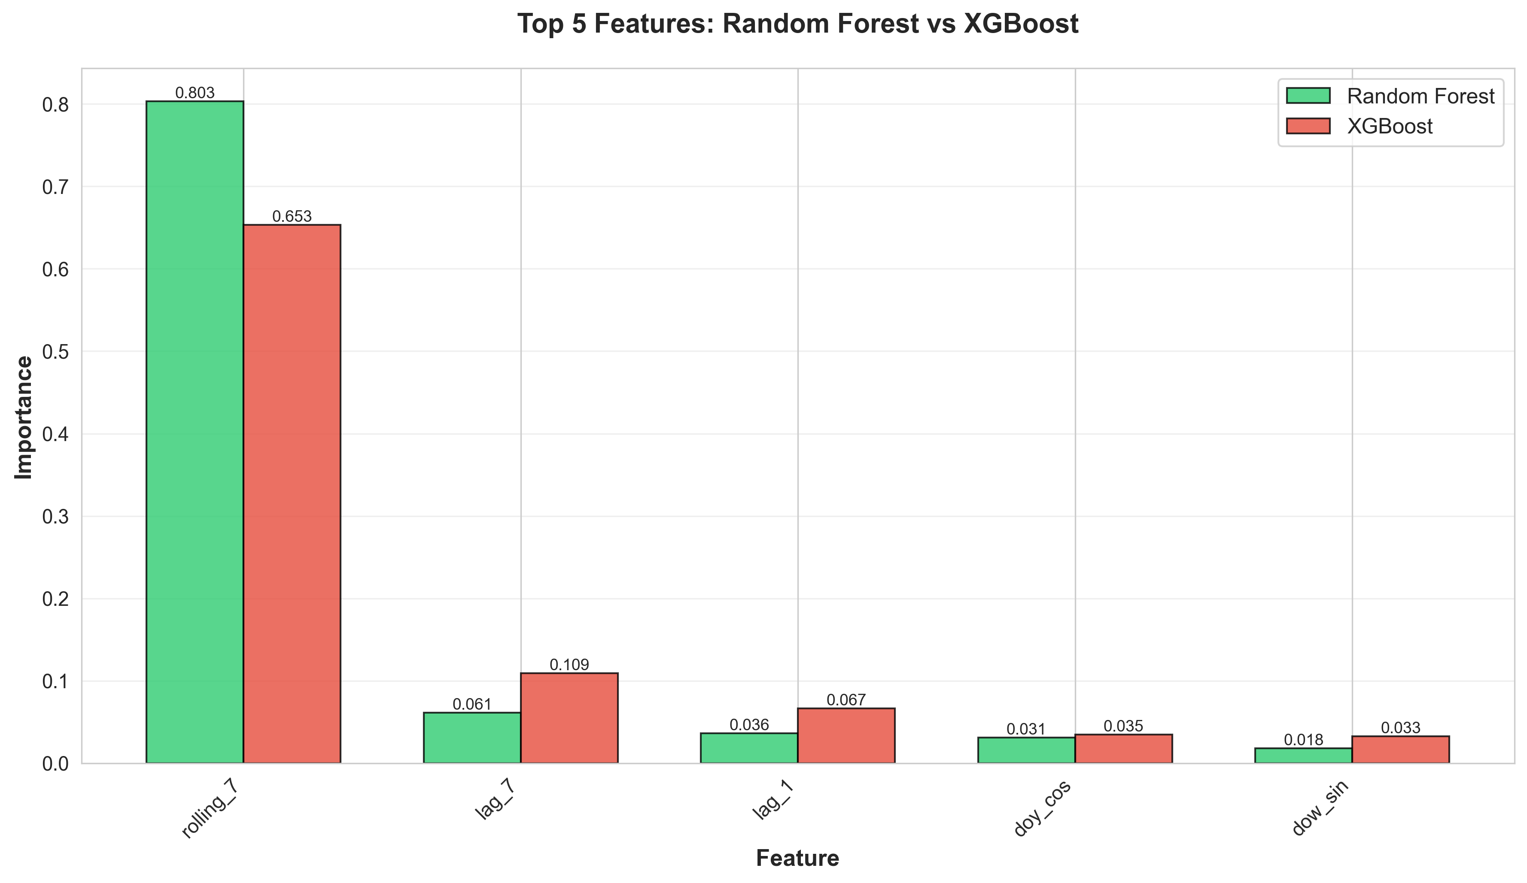

Slide 17
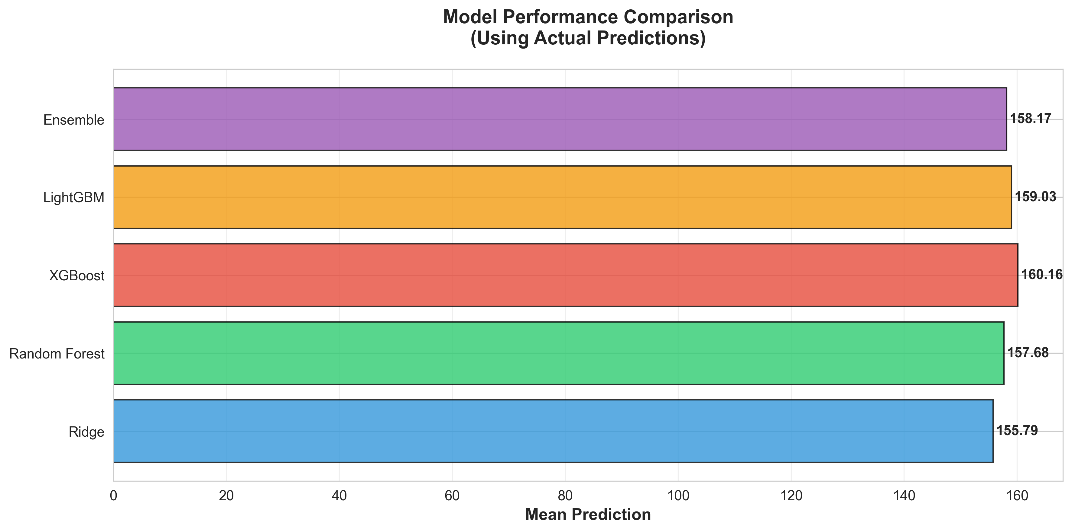

Slide 18
Summary
Past sales are the main predictor
  Lag and rolling features explain ~90% of sales dynamics.
  Simple linear models already capture most patterns.
Feature engineering improves accuracy
  Temporal features (weekday, day of year, weekend) and cyclical encoding help capture routine patterns.
  Event features (Kieler Woche) add small but meaningful improvements.
Neural networks capture nonlinear effects
  Further reduce error compared to linear regression.
  Particularly effective when sales patterns are stable and predictable.
Limitations
  Sudden or irregular demand spikes remain difficult to predict.
  External factors beyond weather/events may still influence sales.
Practical Implications
  ML models can support inventory planning and staffing decisions.
  Ensembles provide more stable and robust predictions than single models.

Slide 19
THANK YOU

