Slide 1
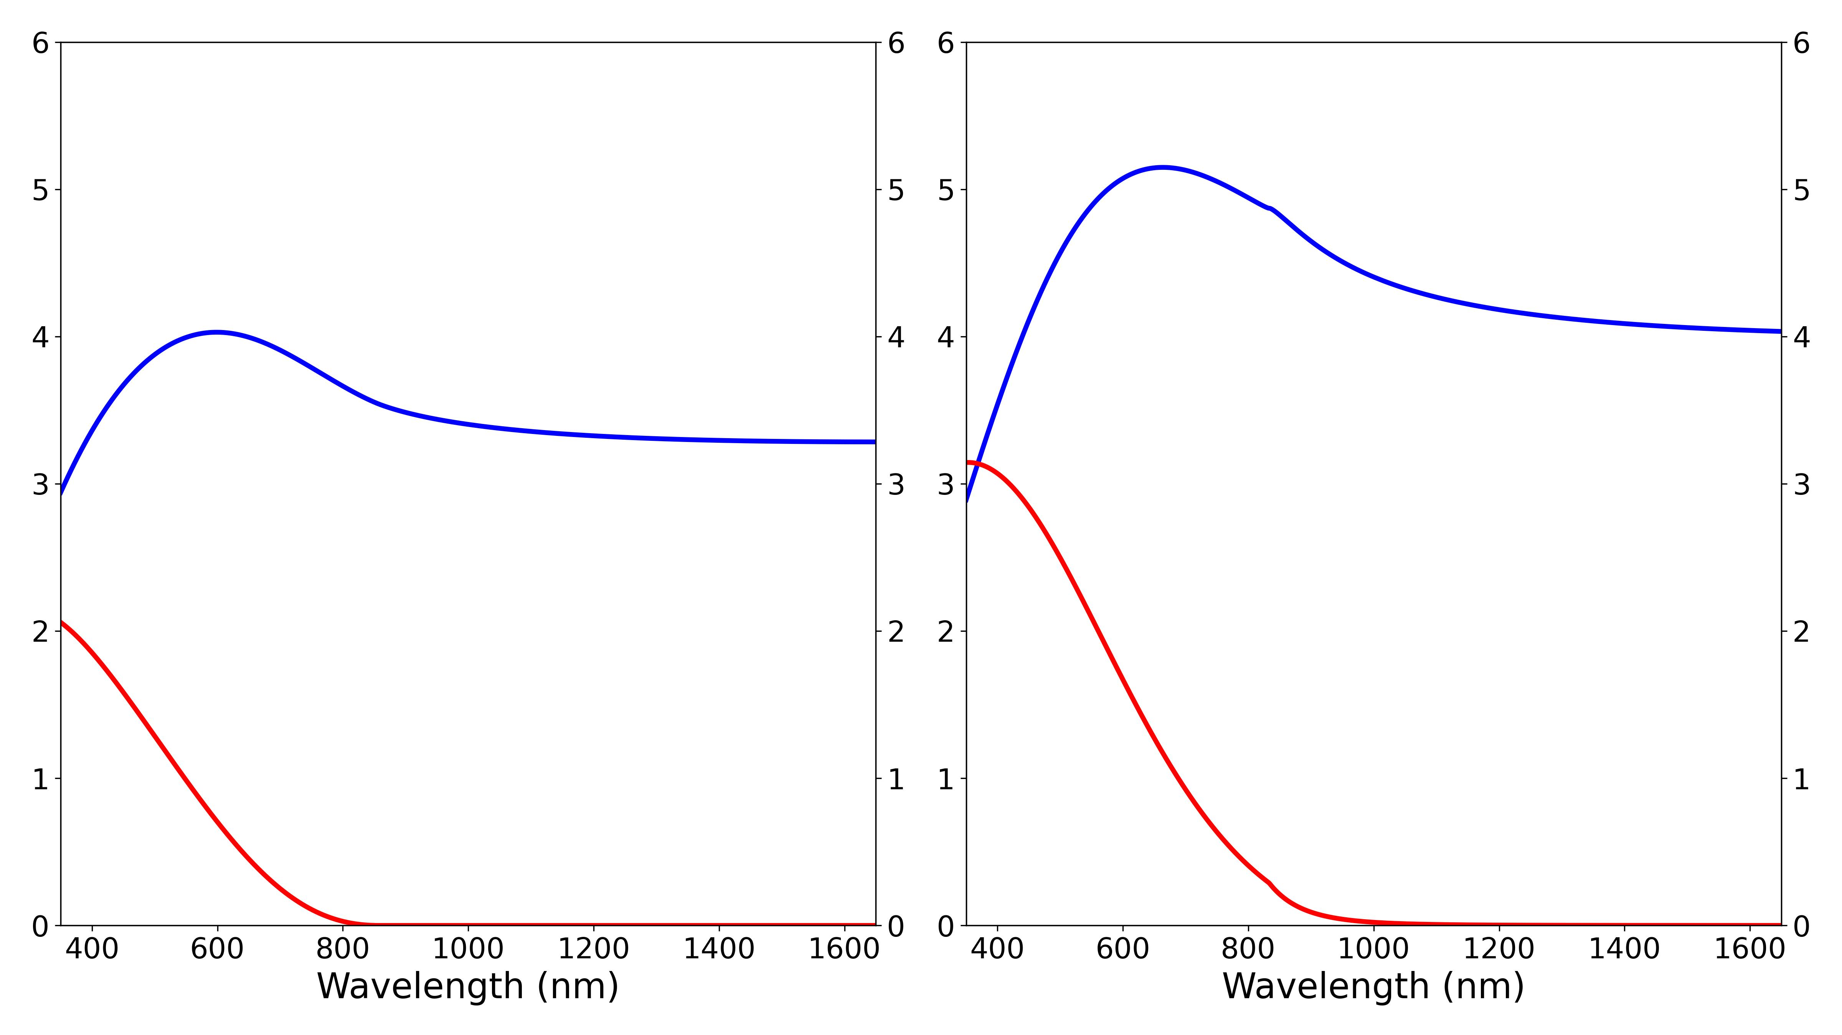
Amorphous Sb₂Se₃
Crystalline Sb₂Se₃
Refractive index n
Refractive index n
Extinction coefficient k
Extinction coefficient k

Slide 2
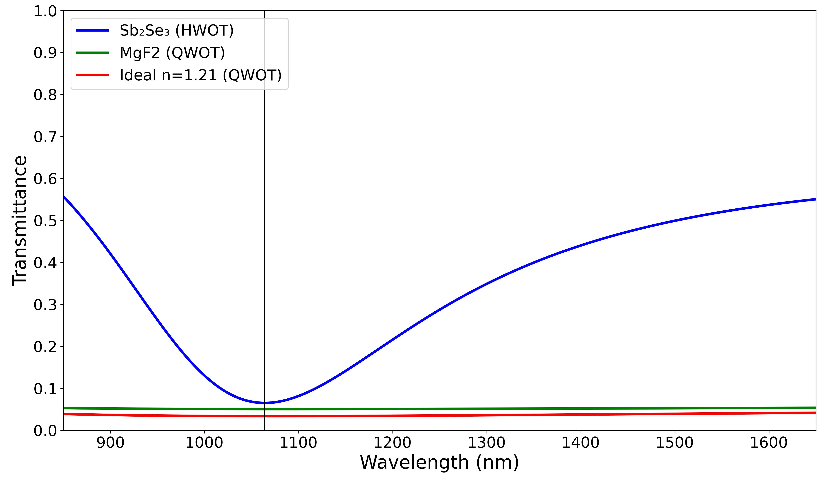
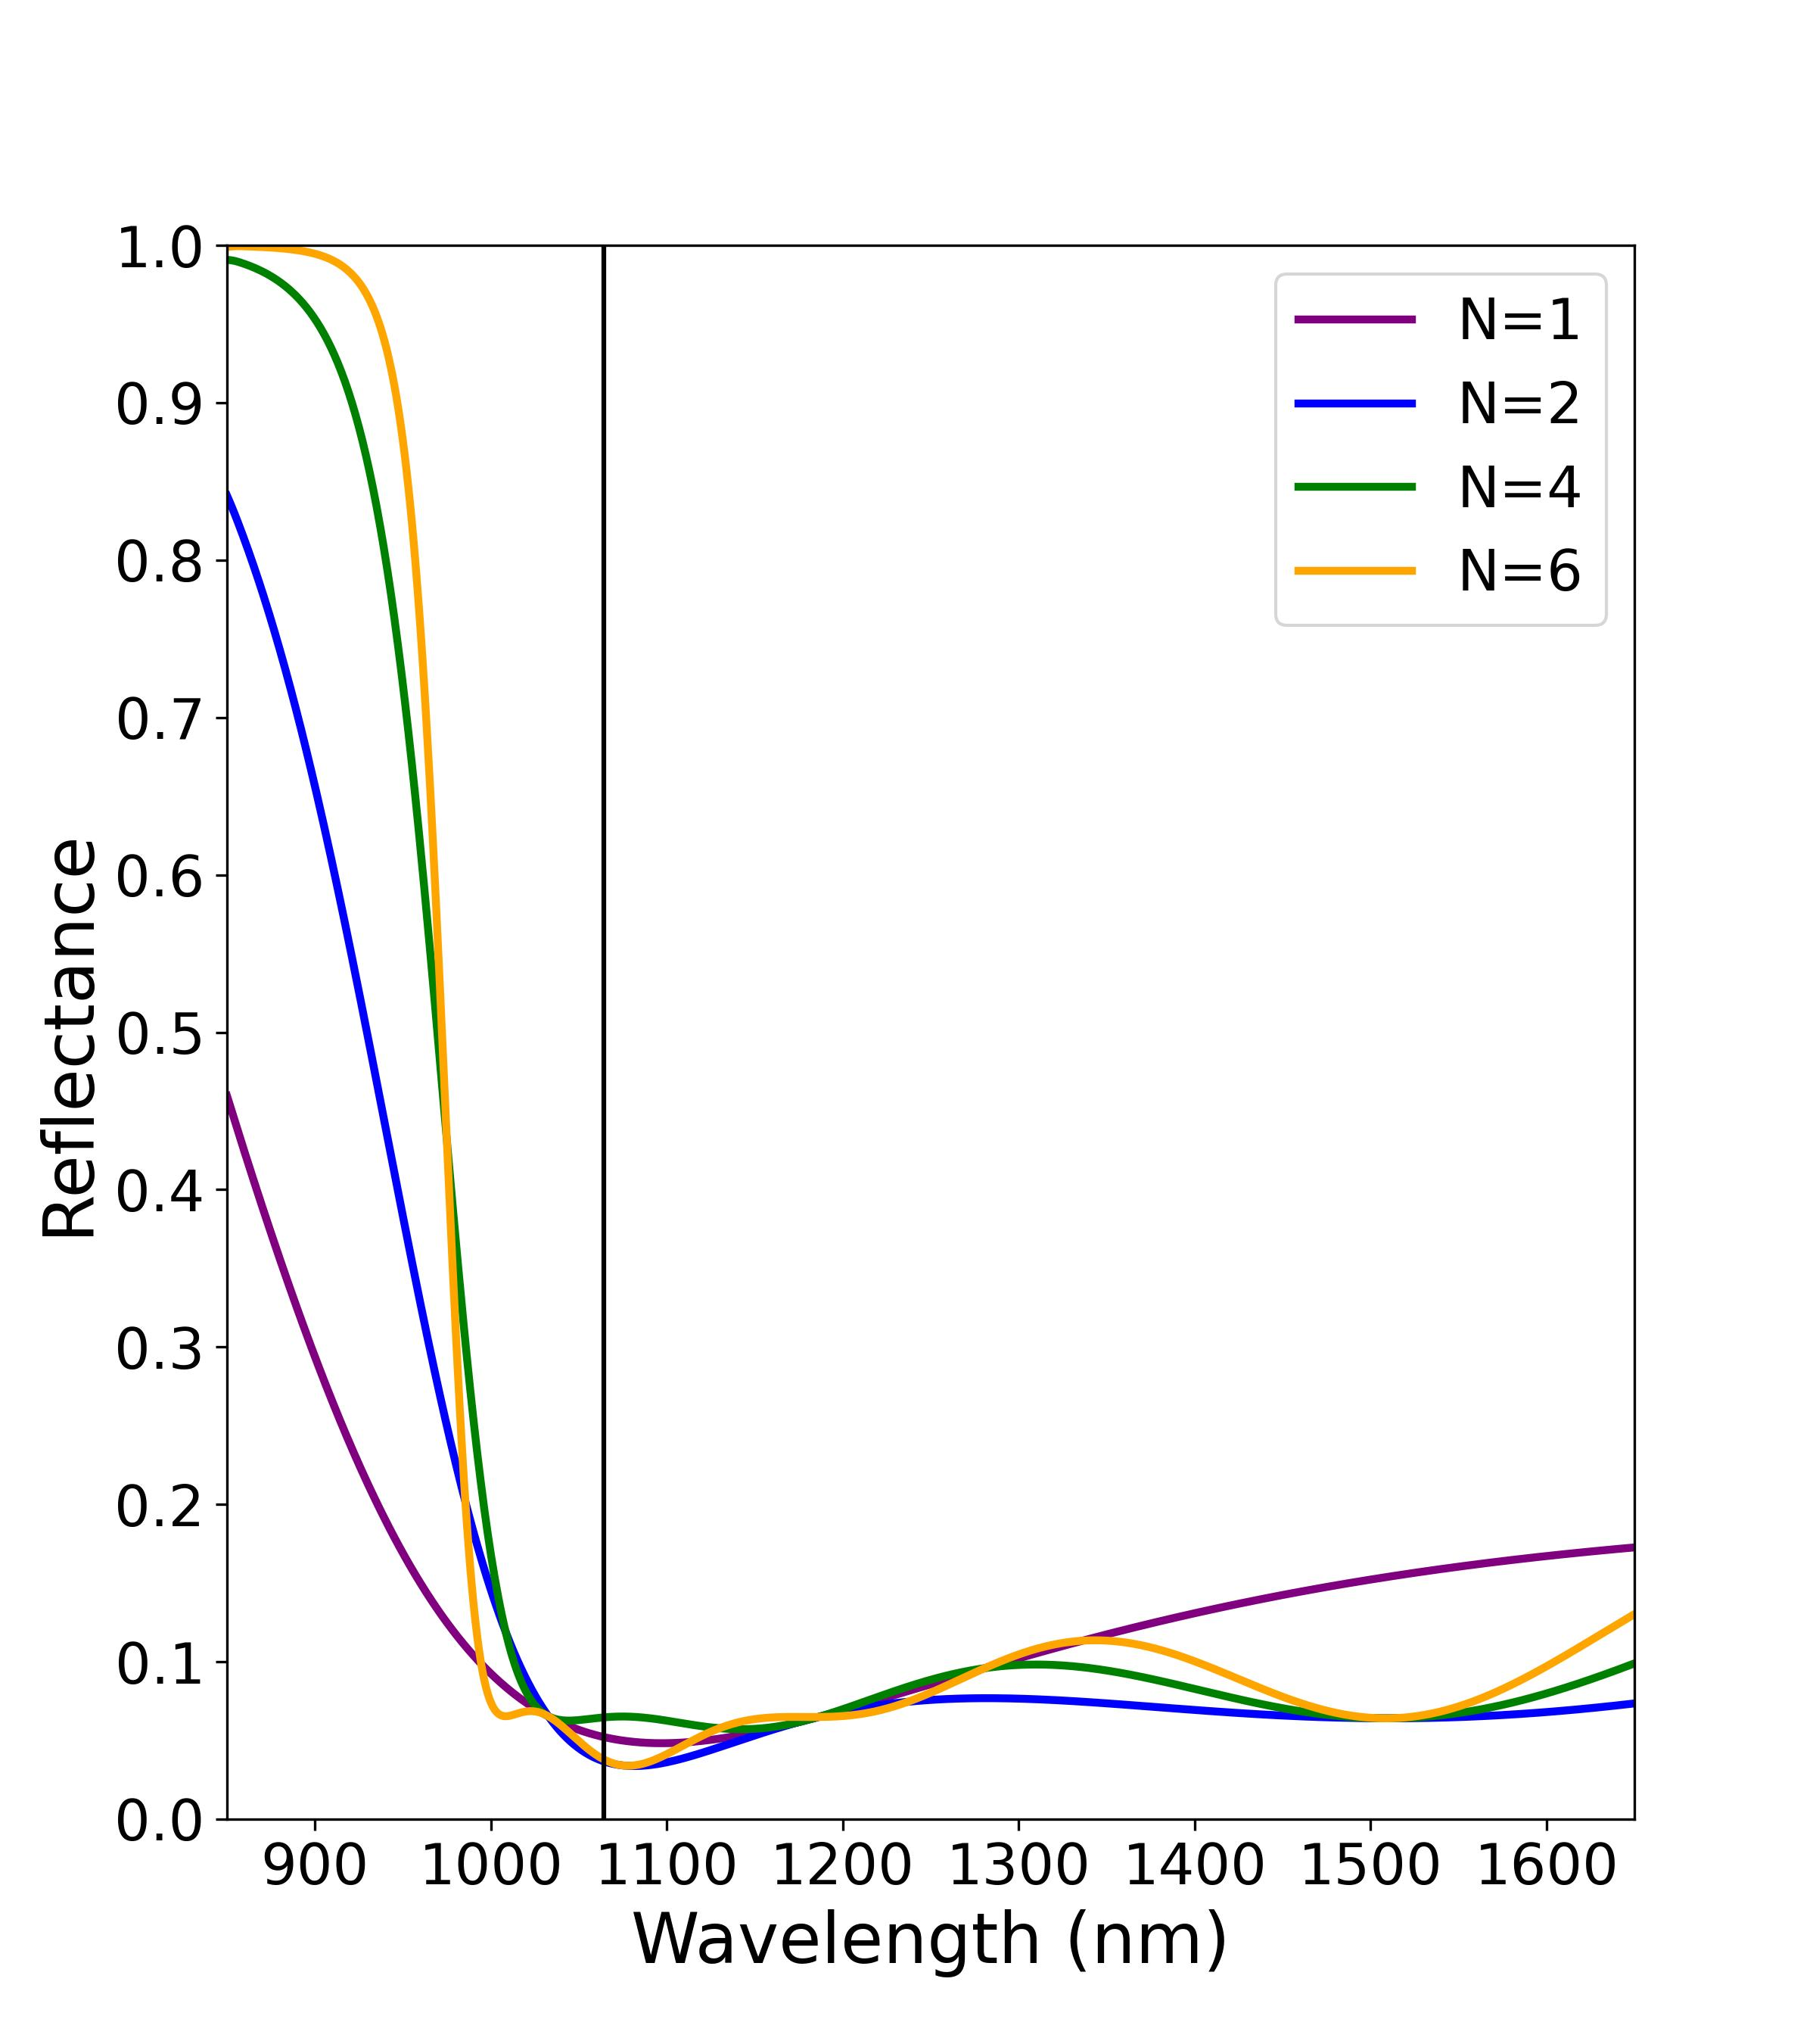

Air
R₂
R₁
Incident light
Film
OT = $\frac{λ}{4}$
Substrate
(SiO₂ )

Slide 3
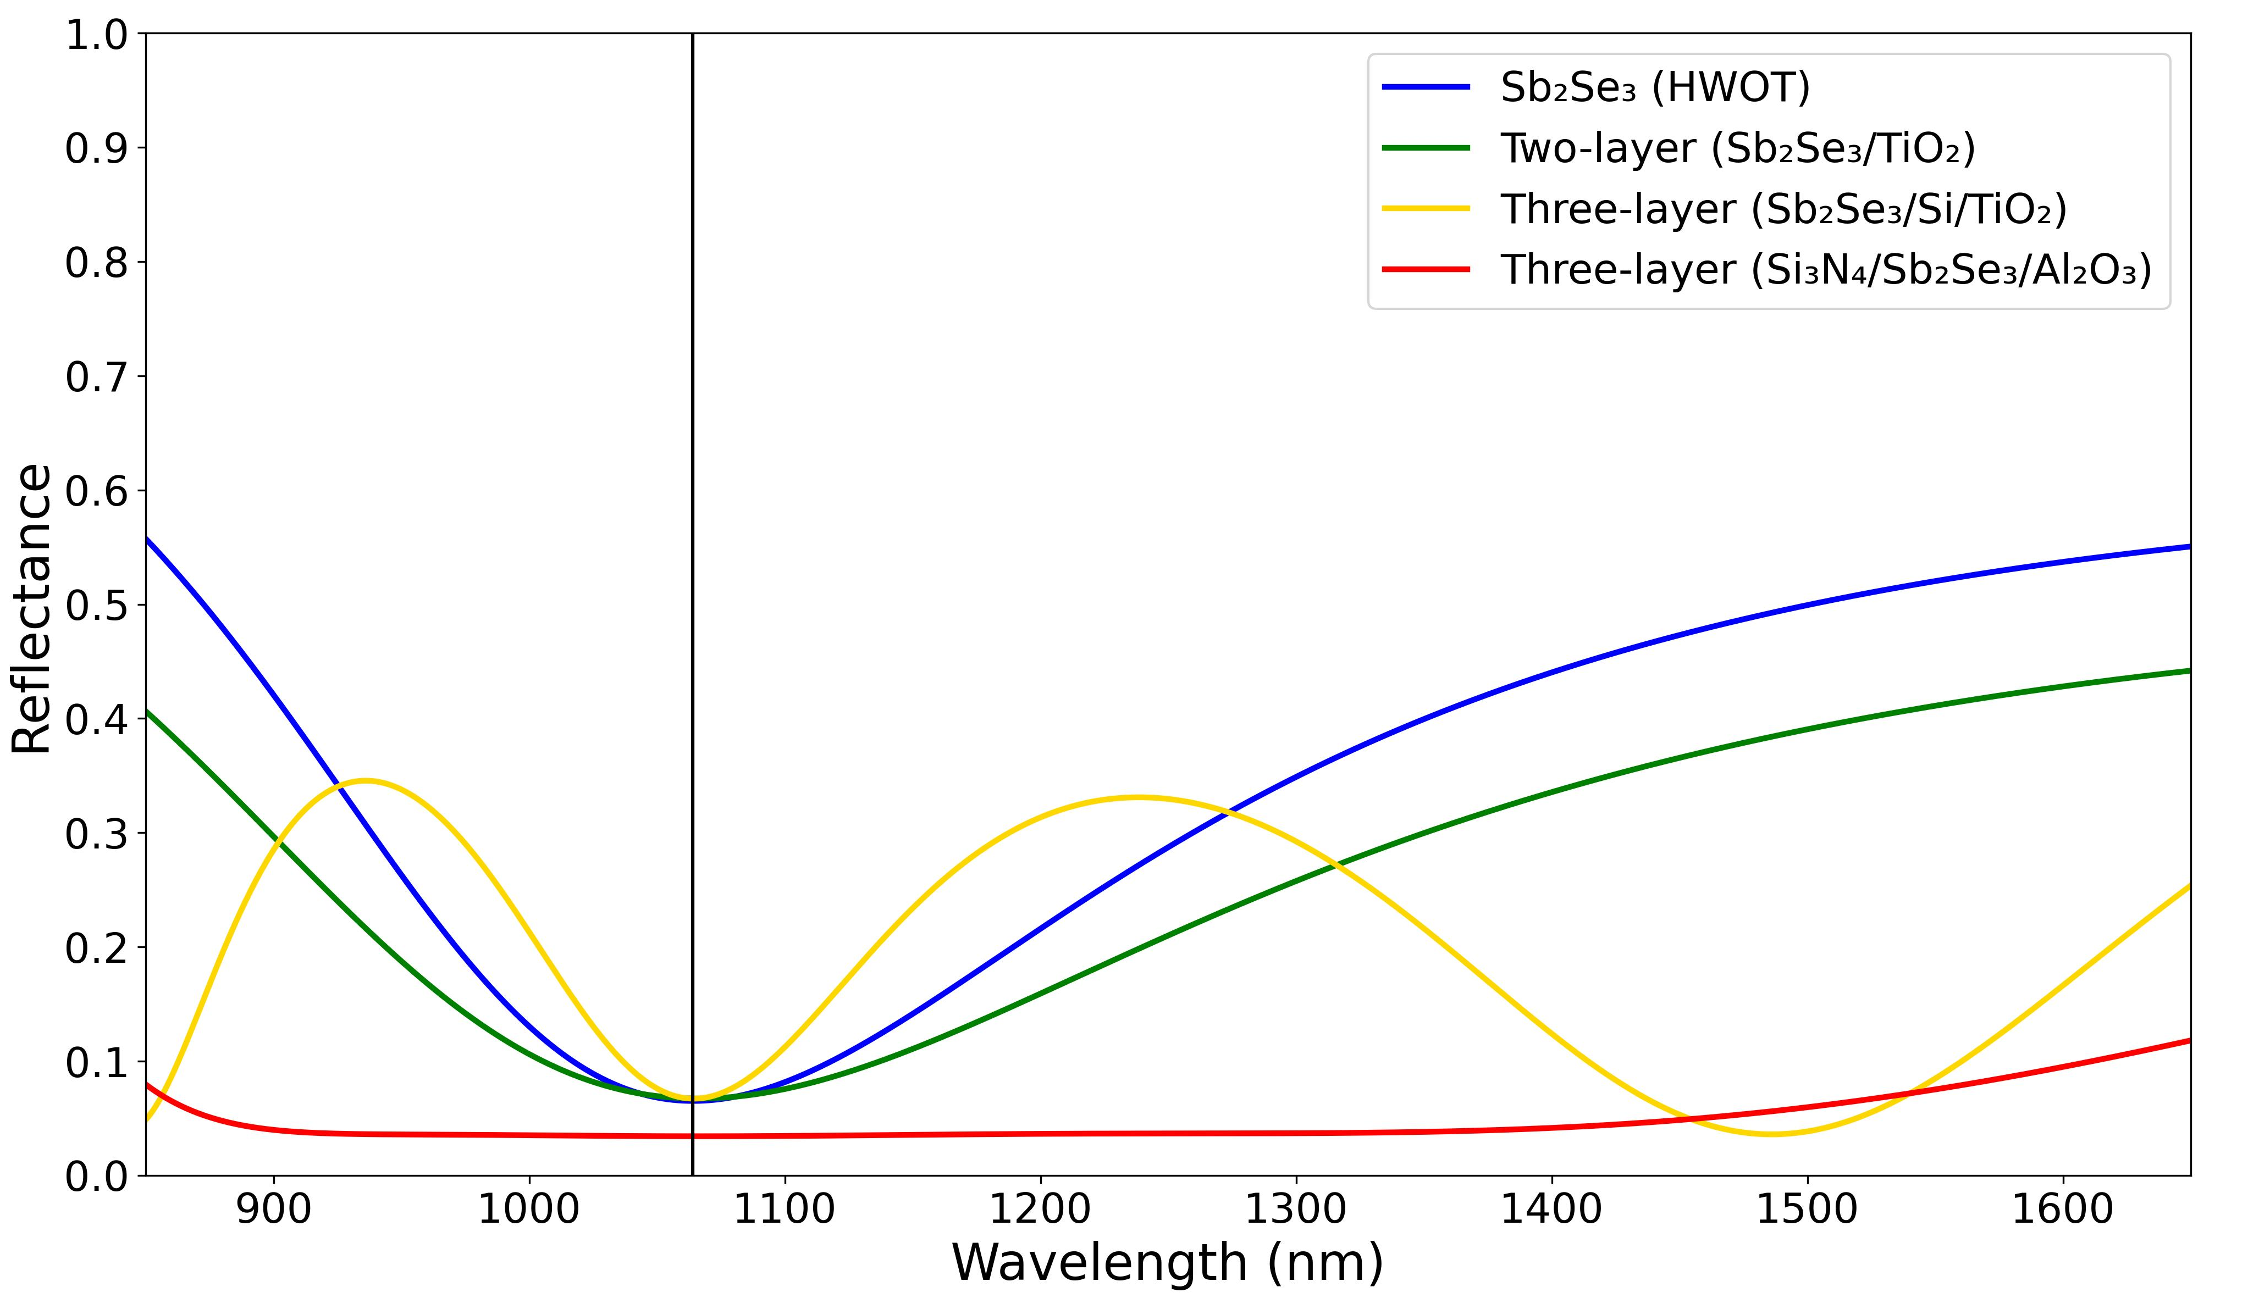

Slide 4
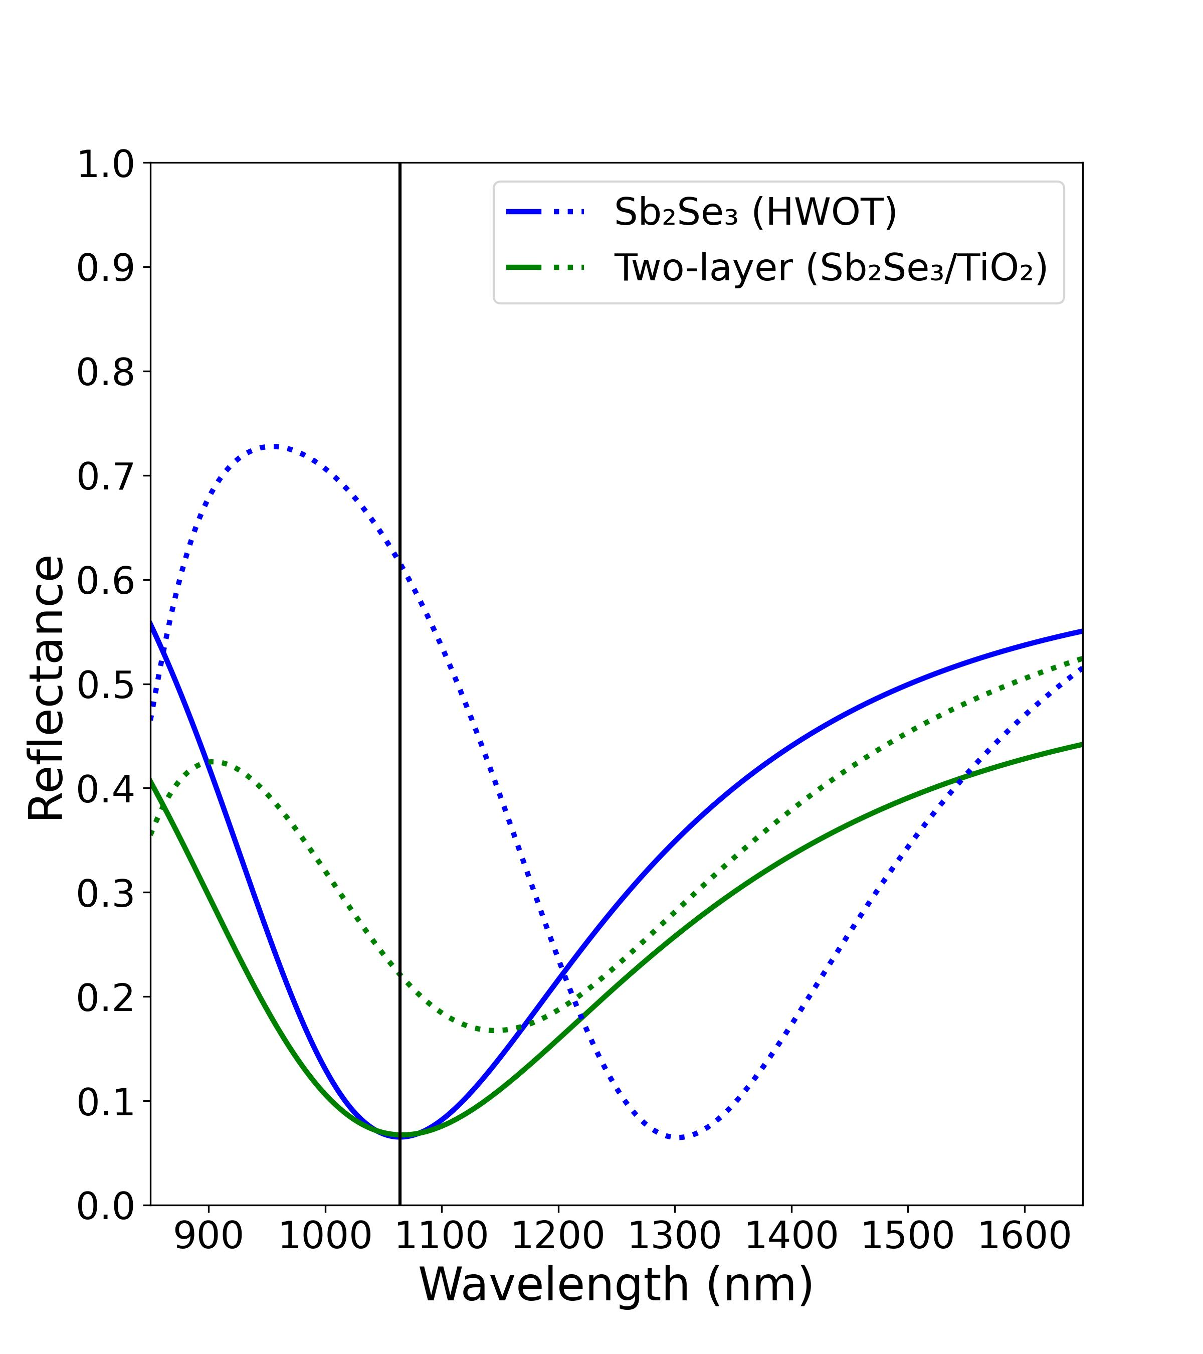
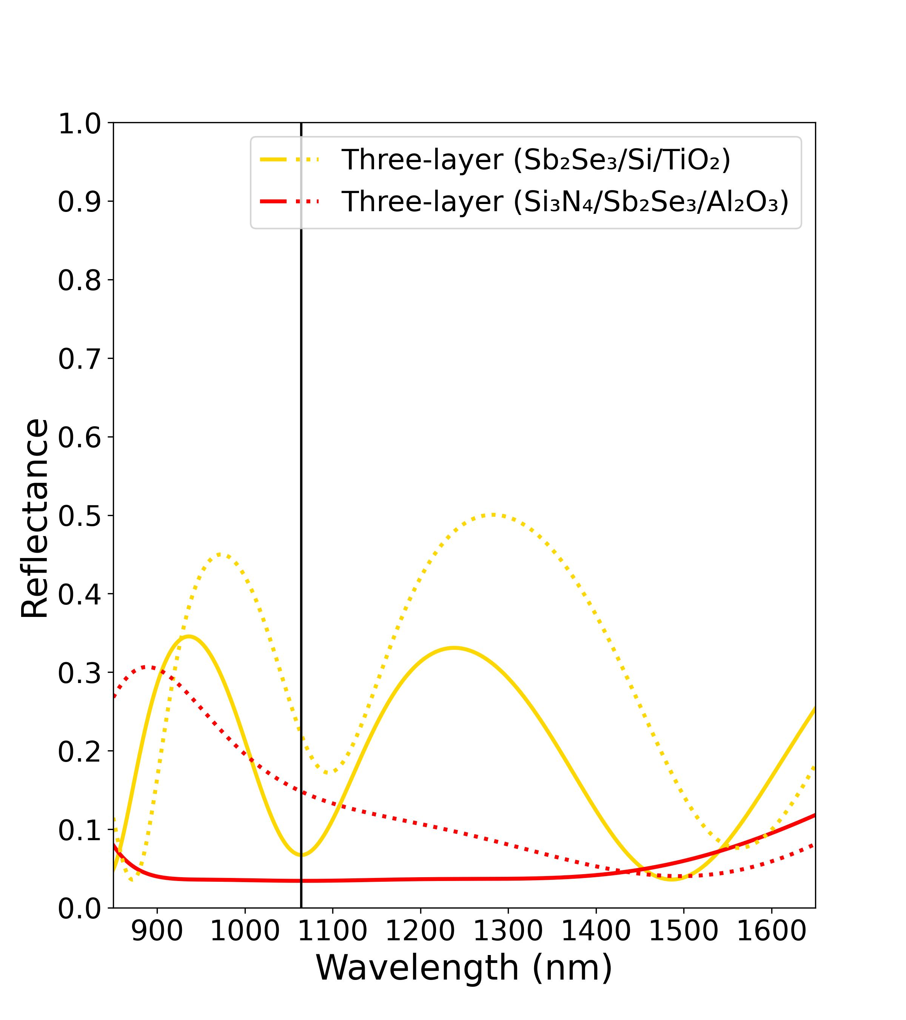
(a)
(b)

Slide 5
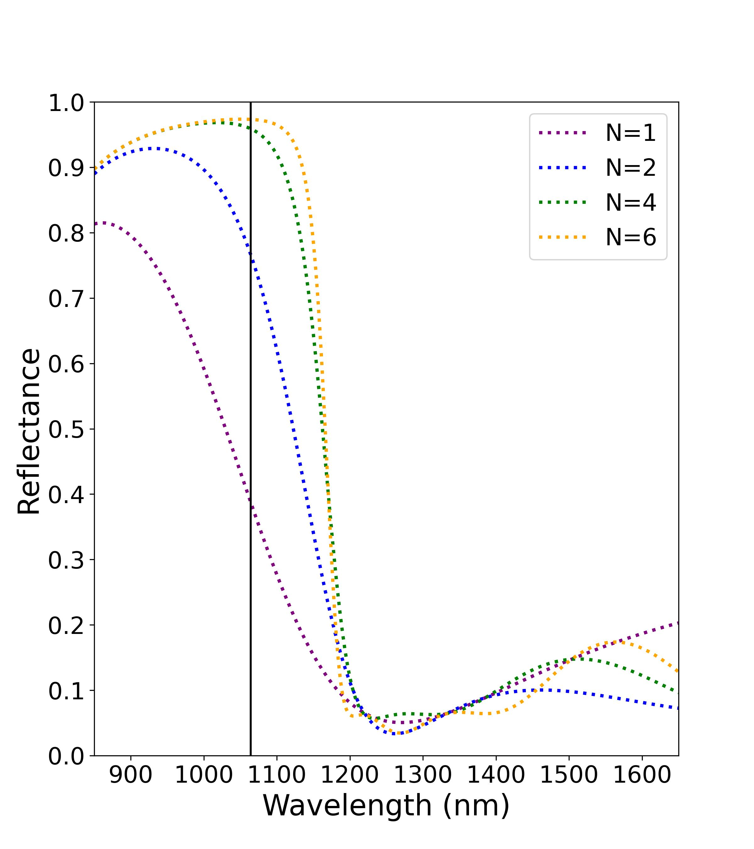
(a) Amorphous phase
(b) Crystalline phase

Slide 6
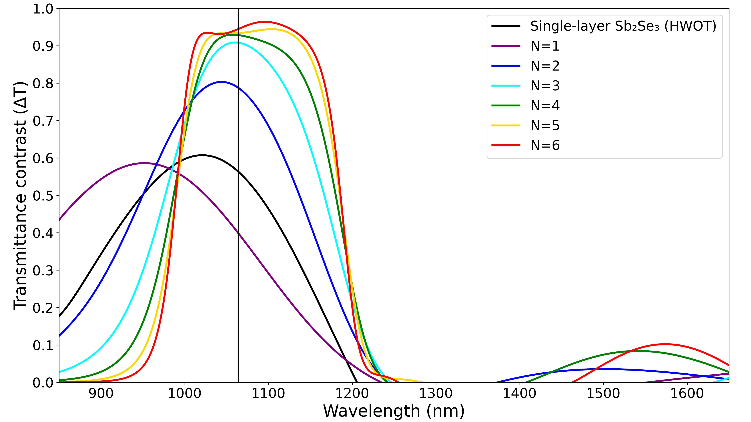

Slide 7
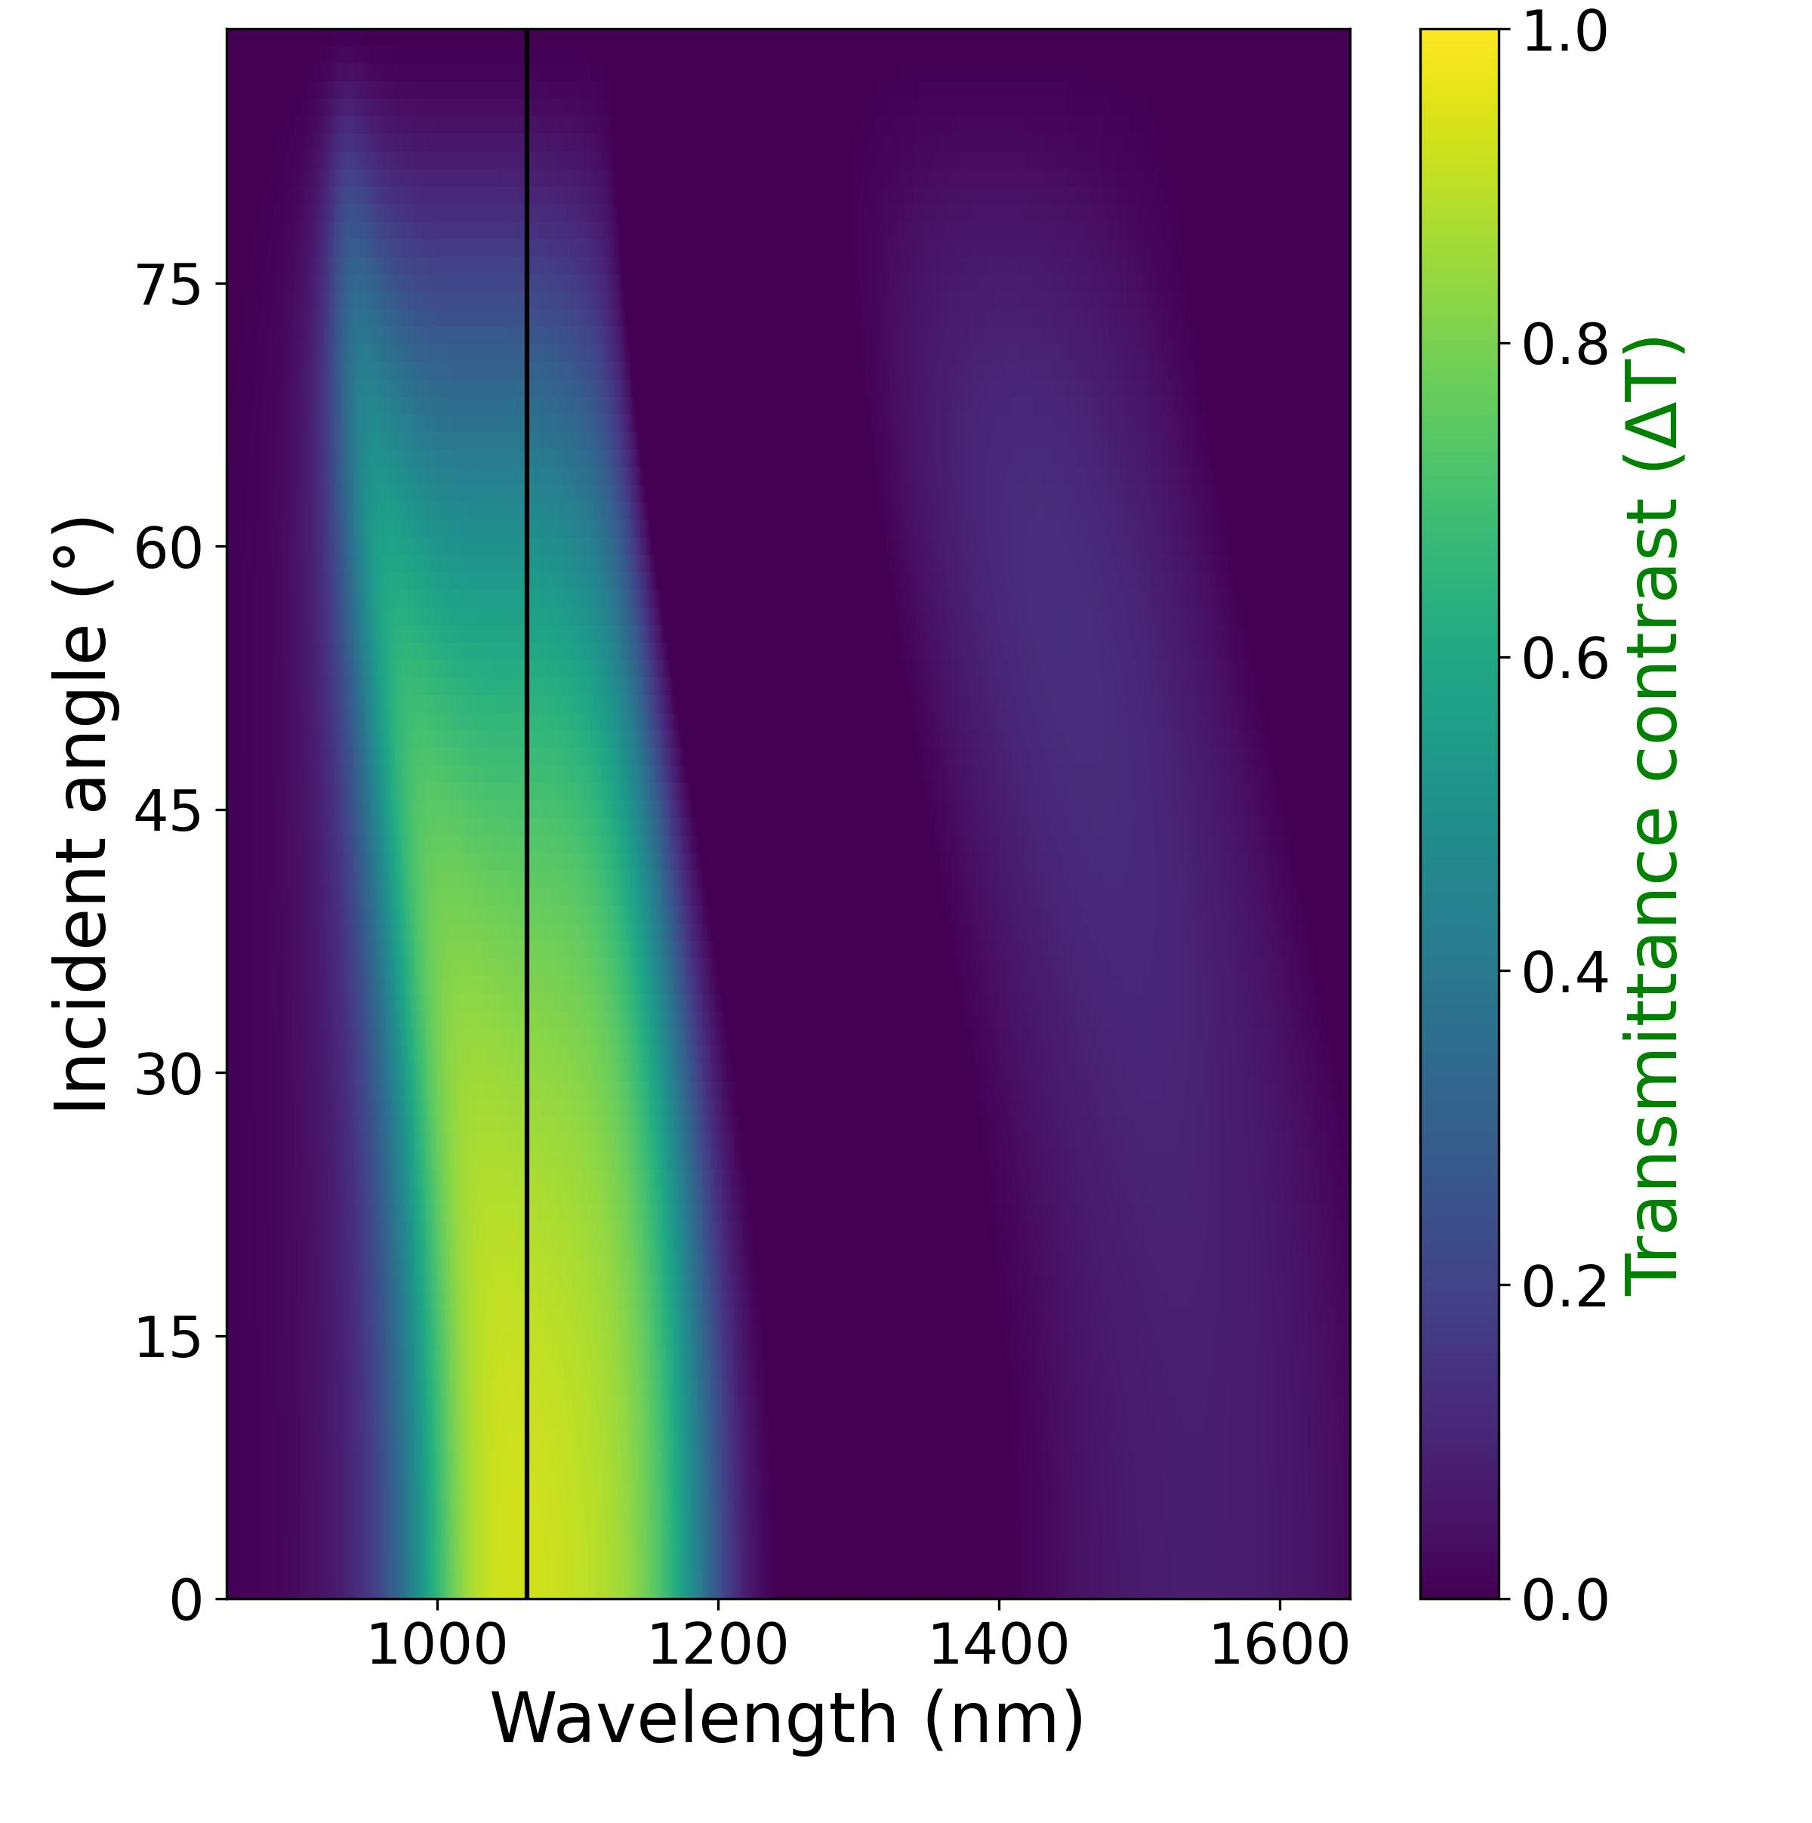
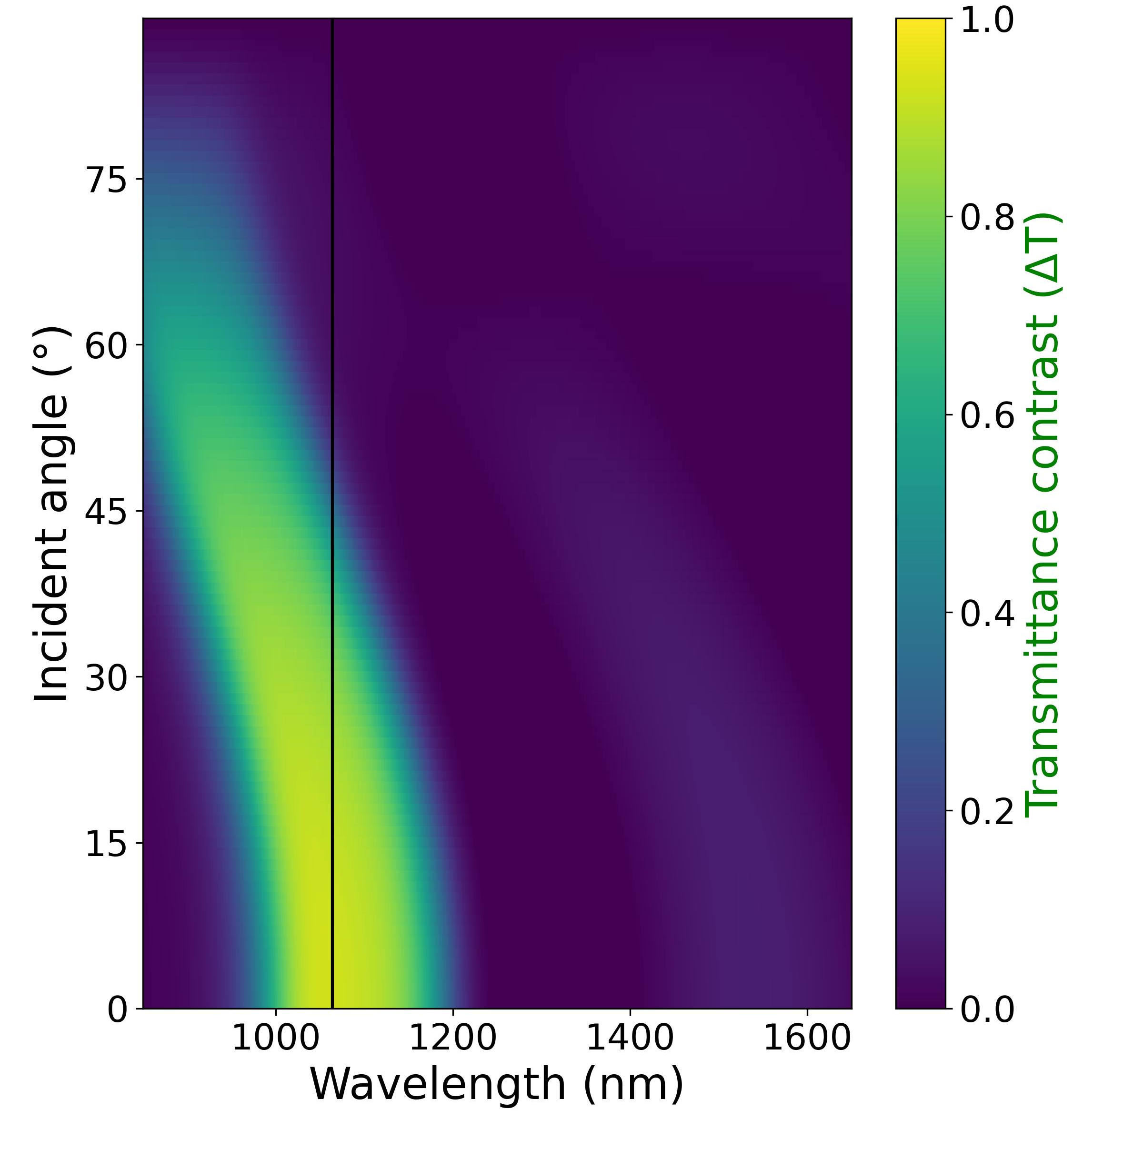
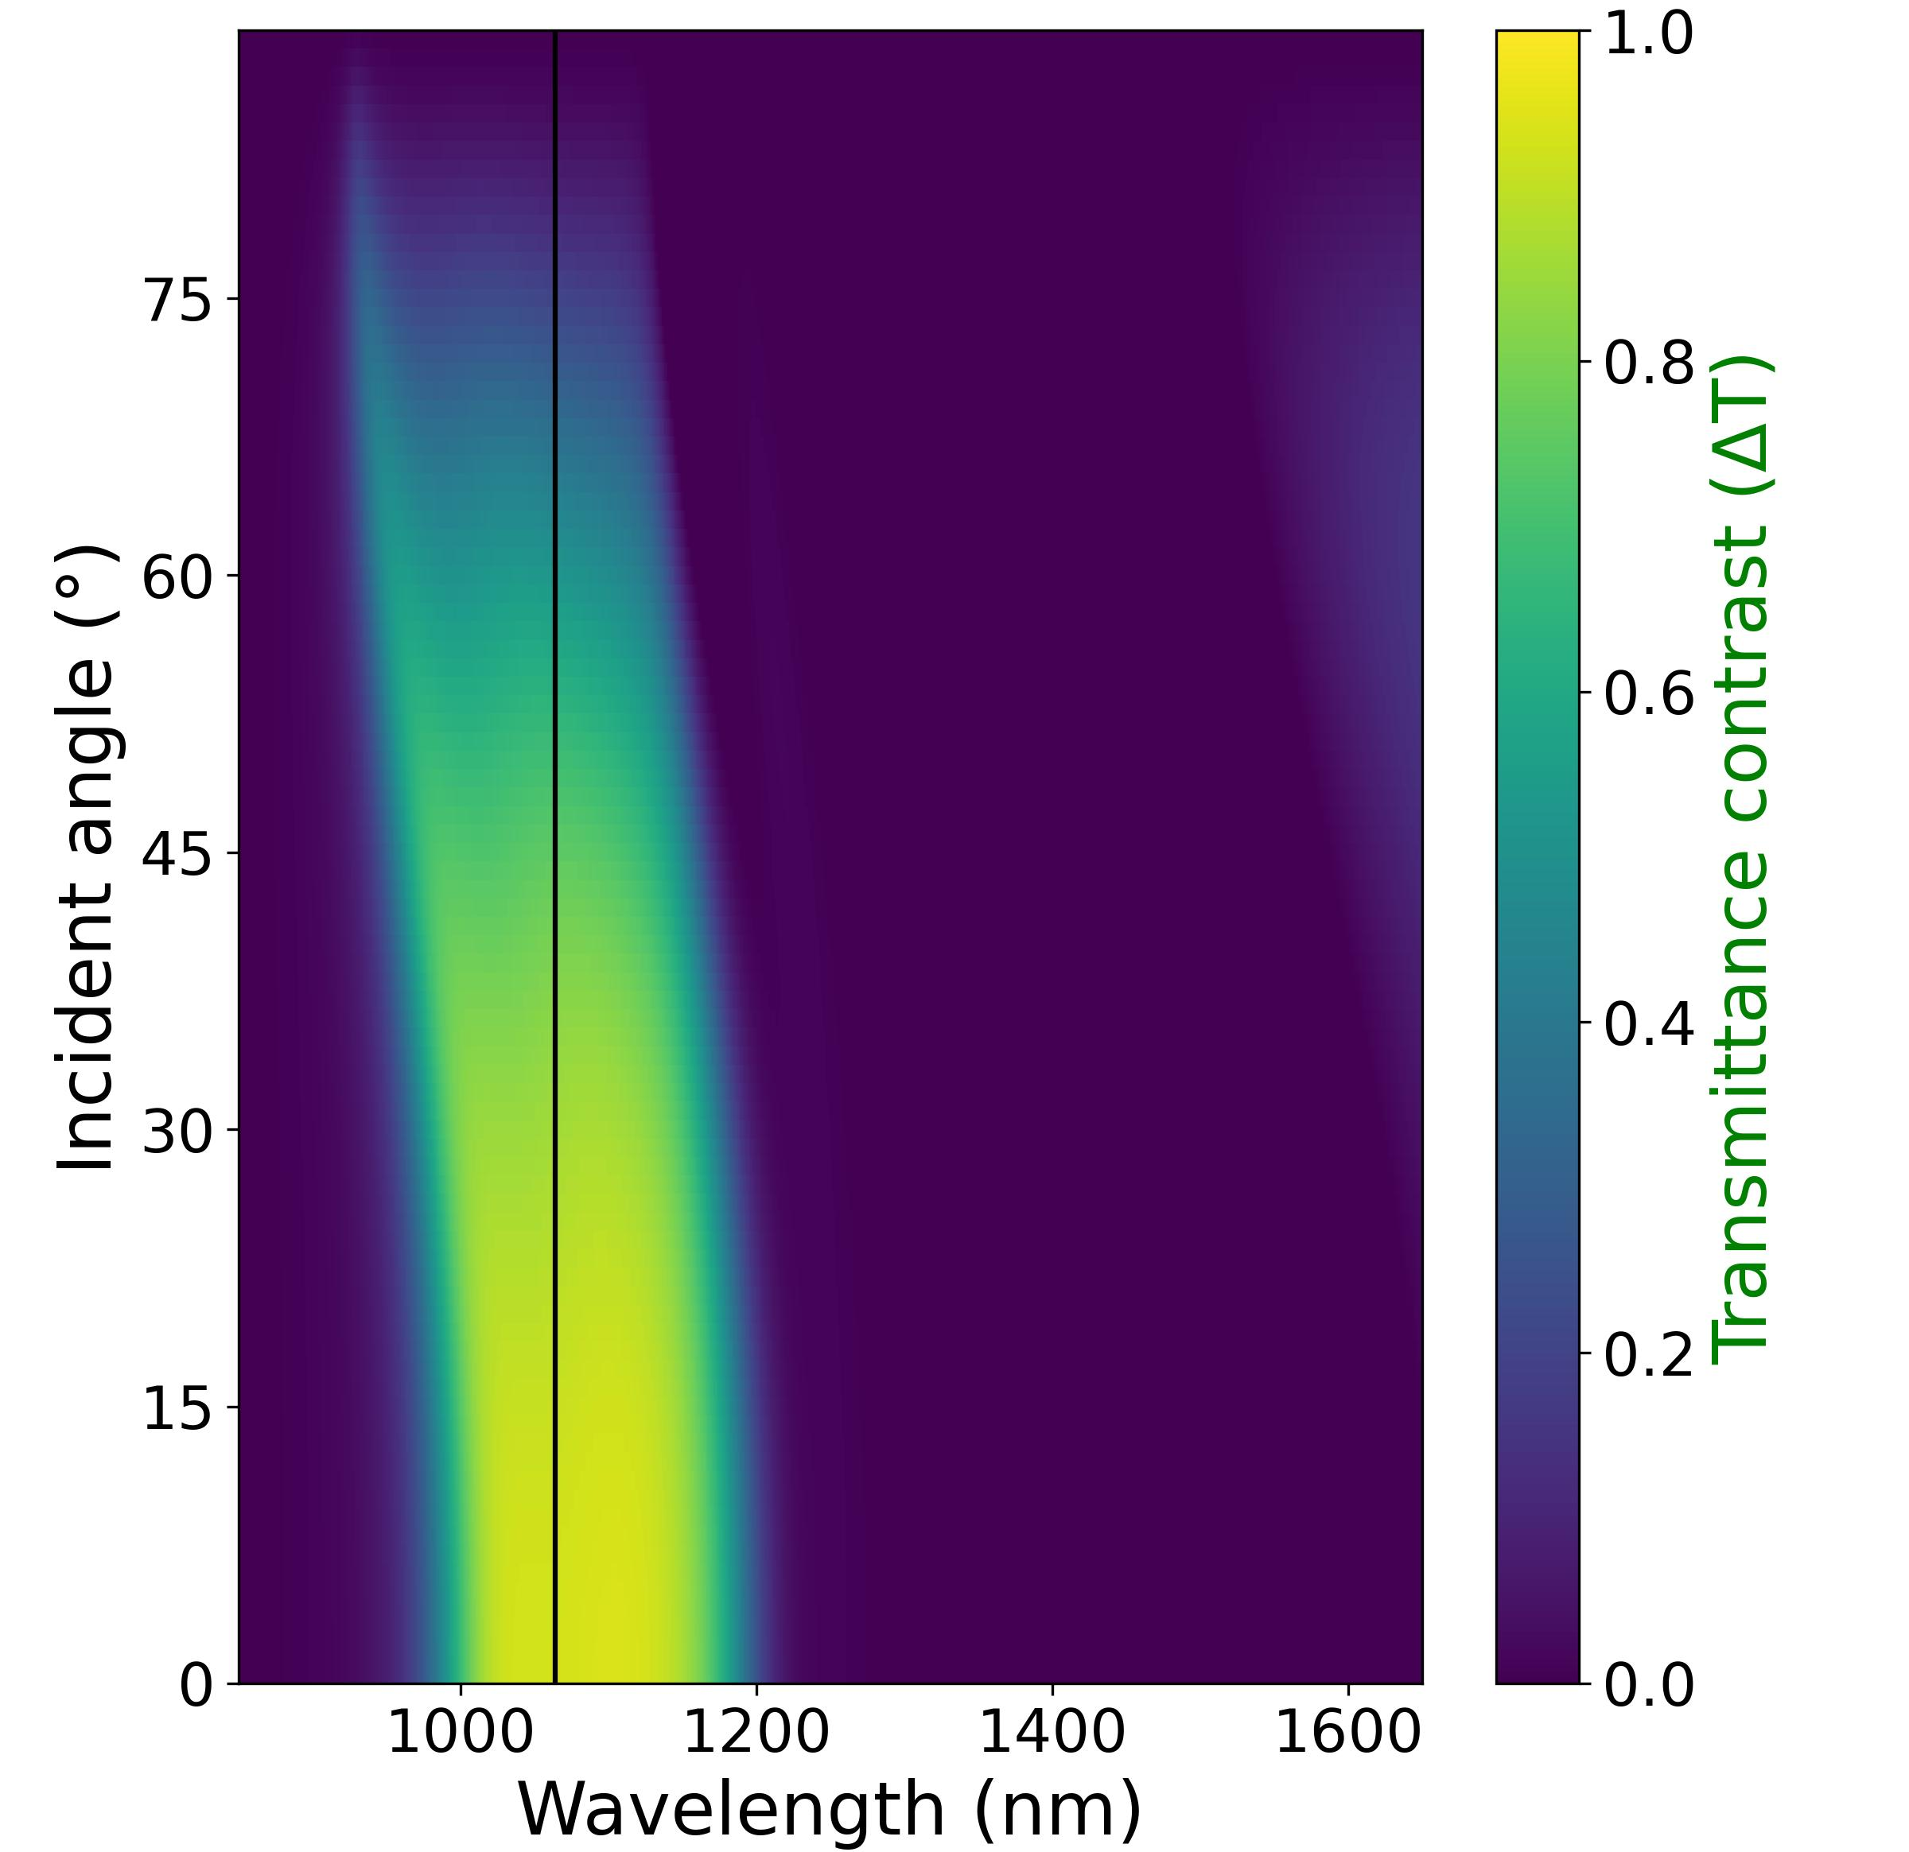
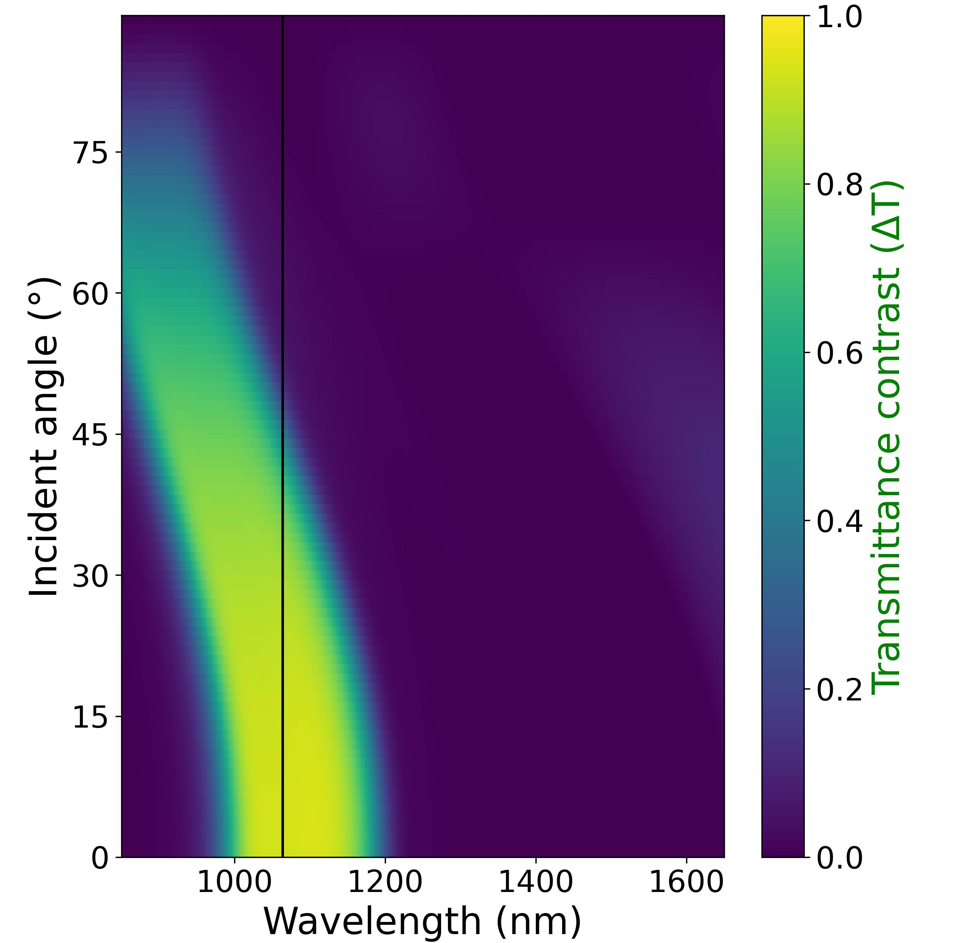
TE
TM
(a)
(b)
4-unit-cell design
(c)
(d)
5-unit-cell design

Slide 8
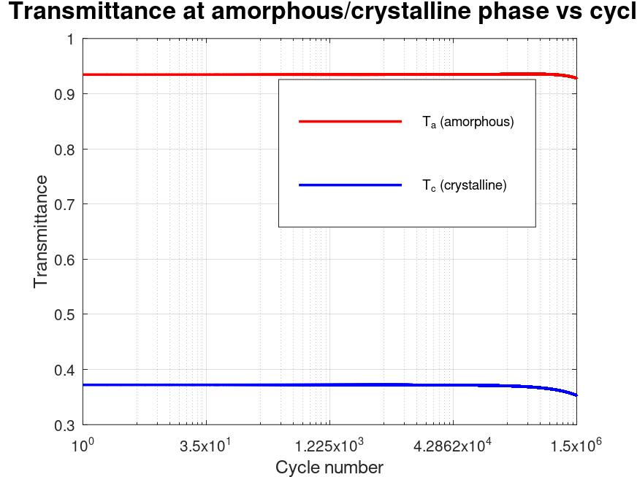
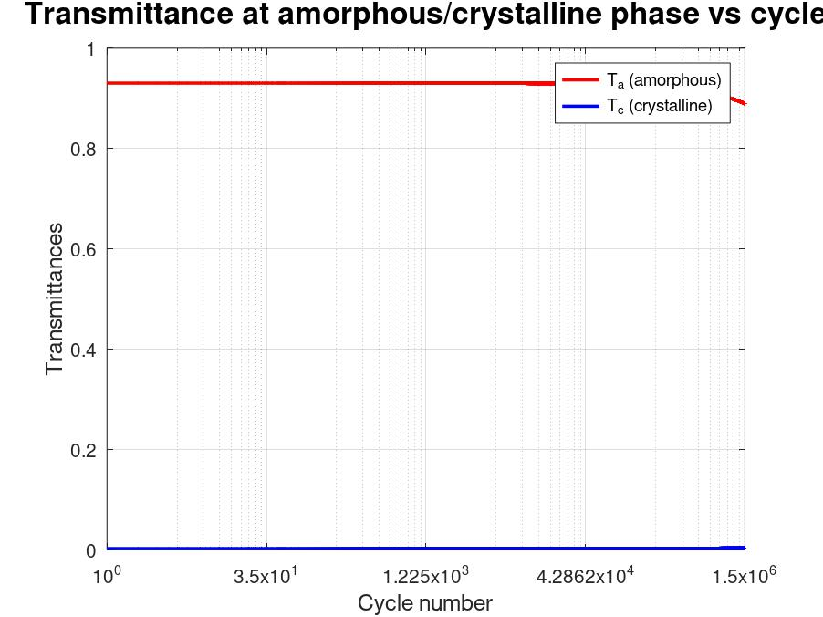
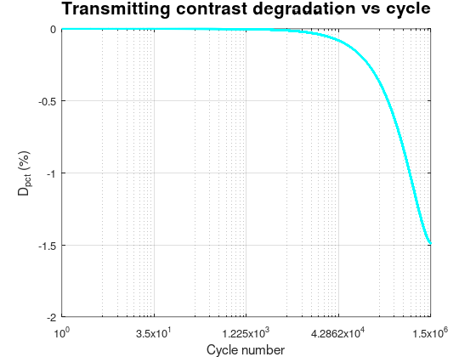
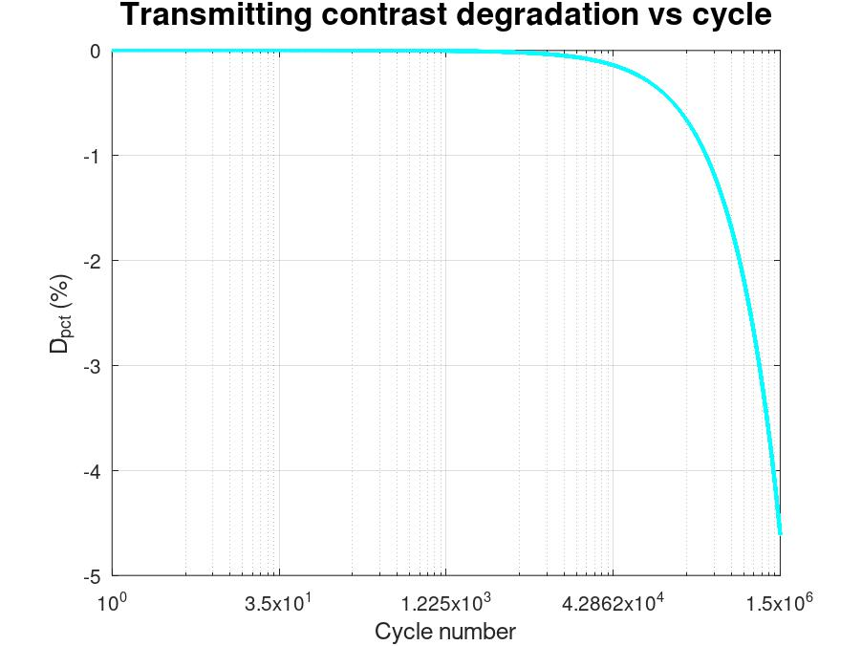
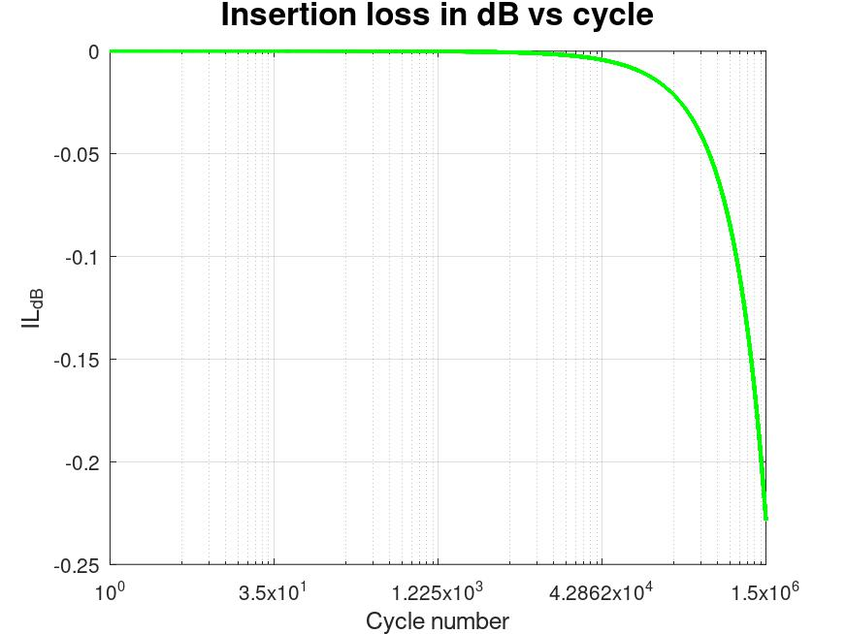
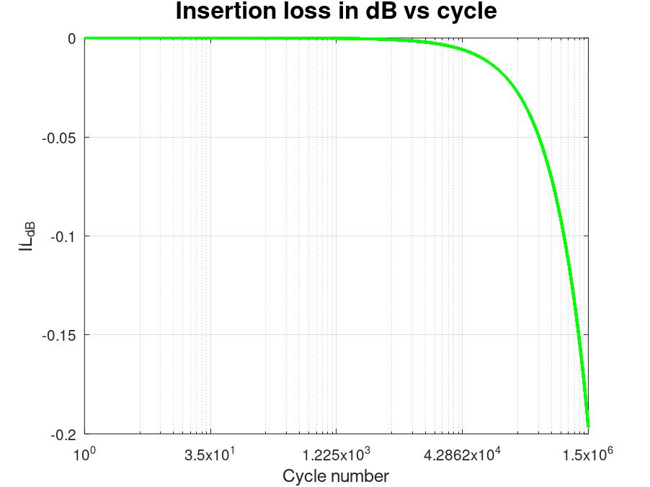

Single-layer design
Edge-filter design $(N=5)$
(a)
(b)
Transmittance
Transmittance
Cycle number
Cycle number
(c)
(d)
D_{pct} (%)
D_{pct} (%)
Cycle number
Cycle number
(e)
(f)
IL (dB)
IL (dB)
Cycle number
Cycle number

Slide 9
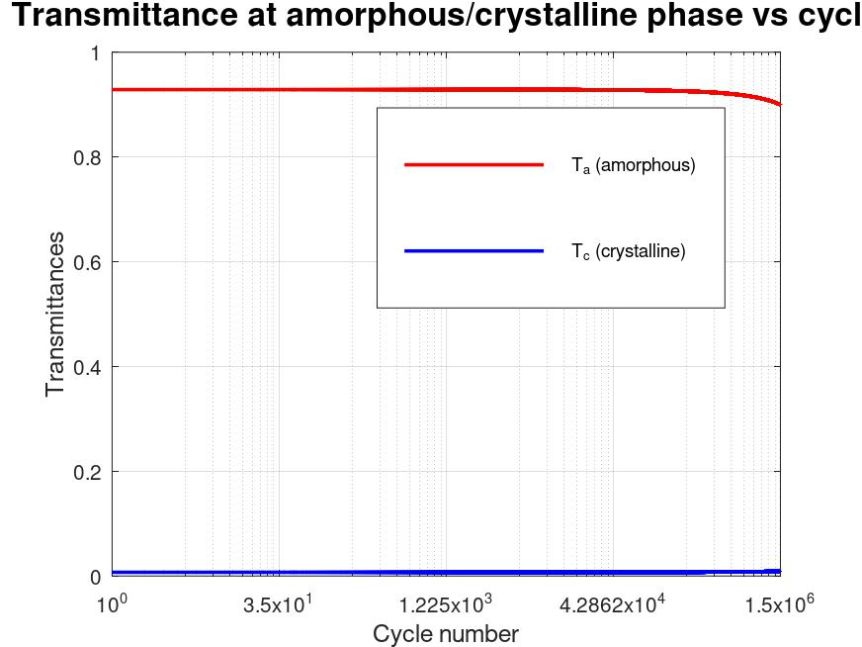
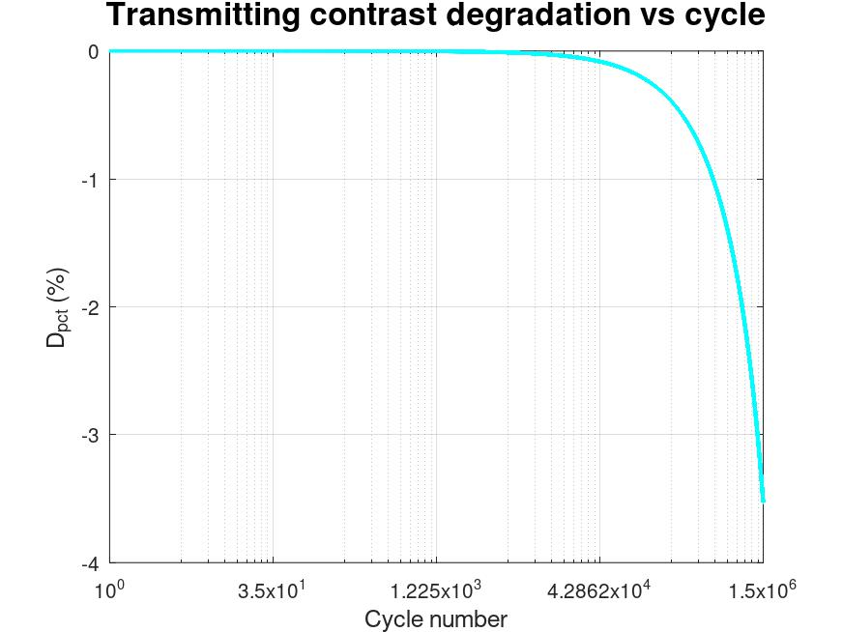
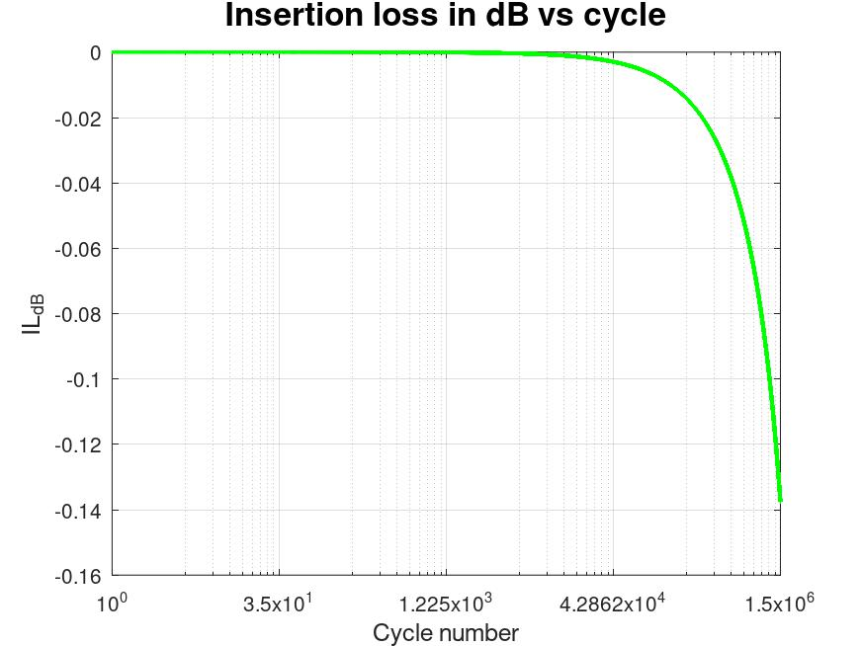


Single-layer design
Edge-filter design $(N=4)$
Edge-filter design $(N=5)$
(a)
(b)
(c)
Transmittance
Transmittance
Transmittance
Cycle number
Cycle number
Cycle number
(d)
(e)
(f)
D_{pct} (%)
D_{pct} (%)
D_{pct} (%)
Cycle number
Cycle number
Cycle number
(g)
(h)
(i)
IL (dB)
IL (dB)
IL (dB)
Cycle number
Cycle number
Cycle number

Slide 10
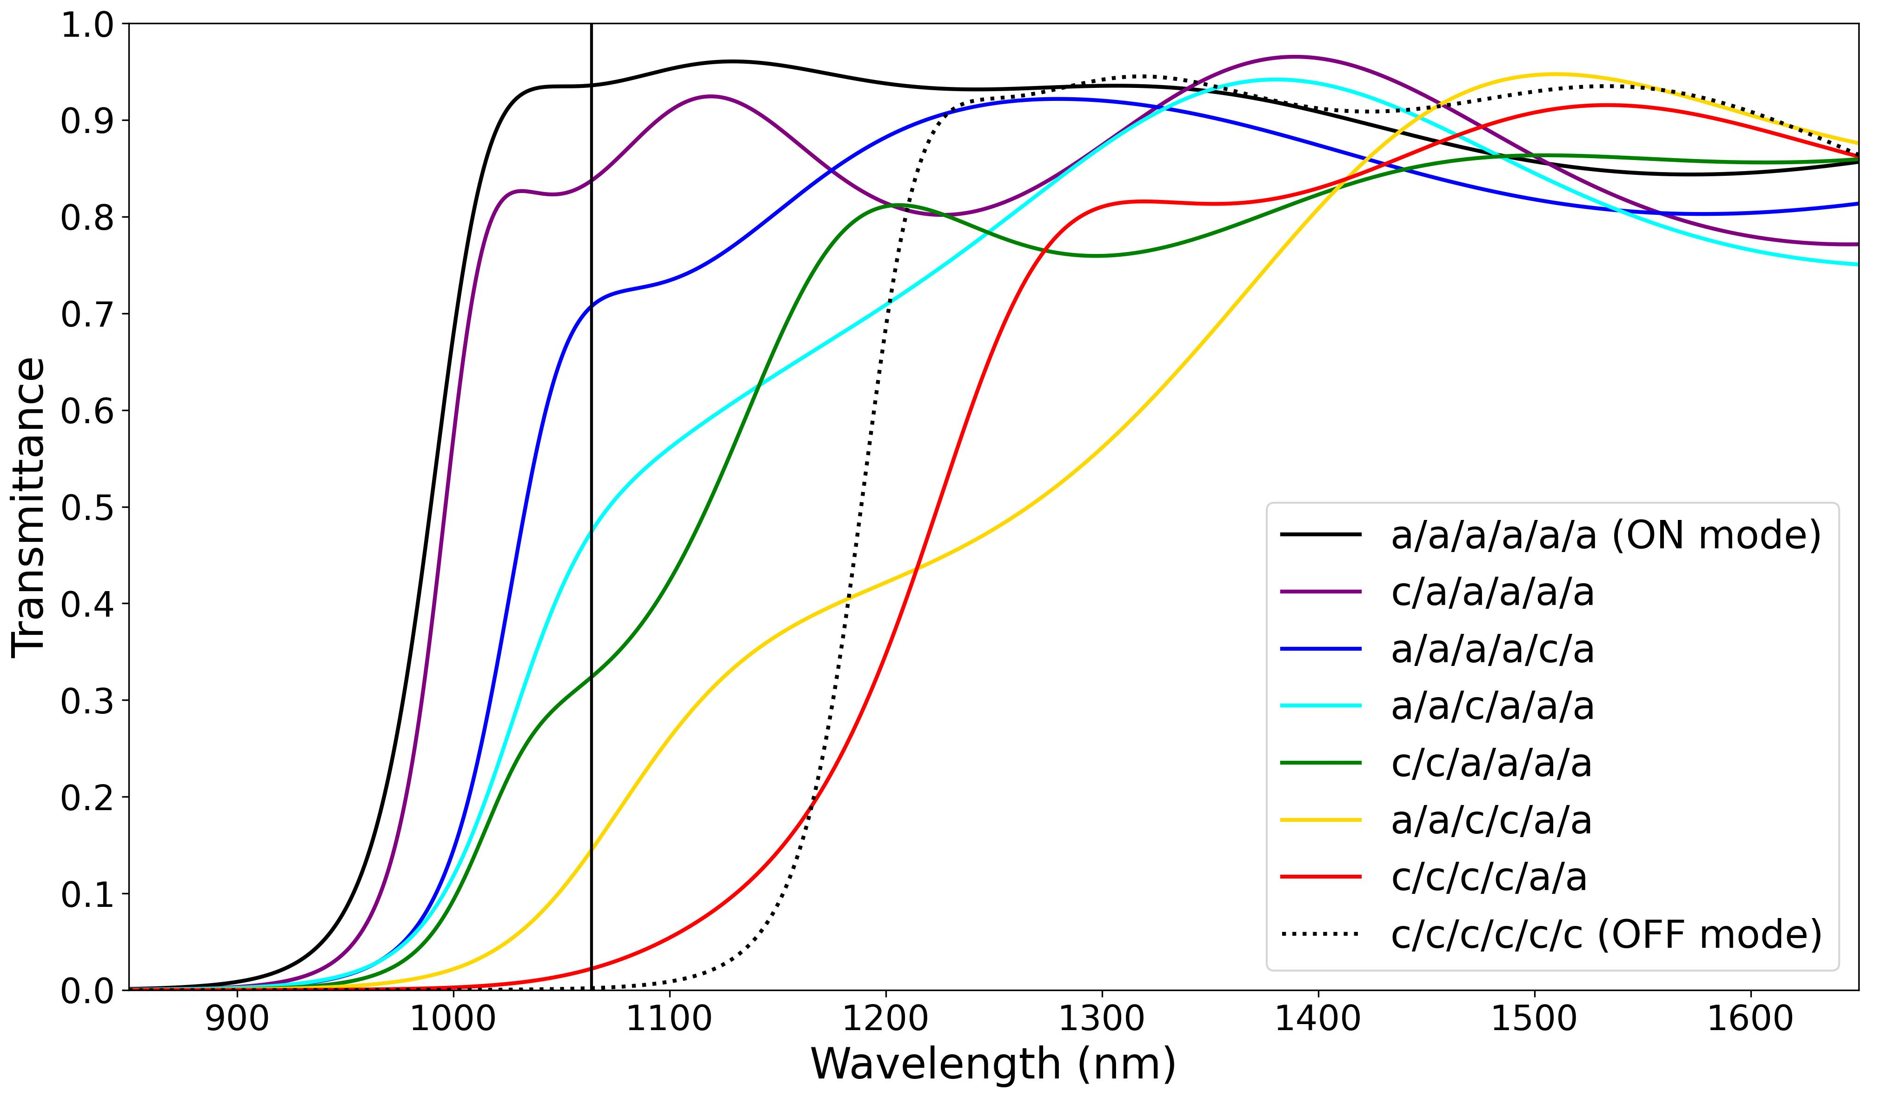

Slide 11
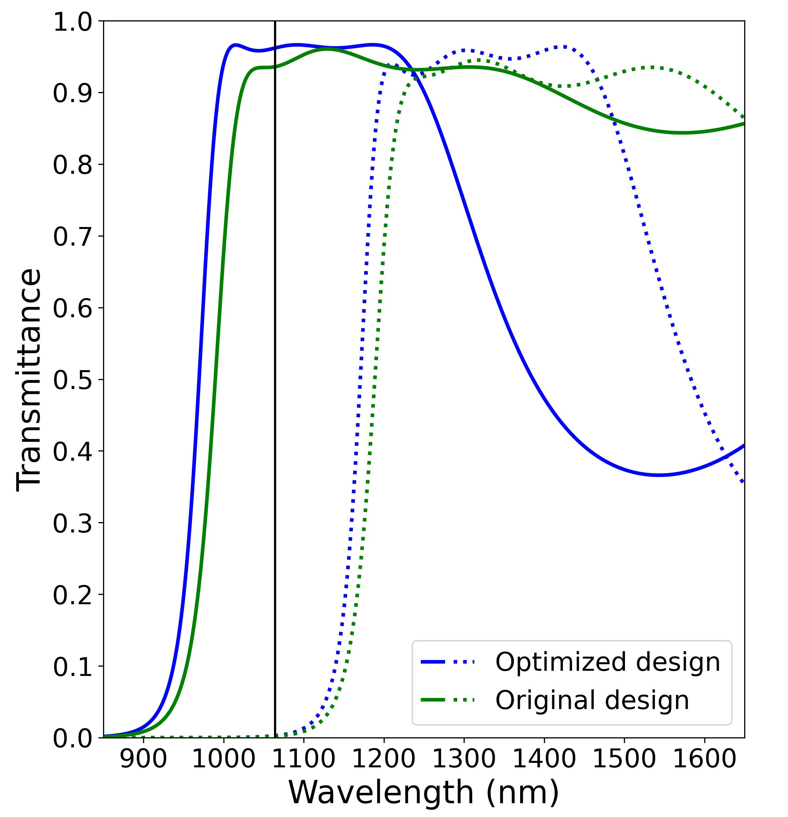
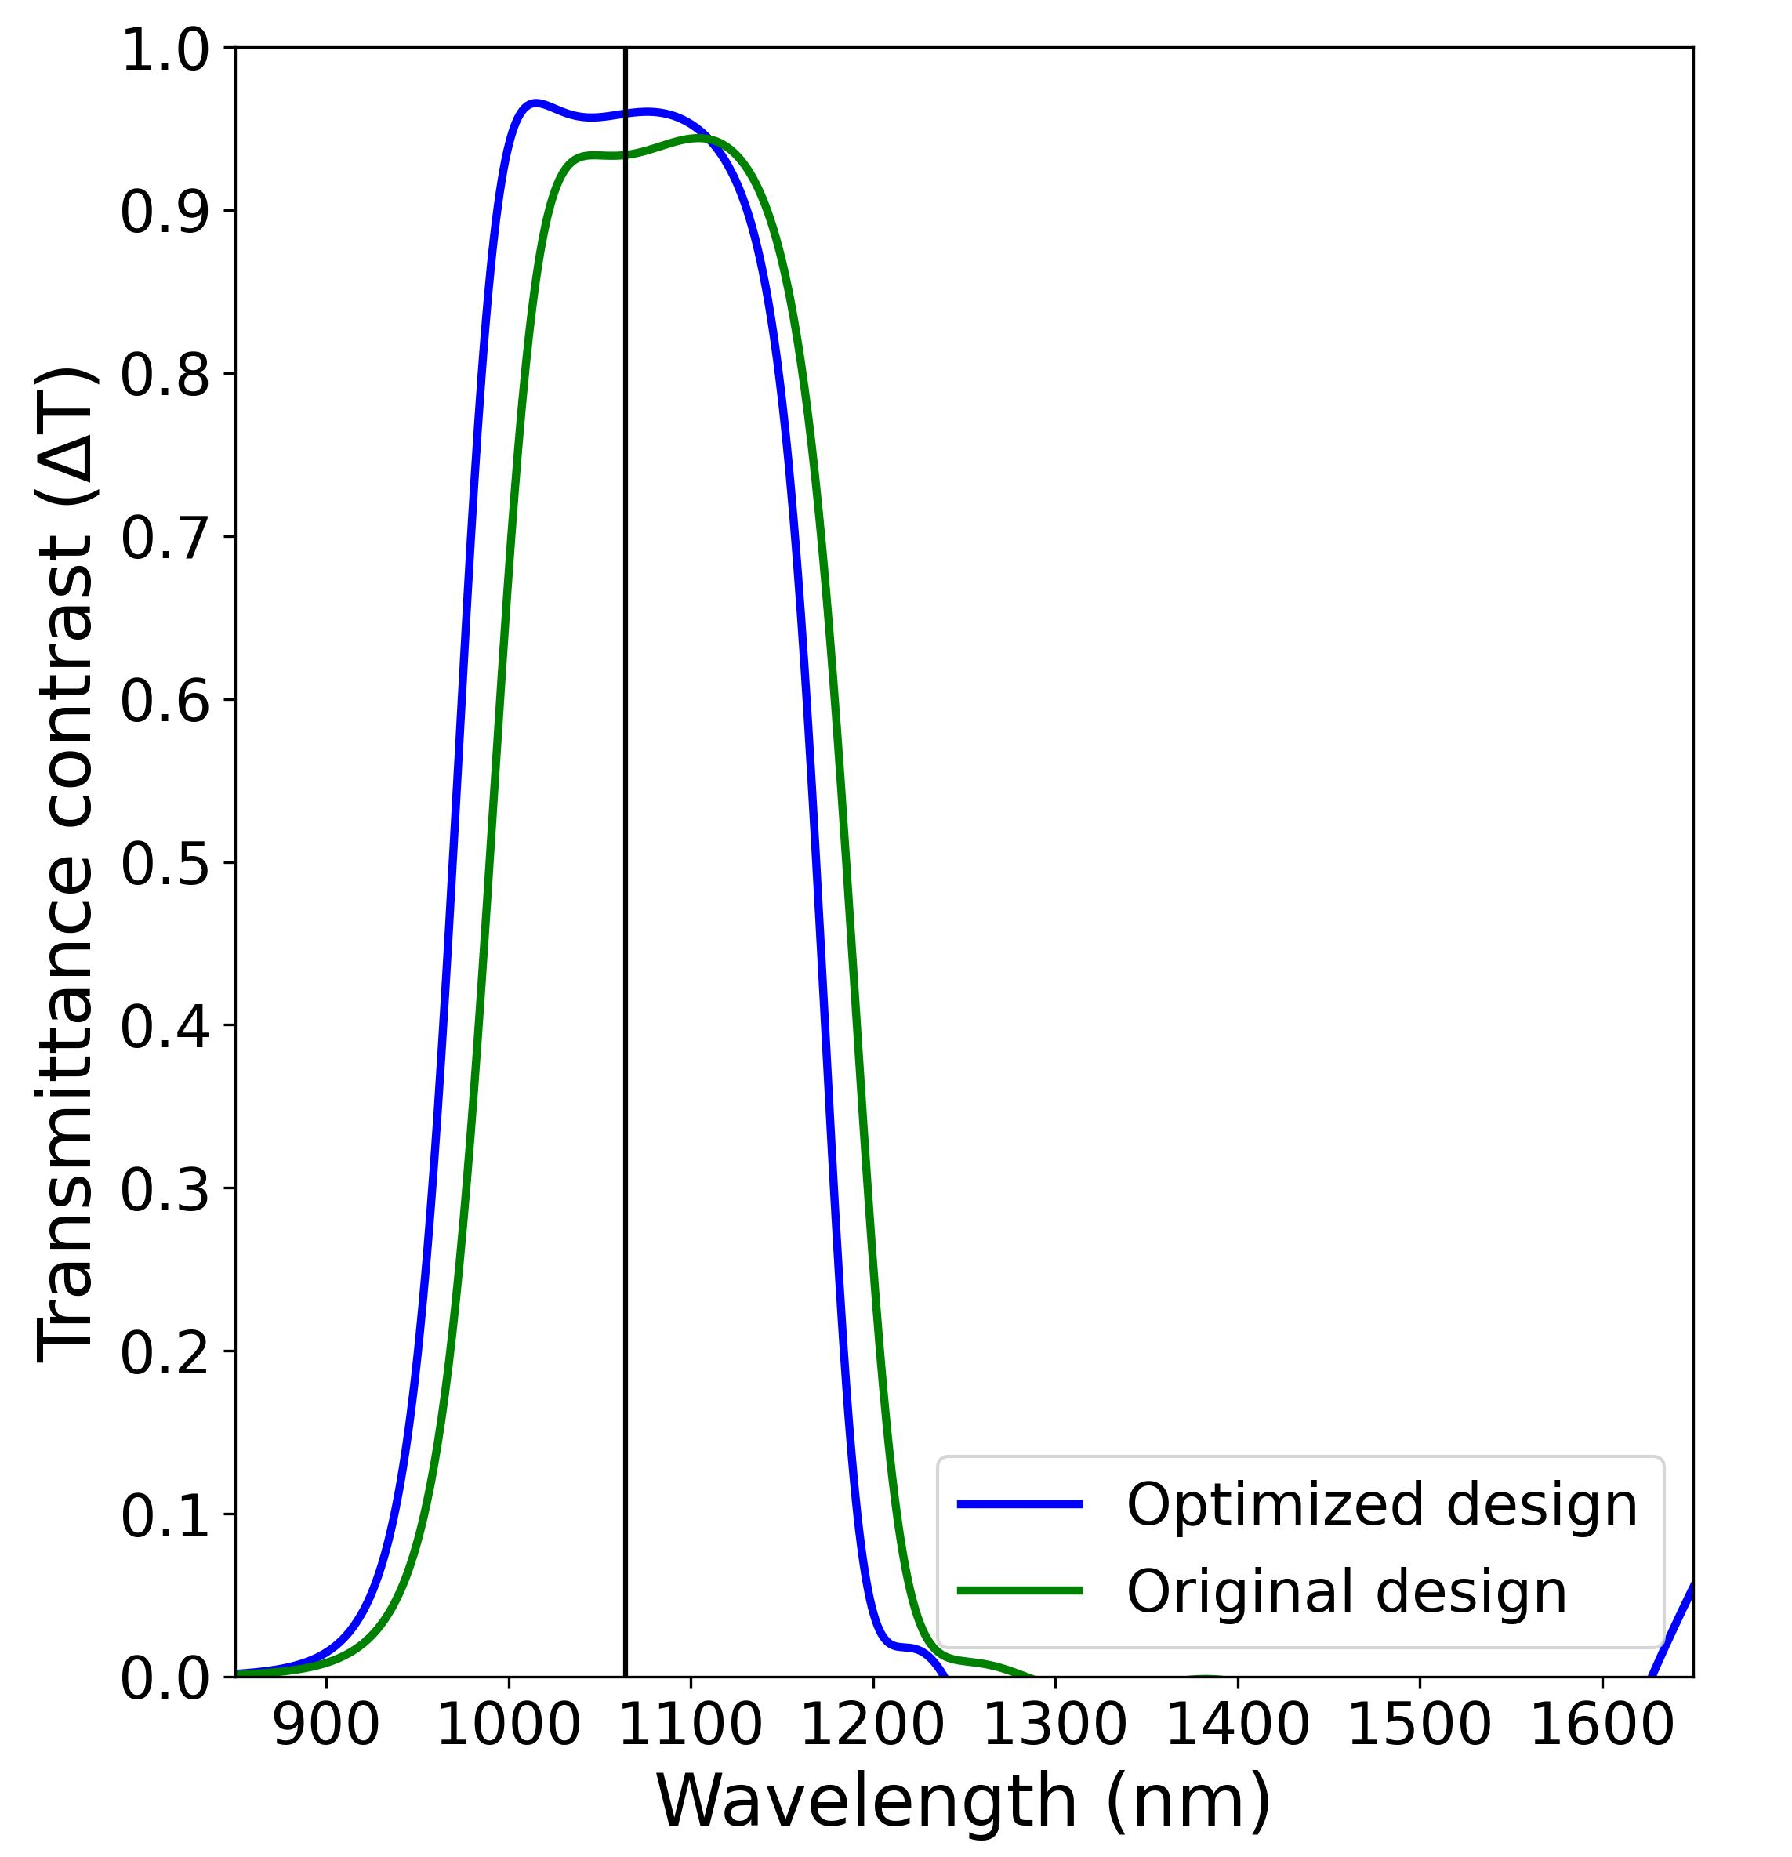
(a)
(b)

Slide 12
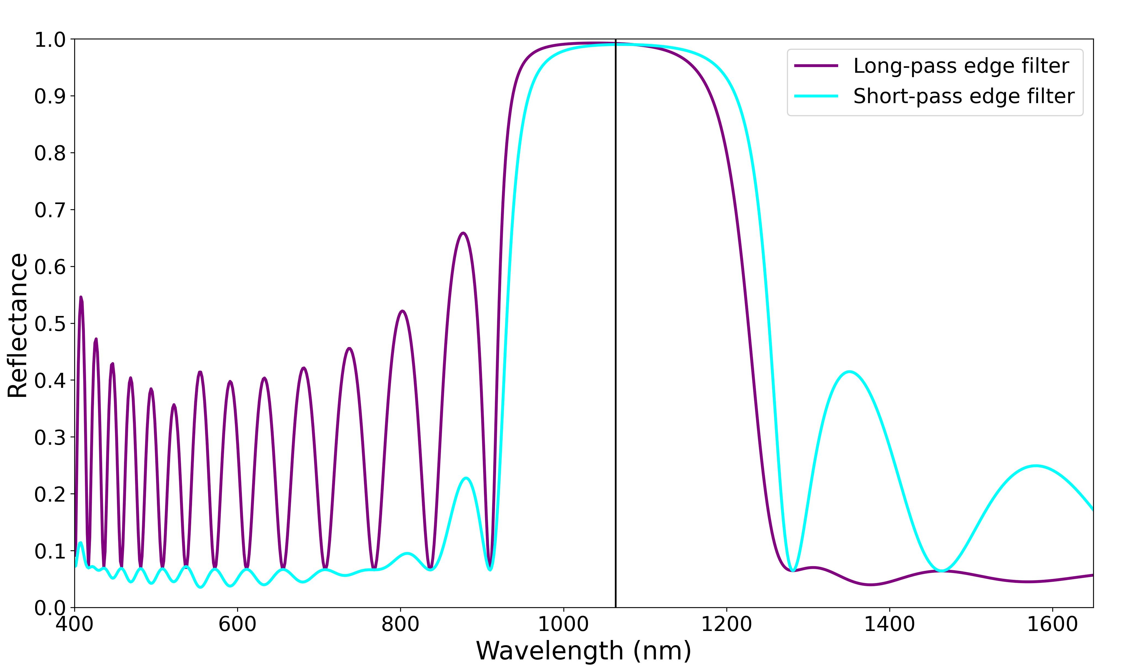
High reflection region
Stable AR-region
Stable AR-region

Slide 13
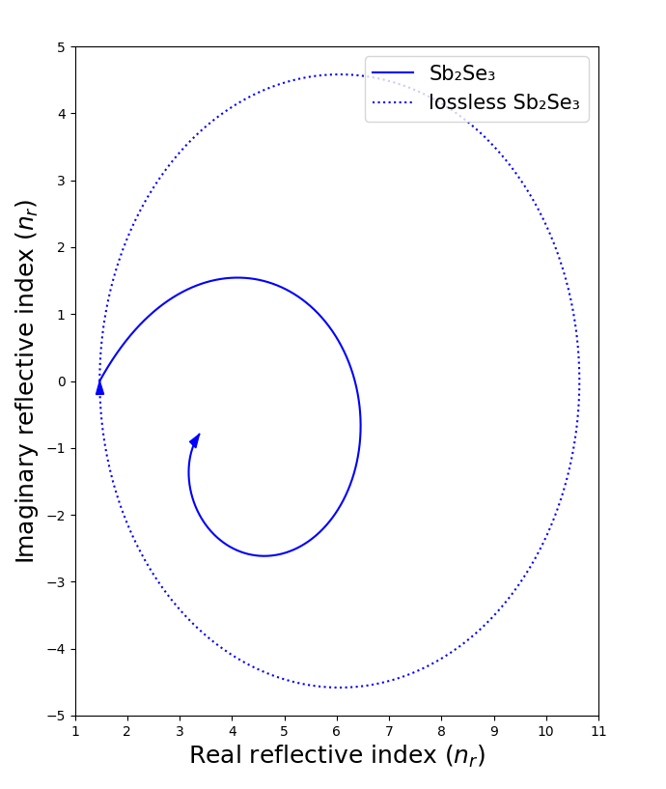
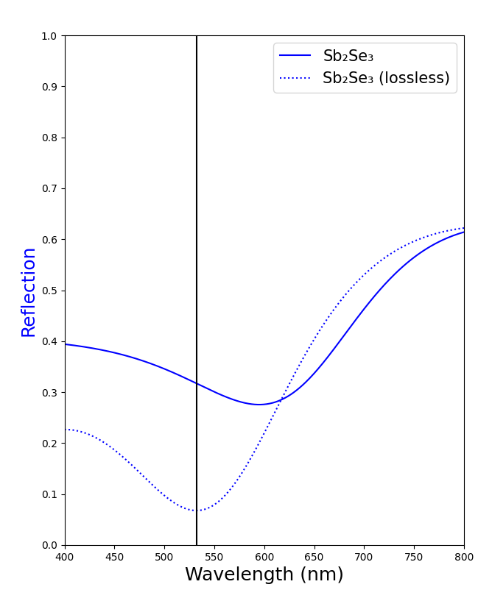
(a)
(b)

Slide 14
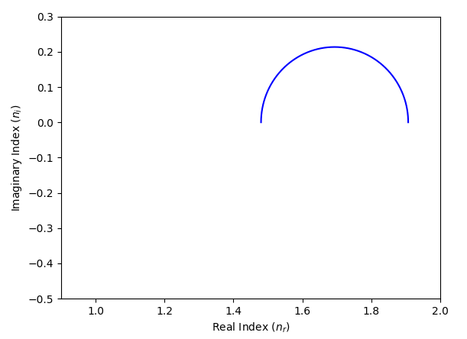
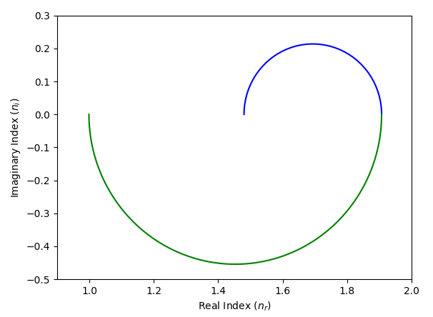
(a)
(b)
n_{r}=n_{a}=1.0
n_{s}=1.5

Slide 15
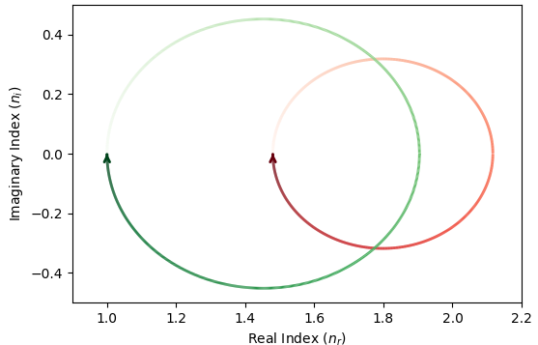

Slide 16
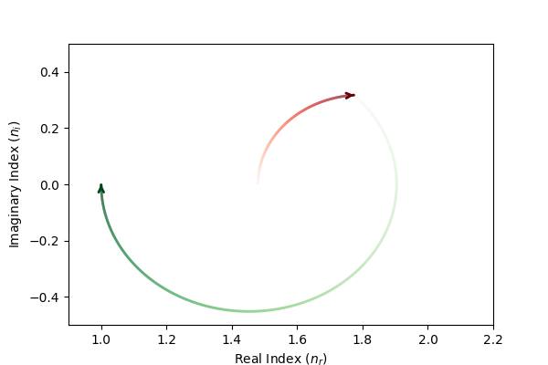
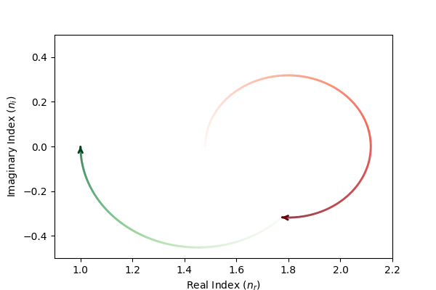
(a)
θ = 0.53 QWOT
(b)
θ = 1.18 QWOT
θ = 0.82 QWOT
θ = 1.47 QWOT

Slide 17
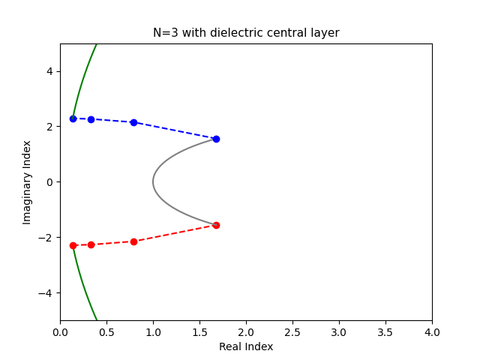
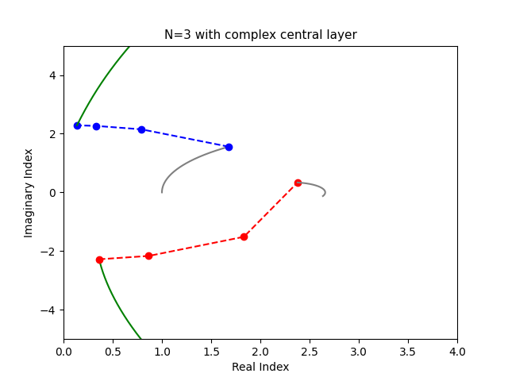
(a)
(b)

Slide 18
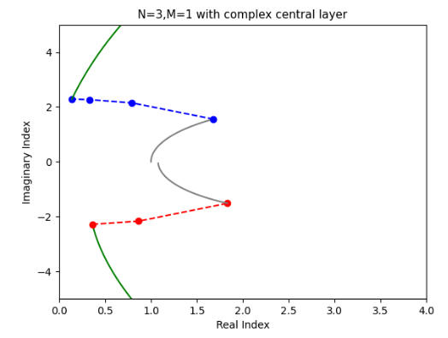

Slide 19

Compensator layer

Slide 20
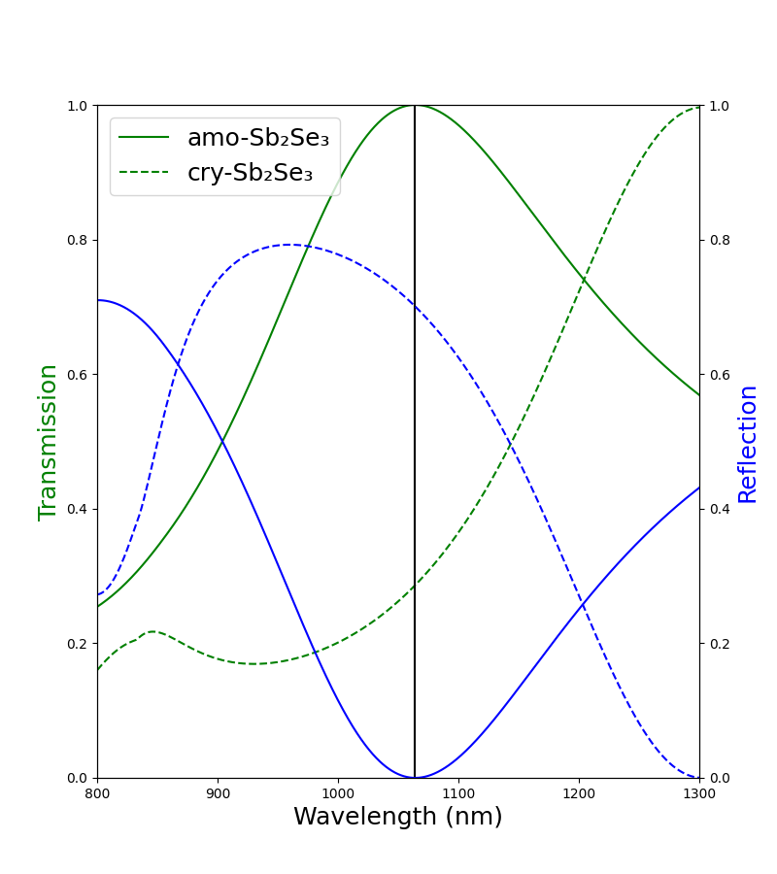
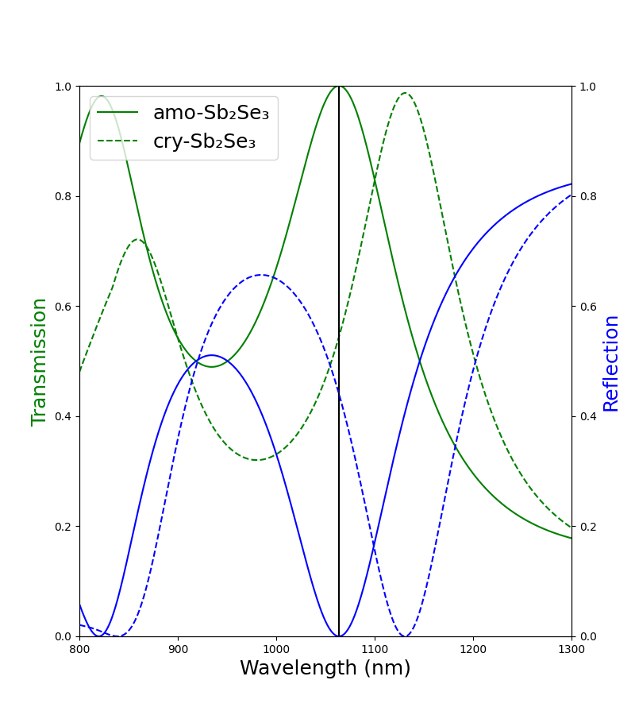
(a)
(b)

Slide 21
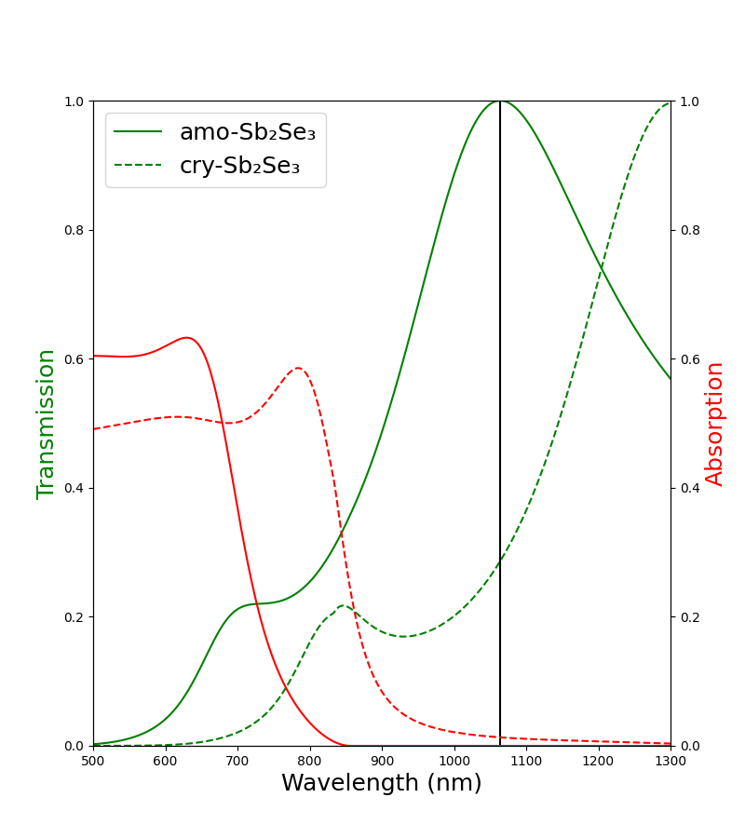
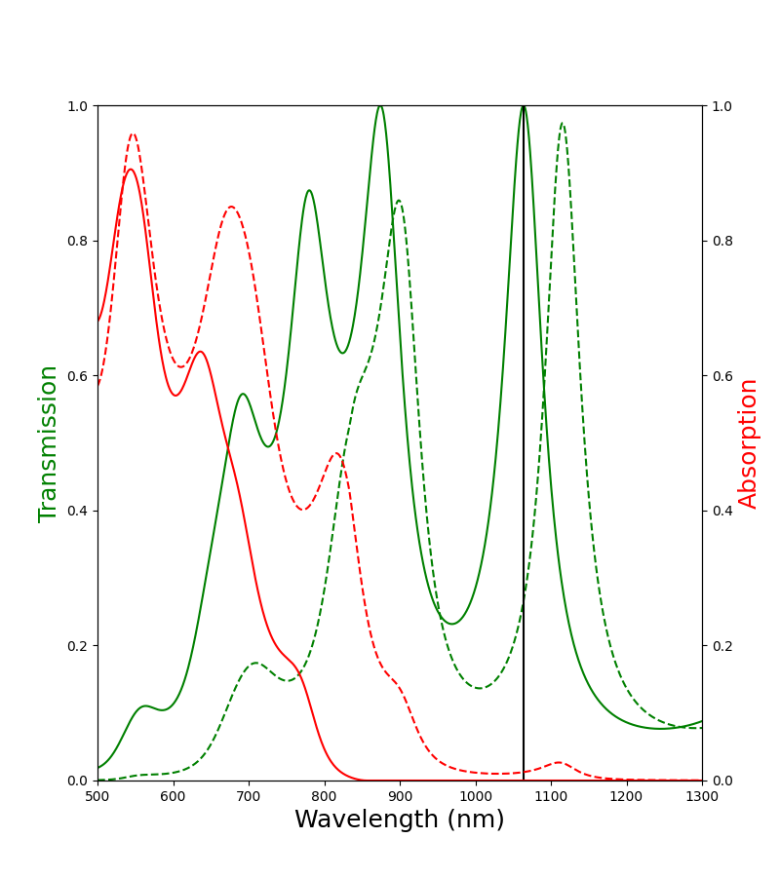
(a)
(b)

Slide 22
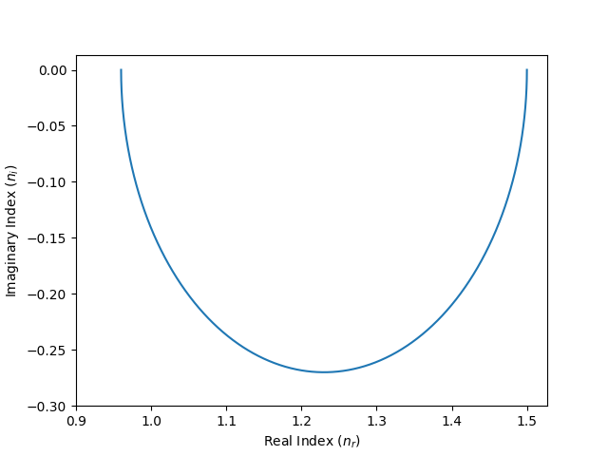
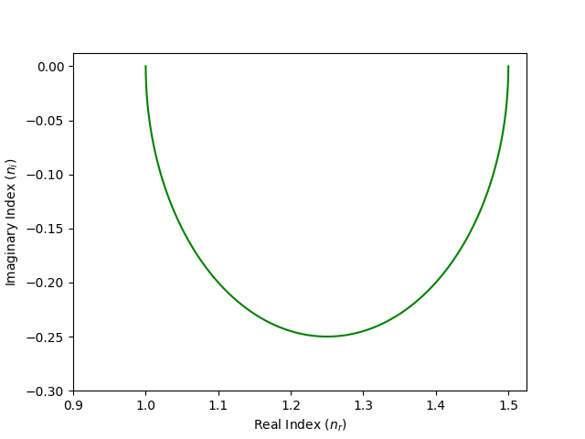
θ = π/2
n_{r} = 0.96
θ = 0
n_{r} = 1.5
θ = π/2
n_{r} = 1.00
θ = 0
n_{r} = 1.5
(a) (b)

