Slide 1
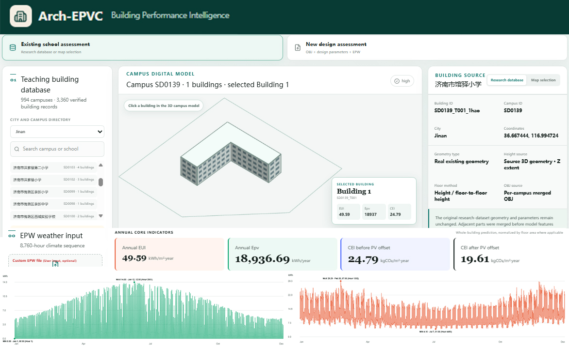
I. Data and user inputs
II. Dual route prediction
Existing school evaluation
Automated preprocessing
Research dataset
OBJ Geometry
Openstreet map
Epw weather file
Database / map linkage • OBJ parsing • Windowed LoD1 reconstruction
Geometry normalization • 32³ voxelization
Route I. Annual prediction
Route II . Hourly prediction
3D-CNN + MLP + TabTransformer
Multimodal feature fusion
Static features + hourly weather
Two-layer LSTM
New school design
OBJ geometry
Design factors
EPW weather file
User-defined proposal
EUI， Epv，CEI
• Annual indicators
• 8,760-hour profiles
• 3D model
Performance
feedback
Energy，PV，Carbon
Visualization model
III. Web interaction and visualization
1.Dual-model selection
1
2.3D geometry view
2
3
3.Design factors
4.Epw inputs
4
5
5.Annual performance
6
6.Hourly performance
Arch-EPVC platform
Notes:
[Sources]
- https://arch-epvc.vercel.app/ (Arch-EPVC interface screenshot; accessed 2026-08-28)
- https://doi.org/10.1016/j.apenergy.2017.07.128 (CityBES platform architecture reference)
- https://doi.org/10.1016/j.enbuild.2021.111566 (MPS multi-source workflow reference)
- https://doi.org/10.1016/j.scs.2021.103534 (UBEM.io web-platform reference)
[/Sources]

Slide 2
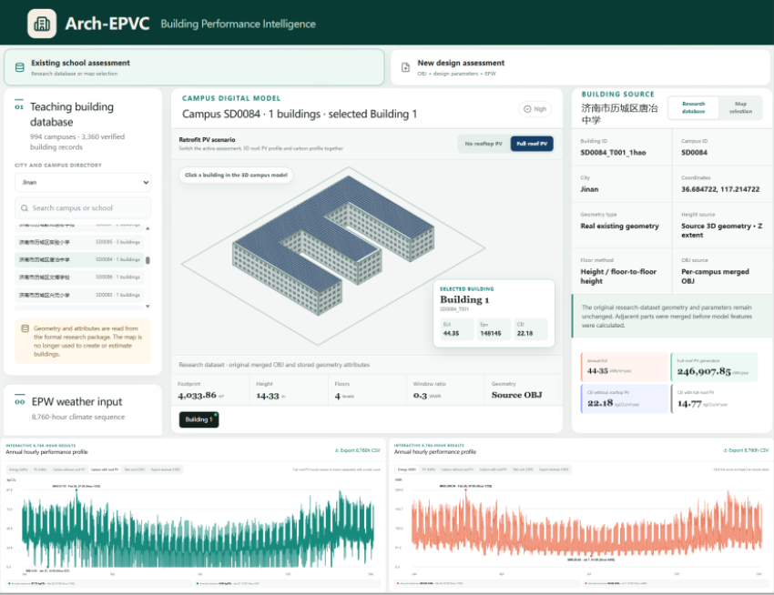
1.Dual-model selection
2.3D geometry view
3.Design factors
4.EPW weather inputs
5.Annual performance
6.Hourly performance

Slide 3
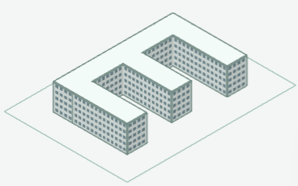
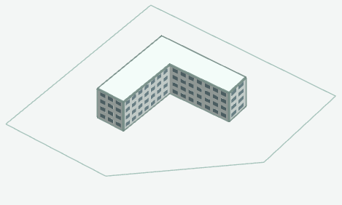
Enclosure typologies
Matched pair
Built school current state
Existing school retrofit
Paired performance comparison
One built school
+
One new school
EUI ↓ CEI ↓ Epv ↑
Detached, Double-sided
Three-sided, Courtyard, Integrated
New design initial proposal
New school design
Annual improvement + hourly robustness
Rapid evaluation and scenario diagnosis
Notes:
[Sources]
- https://arch-epvc.vercel.app/ (Arch-EPVC interface screenshot; accessed 2026-08-28)
- https://doi.org/10.1016/j.apenergy.2017.07.128 (CityBES platform architecture reference)
- https://doi.org/10.1016/j.enbuild.2021.111566 (MPS multi-source workflow reference)
- https://doi.org/10.1016/j.scs.2021.103534 (UBEM.io web-platform reference)
[/Sources]

