Slide 1

Video Summarizer: A tool for summarizing educational videos
DEPARTMENT OF COMPUTER ENGINEERING
SHRI G.S. INSTITUTE OF TECHNOLOGY AND SCIENCE, INDORE(M.P.)
CO34999 - MAJOR PROJECT PLANNING
Guided By:
Ms. Himani Mishra
Assistant Professor
Department of Computer Engg.
Dr. Vandan Tewari
Professor
Department of Computer Engg.
Submitted By:
0801CS201009 – Akshat Gupta
0801CS201012 – Anekant Singhai
0801CS201024 - Avni Sharma 0801CS201027 – Chevi Parsai
0801CS201068 – Pragati Gupta

Slide 2
INDEX
Introduction
Literature Survey
Various Algorithmic Approaches & Existing Solutions
Gaps identified
Problem Statement
Analysis
Design
Proposed Solution
Conclusion
References

Slide 3
INTRODUCTION
Watching long videos is time taking specially when you have a time constraint. To address this problem a video summarizer can be used.
To know whether a video is relevant or not, a user can read the summary generated from video. This would also help him in deciding whether to watch the video or not.
The video summarizer aims at generating a relevant and accurate summary of our video.

Slide 4
LITERATURE SURVEY
"Unsupervised Video Summarization with Adversarial LSTM Networks" by Zhang et al. (2016):
The approach generated summaries by learning to reconstruct the original video sequences while minimizing the reconstruction error.
The adversarial framework encouraged the network to produce concise and diverse video summaries.
"Extractive and Abstractive Methods for Single- and Multi-Document Summarization: A Comparative Study" by Gyawali et al. (2019):
This research conducted a comparative study of extractive and abstractive methods for video summarization.
The study evaluated the performance of various algorithms on benchmark datasets, providing insights into the strengths and weaknesses of different approaches.

Slide 5
ALGORITHM APPROACHES
One promising research direction in audio-video summarization is the integration of multimodal learning techniques, combining visual, audio, and textual information.
This approach aims to leverage the complementary nature of multiple modalities to improve the quality and comprehensiveness of video summaries.
By jointly modeling visual and audio cues, as well as incorporating text analysis, the resulting summaries can capture more nuanced and contextually rich content.

Slide 6
COMPARISION OF VARIOUS APPROACHES
Existing Algorithms Approaches | Description | Limitations | Future Scope
Traditional Keyframe Extraction | May capture irrelevant frames or miss important content | Selects frames at fixed intervals or based on motion thresholds | Our approach considers changes in frames and extracts keyframes based on a customizable threshold, reducing storage usage and capturing more significant content
Importance Scoring using Visual Features | Relies solely on visual features and may overlook important textual or audio information | Assigns importance scores to frames based on visual features | We incorporate both visual features and text extraction to capture a more comprehensive understanding of the video content
Text Summarization | Ignores visual information and may miss important visual context | Generates summaries based on extracted text from frames | We combine both visual and textual information to generate more comprehensive and context-rich summaries
Machine Learning-based Summarization Models | Requires large labeled datasets for training, which may be challenging to acquire | Utilizes machine learning algorithms for summarization | We leverage machine learning techniques and explore transfer learning to overcome data limitations and enhance summarization performance

Slide 7

EXISTING SOLUTIONS
1. YoutubeDigest
YoutubeDigest Generates summaries for youtube videos using ChatGPT. YouTubeDigest can create summaries for YouTube videos in different forms. By default, it provides a summary in five bullet points[1].
There is an option to limit the number of words in summary This is available as Chrome /Firefox /Brave extension. It generated a 2927 words summary for a 11 minute video.
TECHNOLOGY USED - Generative Pre – trained transformers
LIMITATION-
It can only summarize those videos that has a transcript provided by Youtube.

Slide 8

EXISTING SOLUTIONS
2. Wordtune
Wordtune gives us the full rundown on any video you need, including summaries and important timestamps. This is a paid tool and costs approx. $10 per month [2].
This is available as Chrome /Firefox /Brave extension. Generated a 428 words summary for a 11 minute video.
TECHNOLOGY USED – Language Modelling
LIMITATION -
It can only summarize the videos with subtitles

Slide 9
EXISTING SOLUTIONS
3. Summarize.tech: AI-powered video summaries
Get a summary of any long YouTube video, like a lecture, live event or a government meeting. Powered by ChatGPT [3].
This is available as a web based tool. It generated a 320 words summary for a 11 minute video.
TECHNOLOGY USED - Generative Pre – trained transformers
LIMITATION -
It can only summarize the videos with subtitles.

Slide 10
EXISTING SOLUTIONS
4. Upword
Upword is a powerful tool for AI note-taking and summarization that helps you on all websites, not just YouTube [4].
This is available as Chrome /Firefox /Brave extension.
TECHNOLOGY USED – Artificial Intelligence
LIMITATION –
The summaries are not as short compared to what other tools provide.

Slide 11
COMPARISON OF DIFFERENT TOOLS
TOOLS -- CRITERIA | UPWORD | YOUTUBEDIGEST | WORDTUNE | SUMMARIZE.TECH
TECHNOLOGY USED | Deep learning | Generative Pre – trained transformers | Language Modelling | Generative Pre – trained transformers
LIMITATION | Text only and generates in paragraphs. | It can only summarize those videos that has a transcript provided by YouTube. | It can only summarize the videos with subtitles | It can only summarize the videos with subtitles.
AVAILABLE AS | Chrome /Firefox /Brave extension. | Chrome /Firefox /Brave extension. | Chrome /Firefox /Brave extension. | This is available as a web based tool.

Slide 12
GAPS IDENTIFIED
None of the tools available uses both the audio and the video content to create text summary.
The existing tools can only summarize those videos which have captions provided by YouTube.
The summaries provided by some tools were more lengthy such as YouTube Digest.

Slide 13
PROBLEM STATEMENT
“To design and implement a web based video summarizer tool for engineering educational videos, that uses both the audio and images extracted from the video to create a relevant and accurate summary.”

Slide 14
ANALYSIS
DETAILED PROBLEM STATEMENT
To design and implement a web based video summarizer tool that uses the audio as well as images extracted from the video to create a relevant and accurate summary using machine learning and natural language processing tools.

Slide 15
FUNCTIONAL REQUIREMENTS
Enter link to video (maximum length of 15 minutes and 480 pixels resolution):
Generate Summary ()
Usecase 1 Actors Involved Description Pre-condition Post condition Main Flow | Enter link to video User Link to video must be provided and video must be of maximum length of 15 minutes and 480 pixels resolution) None None The link is taken and video is processed to generate the summary
Use Case 2 Actors Involved Description Pre-condition Post condition Main Flow | Generate Summary User The summary is generated by our ml model / system and displayed to the user. Video link must be provided None The video is processed using machine learning models such as RNN, NLP etc.

Slide 16
NON FUNCTIONAL REQUIREMENTS
• Availability: The application is available 24*7.
• Reliability: The summary generated must be useful and correct.
• Usability: The application is user-friendly. Anyone can use the application easily.
• Accessibility: The application is accessible to all.
• Performance: The system response time should be adequate.

Slide 17
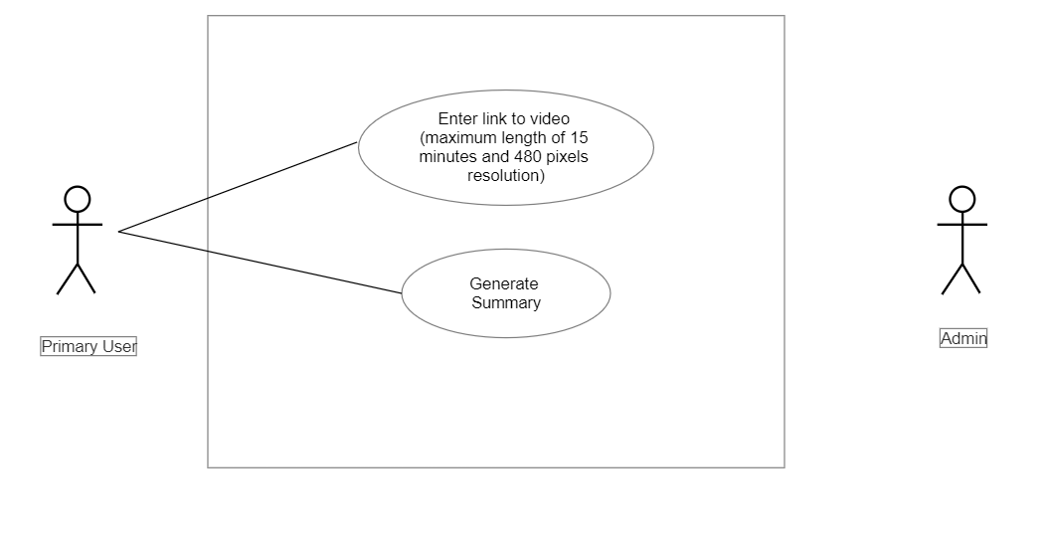
USE CASE DIAGRAM

Slide 18
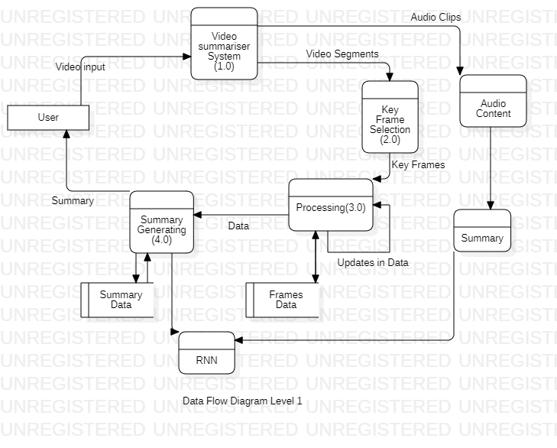
DATA FLOW DIAGRAM – LEVEL 1

Slide 19
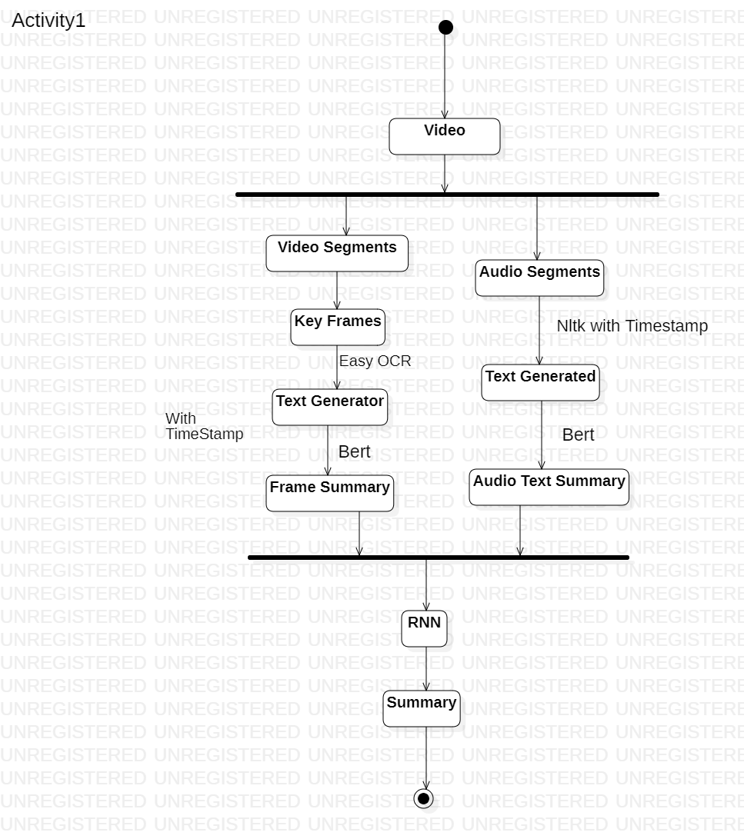
DESIGN DIAGRAMS - ACTIVITY DIAGRAMS

Slide 20
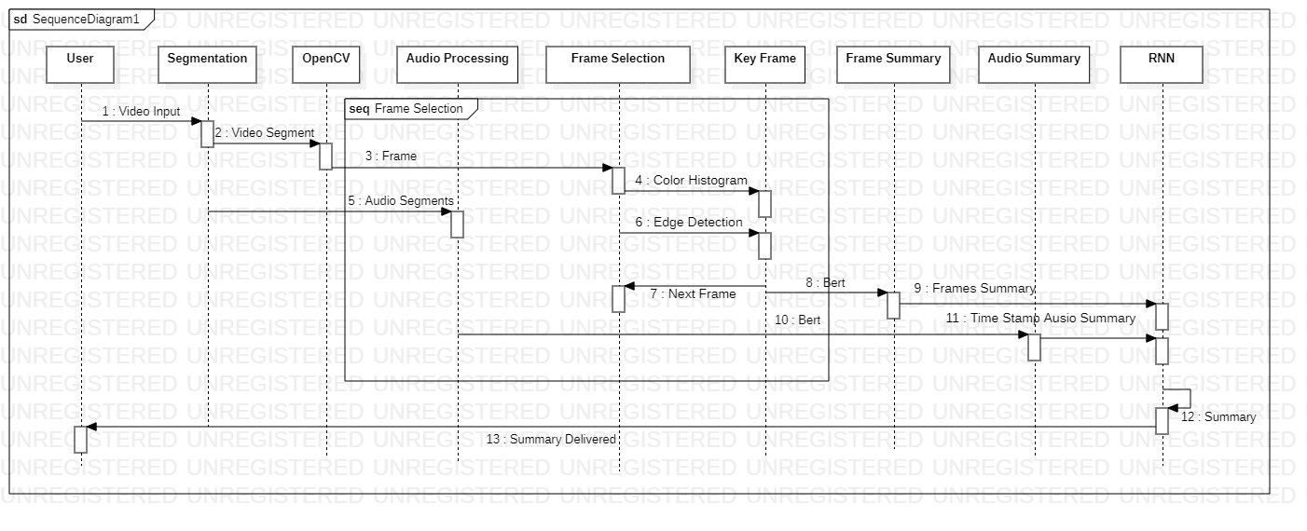
DESIGN DIAGRAMS - SEQUENCE DIAGRAMS

Slide 21
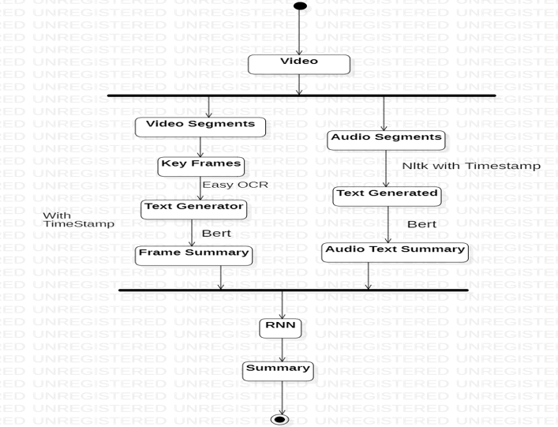
PROPOSED SOLUTION

Slide 22
DETAILED STEPS -
STEP 1. Video Segmentation
• Divide the video into fixed lengths segments.
• This can e done using python libraries such as OpenCV
STEP 2. Audio Extraction
• The next step is to extract audio from the video segments using MoviePy library.
• The audio extracted can then be used to convert to text using NLP (Natural Language Processing).

Slide 23
STEP 3. Frame Extraction
• Frames are extracted from the video using the OpenCV library.
• Instead of capturing frames at a fixed rate, changes in frames are detected using a threshold approach.
• Frames with significant changes exceeding the threshold are selected for further processing and analysis.
STEP 4. Feature Extraction
• Visual features are extracted from the selected frames.
• Object detection techniques, such as YOLO or Faster R-CNN, are employed to identify and localize objects within the frames.
• Image classification models, like ResNet or VGG, are used to classify the content of the frames into specific categories.
• Text recognition algorithms, such as Tesseract, are applied to extract text from frames containing textual information.

Slide 24
STEP 5. Importance Scoring
• Importance scores are assigned to frames based on the extracted visual features.
• Machine learning algorithms, such as SVM or random forests, can be trained to predict the importance of frames.
• Heuristics based on the presence of key objects, text, or significant visual changes can also be used to calculate the importance scores.
STEP 6. Keyframe Selection
• Keyframes are selected from the pool of frames based on their importance scores.
• Frames with higher importance scores are considered as keyframes.
• Keyframes represent the most important visual content or significant changes in the video.

Slide 25
KEYFRAME SELECTION
There are several techniques that can be used to detect visual changes or keyframes in a video for frame extraction. Here are some common methods:
1. Image Differencing: [5]
Image differencing involves subtracting one frame from another to obtain the differences or changes between them.
Frames with higher differences, which indicate significant visual changes, can be selected as keyframes.
2. Motion Detection:
Techniques such as optical flow, background subtraction, or frame differencing can be used to detect motion in a video.
Frames with higher motion can be selected as keyframes, as they indicate significant visual changes or scenes with motion. [6]

Slide 26
3. Scene Change Detection:
Scene change detection algorithms automatically detect changes in the video content, such as transitions between scenes, cuts, or fades.
These algorithms analyze features such as color histograms, edge information, or motion vectors to identify frames where significant visual changes occur. Frames detected as scene changes can be selected as keyframes for summarization. [7]
4. Visual Feature-Based Methods: It includes techniques such as
Optical Character Recognition (OCR) can be used to extract text from frames, object detection algorithms can be used to detect objects or regions of interest in frames, and
Pre-trained Convolutional Neural Networks (CNNs) can be used to extract high-level visual features from frames.

Slide 27
STEP 7. Text Extraction
• Optical character recognition (OCR) techniques are applied to extract text from frames.
• OCR libraries like Tesseract or Google Cloud Vision API are used to recognize and extract text information.
• Extracted text can be utilized for generating text-based summaries or captions for the video.
STEP 8. Combine the text
• The next step is to combine the text generated from the images and audio.
• To combine this text we use RNN (Recurrent neural network)

Slide 28
STEP 9. Summary generation
• A machine learning model, such as an extractive or abstractive summarization model, is employed to generate the video summary.
• The combined text is used as input to the summarization model.
• The model considers visual content, importance scores, and textual information to generate a concise and meaningful summary of the video.

Slide 29
CONCLUSION
• Video summarization is a challenging task that involves frame extraction, feature extraction, importance scoring, keyframe selection, text extraction, and summarization model.
• The proposed methodology provides a systematic approach for generating video summaries.
• Further improvements can be made by exploring advanced techniques, incorporating audio analysis, or integrating user preferences into the summarization process.

Slide 30
VIDEOBERT: A JOINT MODEL FOR VIDEO AND LANGUAGE REPRESENTATION LEARNING
A joint visual-linguistic model is proposed to learn high-level features without any explicit supervision.
VideoBERT builds upon the BERT and S3D model to learn bidirectional joint distributions over sequences of visual and linguistic tokens.
VideoBERT can be used for numerous tasks, including action classification and video captioning.

Slide 31
REFERENCES
https://www.youtubedigest.app/
https://app.wordtune.com/read
https://www.summarize.tech/
https://app.upword.ai/
https://pyimagesearch.com/2017/06/19/image-difference-with-opencv-and-python/
https://pyimagesearch.com/2015/05/25/basic-motion-detection-and-tracking-with-python-and-opencv/
https://towardsdatascience.com/change-detection-using-siamese-networks-fc2935fff82

