Slide 1
Contact Book
Group 1 : Chevron Allen, William Askew, Ryan Dozier, Drew King,
Adam Lahjouji, Nicholas Miller, Stephen Powell

Slide 2
Contact Book
Full stack contact manager where a user may log in and associate contacts with their unique username.
The contact book is web hosted with a dynamic frontend design allowing for mobile access.
Our html page is compact and self explanatory to register an account, add and delete contacts.

Slide 3
The Team Layout A
Chevron Allen : Team leader, Backend API
Nick Miller : Backend API
Ryan Dozier : Backend Database & SQL
William Askew : Frontend HTML & CSS
Adam Lahjouji : Frontend HTML & CSS
Drew King : Frontend JavaScript
Stephen Powell : Frontend JavaScript

Slide 4
The Team Layout B
Frontend
William Askew : HTML & CSS
Adam Lahjouji : HTML & CSS
Drew King : JavaScript
Stephen Powell : JavaScript
Backend
Chevron Allen : Team leader, PHP API
Nick Miller : PHP API
Ryan Dozier : Database & SQL

Slide 5
Technologies
GoDaddy Hosted
LAMP Stack
MYSQL and PHP
More?

Slide 6
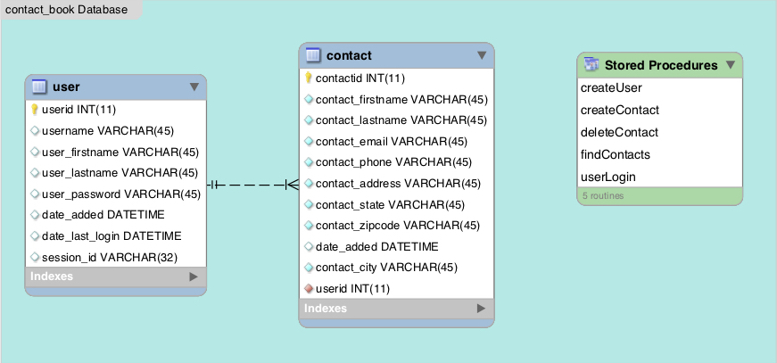
Database

Slide 7
INSERT USECASE HERE

Slide 8
INSERT GANTT CHART HERE

Slide 9
Things that went well
We were able to meet often, minimal schedule conflicts.
We set defined roles allowing members to focus on an obtainable task.
AWS allows for easy database setup.
Database creation and migration was easy using MYSQL Workbench.

Slide 10
Things that went not-so Well
Web hosting through AWS is more complicated than we anticipated
PHP is not the most beginner friendly language
Relied too heavily on live testing versus virtual hosting *maybe?*

Slide 11
Demo
http://cop4331-contactbook.com

