Slide 1


Insurance & Banking: BlingBank
Network and Computer Security Project
Niklas Herbster, Vuk Jurisic, Kevin Ross

Slide 2




Table of contents
01
02
03
04
Secure Document Format
Infrastructure
Secure Channel and Key Distribution
Security Challenge

Slide 3



01
Secure Document Format
Ensuring Confidentiality, Integrity and Freshness
Notes:
We've designed our system with three critical security features at the forefront: confidentiality, integrity, and freshness. Each of these plays a vital role in ensuring that our documents are not only safe from unauthorized access but also protected from tampering and timely in their use.

Slide 4
Design Principles for Secure Document Format
Confidentiality
AES for document encryption
RSA for secret key encryption
Integrity
Creation of a digital signature
Freshness
Timestamp usage
Notes:
When I talk about confidentiality, I'm referring to our use of Advanced Encryption Standard(AES), which is the standard for encrypting documents. It's fast, secure, and widely trusted. But AES uses a symmetric key, which means the same key is used for both encrypting and decrypting the document. To securely transfer this key, we use RSA encryption, which is an asymmetric system using a public and a private key. We encrypt the AES key with the recipient's public key, ensuring that only they can decrypt it with their private key.
Integrity-wise, we are ensuring the document hasn't been tampered with. The document's data is then encrypted with the sender's private key, forming the digital signature. Upon receipt, the receiver decrypts the signature with the sender's public key. If the two match, the integrity of the document is confirmed. This process also provides non-repudiation, meaning the sender cannot deny the authenticity of the document they sent.
Lastly, freshness is tackled through the use of timestamps. We include a timestamp with each piece of data to make sure it's not replayed or stale. Our system only accepts the data if the timestamp verifies that it was recently sent, specifically within a minute of its transmission. This prevents any kind of replay attack, where an old communication is repeated in hopes of deceiving the receiver into accepting an outdated or already processed transaction.

Slide 5

Cryptographic Libraries and Tools
java.security.Signature: For generating and verifying digital signatures for document integrity.
java.security.SecureRandom: For generating IVs to ensure integrity.
javax.crypto.Cipher: For encryption and decryption operations.
javax.crypto.KeyGenerator: For generating symmetric keys (AES).
KeyFactory, PublicKey, PrivateKey: For handling public and private keys in RSA encryption.
Java 21
Custom Cryptographic Library

Slide 6
Sender
Pub Key Encryption
Encrypt Document
Generate iv and encrypt public key using symmetric key and the iv.
Generate a new iv and encrypt the document using session key and iv.
Adding the timestamp
Create Signature
Timestamp is added to the final payload which gets sent to the server.
Encrypting object generate in step 2 using RSA with our private key.
Notes:
Now I will show you the end to end process of ciphering data. This is a graphical representation of how the sender encrypts data.

Slide 7
Receiver
Pub Key Decryption
Signature Verification
Signature is verified using RSA and timestamp is checked.
Using the iv and the symmetric key, public key is retrieved.
Document Decryption
Using the 2nd iv and the session key, document is decrypted
Notes:
Here is a representation of how the receiver verifies and processes received data.

Slide 8
02
Infrastructure
Implementation of our infrastructure

Slide 9
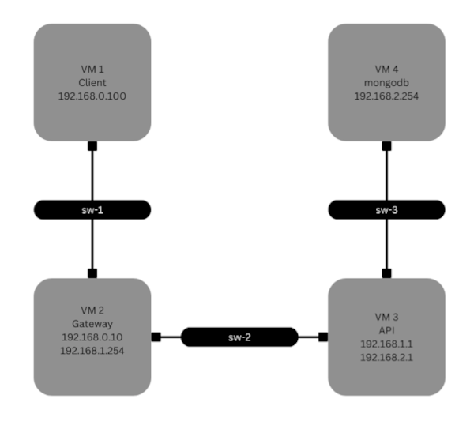
02 Infrastructure
Client
Database
Gateway
Server

Slide 10
03
Secure Channel and Key Distribution
Implementation and details of our cryptographic library

Slide 11
03 Secure Channel and Key Distribution
Secure Channel
Key Distribution
Client and Server communicate via HTTPS
Server and Database communicate via SSL/TLS
Public Keys are encrypted and exchanged when a User creates an account
Session Keys are encrypted and exchanged when a User logs in (PFS)

Slide 12
04
Security Challenge
Enhancing Security: Non-Repudiation, Freshness, and Multi-Owner Accounts

Slide 13

Non-repudiation
Freshness
Multi-Owner Accounts
It is ensured through the usage of the digital signature.
Achieved through the usage of the timestamp.
Transactions are processed once any of the owners initiates the transaction.

Slide 14



Results
Distributed secure Infrastructure
Confidentiality, Integrity and Authenticity are ensured
Perfect Forward Secrecy

Slide 15
Conclusion
Fundamentals of secure communication between all parties
Possible improvements using nonces
Implement Https between client and server

Slide 16
Demo
https://drive.google.com/file/d/1MHrQyi1eSxr_tzU_vSVFUcGWePZF4Quh/view?usp=sharing

