Slide 1
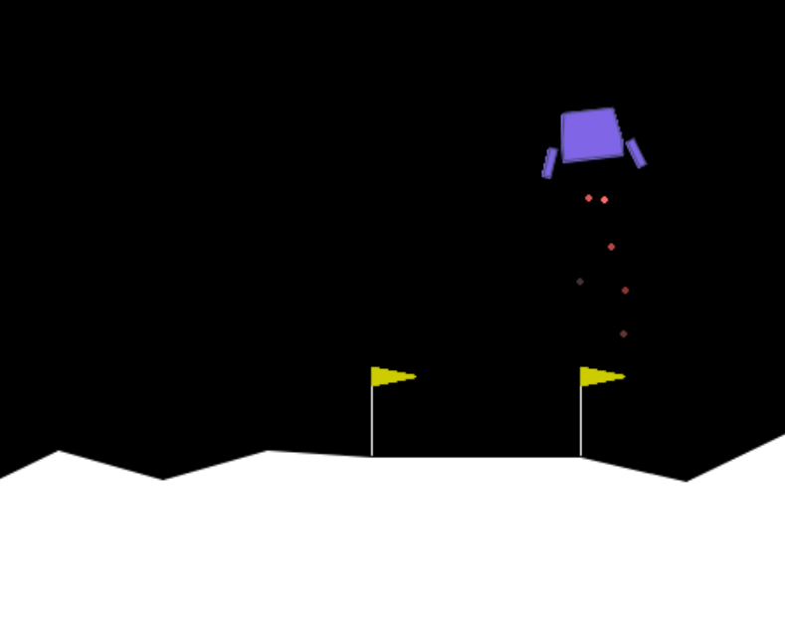
Evolving a Lunar Lander with Genetic Programming
Group 22
Vuk Jurišić
Tom van Beekhoff
Abishek Manikandan
Lucas Hoek
Victor van der Doorn

Slide 2
Challenge
Train a lunar lander to safely land on the moon
Complete/Improve basic codebase given by the course
1

Slide 3
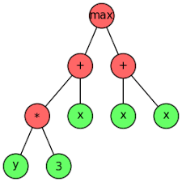
Base model
Genetic programming
Constants are further optimised using AdamW gradient descent
Output chosen by argmax
Inputs | Outputs
x position | do nothing
y position | fire left engine
x velocity | fire right engine
y velocity | fire main engine
angle
angular velocity
left leg touched (bool)
right leg touched (bool)
1

Slide 4
Fitness Score
The sum of episode rewards as defined by the Lunar Lander documentation from Gymnasium.
Reward Increases | Reward Decreases
Closer to landing pad | Further from landing pad
Slower movement of lander | Faster movement of lander
 | Non-horizontal tilt
[+10] Contact of leg with ground
 | [-0.03/frame] Side engine firing
 | [-0.3/frame] Main engine firing
[+100] Safe landing | [-100] Crash
https://gymnasium.farama.org/environments/box2d/lunar_lander/
2

Slide 5
Overview of improvements
Hyperparameter Sweep
Modified Function Nodes
Elitism
Seeding
Fitness Function Improvement
Validation-Based Model Selection
Coefficient Gating
1

Slide 6
Hyperparameter Sweep
Retrieve near-optimal parameters for the baseline by an Optuna Tree-structured Parzen Estimator sampler sweep over 55 trials (35 generations, 8 episodes each).
Parameter | Sweep Range | Best Value
Population Size | [16, 32, 64, 128] | 128
Maximum Tree Size | [15,31,63] | 63
Number of Constants | 1 – 5 | 2
Learning Rate Coefficient | 1e-4 – 1e-2 | 1.69e-4
Gradient Update Steps | [250, 500, 1000] | 250
Discount Factor | 0.95 – 0.99 | 0.9796
3
Notes:
As the best values indicate, the results showed that large population size and maximum tree size corresponded to better scores. However, nearly half of the results converged to the same -1391.95 score. Investigating this, the root causes were proposed to be an unprotected exponential node, lack of elitism and the nature of the fitness function.

Slide 7
Elitism
The worst offspring in each generation is replaced with the single best individual across all generations so far. This ensures the algorithm can evolve around a region of good fitness, eliminating degenerate attractors.
5

Slide 8
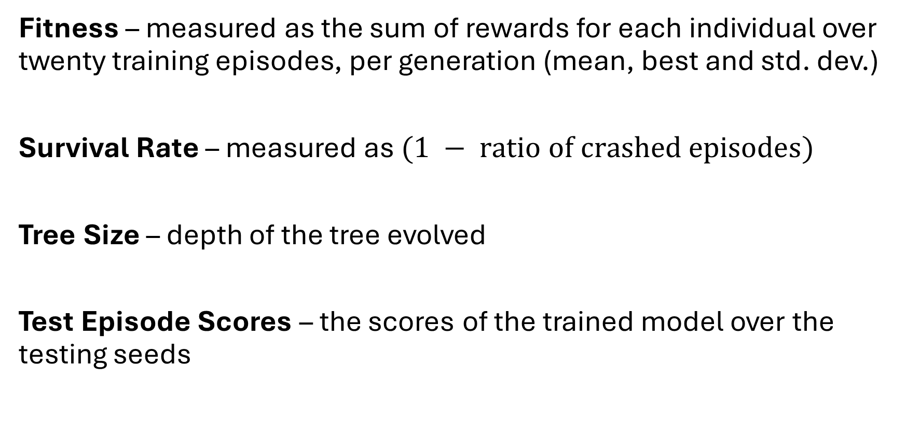
Metrics
6

Slide 9
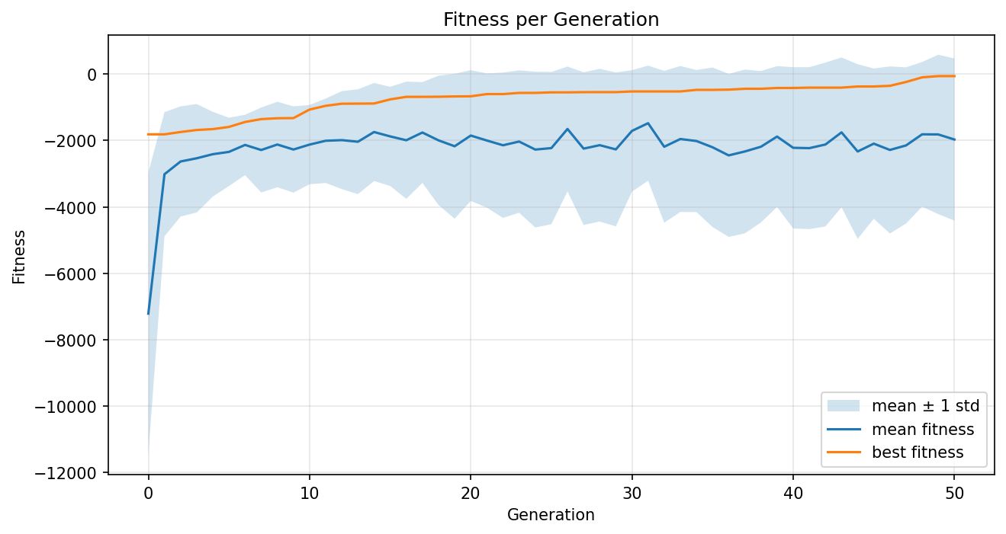
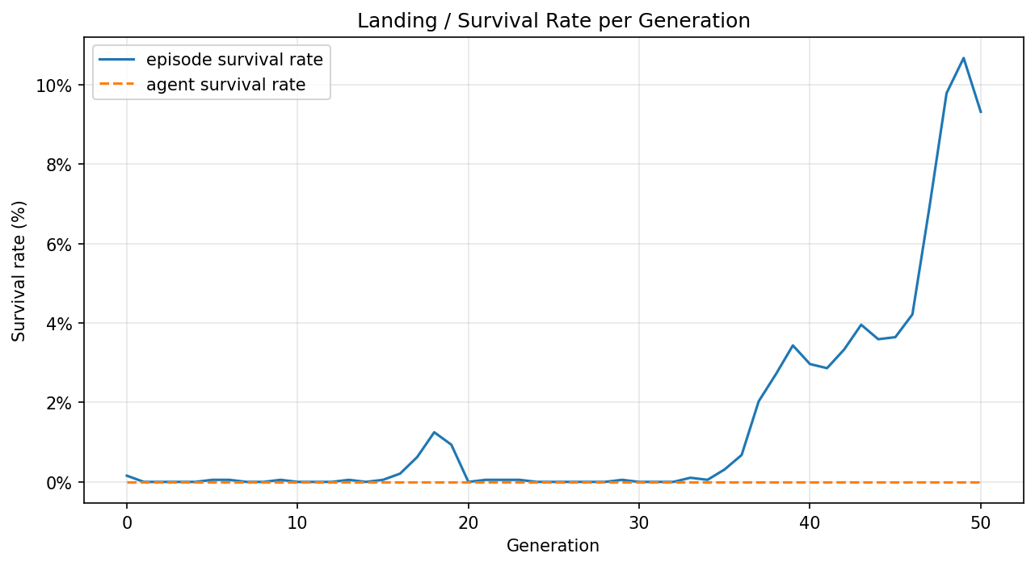
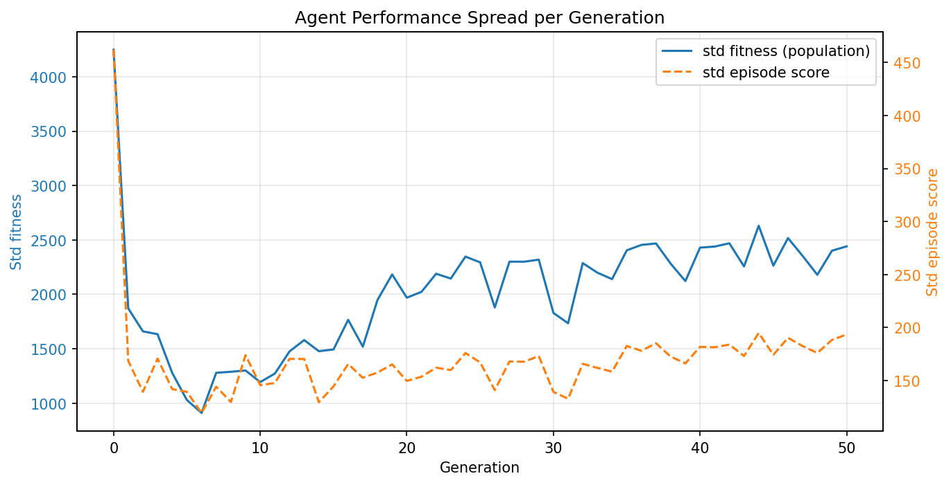
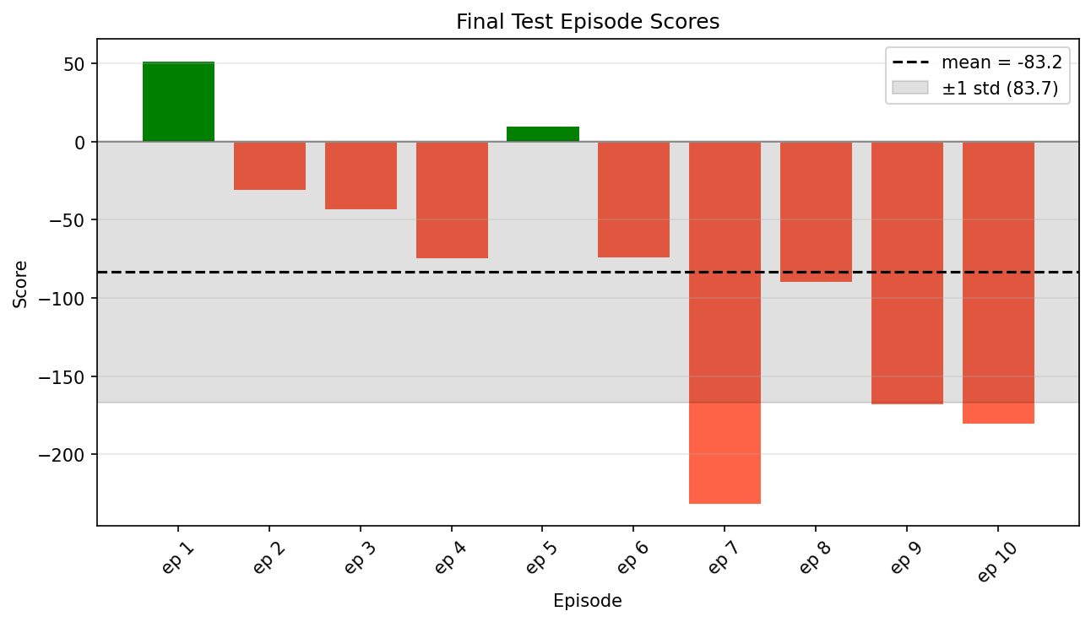
Revised Baseline Run
7
Notes:
Parameters from the hyperparameter sweep, 15 training episodes per individual, 50 generations for training, 10 episodes for testing. Each episode has a duration of 500 frames.

Slide 10
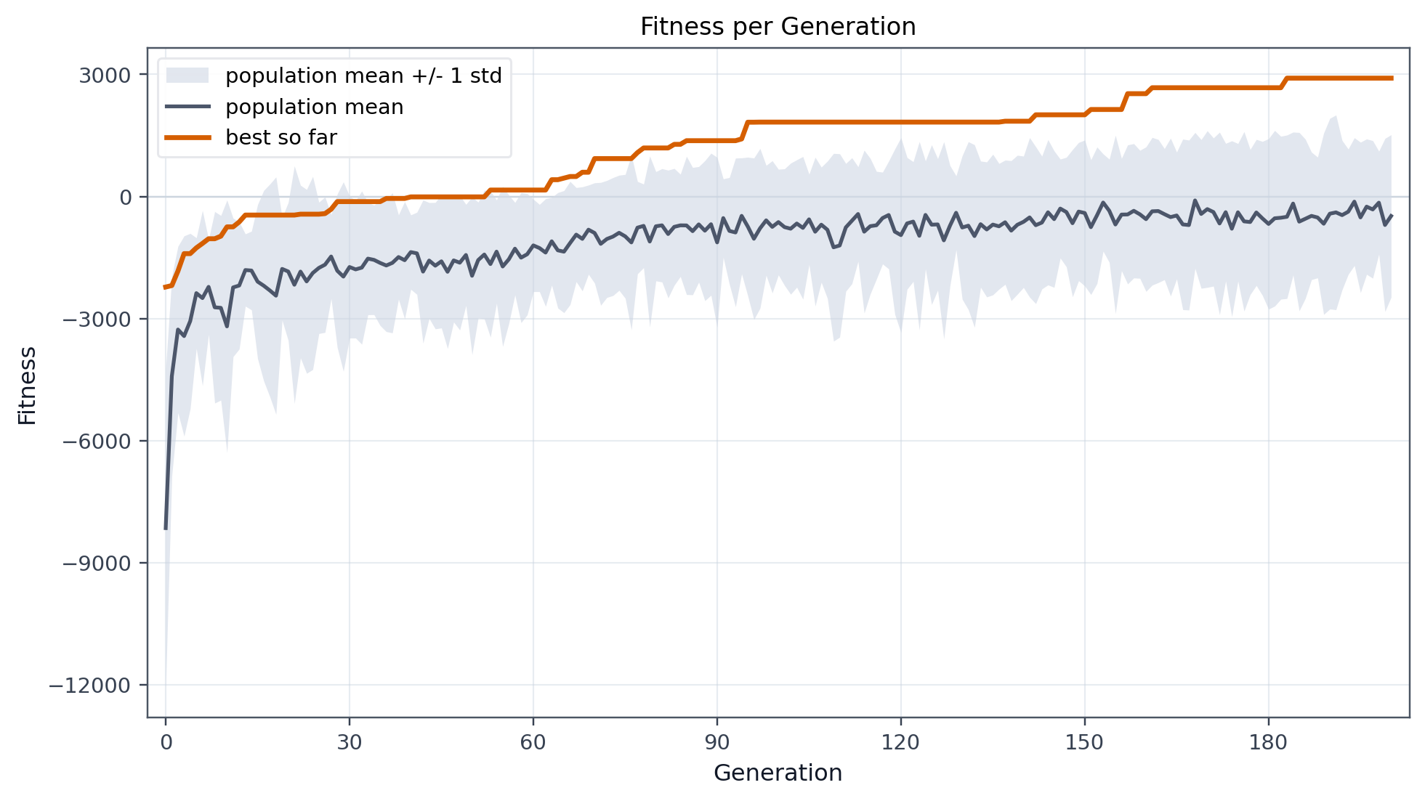
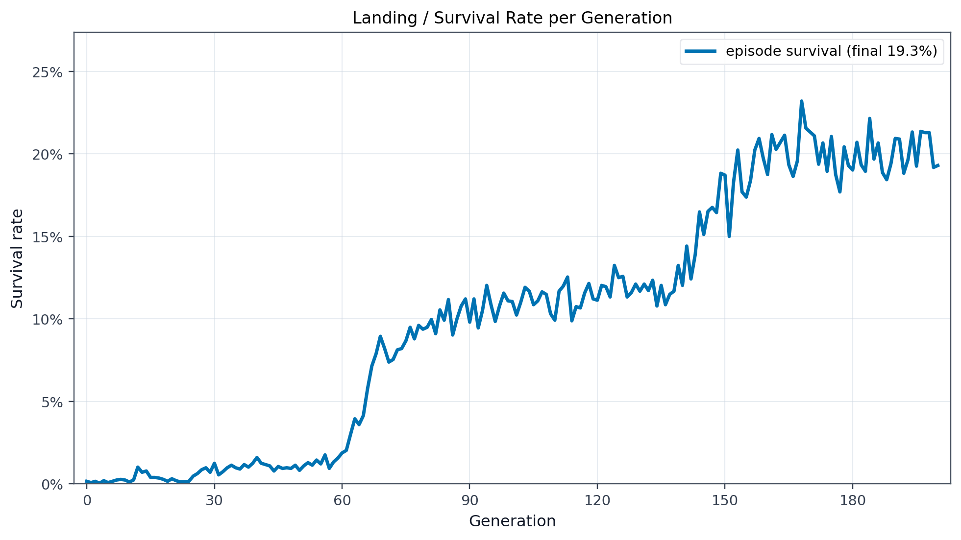
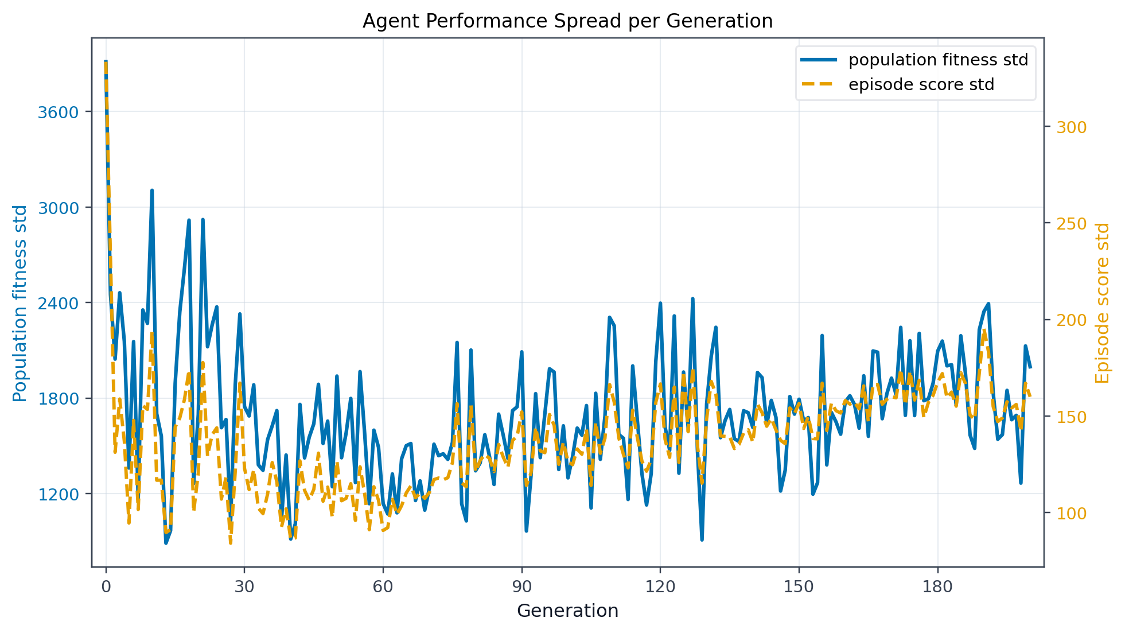
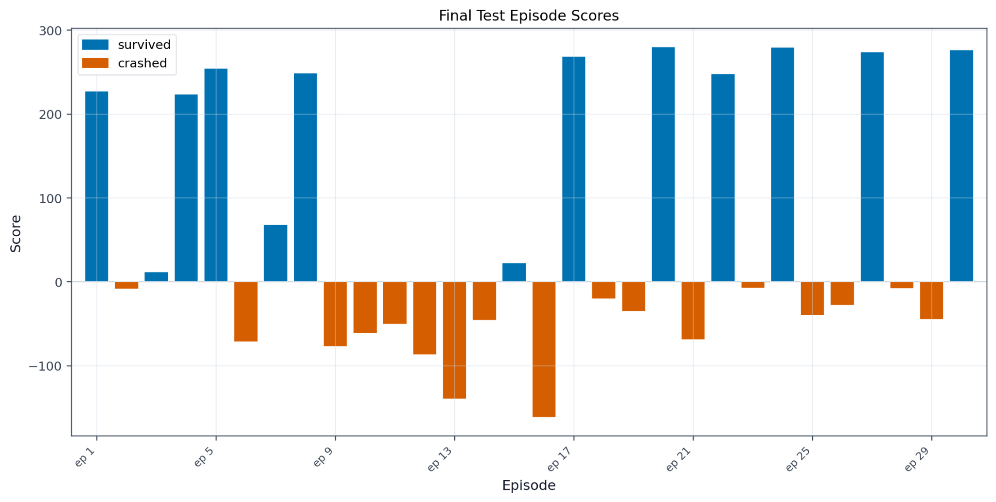
Revised Baseline Run
7
Notes:
Parameters from the hyperparameter sweep, 15 training episodes per individual, 50 generations for training, 10 episodes for testing. Each episode has a duration of 500 frames.

Slide 11
Fitness Function Improvements
Three penalties are added:
1. CRASH_PENALTY
A weight of 10.0 is multiplied with the number of crashed episodes and subtracted from the overall fitness. This was added on top of the scores assigned by the base lunar lander.
8

Slide 12
Fitness Function Improvements
Three penalties are added:
2. PARSIMONY
A small penalty of 0.02 to the fitness was given based on the size of the tree. This is to enforce the model to prefer smaller, more explainable models if no functionality was lost
9
Notes:
A parsimony weight was multiplied with the length of the tree and subtracted from the overall fitness. Done to discourage bloated tree sizes. This was also disabled due to the established maximum tree size parameter being a good enough driver.

Slide 13
Fitness Function Improvements
Three penalties are added:
3. TIME_PRESSURE
A time weight of 0.01 is multiplied to the length of the episode and subtracted from the overall fitness. This is to eliminate hovering without landing and is enabled on all runs.
10

Slide 14
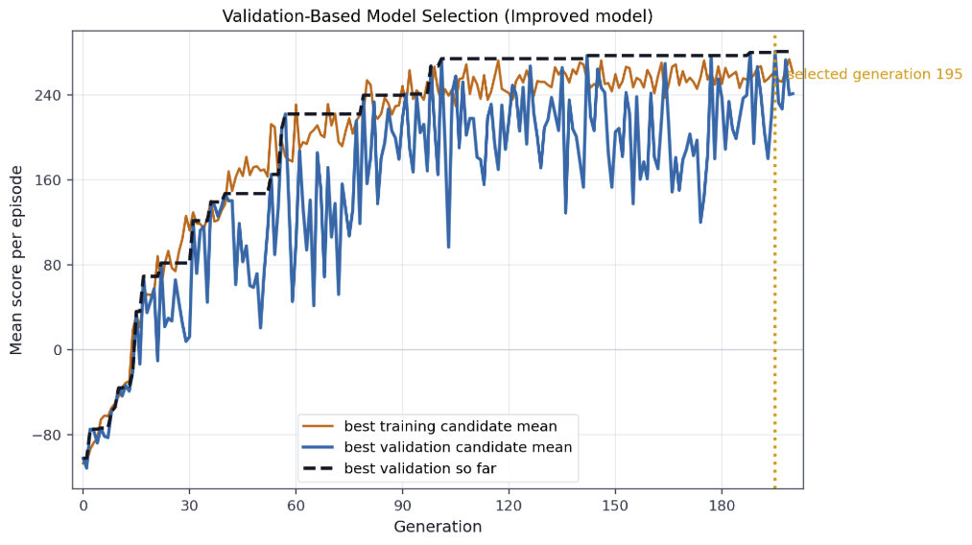
Validation-Based Model Selection
To prevent overfitting of the model to the training seeds, the top four individuals were further evaluated on 10 validation episodes per generation. The final model is chosen as the one with the best validation score across all generations.
11
Notes:
Removes the pure fitness-based selection by allowing the model to be tested on “unseen data”. Validation episode seeds are base_seed + 50000 + generation x 1000. The validation survival rates are noisier due to the validation episode seeds being different every time.

Slide 15
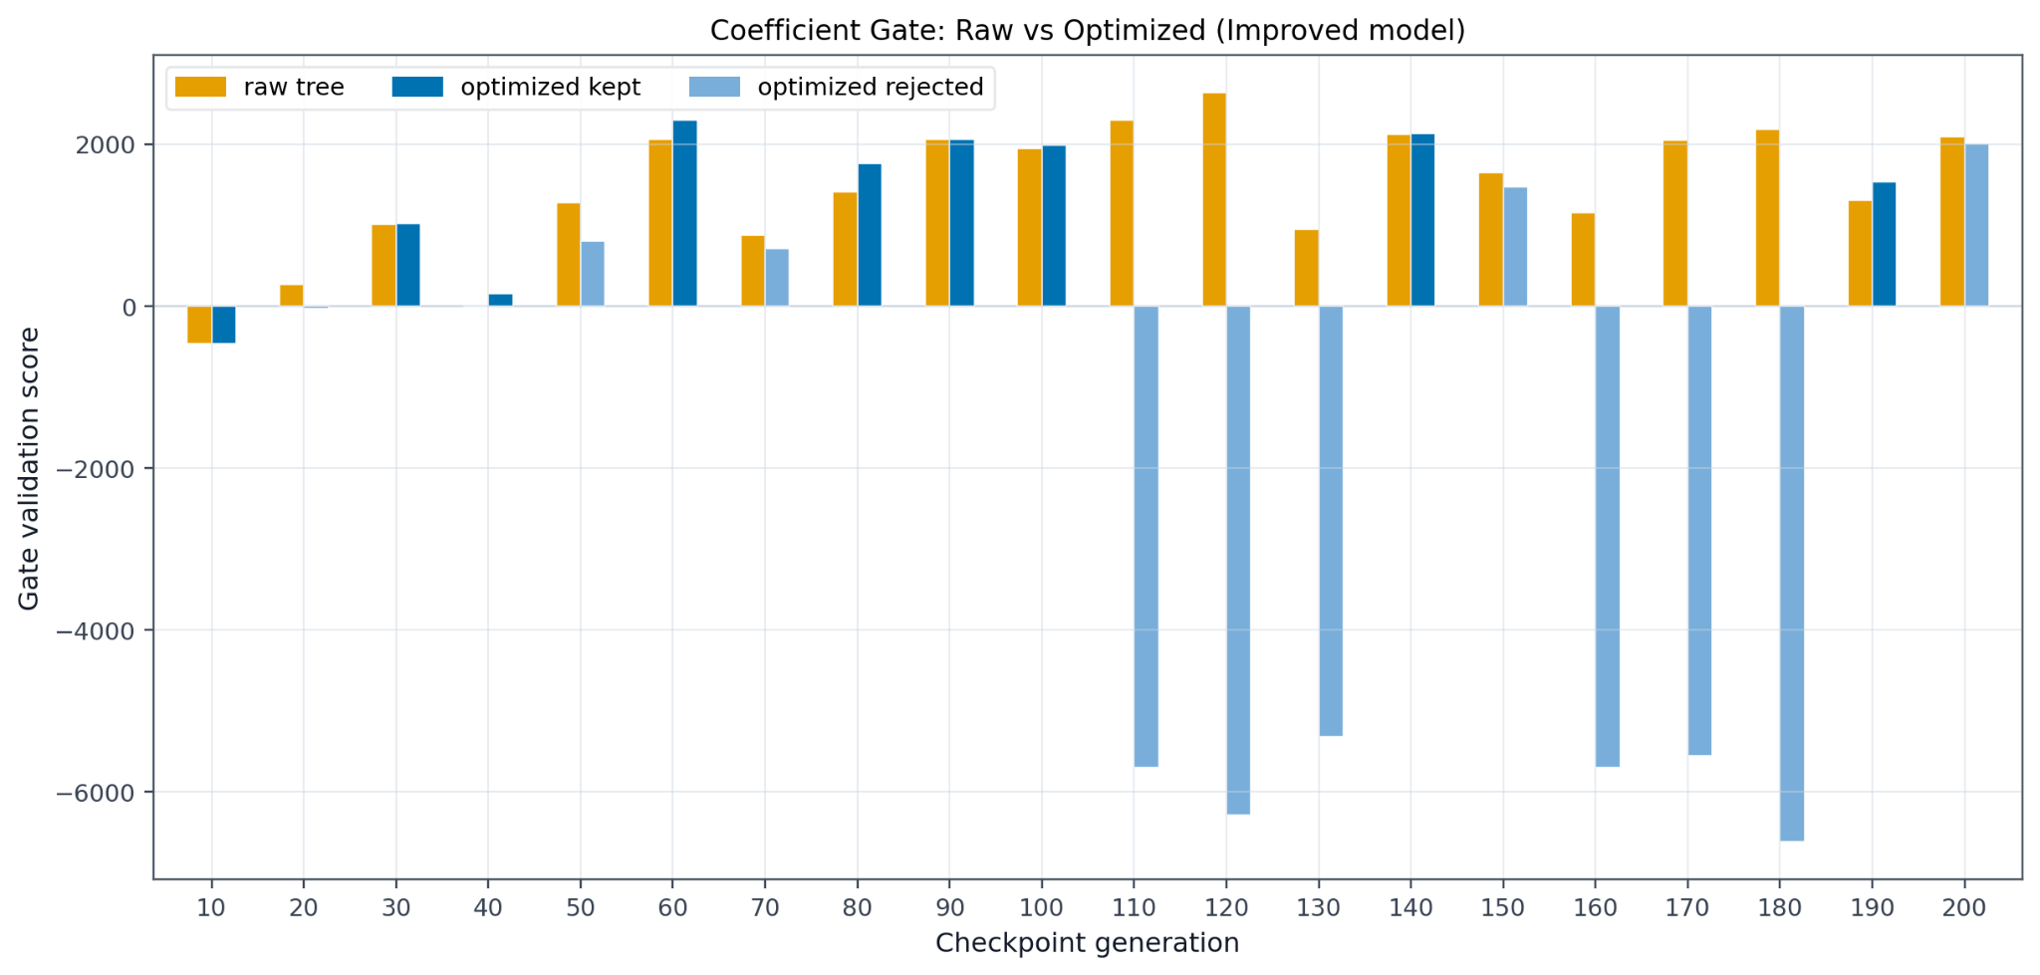
Coefficient Gating
The optimization of coefficients after evolving the tree can sometimes result in locally-optimal values that are globally non-optimal. This feature allows for the selection of the initial tree, preventing a post-evolution degradation in the fitness.
12
Notes:
The raw and evolved trees are evaluated over a certain number of episodes (10) with seeds offset by some amount (75000). The final scores are compared. The interval this is performed in is the same interval for which experiment artifacts are stored.

Slide 16
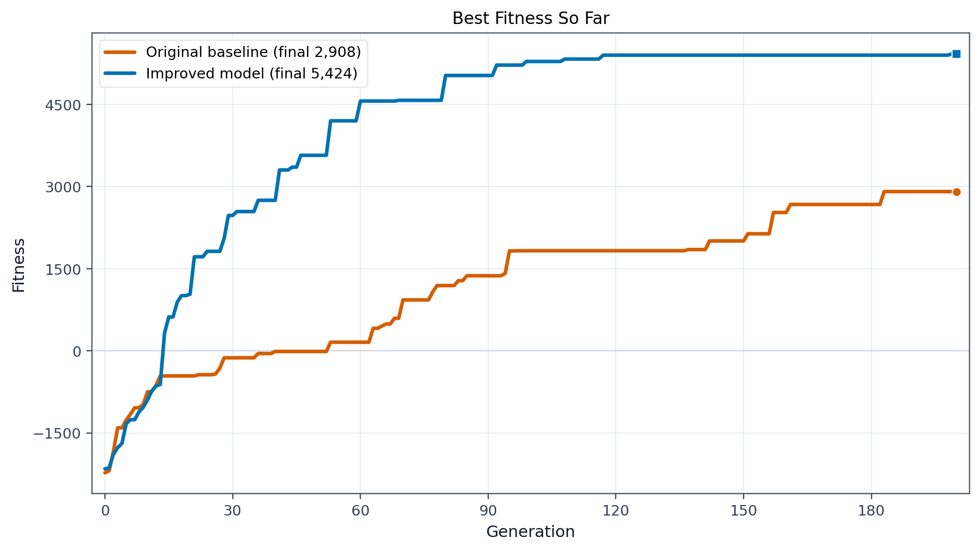
Final Results
13
Notes:
Parameters from the hyperparameter sweep, 20 training episodes per individual, 200 generations for training, 30 episodes for testing. Each episode has a duration of 500 frames. No crash penalty or parsimony. Time pressure with a weight of 0.01. Validation-based and coefficient-gated. The fitness score and survival rates are the highest values obtained so far. The model also shows the first signs of individuals in a generation that had no crashes in their training episodes. The performance on the model on test episodes is also highly satisfactory, with most resulting in a score considered a success by Gymnasium’s standards (above 200).

Slide 17
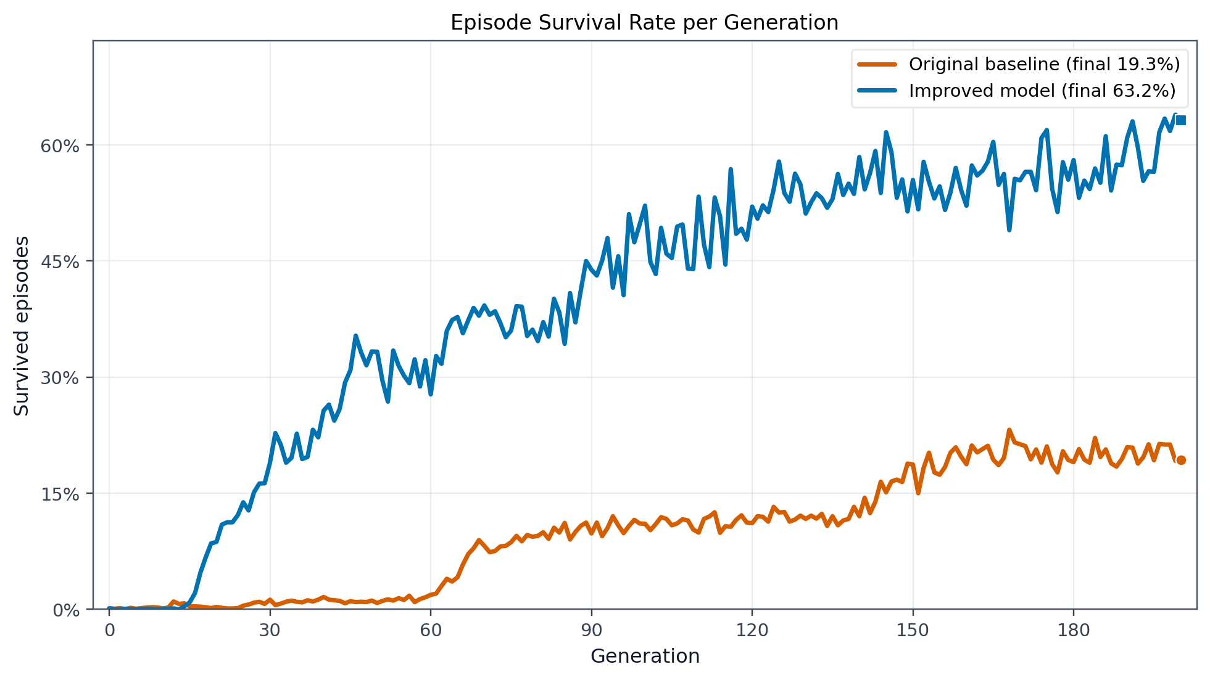
Final Results
13
Notes:
Parameters from the hyperparameter sweep, 20 training episodes per individual, 200 generations for training, 30 episodes for testing. Each episode has a duration of 500 frames. No crash penalty or parsimony. Time pressure with a weight of 0.01. Validation-based and coefficient-gated. The fitness score and survival rates are the highest values obtained so far. The model also shows the first signs of individuals in a generation that had no crashes in their training episodes. The performance on the model on test episodes is also highly satisfactory, with most resulting in a score considered a success by Gymnasium’s standards (above 200).

Slide 18
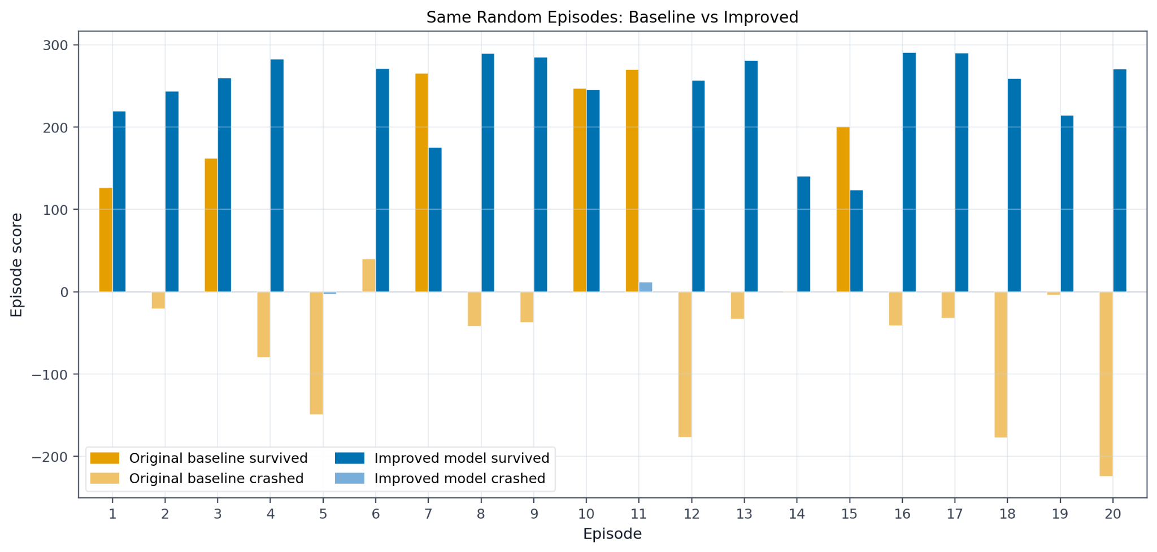
Final Results
13
Notes:
Parameters from the hyperparameter sweep, 20 training episodes per individual, 200 generations for training, 30 episodes for testing. Each episode has a duration of 500 frames. No crash penalty or parsimony. Time pressure with a weight of 0.01. Validation-based and coefficient-gated. The fitness score and survival rates are the highest values obtained so far. The model also shows the first signs of individuals in a generation that had no crashes in their training episodes. The performance on the model on test episodes is also highly satisfactory, with most resulting in a score considered a success by Gymnasium’s standards (above 200).

Slide 19
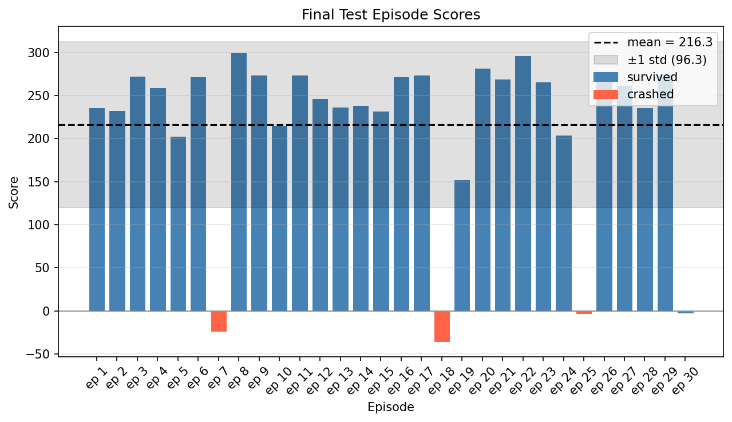
Final Results
13
Notes:
Parameters from the hyperparameter sweep, 20 training episodes per individual, 200 generations for training, 30 episodes for testing. Each episode has a duration of 500 frames. No crash penalty or parsimony. Time pressure with a weight of 0.01. Validation-based and coefficient-gated. The fitness score and survival rates are the highest values obtained so far. The model also shows the first signs of individuals in a generation that had no crashes in their training episodes. The performance on the model on test episodes is also highly satisfactory, with most resulting in a score considered a success by Gymnasium’s standards (above 200).

Slide 20
Gen 10
Gen 50
Gen 80
Gen 120
Gen 160
Gen 200

Slide 21
Seed 7
Seed 42
Seed 777
Seed 2025
Seed 9999
Seed 45298

Slide 22
Thanks for your attention!
9
Notes:
A parsimony weight was multiplied with the length of the tree and subtracted from the overall fitness. Done to discourage bloated tree sizes. This was also disabled due to the established maximum tree size parameter being a good enough driver.

Slide 23
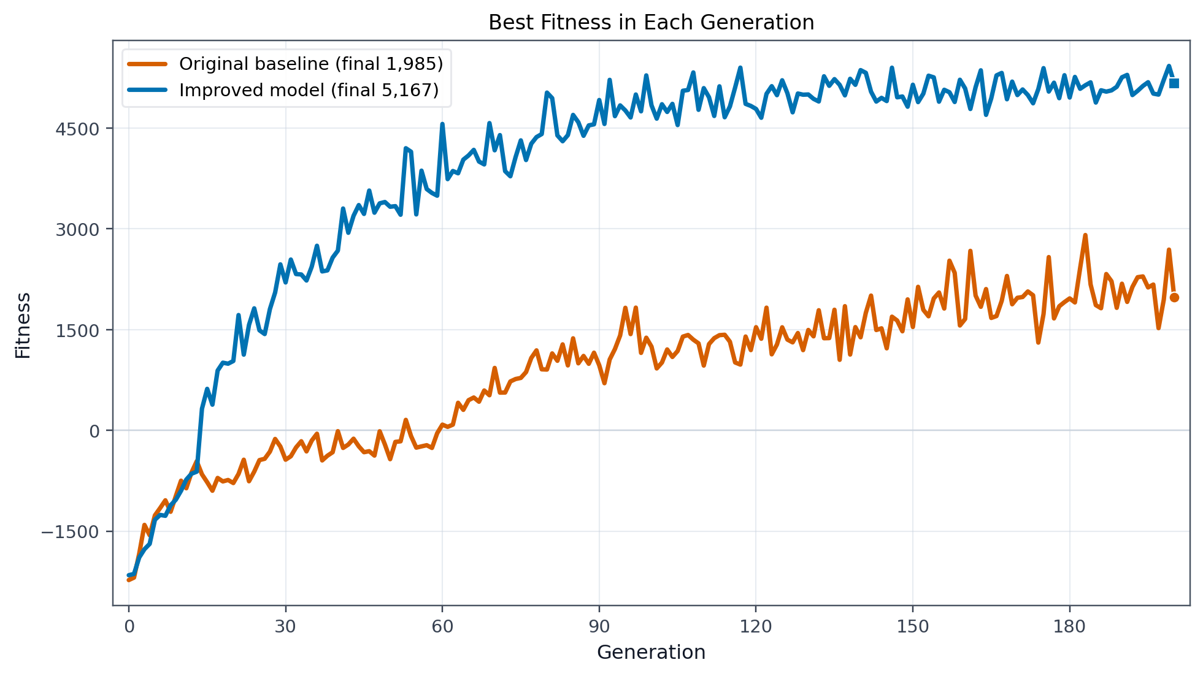
Final Results
13
Notes:
Parameters from the hyperparameter sweep, 20 training episodes per individual, 200 generations for training, 30 episodes for testing. Each episode has a duration of 500 frames. No crash penalty or parsimony. Time pressure with a weight of 0.01. Validation-based and coefficient-gated. The fitness score and survival rates are the highest values obtained so far. The model also shows the first signs of individuals in a generation that had no crashes in their training episodes. The performance on the model on test episodes is also highly satisfactory, with most resulting in a score considered a success by Gymnasium’s standards (above 200).

