Slide 1
People Analytics
Day 1 – 24/01/2022

Slide 2
Main goals of this course

Slide 3
Course Objectives
Be able to work in an HR analytics team
Acquire the relevant knowledge to coordinate and communicate with stakeholders such as HR data analysts, IT and other specialists
Learn about the various applications of analytics and develop an internal business case for your organization
Develop your HR analytics skills to check & analyze HR data
Know where to extract HR data, common data formats, tools, and how to work with HR data
Learn the basics of HR data and how HR adds value through analytics

Slide 4
Program of the 24h
Path Set | Path Content | Duration
Welcome / Introduction | Presentations & Program introduction to Human Resources & People Analytics Why / For who | 2h
Human Resources processes & HR Metrics | Budget & Strategic Workforce Planning/ Recruitment / Employee Branding IA utilization & Associated HR metrics | 2h
 | Onboarding, engagement IA utilization & Associated HR metrics | 2h
 | Development & progress / off boarding IA utilization & Associated HR metrics | 2h
 | HR Management thanks to HR analytics – 10 RETEX | 2h
Case Study & debriefing | Case Study | 2h
HR Analytical skills | Basics & Fundamentals in HR analysis Find, collect analyze, and vizualize the most relevant and useful HR data Take decisions based on HR data & storytelling | 2h
Tools & Enablers | HRIS, Vizualization tools & other tools (ie: Alteryx) | 2h
 | Data Quality, People Data protection & Retention | 2h
Case Study & debriefing | Case Study | 2h
Conclusion & Final evaluation | Summary & conclusion / People Analytics trends for 2023 | 2h
Final Evaluation + débrief | Final Evaluation | 2h
Method: Discussions 25% Presentation 25% Quizzes and case studies (exercise, text, webinar, video & readings) 50%

Slide 5
Introduction to People Analytics

Slide 6

Introduction
HR Analytics, also called People Analytics, is becoming more and more popular.
In just five years, the number of HR professionals with data analytics skills has grown by 242%*
Impressive as it is, this number is hardly surprising given the business impact potential of People Analytics..
*LinkedIn Global Talent Trends

Slide 7

People Analytics goals
« The ultimate goal of people analytics is to provide meaningful insights on various types of people- and HR data, and by providing that information, actively contribute to the business. »

Slide 8
Data that matters!
Only 16% of employees said they seemed engaged to employers
It costs about 33% of an employee’s salary to replace him / her
Over 75% of the reasons for employee turnover are preventable
About 81% of employees consider leaving their company if they have the right offer
A strong learning culture increases retention rates by 30 to 50%

Slide 9
How does Workforce Analytics Help in Solving Employee-related Queries?
People analytics is the process of analyzing employee data, otherwise known as workforce data, talent data or people data, to address critical business questions
HR professionals generally apply four kinds of analytics to get insights about a company’s workforce
1. Descriptive analytics
helps them gather and analyze data that describes the current state of things or past events.
2. Predictive analytics
helps in anticipating future outcomes and values based on the analysis of current and historical data. It uses statistical techniques like data mining and machine learning. Organizations use predictive analytics to optimize operations and improve the employee experience.
3. Prescriptive analytics
gives suggestions on what to do based on predictions and what had happened in the past.
4. Diagnostic analytics
show the causes of the results exhibited descriptive analytics. It explains the underlying cause, which helps us to focus our efforts to decrease the problem.

Slide 10
For who?
Directly:
All the HR members
Managers
CEO and Leadership team
Indirectly:
For the employees

Slide 11
Break 10’

Slide 12
Introduction to Human Resources

Slide 13

Introduction to Human Resources
Are you ready to test your HR knowlegde?

Slide 14
Human Resources (HR) Meaning and Responsibilities
Human resources (HR) is the division of a business that is charged with finding, screening, recruiting, and training job applicants. It also administers employee-benefit programs.
Human resources (HR) is the department within a business that is responsible for all things worker-related. That includes recruiting, vetting, selecting, hiring, onboarding, training, promoting, paying, and firing employees and independent contractors
HR plays a key role in helping companies deal with a fast-changing business environment and a greater demand for quality employees
A human resources department also handles compensation and benefits, and employee terminations.
It must keep up to date with any laws that may affect the company and its employees.
People-related activities that HR must effectively do to add value to a company. They are:
Recruiting, hiring, and onboarding new employees
Handling employee compensation and benefits
Offering employee job/career development that enhance individual and organizational performance
Addressing work-related issues of individual employees
Developing policies that affect a working environment company-wide
Developing employee's competencies that enhance individual and organizational performance
Increasing the innovation, creativity, and flexibility necessary to enhance competitiveness (in developing new approaches to work)

Slide 15
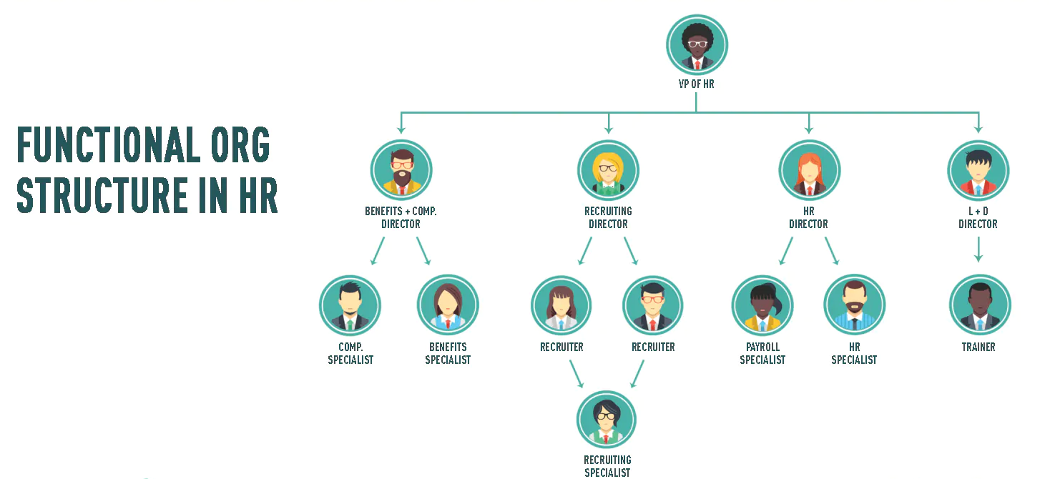
HR ORGANIZATION

Slide 16
ROQUETTE -HR ORGANIZATION
3 ORGANIZATIONAL PILLARS
Centers of Expertise
The HR Centers of Expertise (CoE) design, promote, deploy and enhance common and consistent People and HR processes worldwide in line with Roquette People Strategy (ie : C&B, Talent, Recruitment, Learning...)
COE support when needed local projects.
Head of HR
HR Functions
The Global Functions HR organization is “mirroring” the Roquette Global Functions organization.
Global functions are HR BP of LT and Reporting LT members
They are in charge of designing function’s organization, career path, competencies framework & learning academies, building talent pipelines and preparing forward looking workforce planning
Centers of Expertise
HR Functions
Areas HR
Comp&Ben, HRIS & HR Excellence
Business
Americas
Areas HR
The role of Areas HR is to implement locally the global HR policies & processes in respect of local regulations.
They deliver local HR services (staffing, recruitment, social relations …) and people management support.
They build local initiatives adapted to their context (benefits programs…)
People Capital Development
Operations
Europe
Executive Comp&Ben & International Mobility
Enabling
Greater Asia

Slide 17
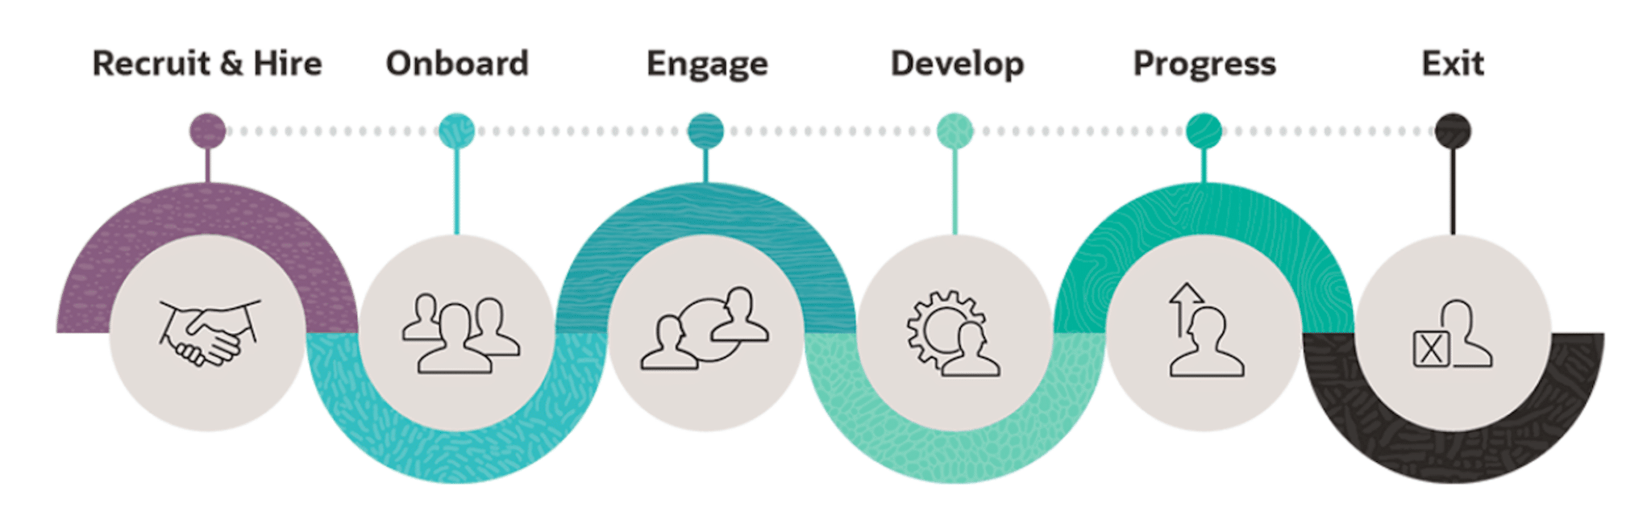
HR Processes
Employee journey
Organization needs / budget
Recruitment
Onboarding
Training/ Career development
Internal mobility or end of contract (off boarding)

Slide 18
Open discussions
https://www.youtube.com/watch?v=nRMlf-ARvxE
Do you know if there is one “People Analytics” team in your company?
Did you already worked on people analytics topics? Or for the HR department?

Slide 19

The next session
Focus on Recruit & Hire
HR processes with more details and with associated Metrics
IA utilization

