Slide 1
People Analytics
Day 2 – 31/01/2022

Slide 2
Key Take aways of the previous lesson
Per group : few words / sentences to summarize the previous lesson

Slide 3
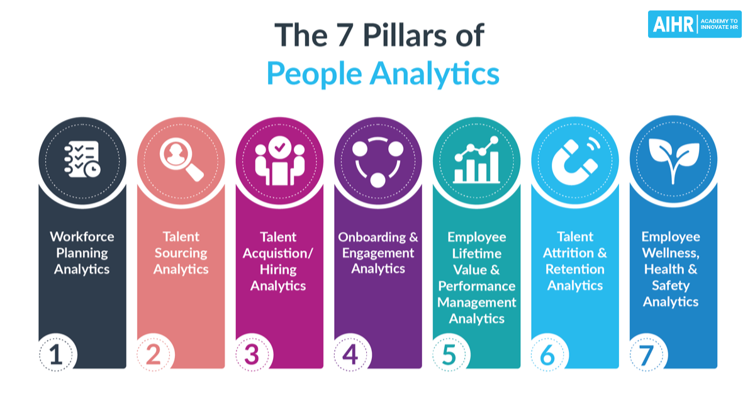
The 7 pillars of people analytics

Slide 4
Recruitment steps
The main steps are:
Identify the hiring needs.
Prepare job descriptions.
Devise recruitment strategy.
Screen and shortlist candidates.
Conduct interviews.
Evaluate and make the offer.
Onboard the new employee.

Slide 5
Recruitment steps
The main steps are:
Identify the hiring needs.
Prepare job descriptions.
Devise recruitment strategy.
Screen and shortlist candidates.
Conduct interviews.
Evaluate and make the offer.
Onboard the new employee.

Slide 6

Plan your workforce needs
Translate the business strategy into people strategies, assessing workforce gaps and defining proactive gap-closure solution to shrenghten our workforce for today and prepare for tomorrow

Slide 7
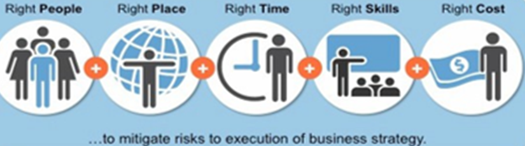
Plan your workforce needs
Strategic workforce planning (3 to 5 years)
To workforce Budget (year +1)
Five steps every effective workforce planning strategy should follow:
Align workforce planning with business objectives
Conduct a workforce analysis
Develop an action plan
Implement an action plan
Monitor, assess and adjust.

Slide 8
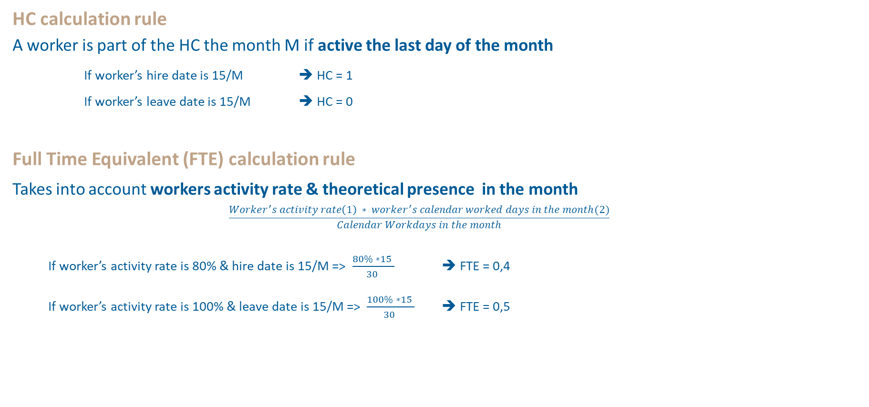
Plan your workforce needs
HC calculation rule
A worker is part of the HC the month M if active the last day of the month
If worker’s hire date is 15/M ➔ HC = 1
If worker’s leave date is 15/M ➔ HC = 0
Full Time Equivalent (FTE) calculation rule
Takes into account workers activity rate & theoretical presence in the month
$$\frac{Worker^{′}s activity rate\left(1\right) ∗ worker^{′}s calendar worked days in the month(2)}{Calendar Workdays in the month}$$
If worker’s activity rate is 80% & hire date is 15/M => $\frac{80\% ∗15 }{30 }$ ➔ FTE = 0,4
If worker’s activity rate is 100% & leave date is 15/M => $\frac{100\% ∗15 }{30 }$ ➔ FTE = 0,5

Slide 9
Plan your workforce needs
HC&FTE and Labor Cost calculation
Volume
Headcount Details
1 | Actual Headcount
2 | Leavers
3 | New Comers
Employees:
Permanent
Fixed-Term
Intern
Labor Cost
Labor Cost Element Group
1 | Wages & Salaries
2 | Bonus
3 | Social Security Charges / employment tax
4 | Employee Benefits and other compensation
Value
Additional Notes
Recruiting Costs are included in External Fees cost element group which is not included in Labor Costs.
Labor Cost Element Group
5 | Trainings
6 | Temporary Staff
7 | Termination Costs
8 | Expatriate Costs
9 | Profit Sharing to Employees
10 | IAS Employee Benefit
11 | Other Labor Costs

Slide 10
Plan your workforce needs
WORKSHOP PER GROUP :
The HRBPs of the company Z defined a Workforce plan for 2024-2026 (with Excel & basic TCD)
They ask your help for a better visualization, analyze the Data of the Strategic Workforce planning (gaps, figures), and define action plan with them
4/5 Groups : prepare an analysis and a plan in answering to all the questions and bring your imputs:
What are the types of jobs increasing and declining?
What are the types of jobs in transformation?
What are the emerging (new) jobs?
Costs impacts?
What is your overal analysis, your remarks?
As an HR data analyst, what could be the preconisation for the company?

