Slide 1
People Analytics
Day 3 – 07/02/2022

Slide 2
Key Take aways of the previous lesson
Per group : few words / sentences to summarize the previous lesson

Slide 3
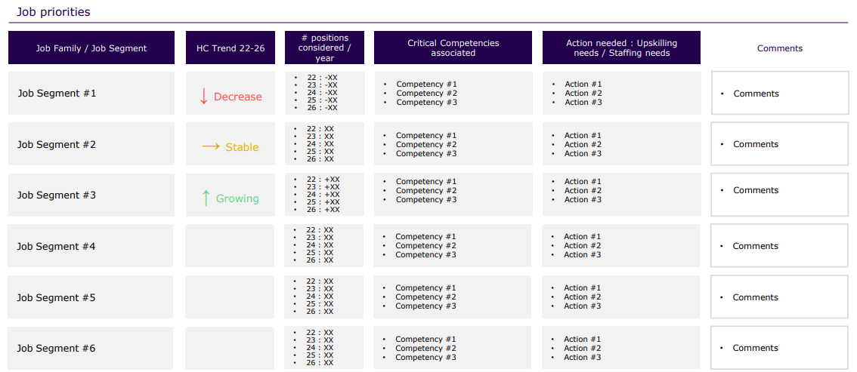
Exemple of action plan Workforce planning

Slide 4
Recruitment steps
The main steps are:
Identify the hiring needs.
Prepare job descriptions.
Devise recruitment strategy.
Screen and shortlist candidates.
Conduct interviews.
Evaluate and make the offer.
Onboard the new employee.

Slide 5
Prepare job descriptions / Candidate experience
Career Site:
Career Sites Are Difficult to Use. A Personalized Candidate Experience Attracts More Qualified Talent
Most career sites seem designed to turn away talent. They force the candidate to read job descriptions and struggle to find the right job. They may take hundreds of clicks to complete an application. This can make candidates feel unwanted and undervalued. Not the first impression you want to create.
AI experience instantly shows each candidate the right jobs for them and explains why their skills and background are a fit. Automation reduces the number of clicks to make applying fast, easy, and encouraging. It’s a true boost to your employer brand.
Application rates increase by four times or more, and candidates who apply are highly qualified
Notes:
Depuis la pandémie en particulier, 38% se posent la question de changer d’entreprise et revoient leur priorité
Pénurie de jobs
Dc pr attire les candidats: experience candidat optimale et intéressante
Vitrine de l’entreprise
1/3 des personnes ne vont pas au bout d’une candidature
Nb clics
Avec experience personnalisée grâce à l’IA : + de candidats qualifies pr le poste et + de candidatures
The results for employers are tremendous. Application rates increase by four times or more, and candidates who apply are highly qualified, with half of all applicants meeting or exceeding role requirements. Candidates are also more likely to be in underrepresented groups, and employers are receiving up to 30% more applications from Black and Hispanic applicants and 90% more applications from female applicants in the U.S. Employers are getting far more hiring value from their career site, and they can handle any volume of applicants.

Slide 6
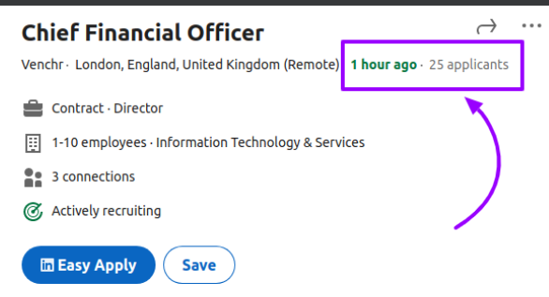
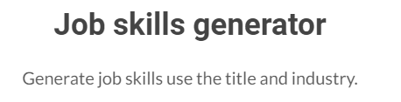
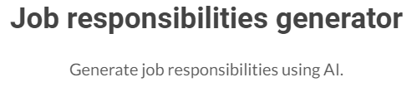
Prepare job descriptions / Candidate experience
Job descriptions:
Your job postings are often the first impression a candidate will have of your business. A vague description that leaves a job seeker with more questions than answers will not do anything to help you attract qualified candidates. You can use AI to have standard job descriptions & win time
Notes:
Skills (compétences) et responsabilités générées par une IA avec Mots clés qui attirent +
Recruiters can't be expected to know everything about the nuances of job requisition language, especially new recruiters or recruiters for highly technical positions.
What are the keywords in a given field that attract the most qualified responses?

Slide 7
Recruitment steps
The main steps are:
Identify the hiring needs.
Prepare job descriptions.
Devise recruitment strategy.
Screen and shortlist candidates.
Conduct interviews.
Evaluate and make the offer.
Onboard the new employee.

Slide 8
Devise recruitment strategy
Make or Buy:
Make : recruit internally by a recruitment team
A permanent position
A fixed Term position (increase of work, replacement, project)
An apprentice / intern : for a dedicated project
Buy : Buy a service (consultant, external provider, temporary staff) for a temporary period
Notes:
IA can préco stratégie based sur le SWP
Exemple: logistic operator dans l’exercise: decrease mais pas tt de suite donc on ne va pas embaucher en CDI, on va prendre des temporaires

Slide 9
Recruitment steps
The main steps are:
Identify the hiring needs.
Prepare job descriptions.
Devise recruitment strategy.
Screen and shortlist candidates.
Conduct interviews.
Evaluate and make the offer.
Onboard the new employee.

Slide 10
Screen and shortlist candidates
Sourcing:
Boost sourcing speed with AI and automation
Get new qualified candidates with a click
Create intelligent, personalized nurture campaigns
Build talent pools with AI-matching and calibration
Greatly reduce sourcing spend on job boards and professional networks
Screening:
Screen the entire Talent Network instantly
Consider all qualifications including skills and skill learnability
Screen without bias and without missing quality candidates
AI could potentially be used to schedule and coordinate interviews with candidates
"How AI is Deciding Who Gets Hired“
Open discussion : comments?

Slide 11
Recruitment steps
The main steps are:
Identify the hiring needs.
Prepare job descriptions.
Devise recruitment strategy.
Screen and shortlist candidates.
Conduct interviews.
Evaluate and make the offer.
Onboard the new employee.

Slide 12
Recruit
Entretien d’embauche video et IA
Open discussion : comments?

Slide 13
Recruitment steps
The main steps are:
Identify the hiring needs.
Prepare job descriptions.
Devise recruitment strategy.
Screen and shortlist candidates.
Conduct interviews.
Evaluate and make the offer.
Onboard the new employee.

Slide 14
Evaluate and make the offer
Skills assessments: AI could potentially be used to assess candidates' skills and abilities in a more objective and standardized manner, potentially using tests or assessments that are designed to measure specific skills or aptitudes.
Reference & Background checks: AI could potentially be used to automate the background check process, potentially using natural language processing to analyze candidates' resumes, social media profiles, or other sources of information to identify potential red flags or discrepancies.
Compensation offer: Based on market data, candidate experience and crossed with expectations

Slide 15
Recruitment steps
The main steps are:
Identify the hiring needs.
Prepare job descriptions.
Devise recruitment strategy.
Screen and shortlist candidates.
Conduct interviews.
Evaluate and make the offer.
Onboard the new employee.

Slide 16
Onboarding

Slide 17
Onboard
Remember & rate your own onboarding experience…

Slide 18

Onboard
Few “Shocking” Employee Onboarding Statistics
Strong onboarding improves new hire retention by 82%
6 out of 10 managers have had an employee leave during probation due to poor onboarding
Turnover costs up to 300% of the replaced employee salary
Onboarding increases performance up to 11%
#Retention #Companybranding #Performance

Slide 19

Onboard
Why is onboarding a key process ?
Understand Company Strategy, market, products …
Promote the culture and the
Values
Accelerate the feeling of belonging to the team
Take ownership of digital tools
Clarify new comers’ role & expectations (including objectives setting)
Discover company, directives and rules (quality, safety…)
Have access to Processes
Develop network
(in and out the function)
Be included in team rituals

Slide 20
Measure the performance of the recruitment

Slide 21
Recruit
The recruiting process should add value to the business, and you should be able to show the return on your investment for recruiting activities.
You can use the data and insights gleaned from recruitment KPIs to align your recruiting funnel with business outcomes.
Gathering and monitoring recruitment analytics like KPIs can be overwhelming if you don’t have the right technology, leadership and strategy in place.
Recruitment KPIs are only as useful as the data-visualization and communication tools you use to analyze and distribute them.
A successful recruitment process aims to fill the open positions with high quality candidates, as quickly as possible, with the minimal costs
Notes:
accablant

Slide 22
Recruitment KPI’s
Exercise:
The CEO is furious about the recruitment process, the Head of finance left the company 8 months ago and the replacement is not finished. And he heards a lots of complaints from the managers. So, he planned a meeting with The Head of HR. He meet him in 2h, he’s asking your help:
1. He wants a visualization Dashboard to show the recruitment figure With a pre-analysis 2. He will give you a budget to improve the recruitment process with the IA. But this is a limited budget so you have to propose few solutions and prioritize

Slide 23
Recruitment KPI’s
Figures sent by the HR Team: 2000 employees in the company 150 recruitments in 2022 / 120 positions still opened 4 recruiters in the team (no budget for agency) 50 filled between 1 and 2months 20 between 2 and 3 months 40 between 3 and 6 months 40 more than 6 months 30 with Internal mobility / 120 with external candidates 20 candidates in average per job 8 screening in average 3 interviews 10% of candidates don’t go further after offer, screening or interview. Reason : recruitment process too long, another offer 1/10 didn’t validate the probation period : always company decision

