Slide 1
People Analytics
Day 4 – 14/02/2022

Slide 2
Measure the performance of the recruitment

Slide 3
Recruit
The recruiting process should add value to the business, and you should be able to show the return on your investment for recruiting activities.
You can use the data and insights gleaned from recruitment KPIs to align your recruiting funnel with business outcomes.
Gathering and monitoring recruitment analytics like KPIs can be overwhelming if you don’t have the right technology, leadership and strategy in place.
Recruitment KPIs are only as useful as the data-visualization and communication tools you use to analyze and distribute them.
A successful recruitment process aims to fill the open positions with high quality candidates, as quickly as possible, with the minimal costs

Slide 4
Recruitment KPIs
1. Time to Hire
This KPI measures the time between when a candidate is contacted for a job opening or enters the recruiting funnel, and when they accept a job offer.
Time to hire = Days elapsed from date the job was posted or candidate was contacted for recruitment to the day an offer is accepted
Time to hire (or days to offer) is an essential measure of efficiency and helps identify bottlenecks in the recruitment process. Top talent can be off the market within a few weeks, as they’re desirable candidates. So, keeping the time-to-hire as short as possible can boost your quality of hire and lower costs. Additionally, monitoring this KPI can inform hiring decisions for specific timelines or outcomes. If you know how long it takes on average to hire new salespeople and customer service agents, for example, it can help inform when to start the hiring process for a new project or product line. It’s an essential metric for HCM strategy and workforce planning.
Segment and track time-to-hire by department, team and hiring managers. Monitor a separate time-to-hire KPI for recruitment consultants and a KPI for recruitment managers if you use third-party recruiting agencies. Use an applicant tracking system (ATS) or human resources management system (HRMS) to automatically monitor and organize this data.

Slide 5
Recruitment KPIs
2. Sourcing Channel Efficiency
This KPI measures the usefulness of your sourcing channels, or where you advertise job openings. It helps you understand where you find the most qualified candidates and the ROI of different sourcing pipelines.
Sourcing channel efficiency = Number of qualified candidates from a specific source – the average number of applicants from all sources
Knowing the sourcing channel efficiency KPI helps you develop effective sourcing strategies and improve the overall recruiting process. To track and monitor this KPI, set up conversion tracking tools like Google Analytics or leverage analytics tools from third-party applications. Use your ATS or HRMS platform to track sourcing channel data for each candidate. Use the data to analyze trends and compare results with related metrics like sourcing channel cost, application drop off rate, cost per hire and recruitment funnel effectiveness.

Slide 6
Recruitment KPIs
3. Number of Qualified Candidates
Use this KPI to assess how well your sourcing efforts are finding and progressing qualified candidates through the recruiting funnel. It’s expressed as a ratio of qualified candidates who make it past the initial stage of recruiting.
Number of qualified candidates ratio = # of candidates hiring managers deem qualified / # of candidates who make it past the initial screening
So how do you decide what makes a qualified candidate? There are a few approaches you can take. The simplest is asking or sending surveys to hiring managers if the candidates who emerge from the screening process are qualified. If you’re unable to do that, you can also look at other metrics. For example, of the candidates who make it through the initial round of screening, how many did hiring managers want to interview? Or you can use recruitment metrics like referral rate or interview-to-hire ratio to give insight into how qualified your candidates are for specific postings. A high interview-to-hire ratio helps surface issues with your advertising efforts, job descriptions, candidate screening process or sourcing channel effectiveness. You can also establish this KPI as a per hire ratio.

Slide 7

Recruitment KPIs
4. Submit to Interview Ratio
This KPI looks at the number of candidates submitted to hiring managers for possible interviews. A higher ratio might indicate issues with sourcing and screening because the sourcing and screening process should result in only qualified candidates that meet the manager’s needs. The ideal ratio here is 1:1.
Submit to interview ratio = # of candidates submitted for consideration / # of candidates interviewed
Monitor recruiting metrics like hiring manager satisfaction and source of hire if you notice issues with achieving your recruiting KPI benchmark for submit to interview ratio.

Slide 8
Recruitment KPIs
5. Interview to Offer Ratio
Interviews are crucial to recruiting, but they can be a time-consuming activity for candidates and hiring managers. An unsatisfactory interview to offer ratio creates a higher cost per hire. Interviews are also key factors in other recruitment KPIs, such as candidate experience and net promoter score (NPS).
The optimum interview to offer ratio is 3:1. If you average a higher rate, verify that the hiring manager is writing or reviewing every job description. Then focus on your sourcing and screening activities and KPIs like source quality, sourcing channel efficiency and the number of qualified candidates.
Interview to offer ratio = # of candidate interviews / # of job offers

Slide 9
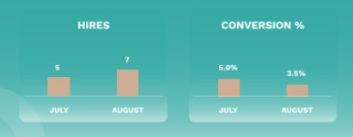
Recruitment KPIs
6. Offer Acceptance Rate
After finding qualified candidates and taking them through the screening and interviewing process, you want them to accept the job offer. If they don’t, there may be some issues with company reputation or your compensation and benefits strategy. Working with your finance team can help inform a proactive retention strategy, as well as boost the offer acceptance rate.
Offer acceptance rate = (# of accepted job offers / total offers extended) X 100
Alongside the offer acceptance rate, keep track of compensation negotiations with qualified candidates to provide even more insight into whether your pay is competitive and if adjustments need to be made. Additional insight can come from looking at if improving other KPIs, such as the time to hire, can help boost the acceptance rate.

Slide 10
Recruitment KPIs
7. Cost Per Hire
How much does it cost to fill a vacant position? This KPI should take into account all the associated costs, including things like how much you pay to post the job on different job boards, any referral fees, the cost of attending job fairs, etc. Additionally, you should account for the time of the HR recruitment team, and if possible, the cost for others to help recruit and train new employees, including onboarding and interview time. By looking at the bigger picture here, you can start to find areas where you can improve efficiency, as well as justify retention efforts to decrease employee turnover. It’s also a key measure to inform your recruiting budget.
Cost-per-hire = Total recruiting cost / # of hires
The average cost per hire varies by industry and position and is heavily influenced by the labor market.

Slide 11
Recruitment KPIs
8. Quality of Hire
There isn’t a one-size-fits-all approach to determining the quality of your hire. Usually, this is a conglomerate of measures that can include everything from employee productivity at the three-, six- and 12-month marks, to new-hire attrition. Generally, this is broken into two categories: pre-hire quality and post-hire quality.
Pre-hire quality
Based on references, resumes and work experience, are you attracting the type of candidate who you believe has the ability to perform the job to your satisfaction? A few measures to look at include time-to-hire and first-offer acceptance rate. And ask your hiring managers how satisfied they are with the pool of candidates they receive for each job posting and track their level of satisfaction.
Pre-hire quality satisfaction rate = (# of managers who are extremely or very satisfied with candidate pool / total number of surveys filled out) x 100

Slide 12
Recruitment KPIs
Post-hire quality
How long does it take for new employees to become productive, and how does that productivity compare to peers who have been doing similar jobs? Also, look at things like cultural fit with specific teams and overall company culture. And consider measures of employee engagement, which can lead to better employee retention and higher employee satisfaction. Employee surveys and performance reviews can be important tools for determining post-hire quality.
One of the KPIs for post-hire quality is one-year attrition. A high turnover rate can indicate a recruiting problem with finding the right employees for the job.
One-year turnover rate = # of employees who leave within one year of hire date / total number of employees who leave during the same period

Slide 13
Recruitment KPIs
9. Hires to Goal
This is a KPI to use if you have a goal for the number of new hires to make for a specific time period. For example, you may need to hire 15 new employees to help roll out a new product line in this quarter. It could comprise salespeople, IT professionals and administrative support.
Hires to goal = (# of new hires in a given period / hiring goal for that period) x 100
Reaching hiring goals is a good measure of the strength of your candidate pipeline, workforce planning and recruiting processes.

Slide 14
Recruitment KPIs
10. Candidate Net Promoter Score (NPS)
This KPI measures the applicant/candidate experience during the recruiting process. Candidate NPS provides insight into how likely candidates are to recommend your company based on their recruiting experiences.
Candidate NPS = % of promoters – % of detractors
Ask applicants, whether they’re hired or not, this survey question: “On a scale of 1-10, how likely are you to recommend our company to a friend or colleague?”
Subtract the percentage of 1-6 responses (detractors) from the percentage of 9 or 10 responses (promoters). Don’t include answers of 7 or 8 in the calculation. Collect NPS data at various stages of the recruiting process and segment the data by recruiter and recruiting stage. An NPS above 50% is usually considered excellent.

Slide 15
Recruitment KPIs
Focus on DE&I:
A meaningful DE&I strategy begins with an effective policy for diversity hiring. Decide on the right diversity strategy for organization, then you need the tools to implement it
Nb recruitments per age / per gender
Nb promotions per age / per gender
Nb of nationalities
Gap in terms of compensations

Slide 16
Employee Development

Slide 17
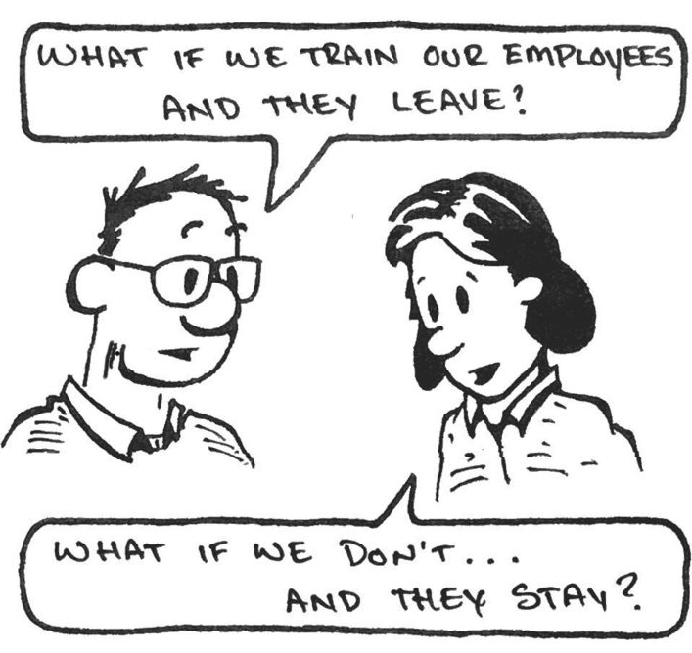
Develop
Why?
#Onboarding
#Upskilling
#Knowledge transfer
#Taking Care
#Valorization
#Recognition
#Career
#Reconnexion

Slide 18





DIFFERENT TYPE OF LEARNING
#E-Learning
#Physical Classroom
#Practical exercises
#Virtual Classroom
#Serious Game

Slide 19
Learning KPIs
Retention of New Skills and Knowledge
Here is an unfortunately common scenario: A business struggles to schedule training in a timely manner. Workers are allowed to participate in training as productivity and staffing needs allow for it. When they are sent to training, they receive huge amounts of new information. After they return to work, it might be days, weeks, or even months before they apply that knowledge. Inevitably, they’ve forgotten huge chunks of it.
Retention of skills and knowledge shows the importance of establishing learning and development KPIs that connect training to job performance.
What causes training to fall short in this area?
Failure to engage participants
Lack of ongoing assessments
Overwhelming participants with too much information at once
Not providing opportunities to apply new knowledge right away
Lack of follow-up
Training teams can improve in this area by making training more timely, employing methods that keep workers engaged, and offering smaller learning modules more often.

Slide 20
Learning KPIs
Business Performance/Productivity Metrics
An effective training strategy should translate into business success. Businesses that offer the right kind of training will see more sales, better customer service ratings, increased productivity, and decreased safety and compliance incidents.
The best way to attract this metric is to start with clear training objectives that tie directly to business outcomes. Then, measurements can be taken in target areas before training, directly after training, and further out into the future.

Slide 21
Learning KPIs
Course Net Promoter Score
A net promoter score (NPS) is traditionally a measure of customer satisfaction. Businesses will poll customers to see how likely they would be to recommend their products or services to friends, family, and associates.
Course net promoter score is basically a twist on the same content. In this case, it’s asking them directly if they would recommend a course of training program to a coworker. The results of this can tell you if a particular training effort is adding value for your employees.
If your course net promoter scores aren’t where they should be, there could be a few different causes for this. Relevance is important. Workers may not see a connection between the training they receive and their role.
In some cases, the course content simply isn’t interesting enough. If this is a problem, look for ways to make the curriculum more engaging. There are ways to integrate elements into training, such as YouTube videos, presentations, and content from professional course providers.

Slide 22
Learning KPIs
Stakeholder Perception
Some of the most important learning and development KPIs are qualitative, not quantitative. Stakeholder perception is one of those learning and development metrics.
Stakeholders are the managers, team leaders, and department heads who are directly impacted by the effectiveness of training. They also have the ability to see firsthand if workers are able to take what they learn in training and apply that on the job.
Stakeholders also track employee performance metrics. They see the sales numbers, safety stats, and productivity reports. If they are satisfied, this is a good indication of training program success.

Slide 23
Learning KPIs
Training Efficiency
Perhaps in an ideal world, every organization could approach training at a leisurely pace that created the ideal environment for people to learn without the added pressure of urgency. Unfortunately, this just isn’t realistic. In order to stay competitive, businesses must prioritize training efficiency. When workers learn quickly, they can incorporate that knowledge and create the competitive advantages businesses count on.
Training efficiency, or time to proficiency, measures how quickly workers gain the desired competencies and skills. One way to track this metric is to simply use LMS data to determine how quickly workers are completing training and passing assessments. Additionally, you can collect feedback from focus groups that are created to assess pre- and post-training proficiency.

Slide 24
Learning KPIs
Employee Engagement
Right now, employee retention is a big challenge for most businesses. Workers hold a significant amount of power over their own destinies. The current job market is working very much in their favor. One of the advantages they enjoy is the sheer availability of information about potential employers. It’s easy for job seekers to find employee reviews, salary data, and cultural information about most companies.
In response to this, employers are paying much closer attention to employee engagement metrics. Training is an important part of this. Professional development matters to workers. So does working for an employer who is willing to invest in that. When workers are happy, engagement rates are high, and attrition is low, there’s a good chance that your training strategy is working.

