Slide 1
People Analytics
Day 5 – 28/02/2022

Slide 2
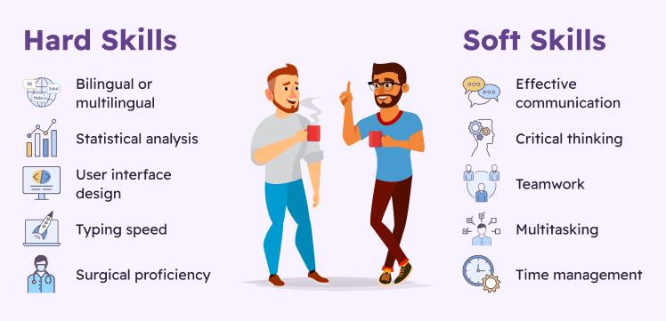
Learning

Slide 3
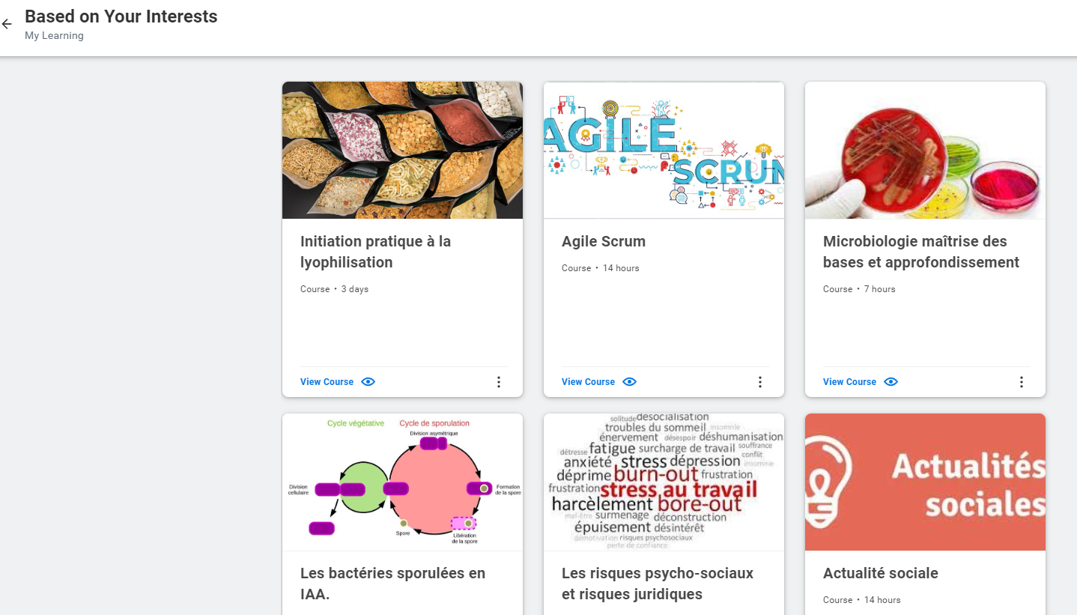
Learning
The AI approach to training involves a shift from acquiring business skills to customizing career paths. With the advent of learning analytics, training techniques are evolving. Data for tracking learning modes (the time needed to acquire knowledge and the level of understanding) can be used to represent the way people learn and individualize suggestions for skills development.
In addition, AI is used to offer employees opportunities for internal mobility based on their wishes, skills and the options available inside the company. AI start-ups put forward solutions for streamlining mobility management that combine assessment, training and suggestions about pathways, positions and programs for developing skills. These are limited in France, however, with the RGPD (General Data Protection Regulation), although they can be individualized in other countries.

Slide 4
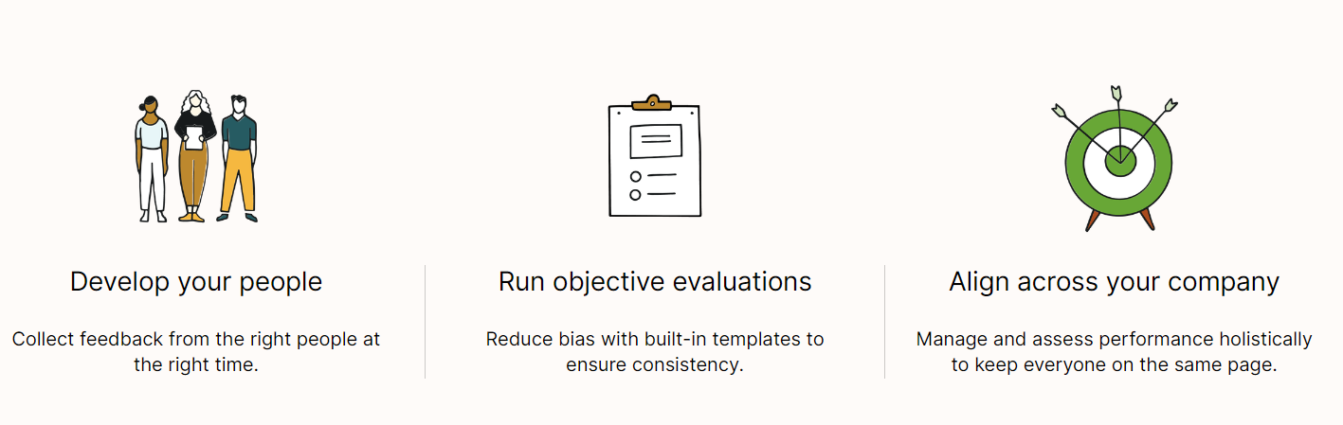
Manage the performance
https://youtu.be/WjvHPdlKoEA
5 Key Success Factors of a Performance Appraisal | AIHR Learning Bite – YouTube
“By having a really strong continuous feedback loop through performance management, we’ve had more opportunities to recognize performance... that keeps employees feeling fulfilled and engaged.”
Deliver better performance management experiences with continuous feedback, goal tracking, and flexible performance reviews.

Slide 5
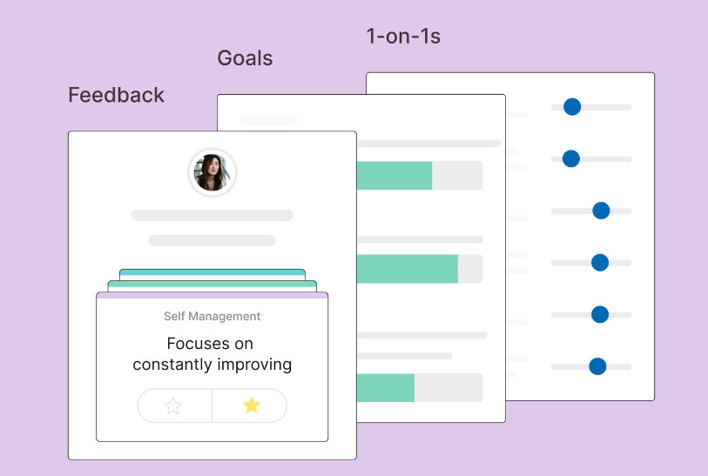
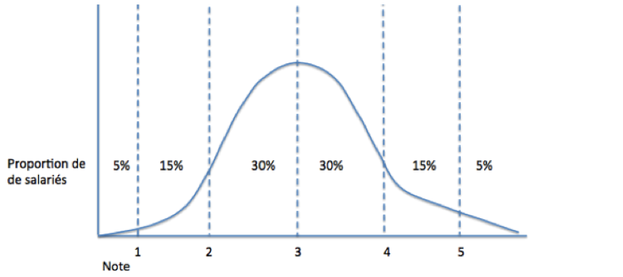
Manage the performance
Build a fair and useful performance review process across your organization
Calibrations are the key to equitable performance reviews. Easily track employee performance across the company and identify opportunities for alignment.
“Courbe de Gauss”

Slide 6
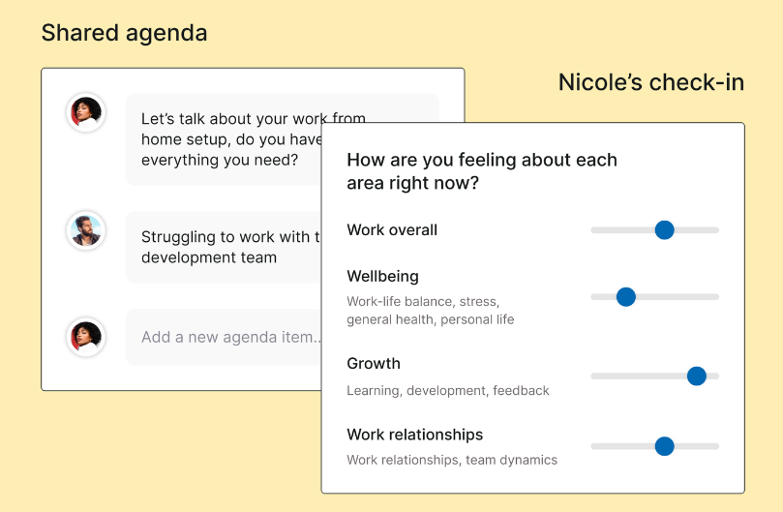
Manage the performance
Empower teams to do their best work
Encourage collaboration and connection between managers and employees with an intuitive, science-backed 1‑on‑1 template.

Slide 7
Manage the performance & AI
Automated performance reviews
Business leaders love Ai-driven performance management. It helps them as well as team leaders to focus on factual information and carry out employee performance reviews. There is a need for employees to collaborate and make decisions. We are now better off to measure results from such collaborations using AI software in performance management.
The ROI of performance management system is pretty much connected to the presence of artificial intelligence in performance management system. We can see 3 major benefits with this:
a. Seamless collection of information
Otherwise, employees have to run around on different office floors and look for the information they need. It is alright if there is ample time for taking certain decisions but what about the ones that need immediate action or approval? Therefore, AI in performance management system is going to ensure that all the information is stored in one single place. This information or employee data can help leaders and stakeholders evaluate employee performance and share it with other team members as well.

Slide 8
Manage the performance & AI
b. The manager can easily extract insights from real-time analysis
This is because the real-time analysis is important to keep a regular check on performance. Nobody needs outdated data or information. Nobody would benefit from that either. Therefore, correct data comes with real-time analysis and it helps improve overall employee performance.
c. It eliminates any form of psychological bias
In fact, it is one of the most crucial reasons why AI in performance management system is going to takeover performance evaluation and employee assessment.
Continuous real-time assessments
Modern and agile performance management guides are helpful in conducting regular feedback sessions. AI in performance management systems can reduce the necessity and burden of rigid performance evaluation cycles. Therefore, it brings more flexibility and relevant insights with the help of performance ai.
It will accelerate and ensure timely feedback. This is important because irregular feedback may impact the overall employee performance. So, timely feedback can immediately highlight areas of improvement and boost business productivity.

Slide 9
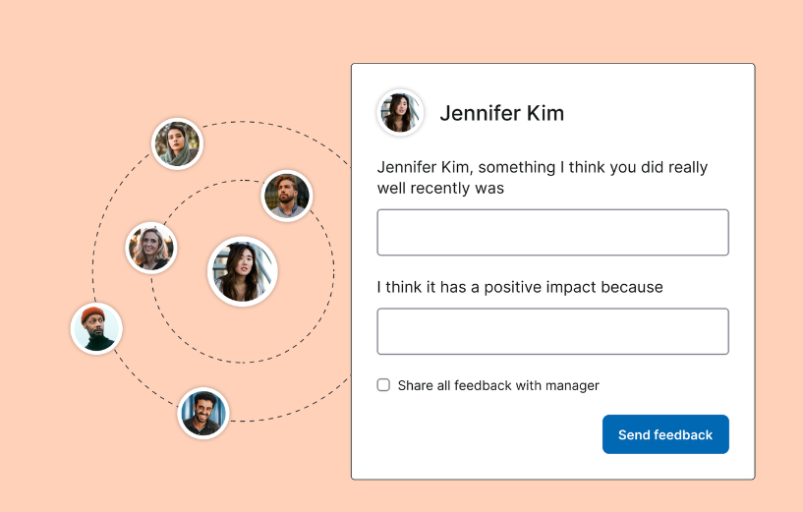
Manage the performance & AI
Quick, agile and continuous performance feedback
Traditional or annual performance reviews are outdated and they do not add much value to a business or employee performance improvement. We now need more proactive feedback solutions so that we can tap into employee potential and offer them a platform to improve.
The process is fair, removes any form of bias and creates a new form of personalised experience for employees. It promotes authentic peer performance review as well.
Evaluation software such as peopleHum also enables business leaders to conduct 360-degree feedback questions. This way, leaders, as well as peers, can provide relevant feedback to employees to ensure holistic improvement.

Slide 10
Manage the performance & AI
Learning and Development
AI can easily determine the areas of improvement for various employees. It can inform the manager if an employee is lacking somewhere and how they can improve.
AI can help employees reinvest their skills much before they become obsolete. Therefore, AI won't take away jobs but help employees stay relevant and improve their skills. This is going to take away the terror of people becoming redundant because they won't. Interpersonal skills and mathematical intelligence are always going to stay relevant.

Slide 11
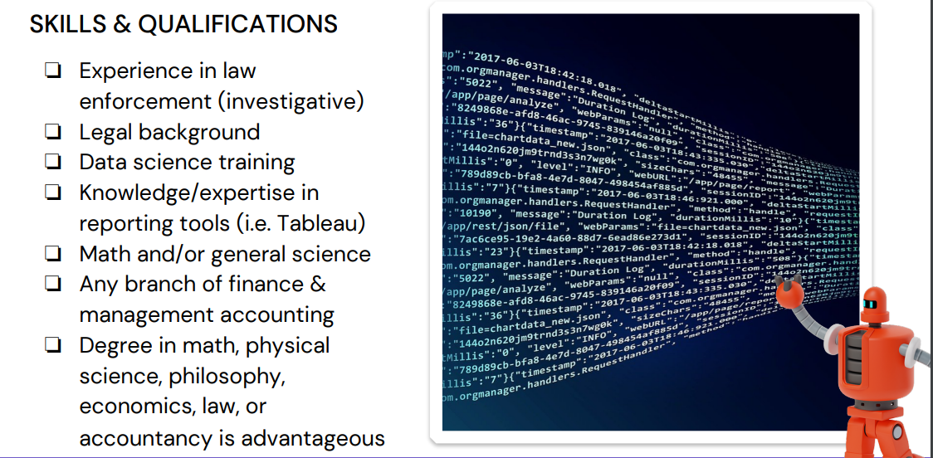
Manage the career

Slide 12

Manage the career
Career path : based on previous experience, compétences, interest, AI propose career path and push internal positions to employees
Career interview : same way than performance management, 1 / year
https://www.phenom.com/blog/AI-skills-management-career-pathing

