Slide 1

Culinary Delights of Italy: A Food Lover's Journey

Slide 2

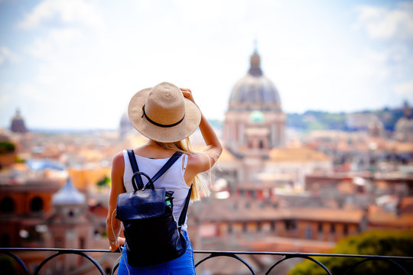
Italy
1. Bologna: Known as the foodie nirvana of Emilia-Romagna, Bologna is a must-visit for anyone who loves food
2. Tuscany: Birthplace of the Renaissance, Tuscany is home to the beautiful city of Florence and the charming town of Siena
3. Rome: A visit to Europe isn't complete without visiting Rome

Slide 3
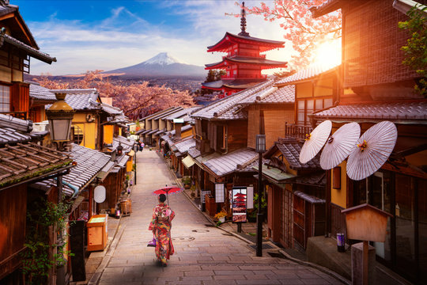
Japan
1. Tokyo: Japan's bustling capital city is home to some of the best food in the country
2. Kyoto: Known for its beautiful temples and gardens, Kyoto is a must-visit for anyone interested in Japanese culture
3. Osaka: Osaka is famous for its delicious street food, including takoyaki (octopus balls) and okonomiyaki (savory pancakes)

Slide 4

Mexico
1. Mexico City: Mexico's vibrant capital city is home to some of the best food in the country
2. Oaxaca: Known for its rich culinary traditions, Oaxaca is a must-visit for anyone interested in Mexican food
3. Yucatan Peninsula: The Yucatan Peninsula is home to some of Mexico's most famous dishes, including cochinita pibil (slow-cooked pork) and ceviche (raw fish marinated in citrus juice)

Slide 5

Thank You!

