Slide 1
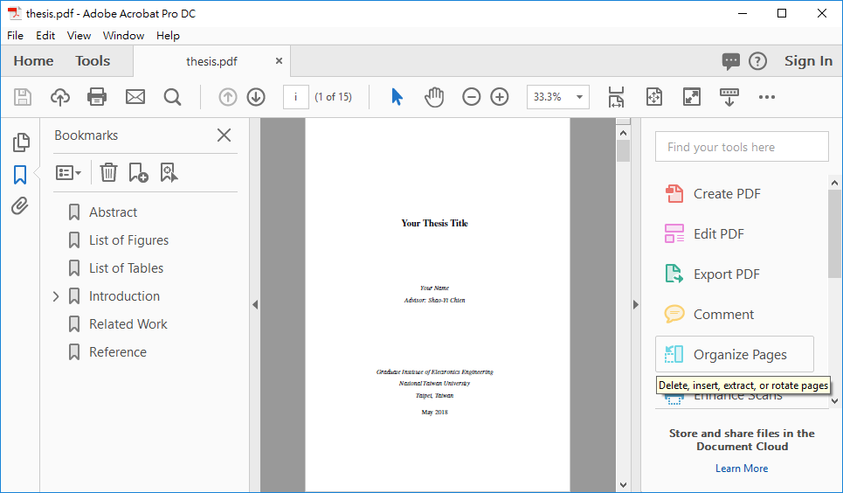
1

Slide 2
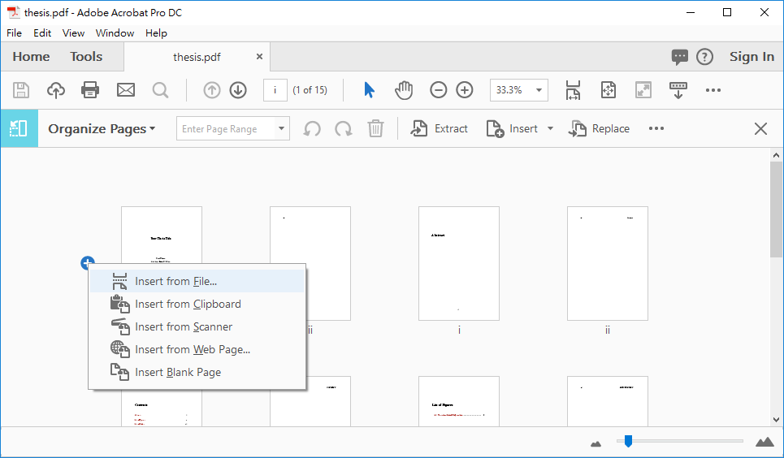
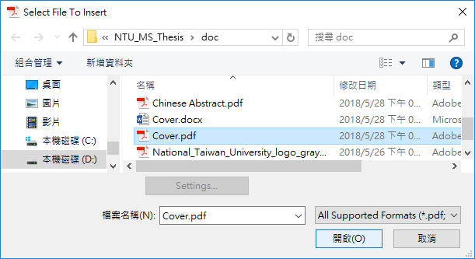
1
2
3
4

Slide 3
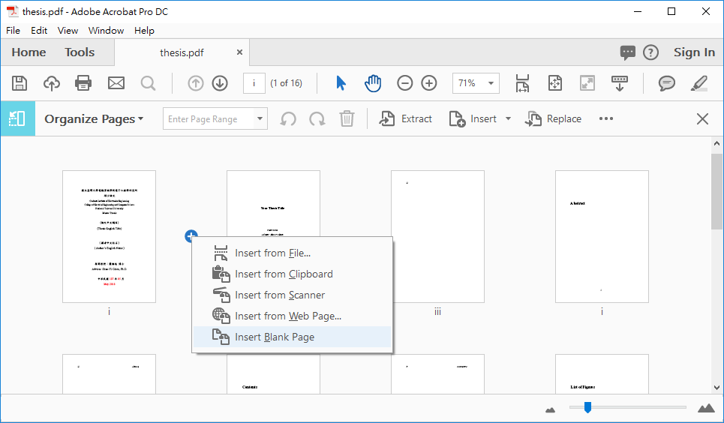
1
2

Slide 4
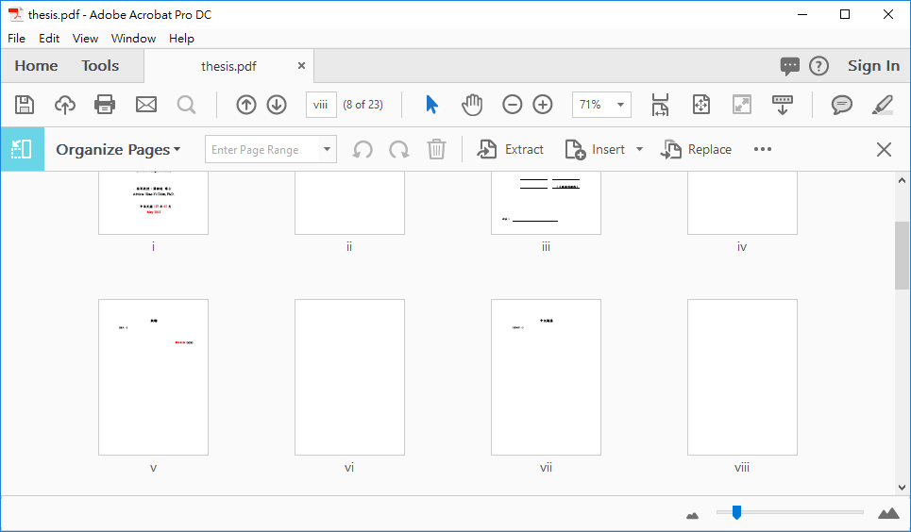
Cover
(Blank)
Approval
(Blank)
Ack.
(Blank)
Chinese Abstract
(Blank)

