Slide 1
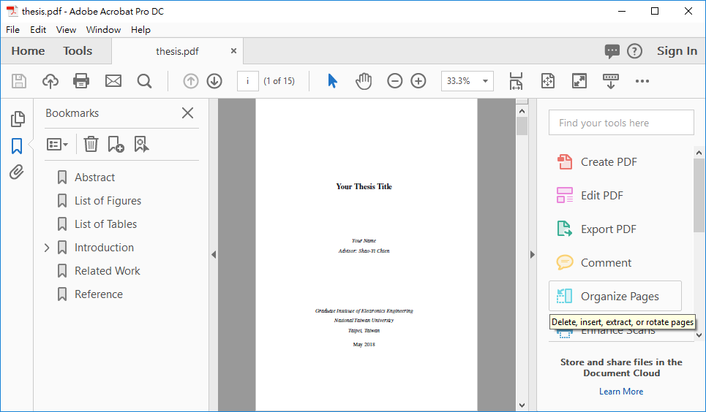
1

Slide 2
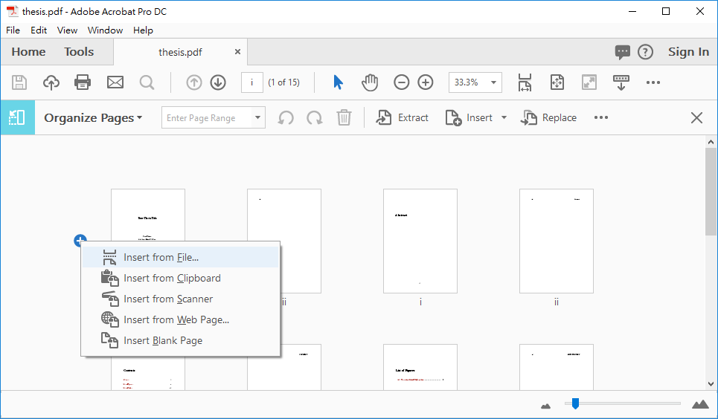
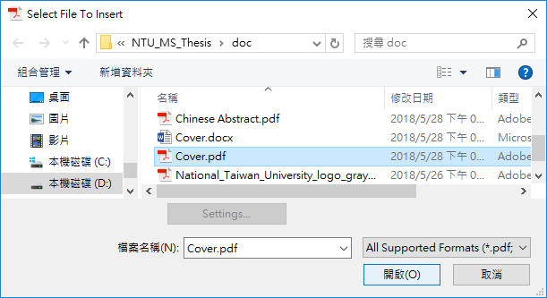
1
2
3
4

Slide 3
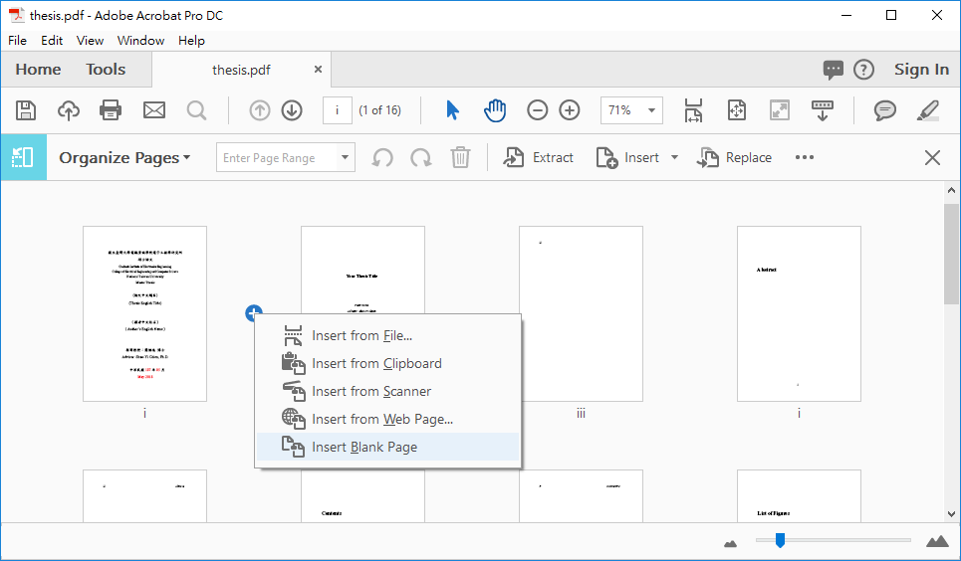
1
2

Slide 4
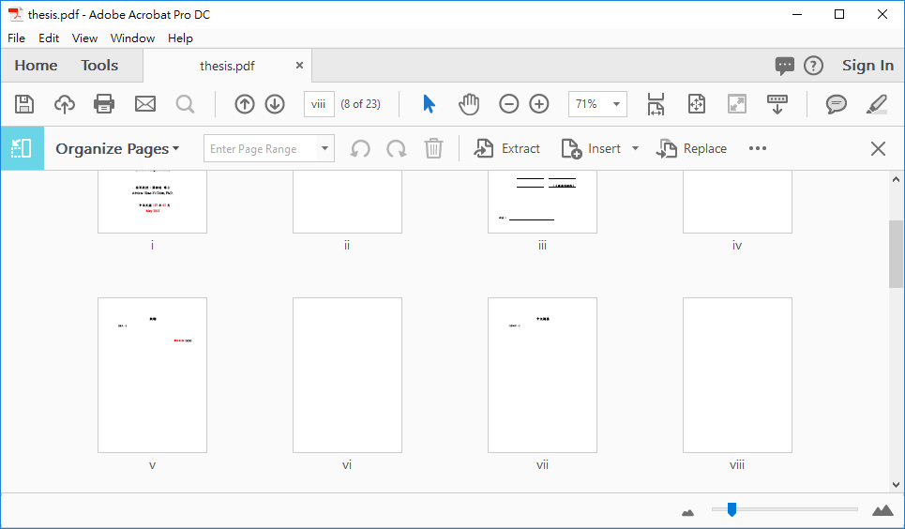
Cover
(Blank)
Approval
(Blank)
Ack.
(Blank)
Chinese Abstract
(Blank)

Slide 5
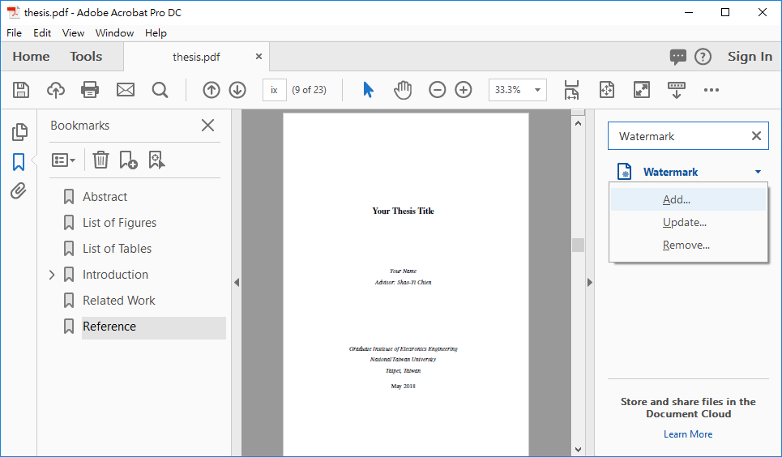
1
2
3

Slide 6
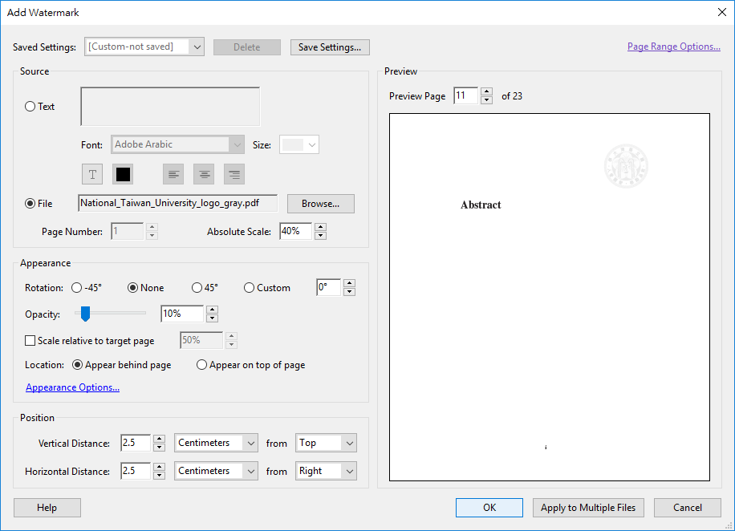
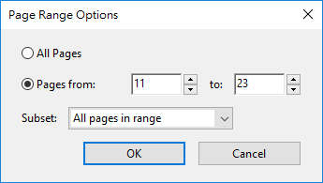
1
4
5
6
2
7
3
8
9

