Slide 1
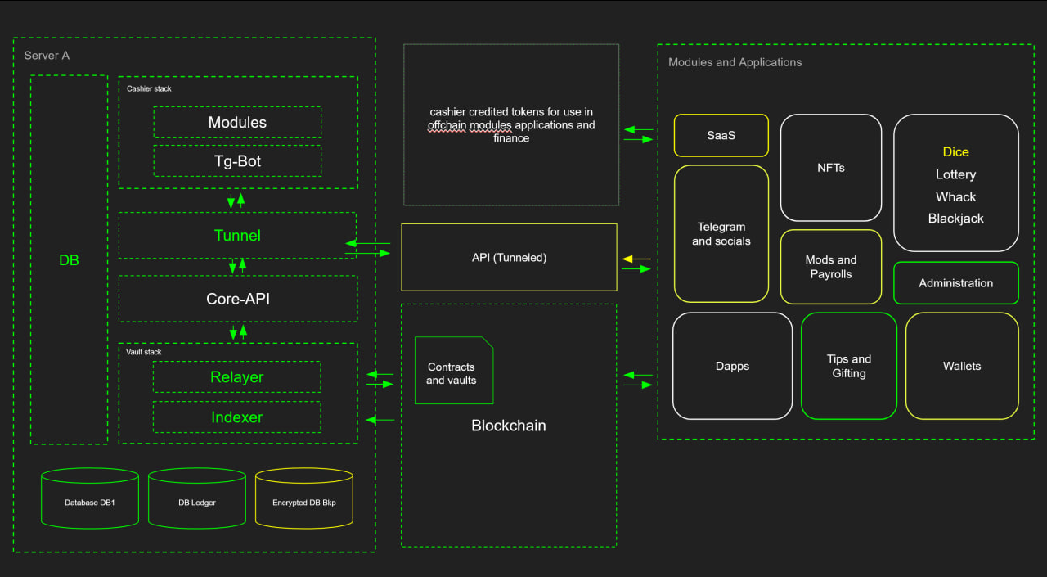
THE HAUS
CASHIER
Avalanche Fuji MVP
Wallet-funded balances for dapps, games, and social modules
3–4 minute walkthrough: deposit → play → social → withdraw
BuildGames Stage 2 MVP Presentation
Cheyne Hayworth
Notes:
Welcome to The Haus Cashier. This MVP shows a modular Avalanche Fuji cashier system that starts with a wallet-funded balance, lets users spend inside a web application more smoothly than one transaction per action, and then extends that same cashier into social modules like Telegram. In the demo, I will show the core dapp flow first, then the dice gameplay and ledger activity, then the Telegram integration, and finally the withdrawal and future roadmap. [Sources] - User-provided architecture diagram. - User-provided project links and MVP scope from chat.

Slide 2
What The Haus Cashier solves
A reusable balance and spend layer for Avalanche applications
Problem
The Haus approach
• Most web3 apps still interrupt users with a wallet transaction for every repeated action. • That friction is especially bad for games, rewards, social spending, and community tools. • Developers keep rebuilding deposits, balances, payouts, and ledger logic from scratch.
• Bring wallet-backed value into a structured cashier balance. • Use signatures and application logic for smoother in-app interaction. • Support dapps, games, tipping, lotteries, admin tools, and future SDK modules from one cashier foundation.
Core thesis: wallet → cashier balance → app or social module → ledgered settlement → withdraw
Notes:
The key problem is friction. Most web3 products still force users through too many direct wallet prompts, and that breaks the experience for games and interactive apps. The Haus Cashier solves that by moving the user from direct wallet ownership into a structured cashier balance that can then power application actions, rewards, and withdrawals more smoothly. The important point is that it stays wallet-rooted and ledger-aware, but it becomes much easier to build usable products on top. [Sources] - Claims based on user-provided project description in chat.

Slide 3
Main MVP demo flow
Wallet-first dapp experience on Avalanche Fuji
1. Connect wallet
2. Deposit to cashier
3. View balance + ledger
4. Spend in dice
5. Withdraw back out
User connects on Fuji and enters the dapp.
Funds move into the cashier flow for application use.
The dapp shows balances and ledger activity.
Gameplay uses credited spend and settles wins/losses.
User exits by withdrawing back to the wallet.
Narration cues
• Show the deposit screen and explain this is wallet-funded value entering the cashier system. • Call out that the ledger gives users visibility into account activity, not just raw wallet events. • Reinforce that the same balance can later be used by multiple modules.
Notes:
This slide sets up the live dapp walkthrough. I will show the flow in a simple order: connect wallet, deposit into the cashier, review the balance and ledger, spend through the dice demo, and then withdraw back to the wallet. That structure is important because it proves the full user loop, not just a single transaction. It shows that The Haus is a usable application layer rather than only a contract demo. [Sources] - Claims based on user-provided project description in chat.

Slide 4
Dice demo: credited gameplay, not one wallet prompt per round
This is the clearest proof of smoother monetised web3 gameplay
What to show on screen
Why this matters
• Open the dice page and explain that gameplay spends from cashier balance. • Run a few browser tests to show play, win, and lose outcomes. • Point to balance changes and ledger entries after each result. • Explain that the user still authorises through web3, but the gameplay loop feels much smoother.
• Developers can build mini-games faster with a reusable spend and settlement layer. • Users get a cleaner experience for repeated actions and rewards. • The same pattern can support weekly leaderboards, tournaments, and other balance-backed game modes.
Talk track: “This is not just a dice page. It is proof that The Haus Cashier can make Avalanche gameplay easier to build, easier to monetise, and smoother for users to actually play.”
Notes:
Here I focus on the dice page as the best live proof point. I want to show that the user can play using the cashier balance, see both winning and losing outcomes, and watch those outcomes reflected in the ledger. The message is that The Haus is not building just one game. It is building the balance and settlement pattern that can support many games, including future ideas like weekly leaderboards, tournaments, and other monetised experiences. [Sources] - Claims based on user-provided project description in chat.

Slide 5
Social modules: Telegram proves the cashier is modular
The dapp is the main focus; Telegram is the secondary proof
Telegram module demonstrates
Why this is valuable
• Notifications for deposits, receipts, and balance-aware actions. • Wallet linking and user account registration flows. • Viewing balances and using commands without being forced back into the dapp for every action. • A second interface into the same cashier system.
• Communities already live in chats and social apps. • A cashier that only works in one browser page misses major real-world usage. • The same vault-backed balance model can support social spending, admin tools, and community games.
Secondary proof, not the core thesis: one cashier can power both the dapp and social interfaces.
Notes:
After the core dapp flow, I introduce Telegram as the modular extension. The point is not that Telegram is required. The point is that the cashier is reusable. The same balance model can power notifications, account linking, commands, and community interactions in a social environment. That makes the system much more valuable because it is not trapped in one interface. [Sources] - Claims based on user-provided project description in chat. - Telegram integration scope from user message.

Slide 6
Telegram examples: spend, lottery, admin, and balances
Concrete proof that the cashier can support more than a web page
Social spending
Lottery example
Admin + treasury
• Gift user / tipping flows from credited balances. • Balance checks and activity messages. • Notifications when value is received or spent.
• Buy tickets directly from social commands. • Debit from credited balance, not a new wallet transaction every time. • Credit winnings back into the cashier balance.
• Show main admin, treasuries, and operational visibility. • Support system management outside only contracts or the dapp. • More usable operations for communities and future modules.
Suggested live sequence: registration → balance command → gift user → lottery ticket purchase → mainadmin / treasuries
Notes:
This is the Telegram feature proof slide. I want to show concrete examples: wallet linking and registration, checking balances, receiving notifications, gifting credits, buying lottery tickets from credited balance, and showing main admin or treasury views. That gives judges a clear sense that The Haus is not only a player-facing frontend. It can also support community mechanics and administration through modular interfaces. [Sources] - Claims based on user-provided project description in chat. - Telegram integration scope from user message.

Slide 7
System architecture behind the MVP
One cashier foundation, multiple interfaces and modules
Architecture callouts
• Core API, tunnel, relayer, indexer, and DB-backed ledger support the user-facing flows. • Contracts and vaults hold the value layer while the cashier manages usable balances and settlement. • Modules can plug in on top: games, tipping, lottery, social tools, admin, and future SDK-driven apps.
Talk track: the backend is not the public repo focus, but it is the reason the MVP is credible.
Notes:
This slide helps connect the demo to the real system design. The public MVP presentation is frontend-first, but the architecture matters because it explains why the product is reusable and credible. I can point out that the backend stack supports deposits, balances, ledger activity, relayed execution, indexing, and modular interfaces, while the same value model can be exposed through multiple surfaces like the dapp and Telegram. [Sources] - User-provided architecture diagram. - Claims based on user-provided project description in chat.

Slide 8
Roadmap and closing
From Fuji MVP to multi-chain modules and an SDK layer
Near-term expansion
Long-term vision
• CCIP and future chain support using main vaults and expanded cashier rails. • Token swap support and richer asset flows inside the broader system. • More games, leaderboards, tournaments, and reusable module patterns.
• An SDK-style toolkit for building and deploying cashier-powered modules. • Support for payment apps, dapps, social bots, mobile gaming, and utility products. • A cleaner way for builders to bring Avalanche-backed value into real user-facing software.
Closing line: “The Haus Cashier makes Avalanche value easier to use inside games, apps, and social systems — and this MVP proves that path today on Fuji.”
Notes:
I close by showing that this MVP is the first step, not the end state. The roadmap includes cross-chain expansion with CCIP, richer token flows including swaps, more game and reward modules, and eventually an SDK-style layer so builders can create new applications on top of the cashier foundation much faster. The closing message should be that this is infrastructure for usable Avalanche applications, not just a one-off demo. [Sources] - Future roadmap claims from user-provided project description in chat.

