Slide 1


A Unified Sparse Matrix Format for Modern SIMD Processors
Advanced Architectures
Ilaria Scarselli
ID: 1918975

Slide 2
Why Do We Need Efficient Sparse Formats?
Page 1

Slide 3
Why Do We Need Efficient Sparse Formats?
Sparse matrices are used everywhere in science and engineering, where one of the most time-consuming building blocks is the multiplication of large sparse matrices with dense vectors (spMVM)...
Page 1

Slide 4
Why Do We Need Efficient Sparse Formats?
Sparse matrices are used everywhere in science and engineering, where one of the most time-consuming building blocks is the multiplication of large sparse matrices with dense vectors (spMVM)…
… but this kernel is usually memory-bound on modern computer architectures
Page 1

Slide 5

Why Do We Need Efficient Sparse Formats?
Sparse matrices are used everywhere in science and engineering, where one of the most time-consuming building blocks is the multiplication of large sparse matrices with dense vectors (spMVM)…
… but this kernel is usually memory-bound on modern computer architectures
CODE BALANCE vs MACHINE BALANCE
Page 1

Slide 6
Why Do We Need Efficient Sparse Formats?
Sparse matrices are used everywhere in science and engineering, where one of the most time-consuming building blocks is the multiplication of large sparse matrices with dense vectors (spMVM)…
… but this kernel is usually memory-bound on modern computer architectures
CODE BALANCE vs MACHINE BALANCE
The optimal choice of sparse matrix format is highly dependent on the underlying hardware, but modern systems are strongly heterogeneous
Page 1

Slide 7
Explored idea: SELL-C-σ
Page 2

Slide 8
Explored idea: SELL-C-σ
Hardware
Test Matrices
Page 2

Slide 9
Explored idea: SELL-C-σ
Architecture | Type | Cores | SIMD width (in bits) | Format typically used
Intel SNB | CPU | 8 | 256 | CRS
Intel Xeon Phi | Vector architecture | 60 | 512 | JDS
Nvidia Tesla K20 | GPGPU | 2496 | 2048 | ELLPACK
Hardware
Test Matrices
Page 2

Slide 10
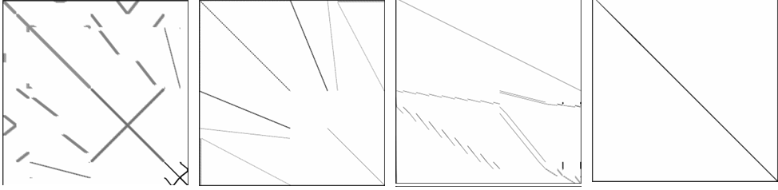
Explored idea: SELL-C-σ
Hardware
Benchmark matrices from The University of Florida Sparse Matrix Collection, representing corner cases of matrix characteristics:
RM07R kkt_power Hamrle3 ML_Geer
Test Matrices
Page 2

Slide 11
Explored idea: SELL-C-σ
Hardware
Benchmark matrices from The University of Florida Sparse Matrix Collection, representing corner cases of matrix characteristics:
RM07R kkt_power Hamrle3 ML_Geer
Then validation of results against the matrices of the Williams group from the same collection
Test Matrices
Page 2

Slide 12
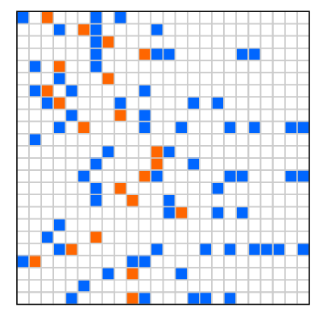
Sparse Matrix Formats Across Architectures
Page 3

Slide 13
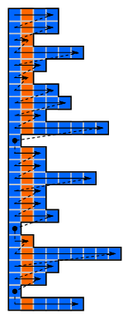
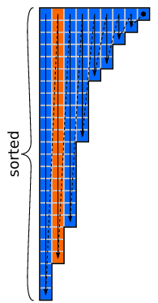
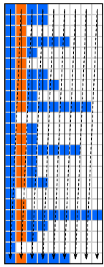
Sparse Matrix Formats Across Architectures
Different hardware prefers different layouts, with differences in terms of storage order of the non-zero entries, the row reordering and the use of padding
CPU → CRS
Vector processors → JDS
GPU → ELLPACK
Page 3

Slide 14
Sparse Matrix Formats Across Architectures
Vector processors → Jagged Diagonal Storage
The main idea is to globally reorder the rows so that the longest rows come first
vector processors and SIMD architectures work better when different rows have a similar number of non-zero elements
Used arrays:
val[]: stores the nonzero values in jagged diagonal order
col[]: stores the column index of each nonzero
jd_ptr[]: stores the starting position of each jagged diagonal
perm[]: stores the permutation of the original row order
Disadvantages: requires row reordering, needs to store the permutation array, can hurt cache locality of the RHS vector
Page 4

Slide 15
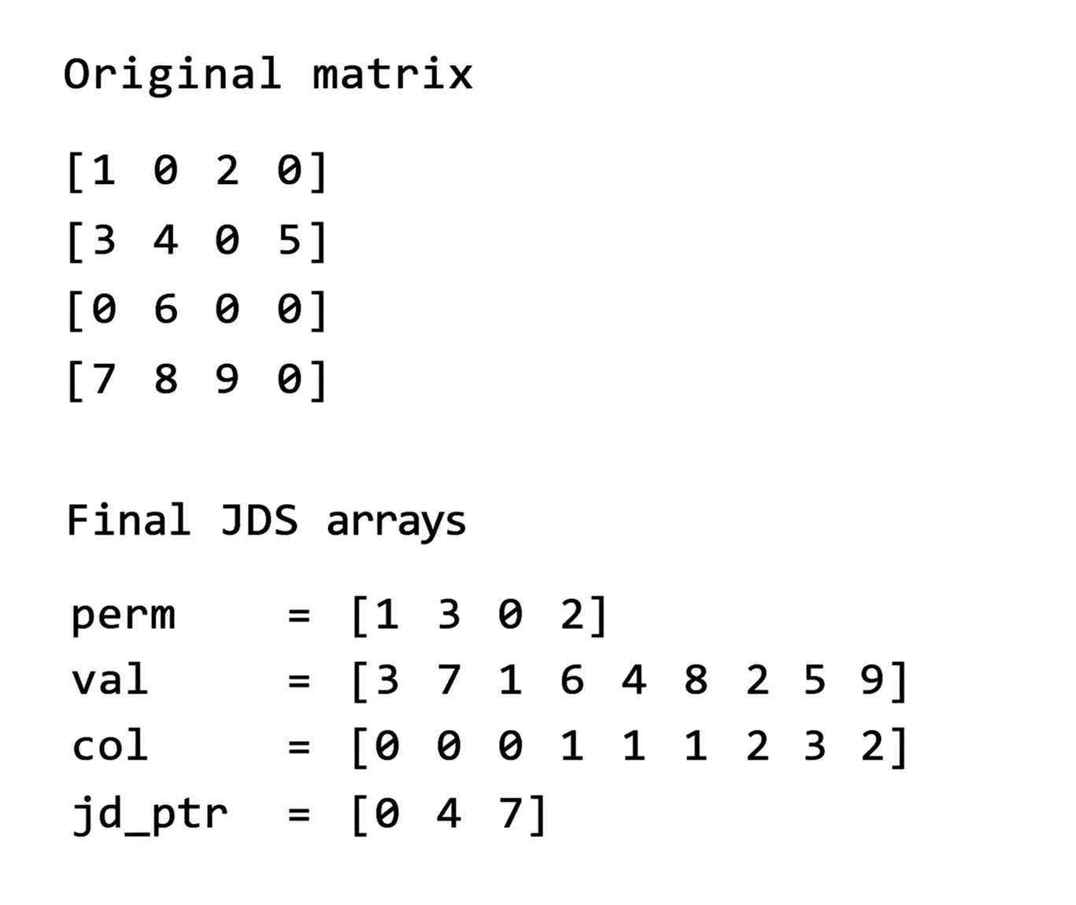
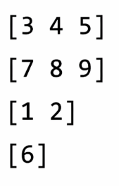
Sparse Matrix Formats Across Architectures
Vector processors → Jagged Diagonal Storage
The main idea is to globally reorder the rows so that the longest rows come first
vector processors and SIMD architectures work better when different rows have a similar number of non-zero elements
Used arrays:
val[]: stores the nonzero values in jagged diagonal order
col[]: stores the column index of each nonzero
jd_ptr[]: stores the starting position of each jagged diagonal
perm[]: stores the permutation of the original row order
Disadvantages: requires row reordering, needs to store the permutation array, can hurt cache locality of the RHS vector
Page 4

Slide 16
Sparse Matrix Formats Across Architectures
CPU → CRS
Cache-friendly layout
3 arrays:
val[]: non-zero elements stored row by row
col[]: original column indices of val[] elements
rpt[]: the starting offsets of the rows
Page 5

Slide 17
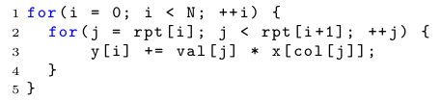
Sparse Matrix Formats Across Architectures
CPU → CRS
Efficient SIMD vectorization requires consecutive data access, so the inner loop is the target for the vectorization
We can formulate this kernel in an SIMD-friendly way for the Intel SNB applying four-way modulo unrolling
Page 5

Slide 18
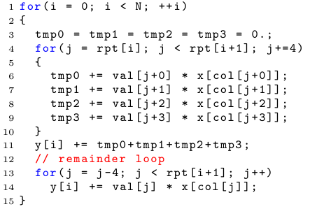
Sparse Matrix Formats Across Architectures
CPU → CRS
PROBLEM: for matrices with few non-zeros per row, the overheads of the vectorized code may nullify the performance gain. The worst case occurs when the row length is smaller than the SIMD width
Page 5

Slide 19
Why ELLPACK Works Well on GPUs
Addresses the problems of CRS for GPGPUs:
Column-wise storage and padding all rows to the same length allow row-wise thread parallelization with consecutive memory access and a good load coalescing.
Page 6

Slide 20
Why ELLPACK Works Well on GPUs
Addresses the problems of CRS for GPGPUs:
Column-wise storage and padding all rows to the same length allow row-wise thread parallelization with consecutive memory access and a good load coalescing.
PROBLEM: The number of rows must be padded to a multiple of the warp size
BIGGER PROBLEM: may incur substantial overhead for padding
Page 6

Slide 21
From ELLPACK to Sliced ELLPACK
Sliced ELLPACK is a variant which reduces overhead by dividing the matrix into chunks of C rows, padding only to match the length of the longest row within each chunk to obtain less zero-padding. Chunks are stored in column-major order, consecutively in memory.
Page 7

Slide 22
From ELLPACK to Sliced ELLPACK
Sliced ELLPACK is a variant which reduces overhead by dividing the matrix into chunks of C rows, padding only to match the length of the longest row within each chunk to obtain less zero-padding. Chunks are stored in column-major order, consecutively in memory.
C parameter
Chunk size
Page 7

Slide 23
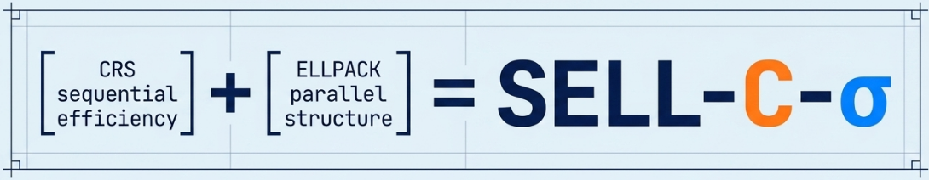
SELL-C-σ
SELL-C-σ is a generalized SELL with:
C parameter
σ parameter
Chunk size
Number of rows padded to a multiple of C
C depends on the architecture
Sorting scope
It tells us how many rows we are allowed to reorder locally
Page 8

Slide 24
SELL-C-σ
SELL-C-σ is a generalized SELL with:
C parameter
σ parameter
Chunk size
Number of rows padded to a multiple of C
C depends on the architecture
Sorting scope
It tells us how many rows we are allowed to reorder locally
Uses:
val[] and col[] as in ELL
cs[] to store the starting offset of each chunk
cl[] to store the length of the longest row in the chunk (the width of the chunk), so that cl[i] = (cs[i+1] – cs[i]) / C
Page 8

Slide 25
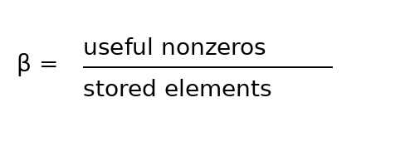
Chunk Occupancy β
When β is close to 1, all the stored elements are meaningful elements. Best case: all rows in a chunk have similar length.
When β is small, we have too much padding. Worst case: one single long row, many very short
Page 9

Slide 26
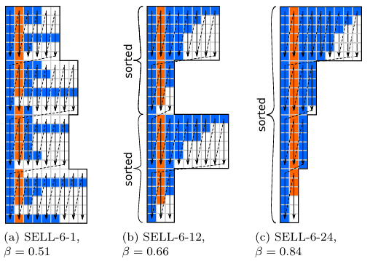
Chunk Occupancy β
To obtain a good β, it’s important to choose the parameters appropriately.
By sorting rows by decreasing length, rows with similar length end up together in the same chunk and padding overhead decreases while chunk occupancy increases instead. BUT too much sorting may hurt RHS locality. That’s why we don’t use global, but local sorting inside a smaller group of rows.
Page 9

Slide 27
Chunk Occupancy β
On GPUs, SELL-C-σ has an extra advantage: each thread can stop when the actual row ends, without processing the padded zeros.
However, threads in the same warp still need to wait for the slowest thread, So low β still hurts performance, even if explicit zero loads are avoided.
Page 9

Slide 28
Performance Model
SpMVM is memory-bound, thus performance depends on:
Memory bandwidth
RHS locality α
Chunk occupancy β
Average number of non-zero elements per row
Page 10

Slide 29
Performance Model
SpMVM is memory-bound, thus performance depends on:
Memory bandwidth
RHS locality α
Chunk occupancy β
Average number of non-zero elements per row
Better locality = smaller α
The smaller the α the better
Less padding = larger β
The bigger the β the better
Page 10

Slide 30
Performance Model
SpMVM is memory-bound, thus performance depends on:
Memory bandwidth
RHS locality α
Chunk occupancy β
Average number of non-zero elements per row
Better locality = smaller α
The smaller the α the better
Less padding = larger β
The bigger the β the better
CRS suffers mainly from poor SIMD efficiency, SELL-C-σ may suffer from padding overhead.
SELL-C-σ mainly improves performance by increasing β
Page 10

Slide 31
Experimental Setup
Architecture | C parameter | Comparison format
Intel SNB | C = 4 | CRS
Intel Xeon Phi | C = 16 | CRS
Nvidia Tesla K20 | C = 32 | HYB (ELL + COO)
Page 11

Slide 32
Main Performance Results
Architecture | C parameter | Comparison format
Intel SNB | C = 4 | CRS
Intel Xeon Phi | C = 16 | CRS
Nvidia Tesla K20 | C = 32 | HYB (ELL + COO)
The format performs well on all the three considered architectures:
Similar to CRS on Intel SNB
Outperforms CRS on Intel Phi
Competitive or better than HYB on GPGPU
The biggest gains appear for matrices with low average number of non-zeros per row, irregular row lengths or poor chunk occupancy. Intel Xeon Phi benefits the most from the format
Page 11

Slide 33
Pathological Test Matrices
Matrices where the presented format still performs poorly. Two main reasons:
Highly irregular access pattern and low β
(webbase-1M)
Matrices too small
(dense2 and rail4284)
Page 12

Slide 34
Pathological Test Matrices
Matrices where the presented format still performs poorly. Two main reasons:
NOTE: even if the matrix storage format is very efficient, we still have a problem: the vector x is not accessed sequentially. RHS vector x is accessed indirectly through column indices, so cache locality may be poor and GPU load coalescing may be lost. Matrix Bandwidth Reduction is a possible solution, reordering the matrix so that non-zeros stay closer to the main diagonal
Highly irregular access pattern and low β
(webbase-1M)
Matrices too small
(dense2 and rail4284)
Page 12

Slide 35
Impact of Sorting Scope
Small σ:
Better RHS locality
More padding
Large σ :
Less padding
Worse RHS locality
Vs
Tradeoff between reducing padding and preserving RHS locality
Validation of the Model
The simplified performance model is not exact, but it predicts the behavior of SELL-C-σ reasonably well. Large matrices follow the bandwidth-bound prediction, while small or irregular matrices deviate more
Page 13

Slide 36
Conclusions
SELL-C-σ combines Sliced ELLPACK, SIMD vectorization and limited row sorting
In most cases, the performance is close to or better than architecture-specific formats, especially on Intel Xeon Phi
It represents a strong candidate for heterogeneous systems, where complementary strategies such as multi-threading across rows and automatic tuning of parameters can be studied to further improve performance
Final considerations
over SELL-C-σ
What happened
to this format
Page 14

Slide 37
Conclusions
Introduced in 2014, SELL-C-σ is not a dominant format today, but it is still used as a baseline for comparisons, a building block for hybrid formats and has influenced modern approaches
While SELL provides a good balance, dynamic approaches, like Morpheus framework, aim to overcome the limitations of fixed formats, dynamically selecting the most suitable sparse matrix format at runtime, adapting to both data and hardware
Final considerations
over SELL-C-σ
What happened
to this format
Page 14

Slide 38
A Unified Sparse Matrix Format for Modern SIMD Processors
Advanced Architectures

