Slide 1
Bitcoin Price Prediction
- Chezhian T N (1934005)
Varsha B (1934055)

Slide 2
Problem Specification - Goal
Main Goal of the project is to predict the price of the bitcoin on a particular day
To compare the accuracy of the regression models used

Slide 3
Dataset Description
Source:
https://in.investing.com/crypto/bitcoin/historical-data
Size:
The dataset consists of 31 rows and 7 columns
The rows represents the respective dates and the columns represents the price in that day.

Slide 4
DATA PRE-PROCESSING

Slide 5
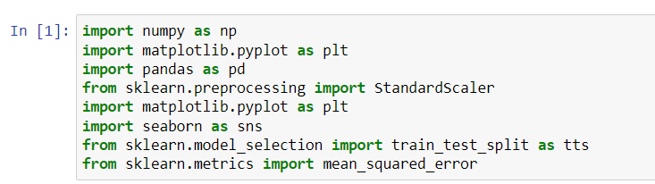
Import the libraries
Import the dataset

Slide 6

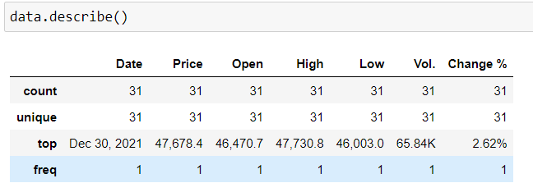
Getting the shape of the dataset
Description of the dataset with its respective rows and columns

Slide 7
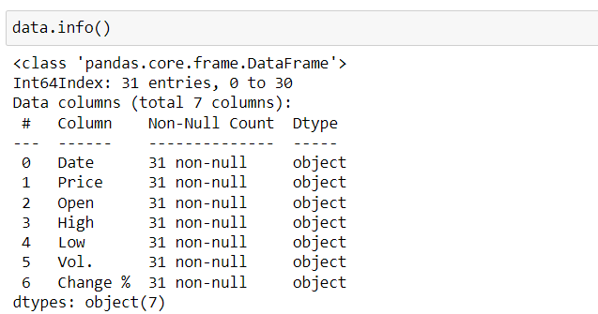
Display the type of objects used in the dataset
Remove the unwanted columns

Slide 8
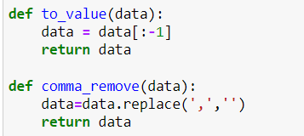
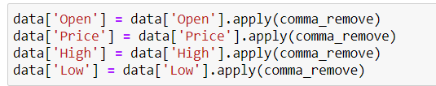
Remove the commas
From each respective column

Slide 9
Training and testing of data
We will now divide the bitcoin dataset into test and train parts. The test size is 0.15 and train size 0.85.

Slide 10
EXPLORATORY DATA ANALYSIS

Slide 11
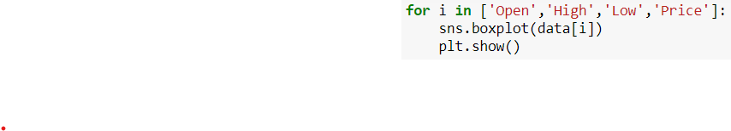
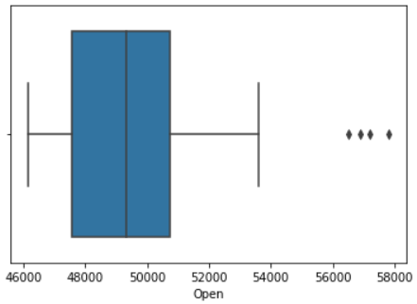
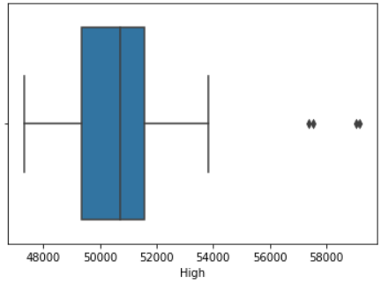
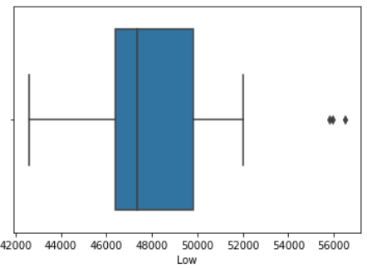
Create a box plot for each the columns to find the outliers.

Slide 12
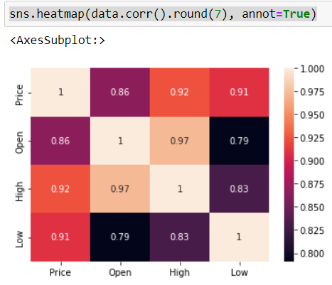
Construct a heatmap to depict the correlation between the target and
the other respective features

Slide 13
MODEL SELECTION

Slide 14
We have used two models for prediction
1) Linear Regression
2) Support Vector Machine

Slide 15
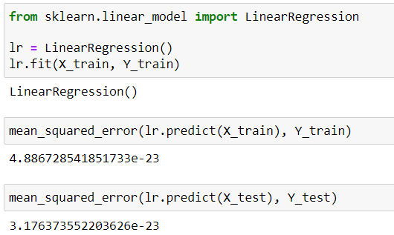
Linear Regression
From sklearn, import linear regression
Training and testing of dataset is done
Mean square error is found as 3.17%

Slide 16
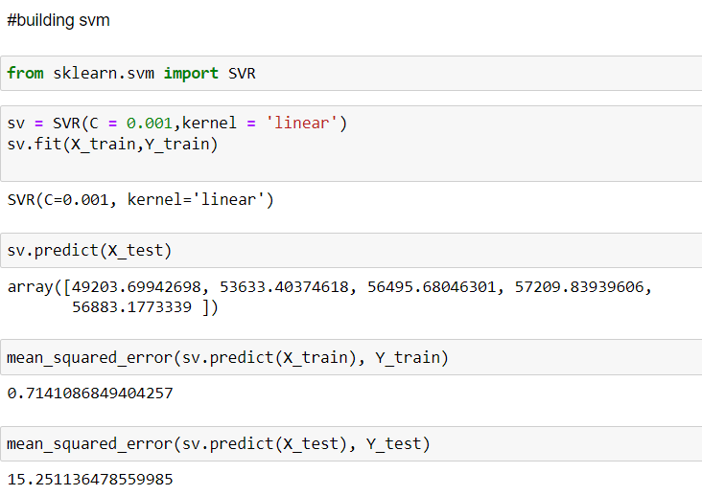
Support Vector Machine

Slide 17
Cont.
Import SVR from sklearn
Training and testing of the dataset is done
Mean square error is found as 15.25%

Slide 18


Result
For logistic regression,
For SVM,
Among the two regression models, we infered that Linear Regression model has a better prediction score.

