Slide 1



SMART INDIA HACKATHON 2026
TITLE PAGE
  Problem Statement ID :- 26121
  Problem Statement Title :- eRTMAC-NWIS (Nearby Wells Intelligence System): An AI-Powered Offset Well Knowledge and Decision Support Platform for Drilling Operations
  Theme :- Smart Automation
  PS Category :- Software
  Team ID :- 161792
  Team Name :- Faltantra

Slide 2
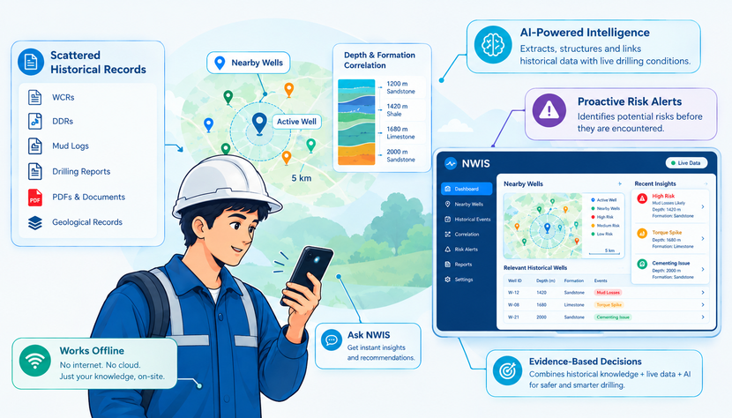
eRTMAC– NWIS
Faltantra
Problem
  Historical drilling knowledge is scattered across WCRs, DDRs, mud logs, PDFs, and geological records, making relevant past well experiences difficult to retrieve quickly.
  Nearby-well experiences are difficult to correlate with the active well’s depth and formation, while critical events such as mud losses, kicks, stuck pipe, overpressure, and cementing issues remain buried in records and individual experience.
Our Idea
  NWIS gives eRTMAC an “Institutional Memory” by converting scattered historical drilling records into searchable, structured knowledge linked to nearby wells, depths, and formations.
  It combines historical well experience with live drilling data to identify relevant past events and provide evidence-based drilling intelligence at the right time and depth.
Unique Value Preposition
  Institutional Memory: Converts scattered drilling records into structured, searchable knowledge.
  At-Depth Intelligence: Connects nearby-well experiences with the same depth and formation.
  Proactive Risk Awareness: Combines historical data with live drilling conditions to identify potential risks before they are encountered
Proposed Solution
  AI-powered document intelligence extracts and structures drilling events, formations, depths, and key experiences from WCRs, DDRs, PDFs, and other historical records.
  Interactive nearby-well intelligence connects the active well with relevant offset wells using geospatial, depth, and formation-based correlation.
  Predictive risk & alert engine combines historical evidence, ML models, physics-based signals, and live drilling data to highlight potential risks and provide evidence-backed recommendations to drilling engineers
@SIH Idea submission- Template
2
Notes:
2

Slide 3
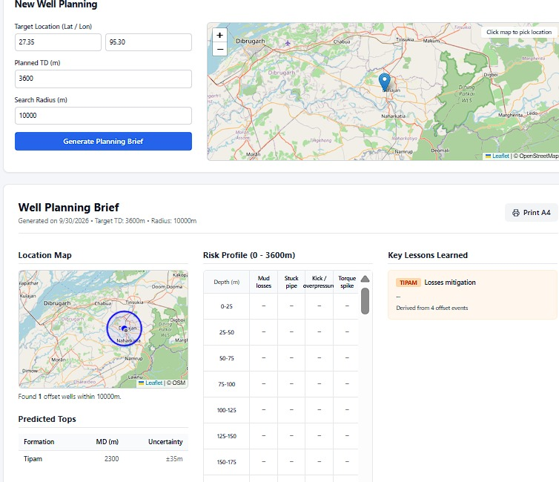
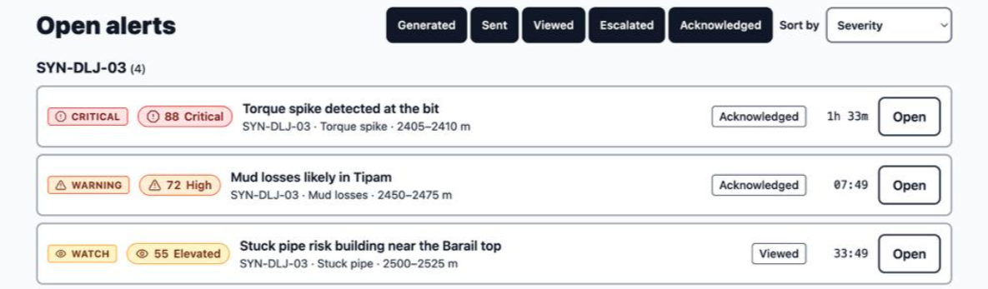
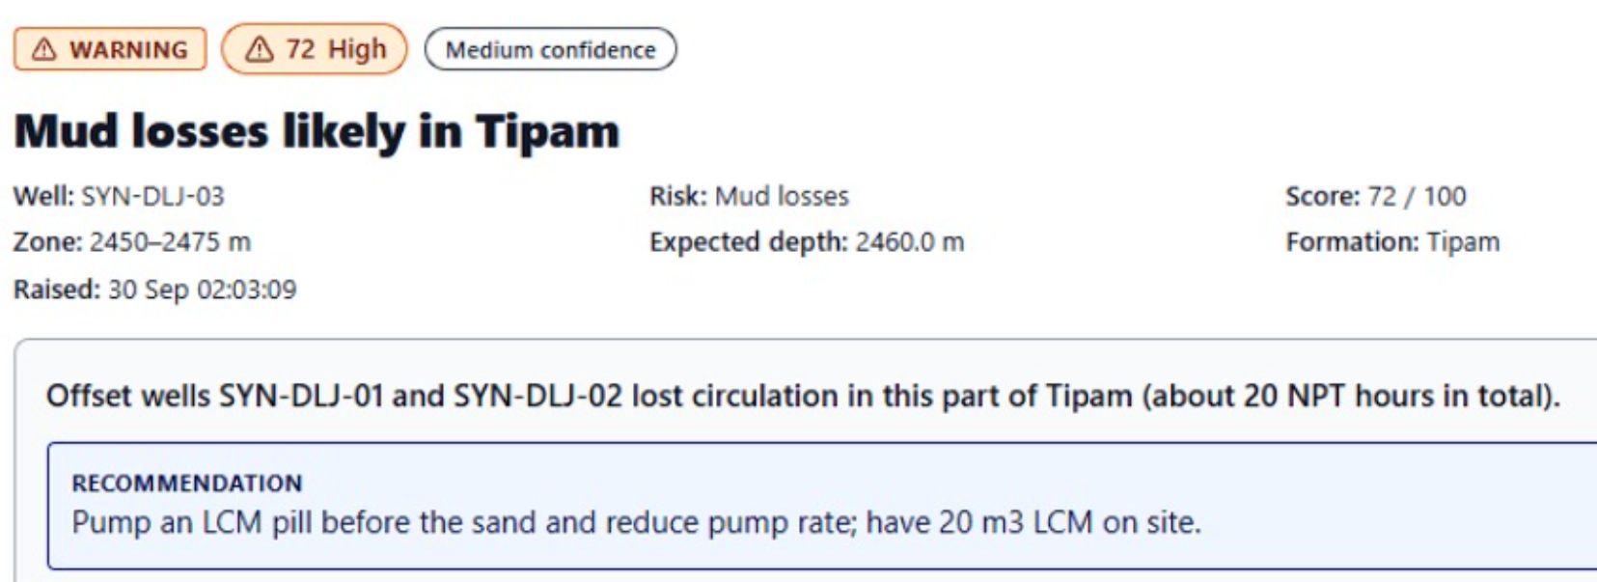
TECHNICAL APPROACH
Falcons
Faltantra
Technology Keypoints
Admin Roles, Stream
Rig/ RTOC ack, log action
Resolved; Rate useful
  Document AI: Uses Docling + RapidOCR + NLP to extract drilling events, depths, formations and lessons from WCRs, DDRs and PDFs.
  Data & Intelligence: Supabase PostgreSQL + PostGIS + pgvector stores well, depth, formation and event data for spatial and semantic search.
  AI/ML Risk Engine: Combines XGBoost/LightGBM + SHAP + physics-based rules + live telemetry to identify potential drilling risks.
  Application Layer: React + Vite + Leaflet + Plotly provides the engineer dashboard, while FastAPI + Node.js connects AI services, data and real-time alerts.
Well AT TD: Final Reports
Rig Engineer evidence, What worked
Data Reviewer
Supabase Realtime
Admin: retrain, swap if better
OCR + Extract Docling, Groq
Alert 50-300m
Fused Score
0-100
Supabase Events, Tops, Chunks, Risks Scores
Validate, Score Fields
L2 ml + SHAP
ERTMAC stream, read-only
L3 Physics
Review queue: approve, edit
L1 Offsets
90% Fully Functioning Prototype Provided.
Demo: ertmac-nwis2.vercel.app
Our Codebase: https://github.com/Chgauravpc/eRTMAC-NWIS
Office Engineer Search, Pre Spud Plan
RTOC Engineer map, risk, Triage
@SIH Idea submission- Template
3
Notes:
3

Slide 4

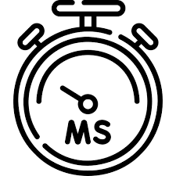

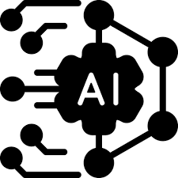
FEASIBILITY AND VIABILITY
Falcons
Faltantra
Feasibility
    Technical Feasibility: Uses proven AI, OCR, NLP, PostGIS and ML technologies.
    Data Feasibility: Supports WCRs, DDRs, PDFs, mud logs and eRTMAC data.
    Deployment Feasibility: Runs on free-tier cloud services without additional hardware.
    Operational Feasibility: Works alongside eRTMAC as a read-only decision-support system
30+ Wells Assam Basin & Volve | < 2s Latency Realtime CDC WebSockets
100% PostGIS 3D Spatial Offsets | 5 Models Calibrated Hazard Engines
Challenges, Risks & Mitigation
    Limited OIL Data: Use public Volve/NPD/NOPIMS and labelled synthetic Assam data.
    Poor OCR Quality: Use multiple OCR engines with confidence checks and human review.
    Limited ML Labels: Use extracted events, class weighting and honest validation.
    Alert Fatigue: Severity levels, deduplication and alert acknowledgement.
VIABILITY
  Cost Effective: Free-tier infrastructure reduces prototype deployment cost.
  Scalable: Can support multiple wells, documents and drilling workflows.
  Decision Support: Provides evidence-backed insights without automating drilling decisions.
  Continuous Learning: Completed wells and alert feedback can improve future risk models.
@SIH Idea submission- Template
4
Notes:
4

Slide 5


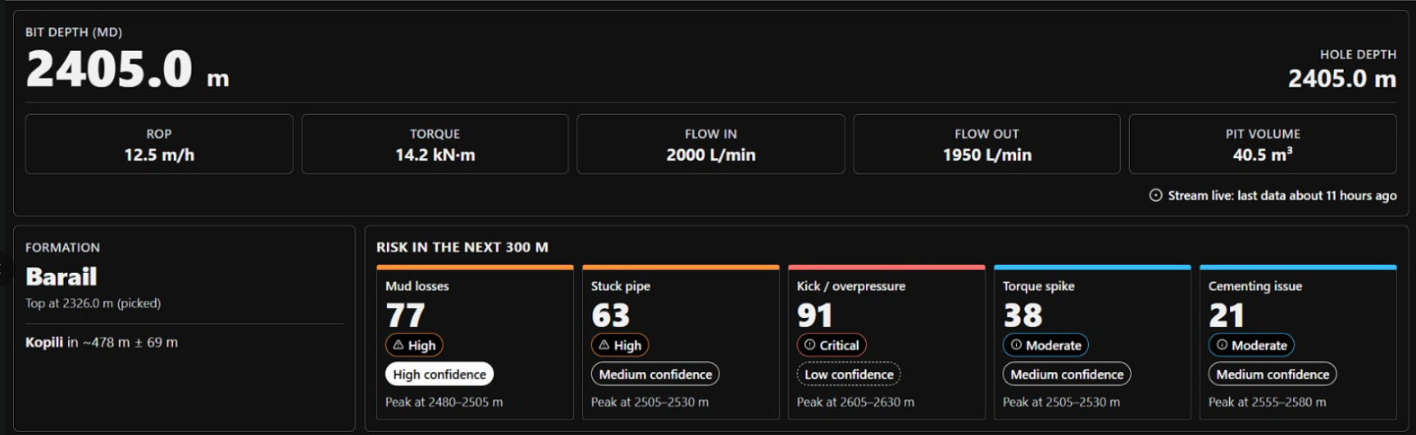
IMPACT AND BENEFITS
Falcons
Faltantra
Potential Impact of our Solution
Faster Decision Making
Instant access to historical well experiances and lessons
Unified Well Intelligence
Connects nearby wells, depths , formation and drilling events.
Reduced Manual Search
Converts scatteres WCRs DDRs and PDFs into searchable knowledge.
Drilling Engineers: Faster access to relevant offset-well experience.
RTOC Teams: Better monitoring and alert triage for active wells.
Planning Teams: Offset-based risk assessment before drilling.
Proactive Risk Awareness
Identifes potential drillong risks before reaching critical zones
Institutional Memory
Preserves drilling knowledge and makes it avilable across teams
Evidence-Based Insights
Provides sourcecited historical evidence for every recommendation
OIL Operations: Centralized institutional drilling knowledge.
Data Teams: Structured, searchable historical drilling records.
Planning Teams: Offset-based risk assessment before drilling.
Field Engineers: Real-time risk alerts with evidence-backed recommendations.
Future Scope
Pre-Spud Planning: Predict formation tops and risk-by-depth for planned wells.
Continuous Learning: Use completed-well outcomes and alert feedback to improve future models.
Expanded Data Integration: Incorporate additional geological, reservoir, drilling and eRTMAC data sources.
Scalable Well Intelligence: Support any well, any depth without a scripted scenario.
@SIH Idea submission- Template
5
Notes:
5

Slide 6
RESEARCH AND REFERENCES
Falcons
Faltantra
Drilling Data & Standards
• IADC DDR Plus: Standard drilling report codes – IADC DDR Plus PDF
• IADC Daily Drilling Report: Rig states and drilling reporting – IADC Daily Drilling Report
• Energistics WITSML: Standard well and drilling data exchange – WITSML Documentation
AI, OCR & Document Intelligence
• Docling OCR: OCR models for document processing – Docling OCR Models
• PDF Table Extraction: Docling-based PDF processing – Docling PDF Processing Research
• Open-Source OCR Comparison: OCR model evaluation – OCR Models Comparison
Project Data & Domain References
• Volve Drilling Dataset: Public WITSML drilling data – Volve Drilling Dataset
• Oil India Limited: Digitalization and eRTMAC – OIL Digitalization
@SIH Idea submission- Template
6
Notes:
6

