Slide 1

SMART CITY
A Smart city is an urban area that uses different types of electronic Internet of Things sensors to collect data and then use these data to manage assets and resources efficiently.
It’s obvious to anyone living in a city that traffic congestion is endemic.
What’s less clear is exactly how to fix it. Congestion is a highly complex problem as there is often no clear, single root cause to tackle.
There are many positive however like that of the city of Columbus, Ohio, which is using Adaptive traffic signals.

Slide 2
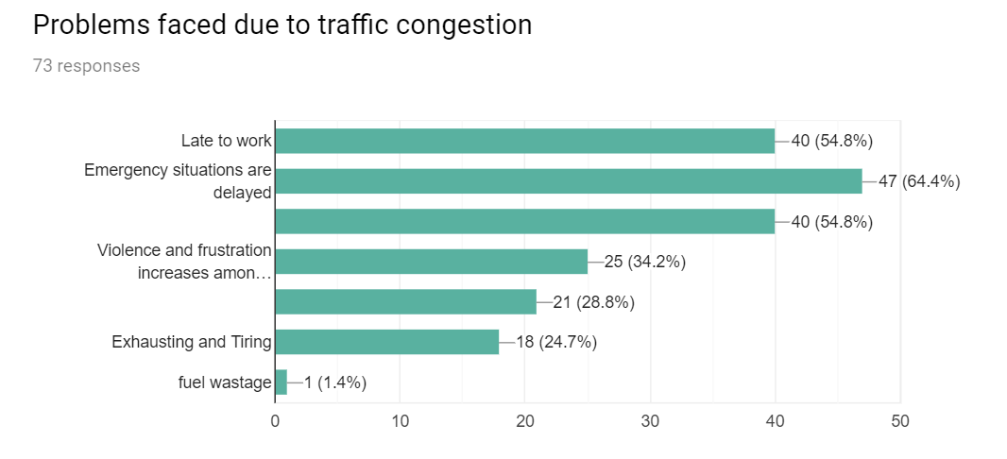
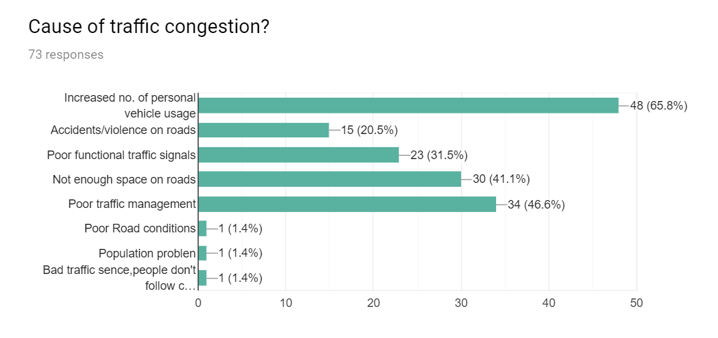
PROBLEMS AND CAUSES
#PROBLEMS
There are several severe problems that could be caused by traffic
congestion including-
1. Late in work .
2. Emergency situations are delayed.
3.Noise and air pollution leading to adverse effect.
4.Violence and frustration increases among passengers and
commuters.
5.Exhausting and tiring experience.
#CAUSES
Core causes of traffic congestion are-
1.Increased number of personal vehicles usage
2.accidents/violence on road.
3.Not enough space on roads.
4.Poor traffic management
5.other

Slide 3
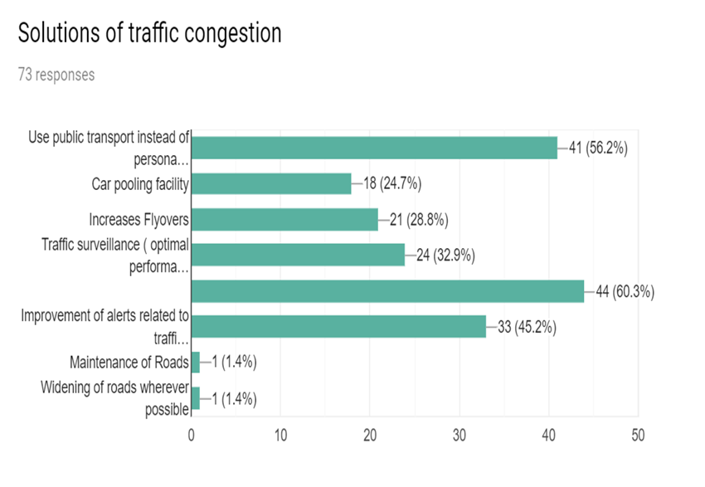
OUR SOLUTION
A smart city that uses Internet Of Things(IOT) will count the number of vehicles in a particular lan, using various traffic sensoring technologies (LiDAR, acoustic fibre, virtual loops, etc).These sensors include inductive loops, non-intrusive traffic detection devices, video cameras and video image processing.
Our solution make use of the data provided by these sensors. It basically priorities the lane with heaviest traffic load for switching green signal ,instead of simple switching method. In a situation where two lanes has same amount of traffic load, priorities would be given to the lane which is in the waiting state ( red light ) for a longer time.

Slide 4
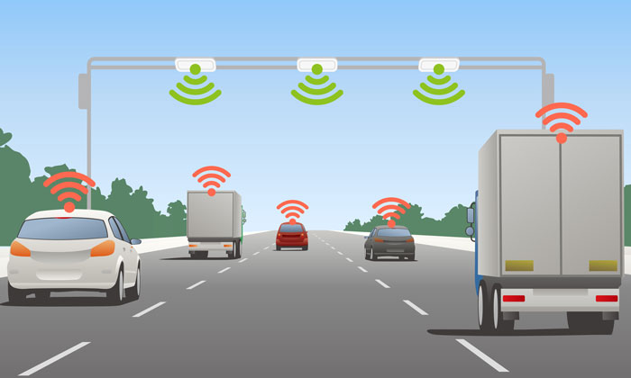
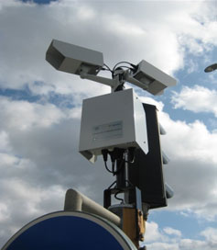
ALORITHM
WE FIRST TAKE THE INPUT FROM Traffic video sensor PLACED ALONG THE ROADS SEND IT TO THE DEVICE THAT EXECUTES OUR SOLUTION AS AN ARGUMENT.
WE ALSO TAKES THE TIME FOR WHICH THE LAST TRAFFIC SIGNAL WAS LEFT IDLE.
OUR SOLUTION CODE WOULD TAKE THE VALUES AND FIRST CHECK IF THE TIME ELAPSED IS MORE THAN 5 MIN IF IT IS SO WE WOULD TURN THE GREEN SIGNAL ON FOR THAT LANE.
OTHERWISE IT WOULD CHECK THAT WHICH LANE HAS MAXIMUM LOAD ,THAT LANE WOULD BE NOW PRIORITISED FOR GREEN SIGNAL.
In a situation where two lanes has same amount of traffic load, priorities would be given to the lane which is in the waiting state ( red light ) for a longer time.
ALL THE STEPS WOULD BE REPEATED.

Slide 5
THANK YOU

