Slide 1

SESSION 21 / FINAL DEVOPS PROJECT
OpsPulse
Mission control
for incidents.
Chhavi Ahlawat · 24BCS10201
Notes:
Introduce OpsPulse as both a working incident-management product and the DevOps platform used to deliver it. The screenshots use local demonstration data; cloud infrastructure is prepared but the AWS demo is deferred.
[Sources]
https://github.com/Chhavi07-arch/OpsPulse-devops-platform/blob/fa87670/README.md
https://github.com/Chhavi07-arch/OpsPulse-devops-platform/blob/fa87670/application/frontend/public/images/orbital-earth.png
Screenshots: captured from running local OpsPulse UI/API on 14 October 2026 using seeded demonstration data; CI screenshot is the actual public workflow run.
[/Sources]

Slide 2
01 / THE PROBLEM
Incidents need a shared operational picture
OpsPulse brings impact, ownership and communication into one workflow.
01
Understand the impact
See affected services and prioritise by severity.
02
Coordinate the response
Record ownership, status changes and a response timeline.
03
Keep users informed
Publish the current impact and incident history.
OPSPULSE / CHHAVI AHLAWAT
02
Notes:
Explain the intended use case: an on-call team needs a shared record during an incident. These are product design goals, not measured improvements in a real organisation.
[Sources]
https://github.com/Chhavi07-arch/OpsPulse-devops-platform/blob/fa87670/application/frontend/src/pages/Overview.jsx
https://github.com/Chhavi07-arch/OpsPulse-devops-platform/blob/fa87670/application/backend/app
Screenshots: captured from running local OpsPulse UI/API on 14 October 2026 using seeded demonstration data; CI screenshot is the actual public workflow run.
[/Sources]

Slide 3
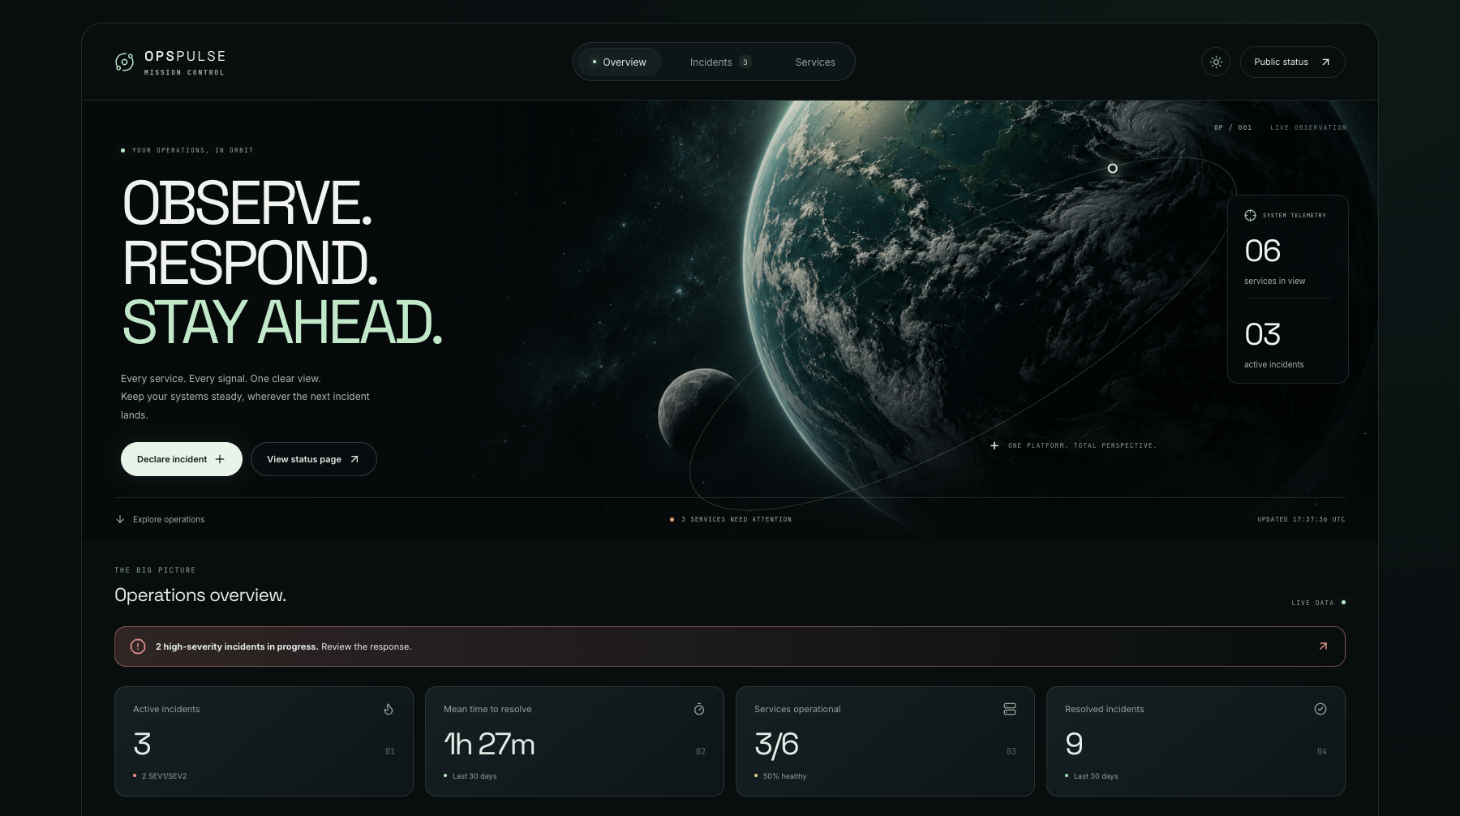
02 / PRODUCT TOUR
A landing page built around operational clarity
A space-inspired interface with a restrained mint palette.
OPSPULSE / CHHAVI AHLAWAT
03
Notes:
Show the live application entry point. The navigation leads to incidents, services and the public status page. Counts come from the local API and seeded records, not static screenshot annotations.
[Sources]
https://github.com/Chhavi07-arch/OpsPulse-devops-platform/blob/fa87670/application/frontend/src/components/OrbitHero.jsx
Screenshots: captured from running local OpsPulse UI/API on 14 October 2026 using seeded demonstration data; CI screenshot is the actual public workflow run.
[/Sources]

Slide 4
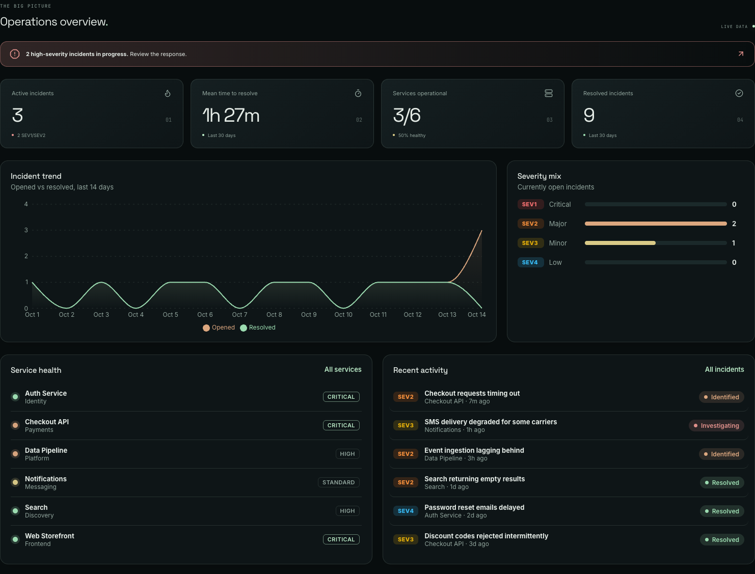
03 / OVERVIEW
See impact before opening an incident
The overview combines response KPIs with current service health.
3 active incidents
3 / 6 services operational
Demo data
OPSPULSE / CHHAVI AHLAWAT
04
Notes:
Describe active incidents, MTTR, service health, trends and severity. Numbers shown are seeded demonstration values, not real production SLOs. Service health is derived from incident records; the app does not independently probe the example services.
[Sources]
https://github.com/Chhavi07-arch/OpsPulse-devops-platform/blob/fa87670/application/frontend/src/pages/Overview.jsx
https://github.com/Chhavi07-arch/OpsPulse-devops-platform/blob/fa87670/application/backend/app
Screenshots: captured from running local OpsPulse UI/API on 14 October 2026 using seeded demonstration data; CI screenshot is the actual public workflow run.
[/Sources]

Slide 5
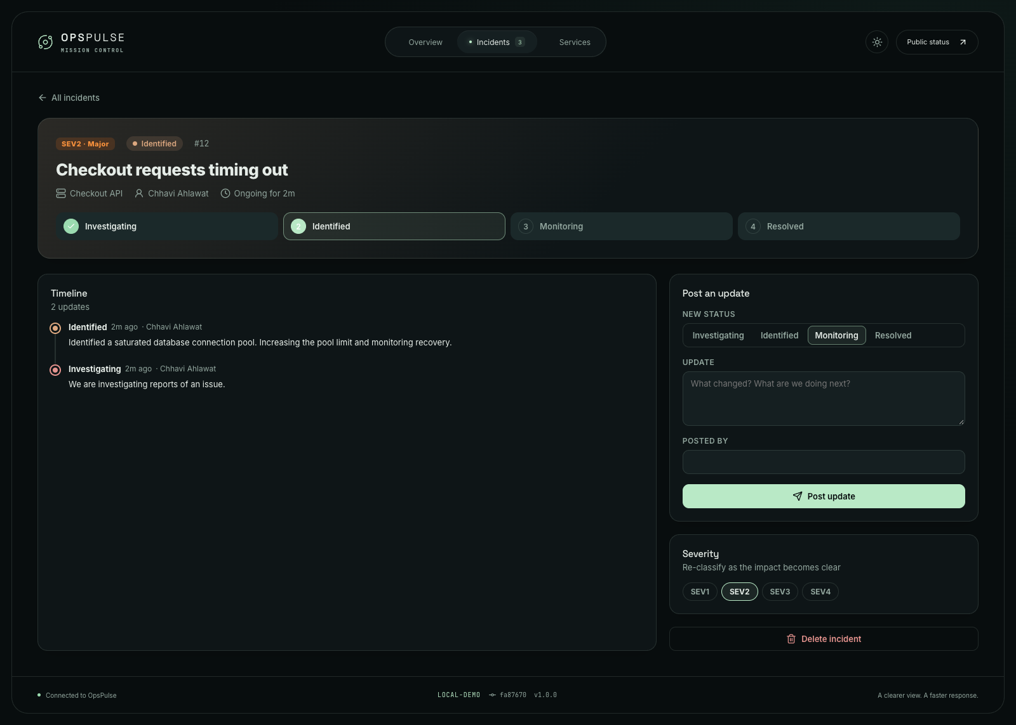
04 / RESPONSE
A clear timeline keeps the response moving
Investigating → Identified → Monitoring → Resolved
Impact
Ownership
Timestamped updates
OPSPULSE / CHHAVI AHLAWAT
05
Notes:
Demonstrate the declared checkout incident and the Identified update. Explain that author names are manually entered; there is no authentication or verified identity yet. The incident can be resolved or reopened.
[Sources]
https://github.com/Chhavi07-arch/OpsPulse-devops-platform/blob/fa87670/application/frontend/src/pages/IncidentDetail.jsx
https://github.com/Chhavi07-arch/OpsPulse-devops-platform/blob/fa87670/application/backend/app
Screenshots: captured from running local OpsPulse UI/API on 14 October 2026 using seeded demonstration data; CI screenshot is the actual public workflow run.
[/Sources]

Slide 6
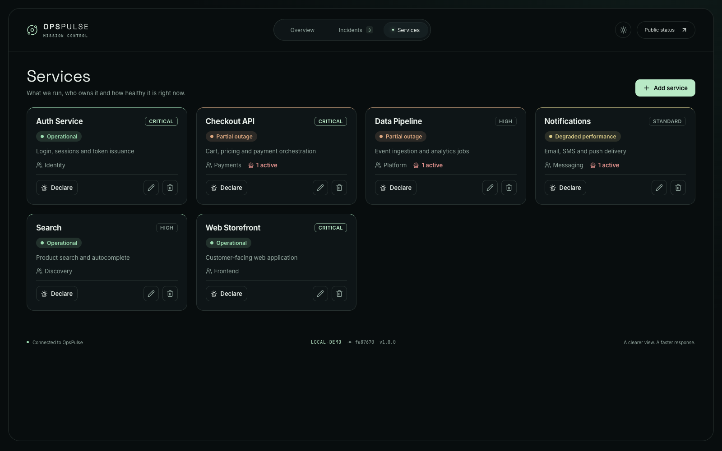
05 / SERVICE CATALOGUE
Connect each service to its owner and incidents
The catalogue links service criticality, team ownership and current impact.
OPSPULSE / CHHAVI AHLAWAT
06
Notes:
Point to service teams and tiers. Service status is derived from the most severe active incident. Relationships are preserved when a service has incident history.
[Sources]
https://github.com/Chhavi07-arch/OpsPulse-devops-platform/blob/fa87670/application/frontend/src/pages/Services.jsx
Screenshots: captured from running local OpsPulse UI/API on 14 October 2026 using seeded demonstration data; CI screenshot is the actual public workflow run.
[/Sources]

Slide 7
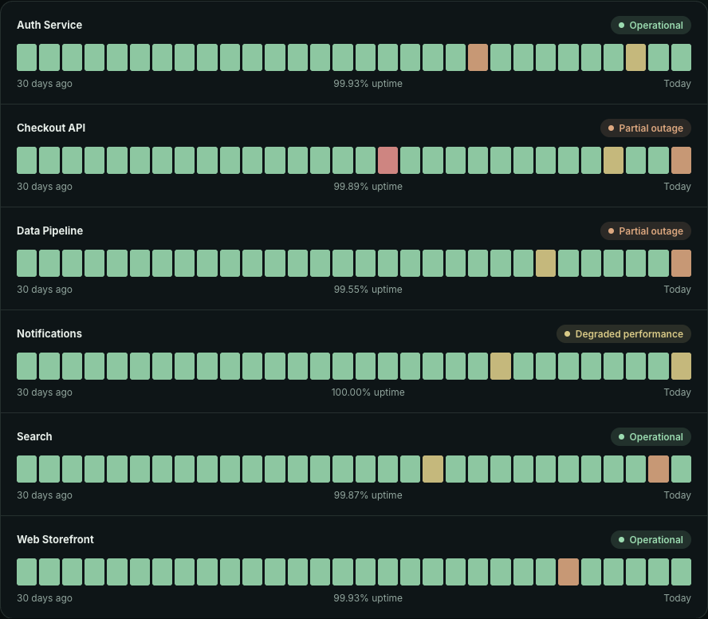
06 / PUBLIC COMMUNICATION
Share status without exposing the response console
Thirty-day history is calculated from recorded incidents.
One outage interval,
counted once.
Overlapping outages are merged before uptime is calculated.
These are incident-derived figures, not external probe measurements.
OPSPULSE / CHHAVI AHLAWAT
07
Notes:
Explain the public page and its uptime history. Interval merging prevents duplicate downtime when multiple incidents affect the same service. Values are demonstrations.
[Sources]
https://github.com/Chhavi07-arch/OpsPulse-devops-platform/blob/fa87670/application/frontend/src/pages/StatusPage.jsx
https://github.com/Chhavi07-arch/OpsPulse-devops-platform/blob/fa87670/application/backend/app
https://github.com/Chhavi07-arch/OpsPulse-devops-platform/blob/fa87670/application/backend/tests
Screenshots: captured from running local OpsPulse UI/API on 14 October 2026 using seeded demonstration data; CI screenshot is the actual public workflow run.
[/Sources]

Slide 8
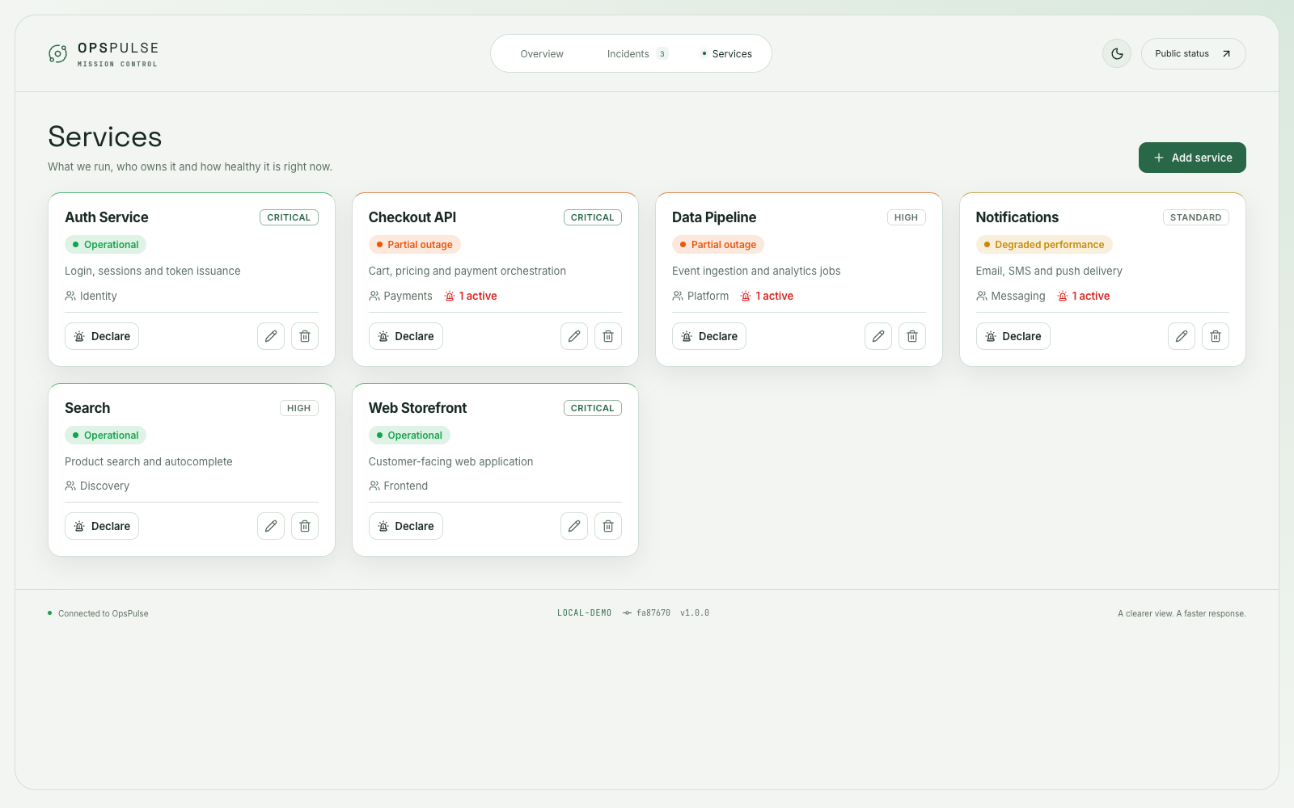
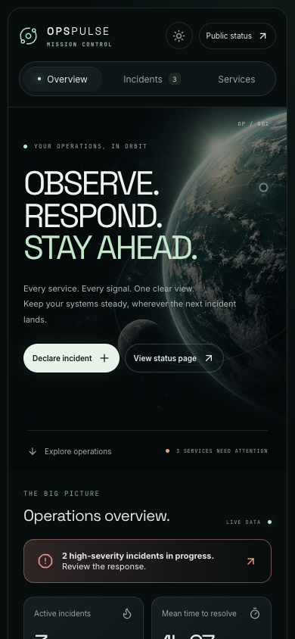
07 / INTERFACE DESIGN
The experience adapts to different screens
Responsive navigation, light/dark themes and clear feedback states.
OPSPULSE / CHHAVI AHLAWAT
08
Notes:
Show a desktop light-mode view and mobile dark-mode overview. The mobile viewport was tested for horizontal overflow. Forms and status updates stay part of the same product workflow.
[Sources]
https://github.com/Chhavi07-arch/OpsPulse-devops-platform/blob/fa87670/application/frontend/src
Screenshots: captured from running local OpsPulse UI/API on 14 October 2026 using seeded demonstration data; CI screenshot is the actual public workflow run.
[/Sources]

Slide 9
08 / ARCHITECTURE
Three application layers form one release
React presents the workflow; FastAPI validates it; PostgreSQL persists it.
Browser
React + Nginx
FastAPI
PostgreSQL
Web client
UI and API proxy
Validation and logic
Persistent history
Service → Incident → IncidentUpdate
Compose and Kubernetes use PostgreSQL. Screenshots use an isolated SQLite demo database.
OPSPULSE / CHHAVI AHLAWAT
09
Notes:
Walk through a browser request. Kubernetes ingress routes to the frontend or API; Nginx also proxies /api. SQLAlchemy maps the entities and Alembic manages schema changes. SQLite is used only for this isolated screenshot session and tests.
[Sources]
https://github.com/Chhavi07-arch/OpsPulse-devops-platform/blob/fa87670/docker/docker-compose.yml
https://github.com/Chhavi07-arch/OpsPulse-devops-platform/blob/fa87670/helm/opspulse/templates/ingress.yaml
https://github.com/Chhavi07-arch/OpsPulse-devops-platform/blob/fa87670/application/backend/app/models.py
Screenshots: captured from running local OpsPulse UI/API on 14 October 2026 using seeded demonstration data; CI screenshot is the actual public workflow run.
[/Sources]

Slide 10
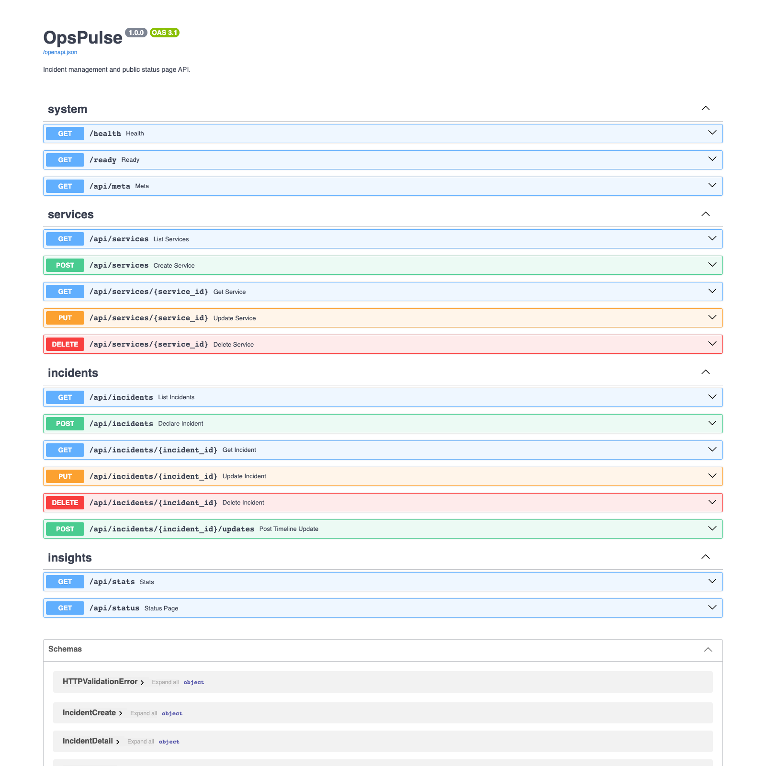
09 / API
A documented API keeps behaviour explicit
Interactive OpenAPI documentation is served directly by FastAPI.
/api/services
Catalogue and ownership
/api/incidents
Lifecycle and timeline updates
/health · /ready · /metrics
Process health, database readiness and telemetry
OPSPULSE / CHHAVI AHLAWAT
10
Notes:
Open localhost:8000/docs during a live demonstration if time allows. Explain request validation and the different purposes of health, readiness and metrics.
[Sources]
https://github.com/Chhavi07-arch/OpsPulse-devops-platform/blob/fa87670/application/backend/app/main.py
Screenshots: captured from running local OpsPulse UI/API on 14 October 2026 using seeded demonstration data; CI screenshot is the actual public workflow run.
[/Sources]

Slide 11
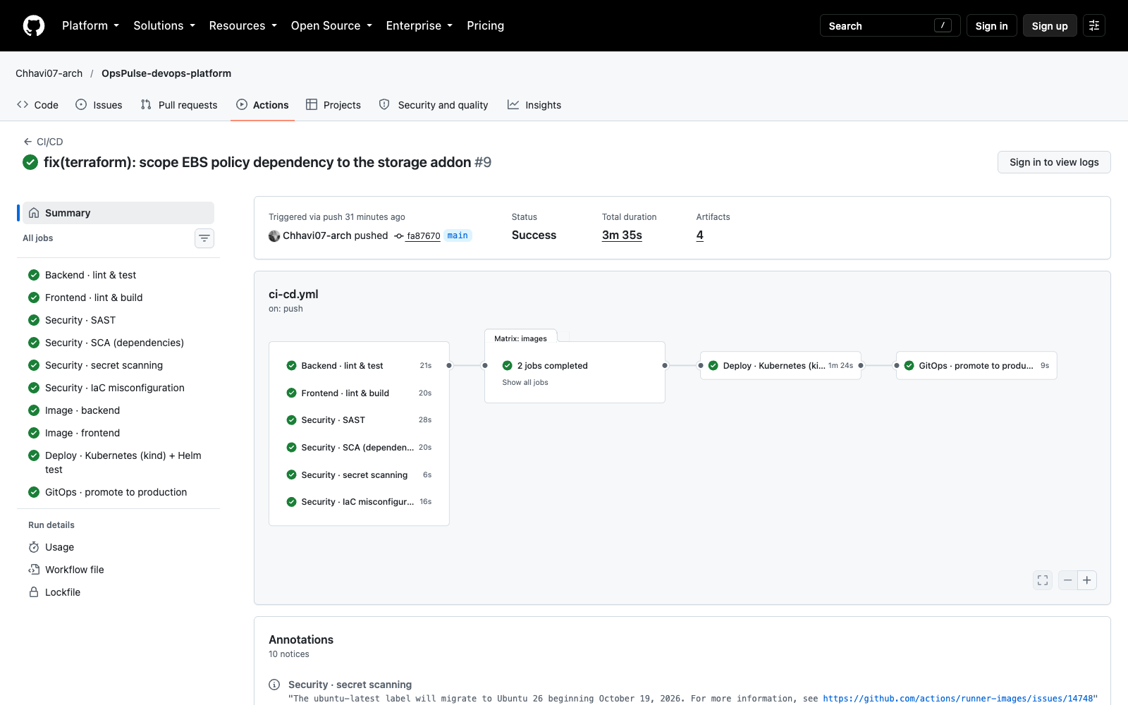
10 / CONTINUOUS DELIVERY
Every release must pass the delivery gates
An actual successful workflow run provides repeatable evidence.
10 jobs
passed
Tests → scans → images → kind + Helm → GitOps promotion
OPSPULSE / CHHAVI AHLAWAT
11
Notes:
Source: run 38599535048 for fa87670. All ten jobs passed, including two image builds and a real temporary kind deployment. Pull requests validate but do not publish/promote. This does not prove a separate Codespace or AWS deployment is currently running.
[Sources]
https://github.com/Chhavi07-arch/OpsPulse-devops-platform/actions/runs/38599535048
https://github.com/Chhavi07-arch/OpsPulse-devops-platform/blob/fa87670/.github/workflows/ci-cd.yml
Screenshots: captured from running local OpsPulse UI/API on 14 October 2026 using seeded demonstration data; CI screenshot is the actual public workflow run.
[/Sources]

Slide 12
11 / VERIFICATION
Tests check behaviour and deployment readiness
Evidence from the successful CI run for commit fa87670.
30
97%
backend tests passed
backend coverage
Beyond unit tests
Frontend lint/build, Helm installation in kind, and in-cluster endpoint checks.
OPSPULSE / CHHAVI AHLAWAT
12
Notes:
The CI log reports 30 passing tests and total backend coverage of 97%. Coverage does not refer to frontend or infrastructure. Explain service CRUD, validation, incident lifecycle, statistics and outage edge cases. The Helm smoke test checks readiness and service endpoints.
[Sources]
https://github.com/Chhavi07-arch/OpsPulse-devops-platform/actions/runs/38599535048
https://github.com/Chhavi07-arch/OpsPulse-devops-platform/blob/fa87670/application/backend/tests
https://github.com/Chhavi07-arch/OpsPulse-devops-platform/blob/fa87670/helm/opspulse/templates/tests/test-api.yaml
Screenshots: captured from running local OpsPulse UI/API on 14 October 2026 using seeded demonstration data; CI screenshot is the actual public workflow run.
[/Sources]

Slide 13
12 / DEVSECOPS
Security checks run before image promotion
Build-time gates and runtime controls address different failure modes.
Before release
At runtime
Source: Bandit + Semgrep
Dependencies: pip-audit + npm audit
Secrets: Gitleaks
IaC and images: Trivy
Non-root containers
Read-only root filesystems
Dropped Linux capabilities
Restricted PostgreSQL ingress
Demo boundary: write APIs stay private; authentication and RBAC are future work.
OPSPULSE / CHHAVI AHLAWAT
13
Notes:
Image gates block fixable HIGH/CRITICAL findings. Unfixed findings remain visible, and two EKS IaC exceptions are documented in security/.trivyignore. No scan proves the absence of all vulnerabilities. The application has no sign-in or role enforcement yet.
[Sources]
https://github.com/Chhavi07-arch/OpsPulse-devops-platform/blob/fa87670/.github/workflows/ci-cd.yml
https://github.com/Chhavi07-arch/OpsPulse-devops-platform/blob/fa87670/security/.trivyignore
https://github.com/Chhavi07-arch/OpsPulse-devops-platform/blob/fa87670/helm/opspulse/templates
Screenshots: captured from running local OpsPulse UI/API on 14 October 2026 using seeded demonstration data; CI screenshot is the actual public workflow run.
[/Sources]

Slide 14
13 / KUBERNETES
Health checks, replicas and storage work together
The Helm chart packages operational behaviour with the application.
Availability
Two frontend and two backend replicas; disruption budgets retain one.
Readiness
Separate process and database checks prevent premature traffic.
Scaling
CPU target 70%; backend 2–6 replicas, frontend 2–4.
Persistence
PostgreSQL StatefulSet + PVC; migrations run with an advisory lock.
OPSPULSE / CHHAVI AHLAWAT
14
Notes:
Explain why multiple replicas alone are insufficient: probes control traffic, persistence survives pod replacement, and migration locking avoids concurrent schema changes. Defaults can be overridden by environment values.
[Sources]
https://github.com/Chhavi07-arch/OpsPulse-devops-platform/blob/fa87670/helm/opspulse/values.yaml
https://github.com/Chhavi07-arch/OpsPulse-devops-platform/blob/fa87670/helm/opspulse/templates/backend.yaml
https://github.com/Chhavi07-arch/OpsPulse-devops-platform/blob/fa87670/helm/opspulse/templates/frontend.yaml
https://github.com/Chhavi07-arch/OpsPulse-devops-platform/blob/fa87670/helm/opspulse/templates/postgres.yaml
https://github.com/Chhavi07-arch/OpsPulse-devops-platform/blob/fa87670/application/backend/alembic
Screenshots: captured from running local OpsPulse UI/API on 14 October 2026 using seeded demonstration data; CI screenshot is the actual public workflow run.
[/Sources]

Slide 15
14 / GITOPS
A running release can be traced back to Git
Images are identified by the full commit SHA.
01
Build immutable image tags
GitHub Actions publishes backend and frontend images to GHCR.
02
Promote only after the gates pass
The workflow updates production image tags in Git.
03
Reconcile the declared state
Argo CD reads the Helm chart and values, then syncs, self-heals and prunes.
OPSPULSE / CHHAVI AHLAWAT
15
Notes:
Describe the multi-source Argo CD Application: chart and values come from the same repository. ServerSideDiff=true was added while investigating StatefulSet differences. Current live Argo CD status is not asserted by this slide; it describes implemented configuration and verified promotion.
[Sources]
https://github.com/Chhavi07-arch/OpsPulse-devops-platform/blob/fa87670/gitops/argocd/application.yaml
https://github.com/Chhavi07-arch/OpsPulse-devops-platform/blob/fa87670/gitops/environments/production/values.yaml
https://github.com/Chhavi07-arch/OpsPulse-devops-platform/blob/fa87670/.github/workflows/ci-cd.yml
Screenshots: captured from running local OpsPulse UI/API on 14 October 2026 using seeded demonstration data; CI screenshot is the actual public workflow run.
[/Sources]

Slide 16
15 / OBSERVABILITY
Metrics help explain user-facing symptoms
Prometheus, Grafana and structured logs are configured alongside the app.
Request signals
Response signals
Rate · errors · latency
HTTP status codes
Pod CPU and memory
Active incidents by severity
Declarations and resolutions
Resolution duration
Alerts: unavailable backend, elevated errors, high latency and an open SEV1.
Configuration is implemented; no live monitoring screenshots are claimed.
OPSPULSE / CHHAVI AHLAWAT
16
Notes:
A ServiceMonitor discovers the API metrics. PrometheusRule defines alerts and a ConfigMap provisions the Grafana dashboard when the operator stack is installed. JSON logs include request identifiers and timing. This presentation intentionally omits extra monitoring/terminal captures.
[Sources]
https://github.com/Chhavi07-arch/OpsPulse-devops-platform/blob/fa87670/helm/opspulse/templates/monitoring.yaml
https://github.com/Chhavi07-arch/OpsPulse-devops-platform/blob/fa87670/monitoring/kube-prometheus-stack-values.yaml
https://github.com/Chhavi07-arch/OpsPulse-devops-platform/blob/fa87670/application/backend/app
Screenshots: captured from running local OpsPulse UI/API on 14 October 2026 using seeded demonstration data; CI screenshot is the actual public workflow run.
[/Sources]

Slide 17
16 / CLOUD DEMONSTRATION
AWS is prepared for a short, controlled demo
Existing project: Hello World · Sydney: ap-southeast-2
60
EKS 1.35
Two t3.medium workers
Encrypted database volume
Private port-forward access
resources in the verified plan
NOT DEPLOYED
Launch for the demo, then tear down. Total budget: $1–$2.
OPSPULSE / CHHAVI AHLAWAT
17
Notes:
The successful Terraform plan reports 60 create, 0 change, 0 destroy. No apply has run. The demo was explicitly deferred by the owner. The $1–$2 figure is a total spending target, not an enforced cap; AWS metering and cleanup can lag. Refresh the plan and access CIDR before a future launch. Existing promotional credits are not permission to spend more.
[Sources]
https://github.com/Chhavi07-arch/OpsPulse-devops-platform/blob/fa87670/terraform/main.tf
https://github.com/Chhavi07-arch/OpsPulse-devops-platform/blob/fa87670/terraform/variables.tf
https://github.com/Chhavi07-arch/OpsPulse-devops-platform/blob/fa87670/docs/operations-guide.md
Screenshots: captured from running local OpsPulse UI/API on 14 October 2026 using seeded demonstration data; CI screenshot is the actual public workflow run.
[/Sources]

Slide 18
17 / ENGINEERING LESSONS
The hard parts shaped the implementation
Three issues turned into specific engineering decisions.
Concurrent migrations
Use a PostgreSQL advisory lock before changing the schema.
Overlapping outages
Merge intervals so downtime is not counted twice.
Deferred Terraform values
Narrow the EBS policy dependency to the storage add-on.
OPSPULSE / CHHAVI AHLAWAT
18
Notes:
Explain trigger, fix and verification for each issue. Migration init containers can run concurrently on replica startup. Overlapping incidents should not double downtime. A module-wide Terraform depends_on deferred lookups and broke resource counts; a scoped dependency restored the full plan.
[Sources]
https://github.com/Chhavi07-arch/OpsPulse-devops-platform/blob/fa87670/application/backend/alembic
https://github.com/Chhavi07-arch/OpsPulse-devops-platform/blob/fa87670/application/backend/tests
https://github.com/Chhavi07-arch/OpsPulse-devops-platform/blob/fa87670/terraform/main.tf
Screenshots: captured from running local OpsPulse UI/API on 14 October 2026 using seeded demonstration data; CI screenshot is the actual public workflow run.
[/Sources]

Slide 19
18 / OUTCOME
A working product with a reproducible delivery path
OpsPulse connects incident response to the engineering system that ships it.
Built and verified
Next milestones
Incident workflows and public status
Responsive UI and documented API
30 passing tests and 97% coverage
Security gates + kind/Helm smoke test
Run and tear down the AWS demo
Add authentication and permissions
Integrate notifications
Add external health probes
github.com/Chhavi07-arch/OpsPulse-devops-platform
OPSPULSE / CHHAVI AHLAWAT
19
Notes:
Close by connecting the original problem to the result: a shared incident record delivered through a tested pipeline. Distinguish the completed implementation from future product features and the deferred AWS demonstration. Invite questions.
[Sources]
https://github.com/Chhavi07-arch/OpsPulse-devops-platform/blob/fa87670/README.md
Screenshots: captured from running local OpsPulse UI/API on 14 October 2026 using seeded demonstration data; CI screenshot is the actual public workflow run.
[/Sources]

