Slide 1
C598 Deep Learning in HealthCare Final Project Chhavi Jain and Rathiv Bal {chhavi2,rbal2}@illinos.edu Group ID: 126 Paper ID: 104

Slide 2

Problem Background & Motivation
In the healthcare domain, Electronic Health Records or EHRs are digital versions of patients' paper charts. They are real-time, patient-centered records containing essential medical information. However, the manual assignment of ICD codes to clinical notes is time-consuming, error-prone, and sometimes results in misjudged severity of conditions or code omissions. This can lead to billing issues, revenue loss, and federal penalties. As a result, there is a clear need for a reliable automated classification of unstructured clinical notes.

Slide 3

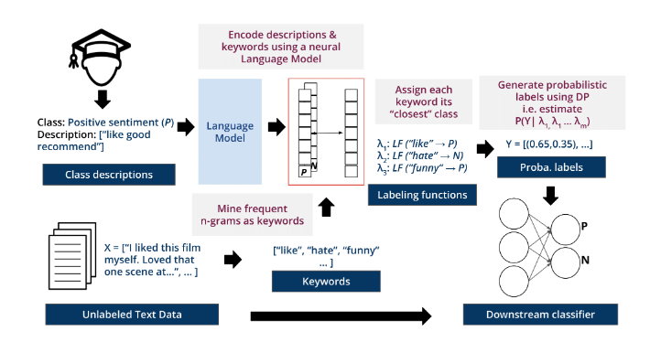
KeyClass Methodology Overview
KeyClass classifies documents without access to any labeled data.
It automatically creates interpretable labeling functions (LFs) by extracting frequent keywords. It then uses these LFs along with Data Programming (DP) to generate probabilistic labels for training data, which are used to train a downstream classifier

Slide 4
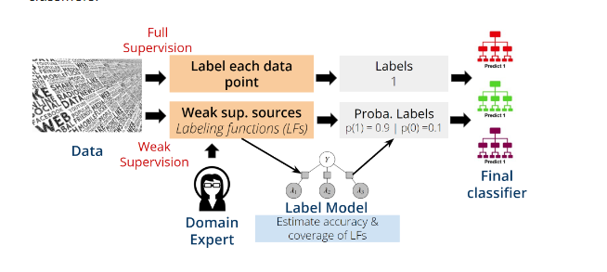
KeyClass Methodology Overview
Data programming, or weak supervision compared to fully supervised ML. The orange boxes indicate the effort required by expert annotators. Instead of having to label extensive quantities of data by hand, the effort in data programming framework lies in obtaining labeling functions. In KeyClass, these labeling functions are our keyword-matching rules automatically extracted from reference data, to further reduce required human effort.

Slide 5
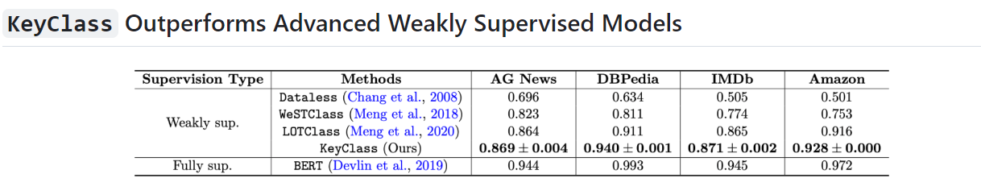
Results
We could reproduce results from paper with high accuracy

Slide 6

Training Conclusion
In conclusion, KeyClass offers a novel approach to efficient and interpretable text classification. Its successful application in clinical text classification demonstrates its potential for making social impact by allowing quick and affordable development and deployment of effective text classifiers.

Slide 7
Ablation study
Knowledge Injected Prompt Based Fine-tuning for Multi-label Few-shot ICD Coding
Automatic International Classification of Diseases (ICD) coding aims to assign multiple ICD codes to a medical note with average length of 3,000+ tokens.
This task is challenging due to a high-dimensional space of multi-label assignment (tens of thousands of ICD codes)
And the long-tail challenge: only a few codes (common diseases) are frequently assigned while most codes (rare diseases) are infrequently assigned.
This study addresses the long-tail challenge by adapting a prompt-based fine-tuning technique with label semantics, which has been shown to be effective under few-shot setting.

Slide 8
Ablation study
We found that using prompting approach as original paper authors expected increased the accuracy on low prevalence classes.
Model AUC F1 Precision
KEPTLongformer 91.07 93.45 64.82

Slide 9
What-If Tool
Understanding model performance: By visualizing the classification results, the What-If Tool can help you identify patterns and trends in your model's performance, such as misclassifications, false positives, or false negatives.
Feature importance analysis: The What-If Tool allows you to analyze the importance of different features in your model's predictions. This can help you understand which aspects of the input data contribute most to the classification results and may reveal potential areas for improvement in the labeling functions.
Counterfactual analysis: Using the What-If Tool, you can explore counterfactual instances, where you modify the input features to observe how the changes affect the model's predictions. This can provide valuable insights into your model's behavior and help identify potential biases or shortcomings in the classification process.
Model comparison: The What-If Tool enables you to compare the performance of different models or hyperparameter settings side by side. This can help you identify the best-performing configuration and gain insights into the trade-offs between various hyperparameters.

Slide 10
What-If Tool

Slide 11
Thank you

