Slide 1





SMART INDIA HACKATHON 2026
  Problem Statement ID –SIH26133
  Problem Statement Title- VitalSense
  Theme- MedTech/BioTech/ HealthTech
  PS Category- Software
  Team ID- 1049
  Team Name- ArogyaX

Slide 2
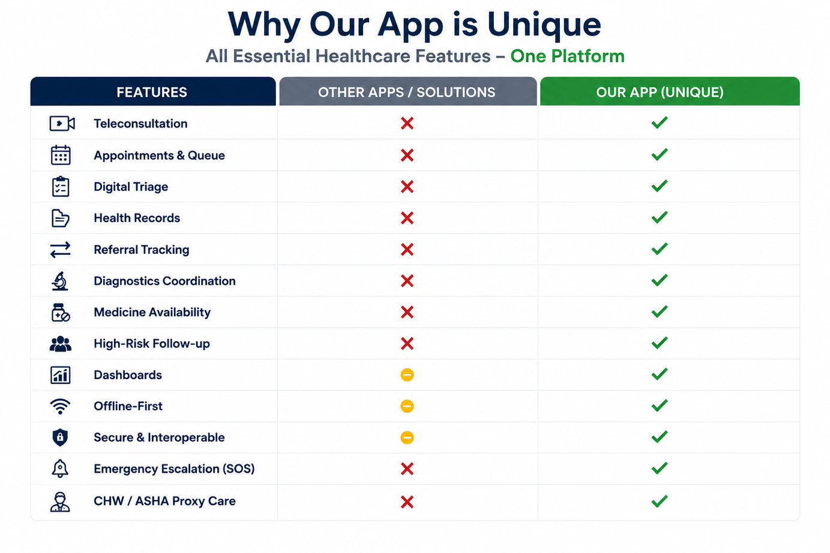
VitalSense
ArogyaX
The Problem
  Limited Rural Access: Patients face long travel and limited specialist access.
  Poor Connectivity: Rural areas may have weak or no internet, affecting healthcare access.
  Fragmented Records: Patient information is spread across different healthcare services.
  Delayed Referrals: Lack of proper referral tracking can delay treatment.
  Long Waiting Time: Manual OPD appointments and queues increase waiting.
  Weak Health Monitoring: Health officials lack centralized village-level data for monitoring.
Our Solution
  One Connected Platform: Brings patients, ASHA workers, doctors and admins together.
  Offline Healthcare: Room + sync system allows important work even without internet.
  Digital Patient Records: Connects patient, prescription, lab and medical data.
  Referral Management: Dedicated referral modules help connect patients with the right care.
  OPD & Appointment System: Supports appointments and queue management to reduce waiting.
  Health Monitoring: Admin dashboards and outbreak tracking help monitor village-level health trends.
2
Notes:
2

Slide 3
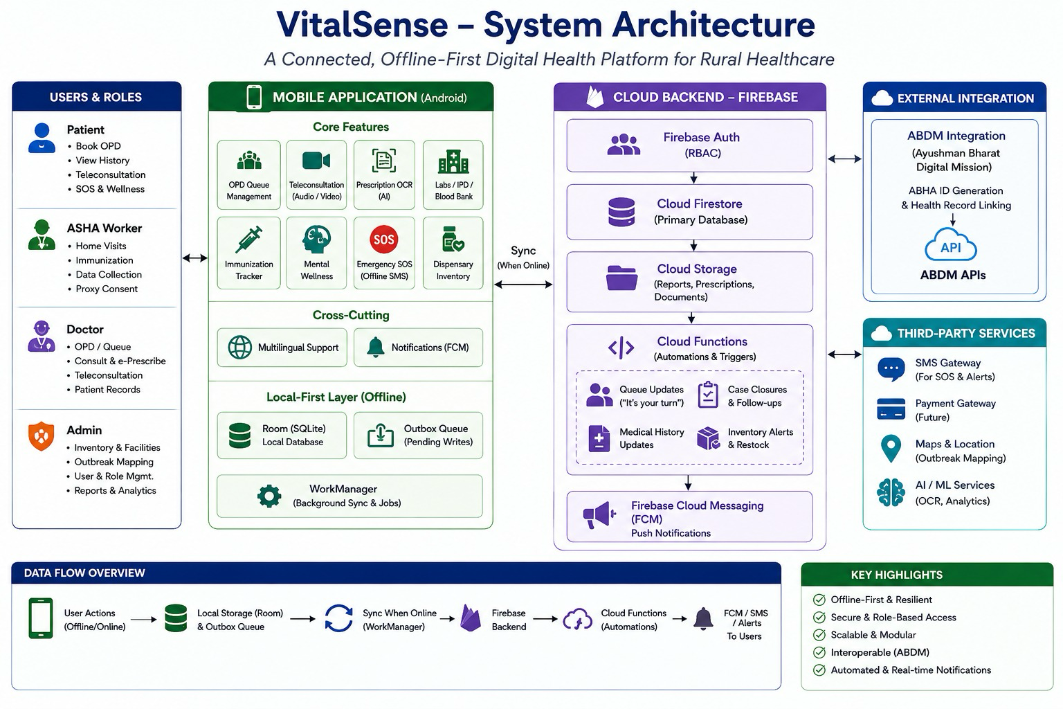
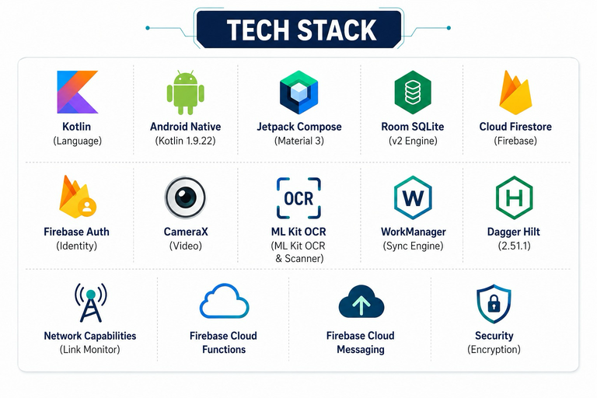

ArogyaX
TECHNICAL APPROACH
Scan for prototype!!
3
Notes:
3

Slide 4
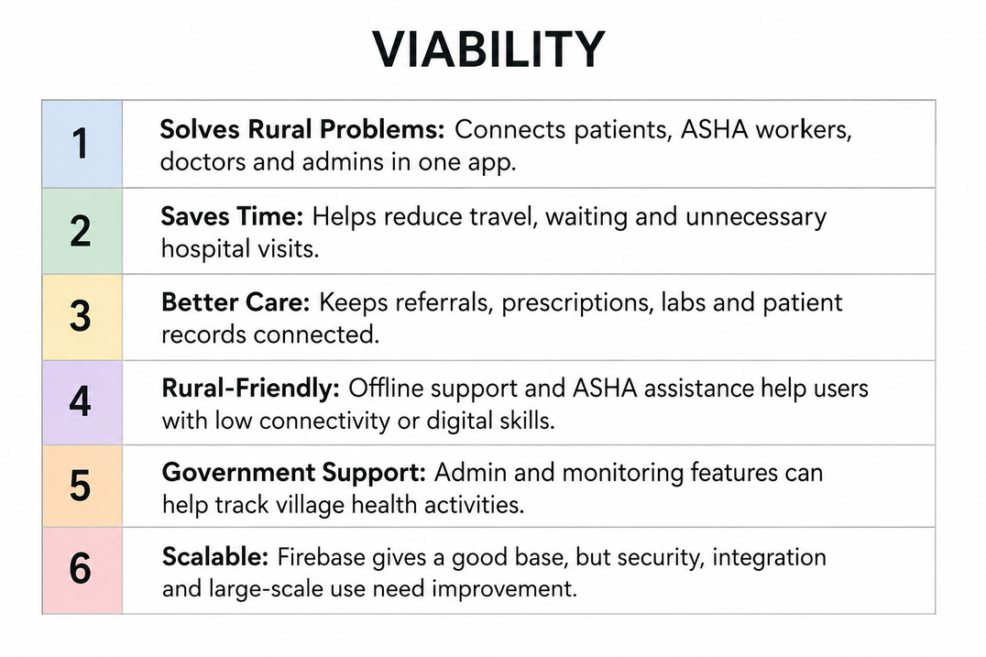
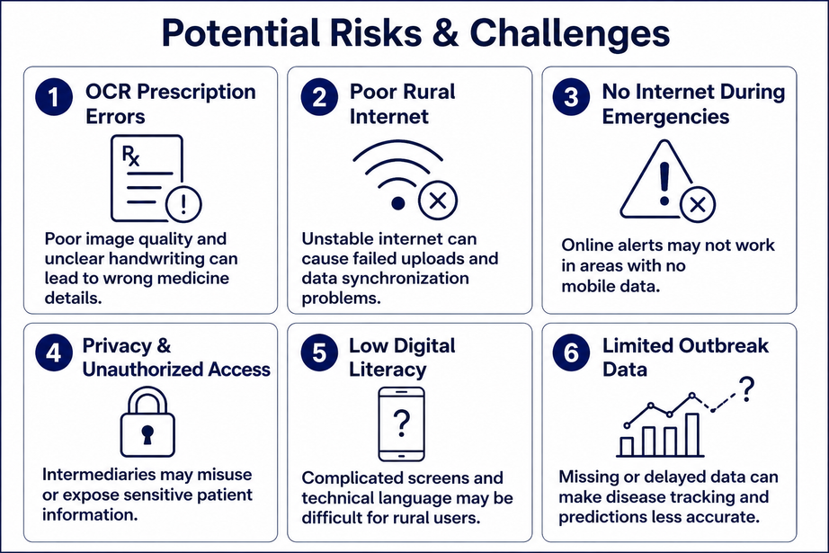
FEASIBILITY AND VIABILITY
ArogyaX
4
Analysis of the Feasibility of the Idea
  Proven Tech: Built with Kotlin, Jetpack Compose, Room, Firebase, Hilt & WorkManager.
  Offline Support: Local storage + background sync keeps the app usable with poor internet.
  Working Modules: Includes Patient, ASHA, Doctor, Lab, OPD, Referral, Blood Bank & Admin.
  Real-Time Updates: Firebase Functions + FCM handle notifications and queue updates.
  AI & Maps: ML Kit OCR supports prescription digitization and Places API supports location services.
Strategies to Overcome Challenges
  Offline-first: Room DB + Outbox queue → works during poor/no internet.
  Reliable Sync: Queued writes + retries → minimizes data loss.
  Real-time Care: Firestore listeners → instant case/notice updates.
  Timely Consultations: WorkManager → automated appointment reminders.
  Fair OPD Queue: Firestore transactions → unique authoritative tokens.
  Secure Access: Firebase Authentication + security rules.
  Interoperable Records: ABDM/ABHA integration + consent flow.
  Structured Data: Typed entities/enums → fewer inconsistent records.
4
Notes:
4

Slide 5
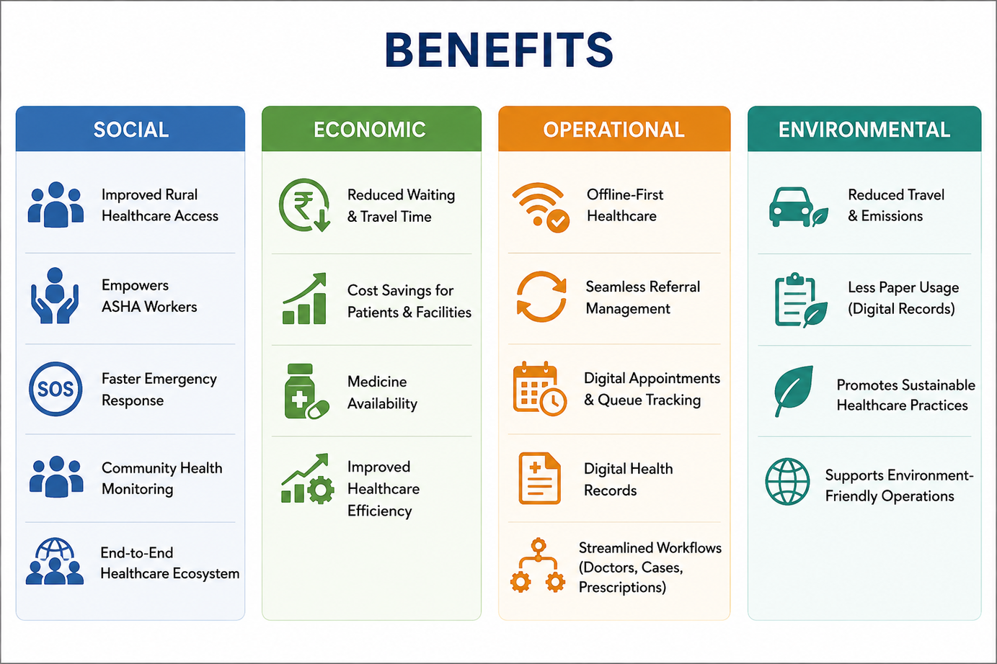
IMPACT AND BENEFITS
ArogyaX
Potential Impact on the Target Audience
  Better Rural Access – Connects patients, ASHA workers, doctors & hospitals.
  Faster Healthcare – Reduces travel, waiting time & delays through teleconsultation and appointments.
  Connected Patient Care – Enables easy sharing of records, prescriptions & referrals.
  Quick Emergency Support – Helps patients get faster assistance during emergencies.
  Empowered ASHA Workers – Gives ASHA workers better tools to support and monitor patients.
  Inclusive & Smarter Healthcare – Multilingual support and health heatmaps improve accessibility and identify local health trends.
5
Notes:
5

Slide 6
RESEARCH AND REFRENCES
ArogyaX
National Health Frameworks
Clinical & Field Research
System Architecture & Algorithms
  eSanjeevani Telemedicine Framework ↳ Graceful degradation to 2G audio/UI for low-bandwidth rural consults.
  WHO mhGAP Intervention Guide ↳ Adapted low-literacy, icon-driven mental wellness screening.
  WHO Digital Health (mHealth) ↳ SMS-fallback architectures for last-mile emergency SOS.
  Ayushman Bharat Digital Mission (ABDM) ↳ Foundation for our Offline Health Card & QR Identity.
  NHM ASHA Guidelines ↳ Digitized proxy-care and household visit workflows.
  IDSP Surveillance Protocols ↳ GIS-based heatmaps for village-level outbreak detection.
  Designing Data-Intensive Applications (Kleppmann) ↳ Transactional outbox pattern for our offline-first background sync.
  M/M/1 Queueing Theory ↳ Mathematical foundation for our dynamic OPD wait-time (ETA) engine.
  Google ML Kit Vision v2 ↳ On-device OCR heuristic modeling for digitizing handwritten prescriptions.
6
Notes:
6

