Slide 1

E-Commerce
Company
The Best Product
Help you solve your problem with your computer

Slide 2
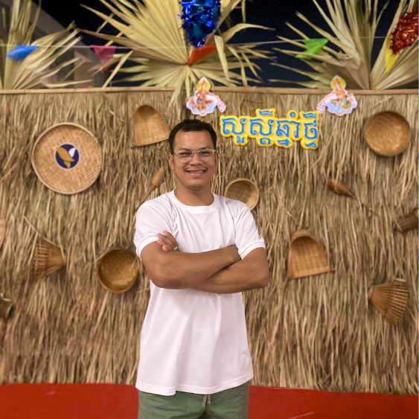
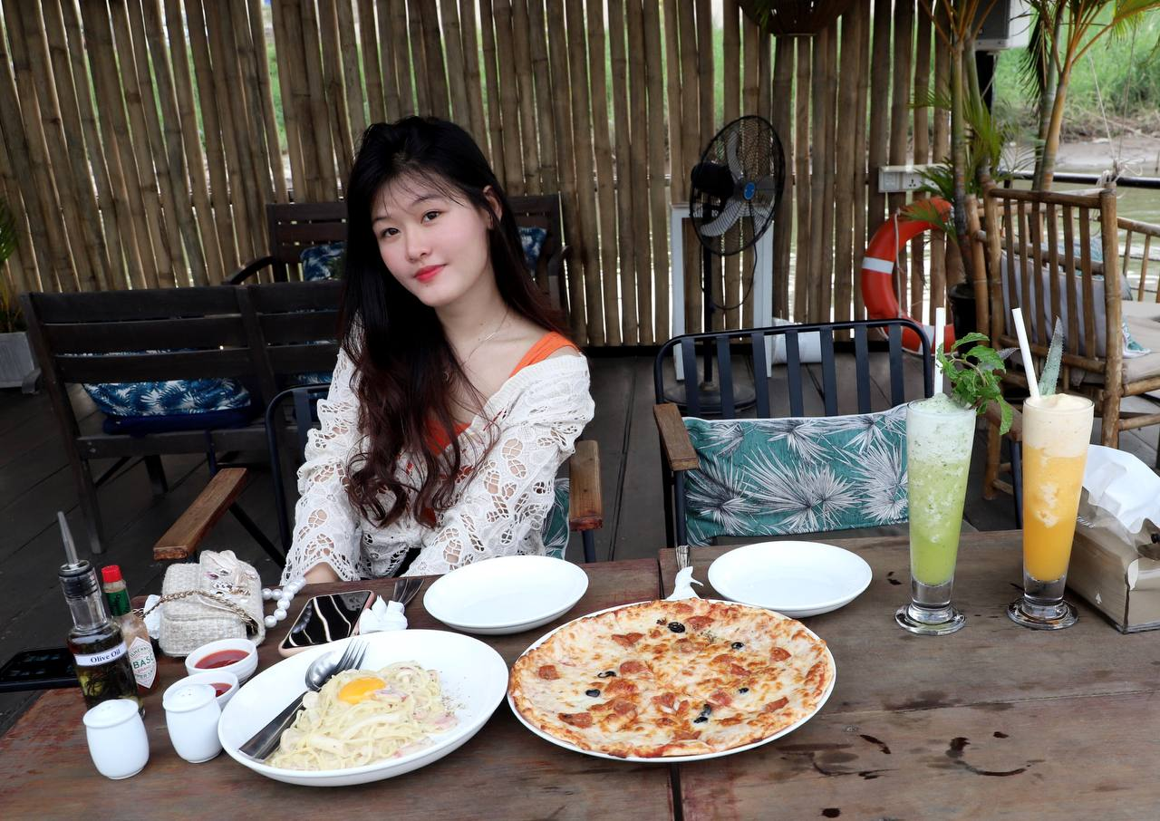
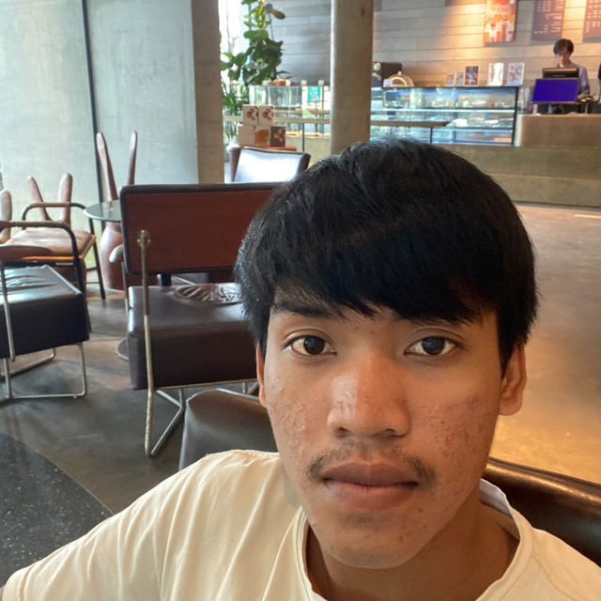

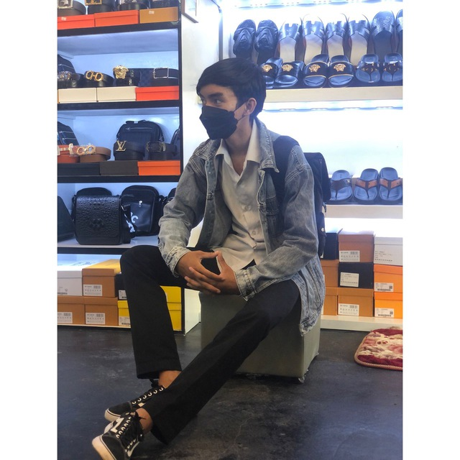
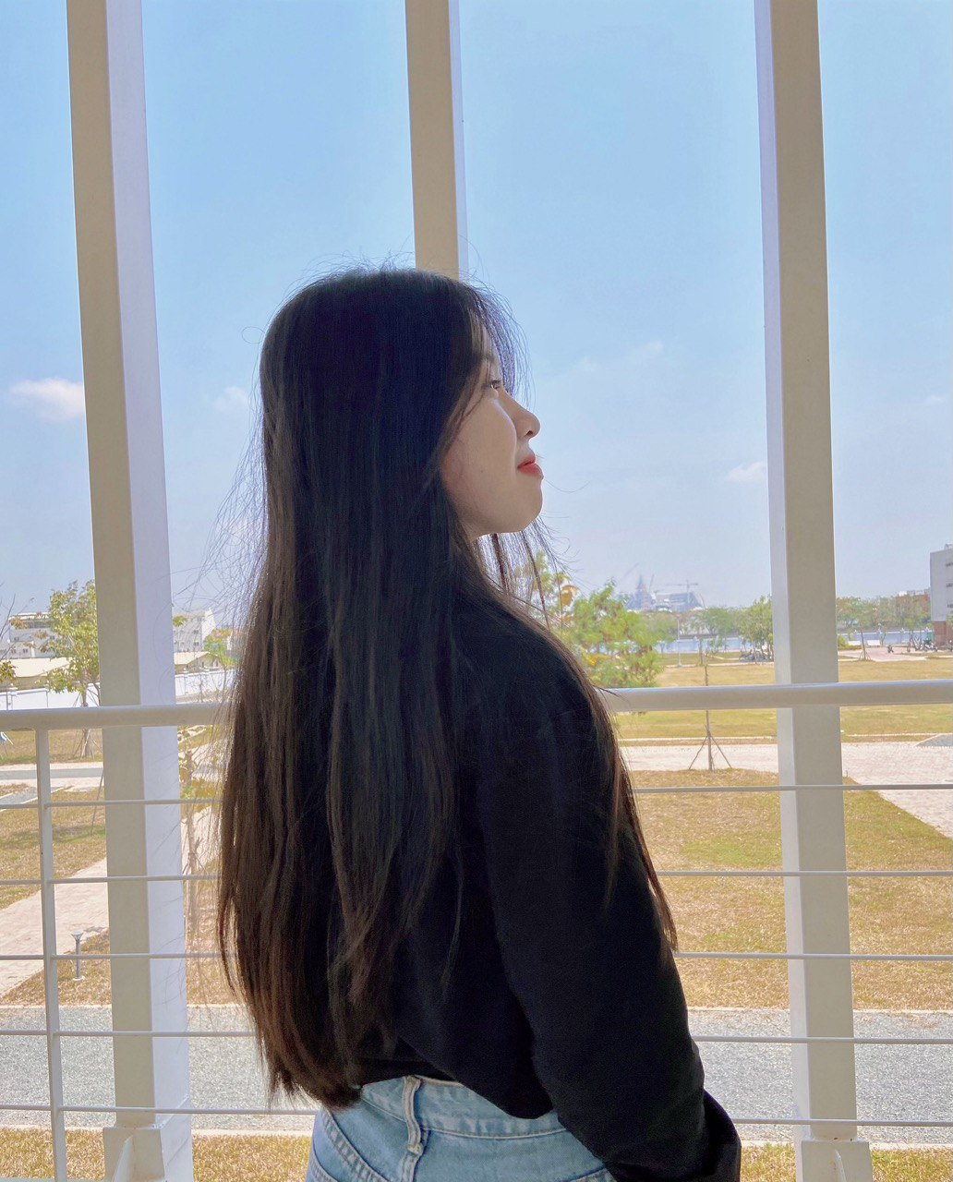
E-Commerce
Chhoeun Mach
Vy Eiliza
Ponlieu Nhoem
Group Member
Vichet Somphors
Keo Lux
Kong Chanchury

Slide 3
E-Commerce
Vy Eiliza
Chhoeun Mach
I am a leader team. My task is assign all of task to my member group, choose topic, analyze layout and design.

Slide 4
Ponlieu Nhoem
E-Commerce
Vy Eilliza
I am a member team. My task is design and prototypes

Slide 5
Vichet Somphors
E-Commerce
Ponlieu Nhoem
I am a member team. My task is analyze database

Slide 6
Koe Lux
E-Commerce
Vichet Somphors
I am a member team. My task is analyze database.

Slide 7
Kong Chanchury
E-Commerce
Koe Lux
I am a member team. My task is QC.

Slide 8
Chhoeun Mach
E-Commerce
Kong Chanchury
I am a member team. My task is QC.

Slide 9
Demo Prototypes
Don’t
Give
Up 💪

Slide 10
Thanks For your attention
Q
Be Creative
and
Research
A
😒

