Slide 1
HTML & CSS
TP 1
Name : Chhorn Kakada
ID : e20190146
Group : I4-GIC-A

Slide 2
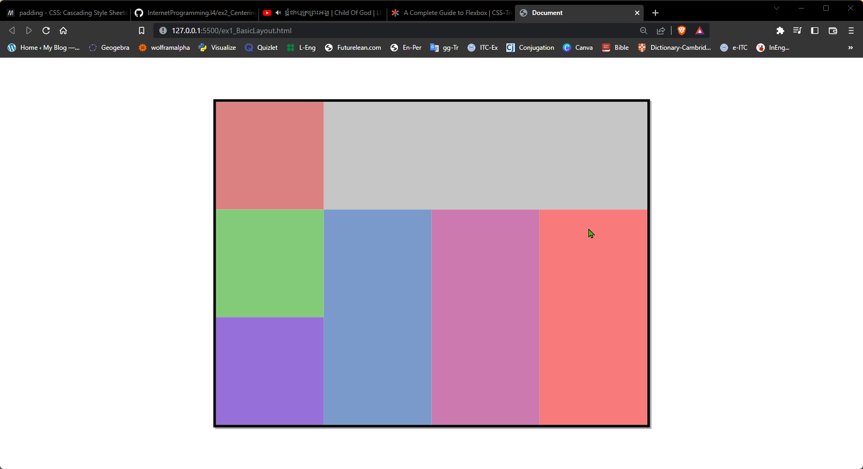
Ex1. Basic Layout

Slide 3
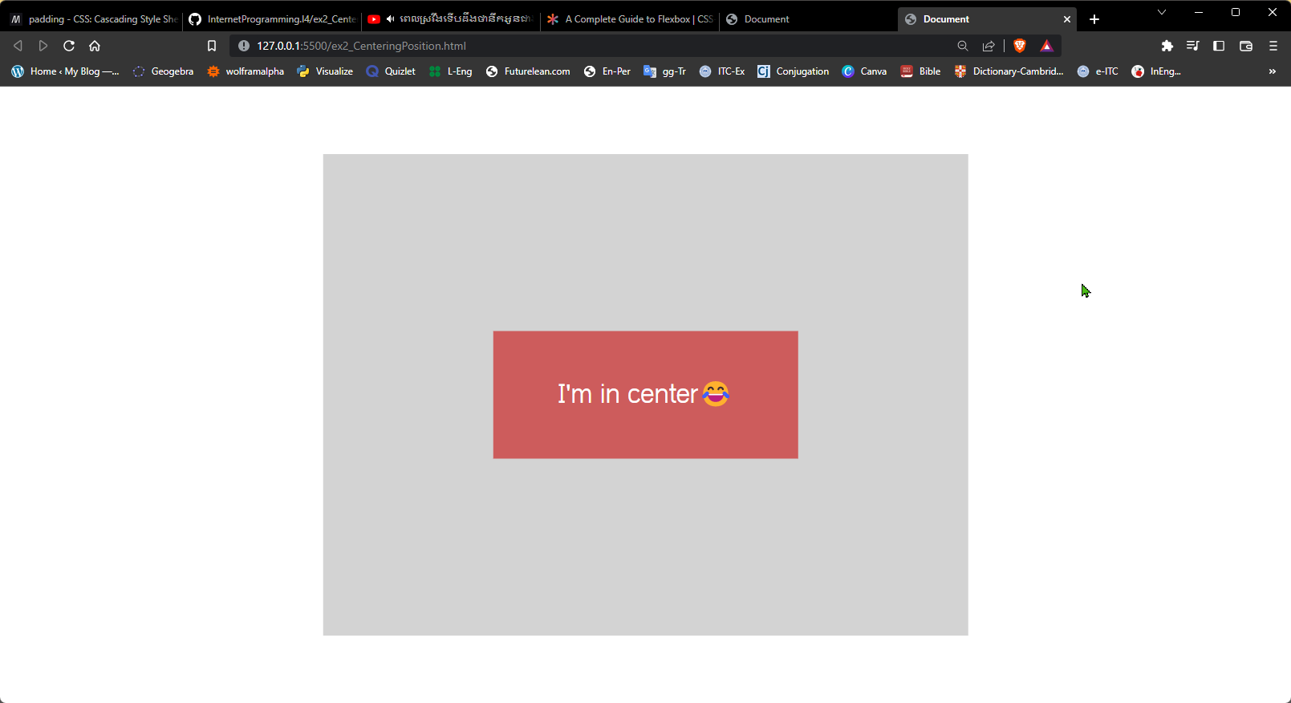
Ex2. Centering a “div” in container

Slide 4
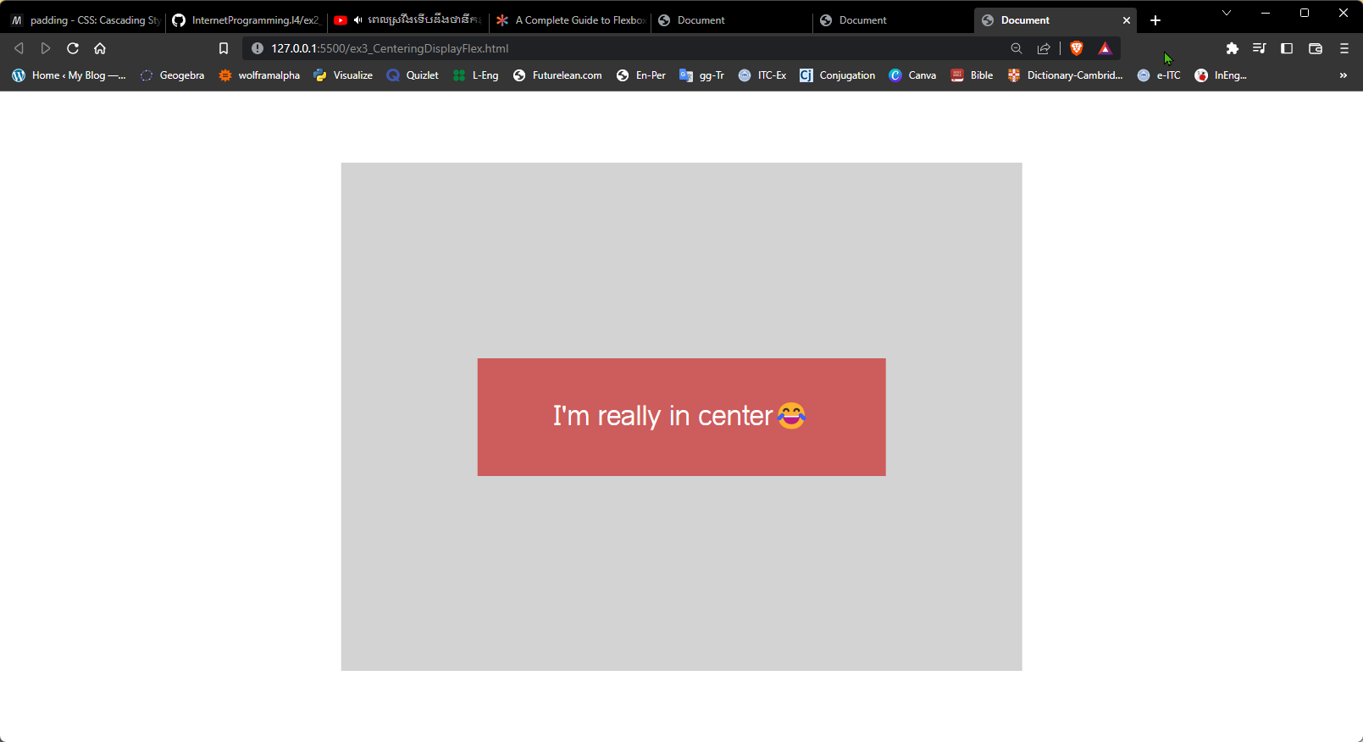
Ex3. Centering a “div” in container

Slide 5
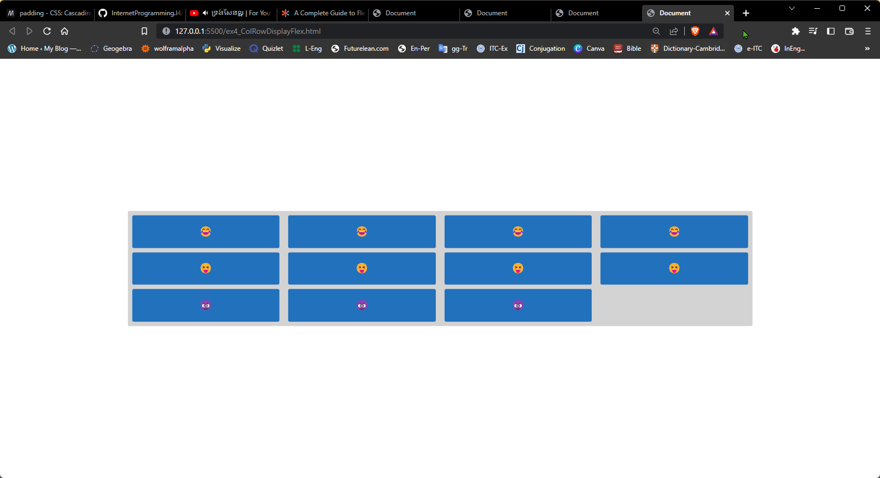
Ex4. Column and Row

Slide 6
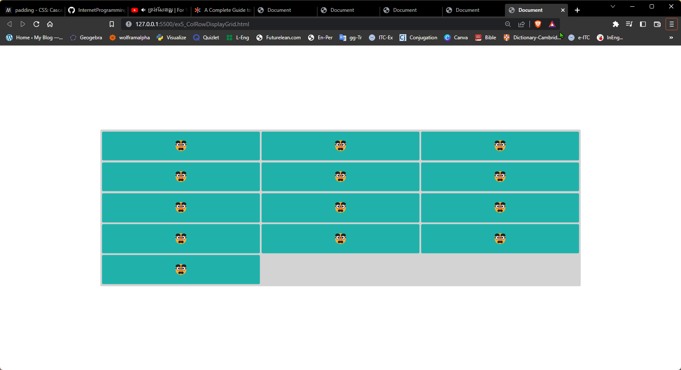
Ex5. Column and Row

Slide 7
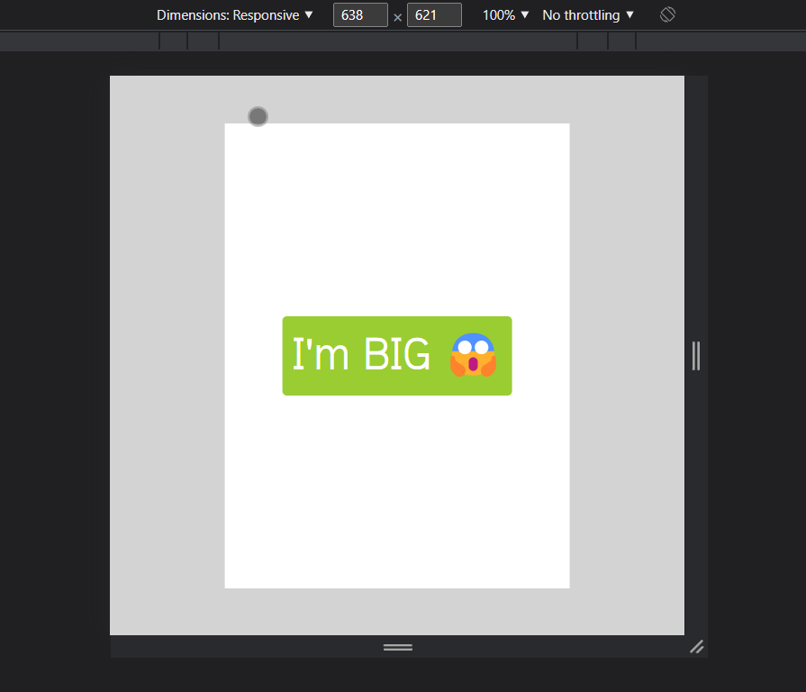
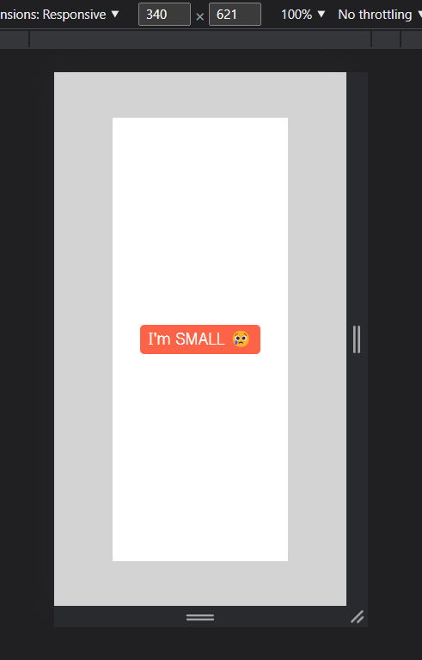
Ex6. Column and Row

Slide 8
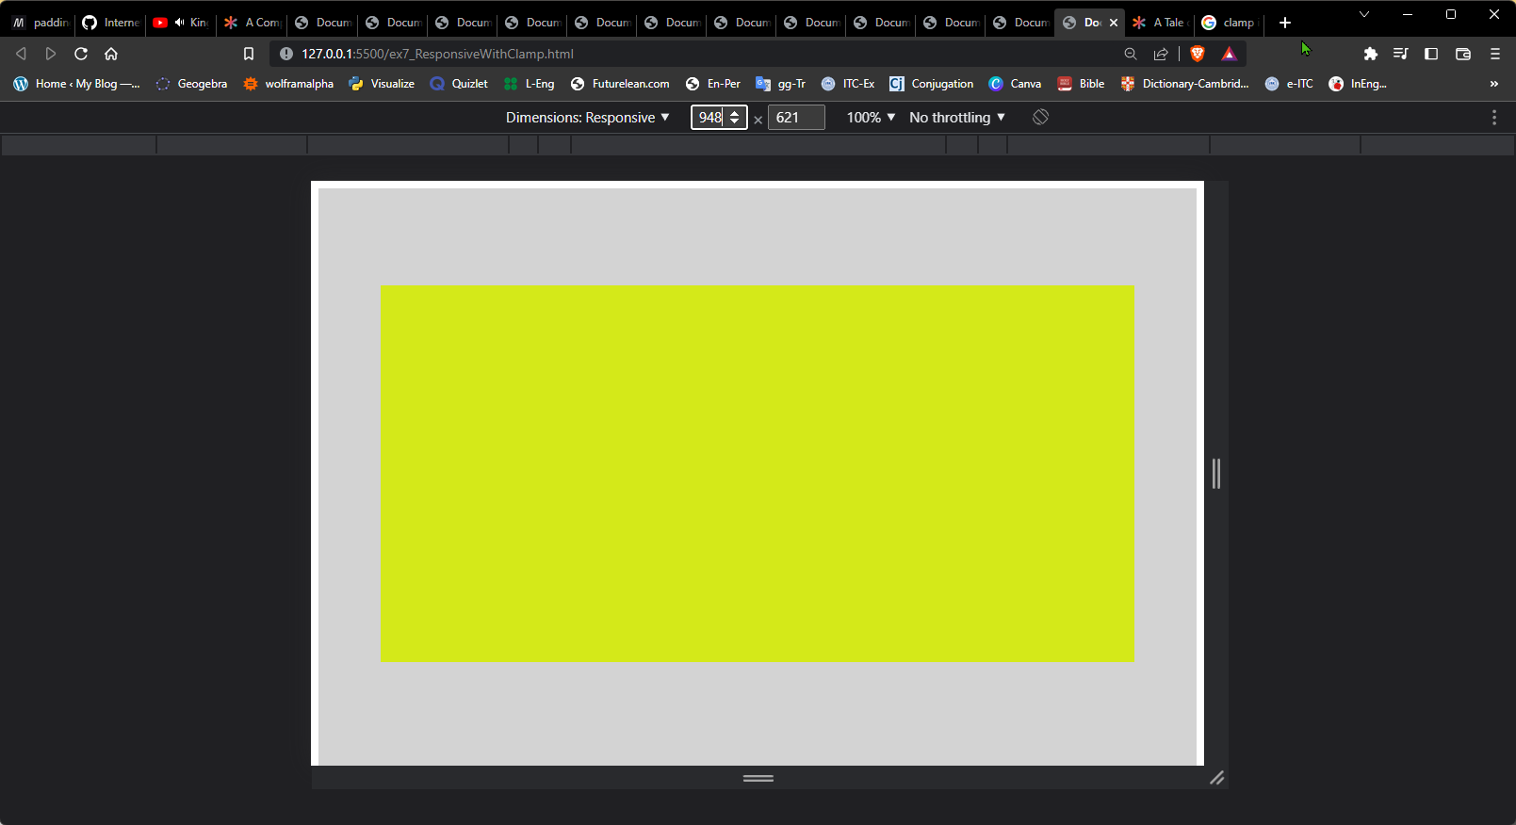
Ex7. Column and Row

Slide 9
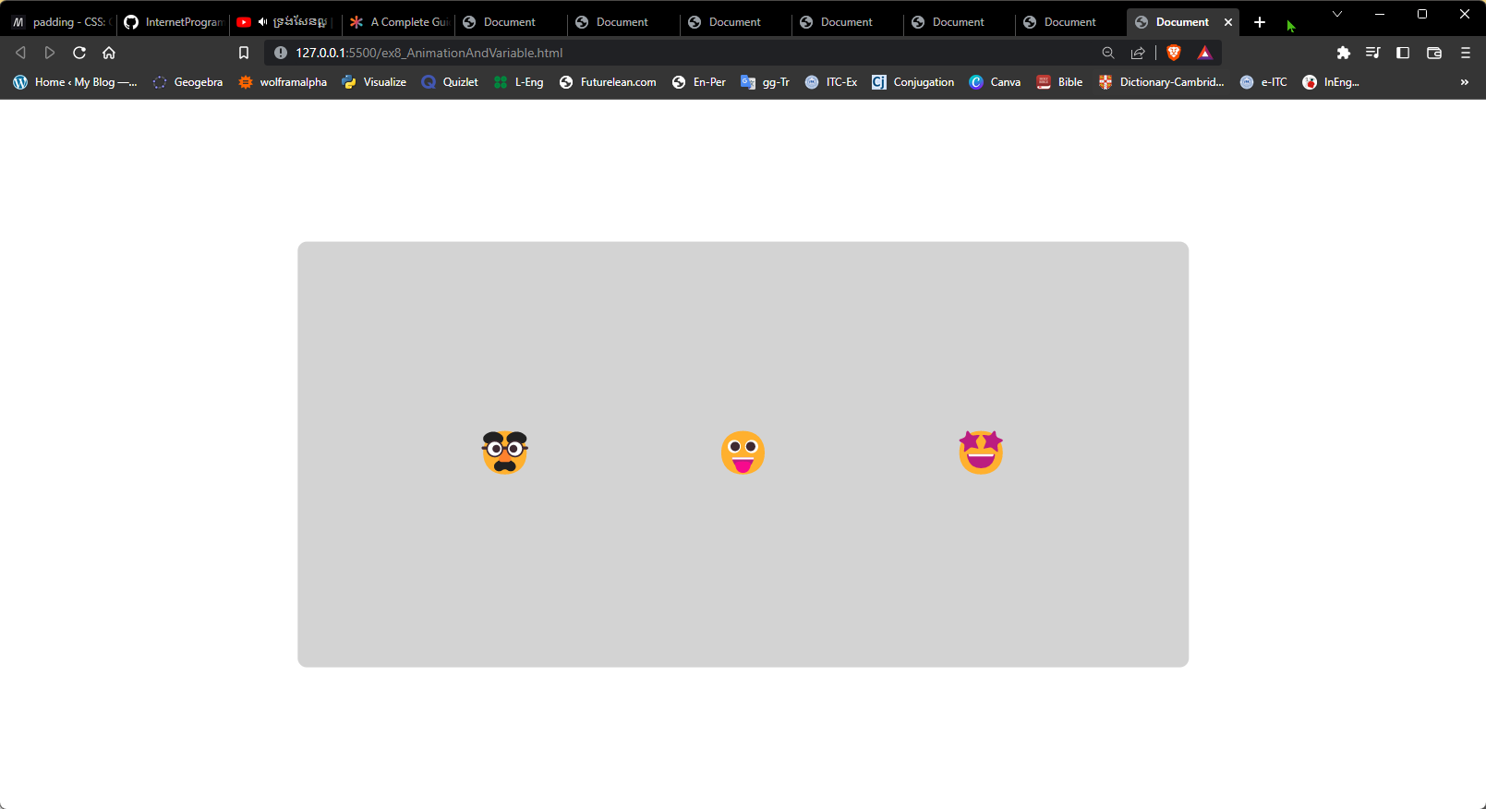
Ex8. Animation & Variable

Slide 10
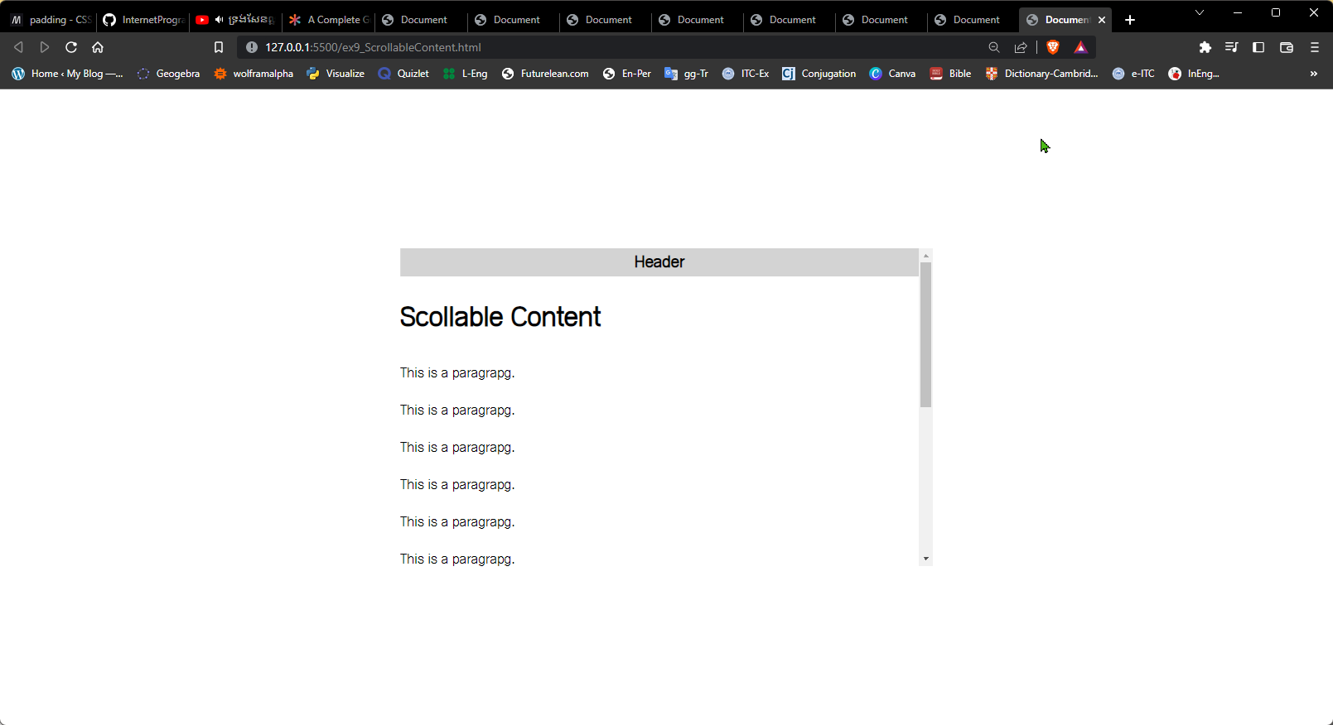
Ex9. Scrollable Content

Slide 11
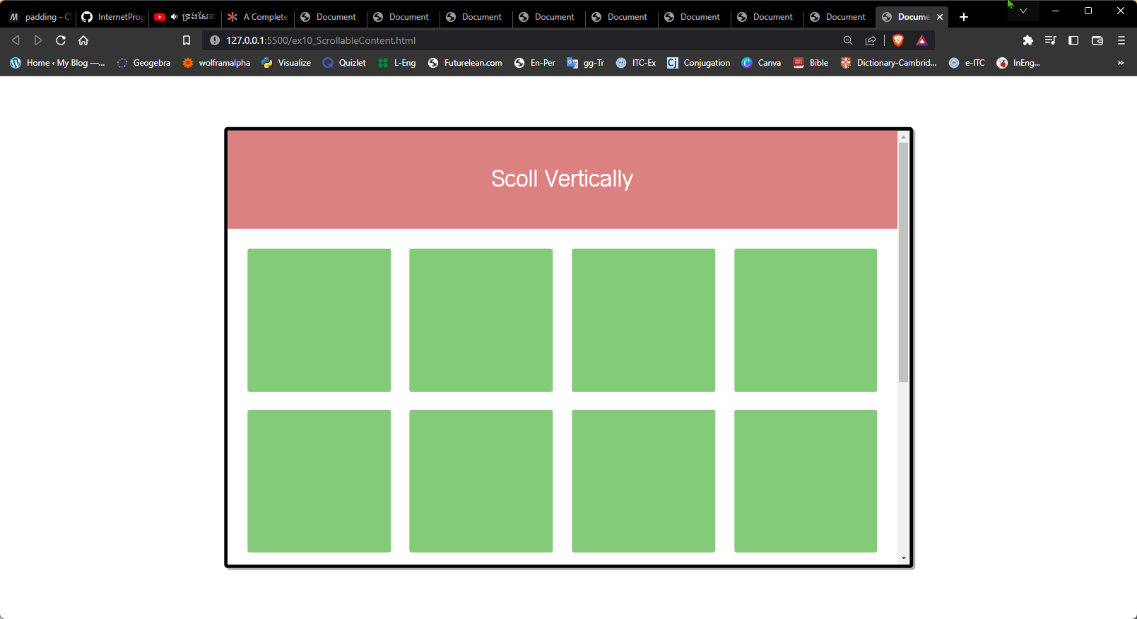
Ex10. Scrollable Content

Slide 12
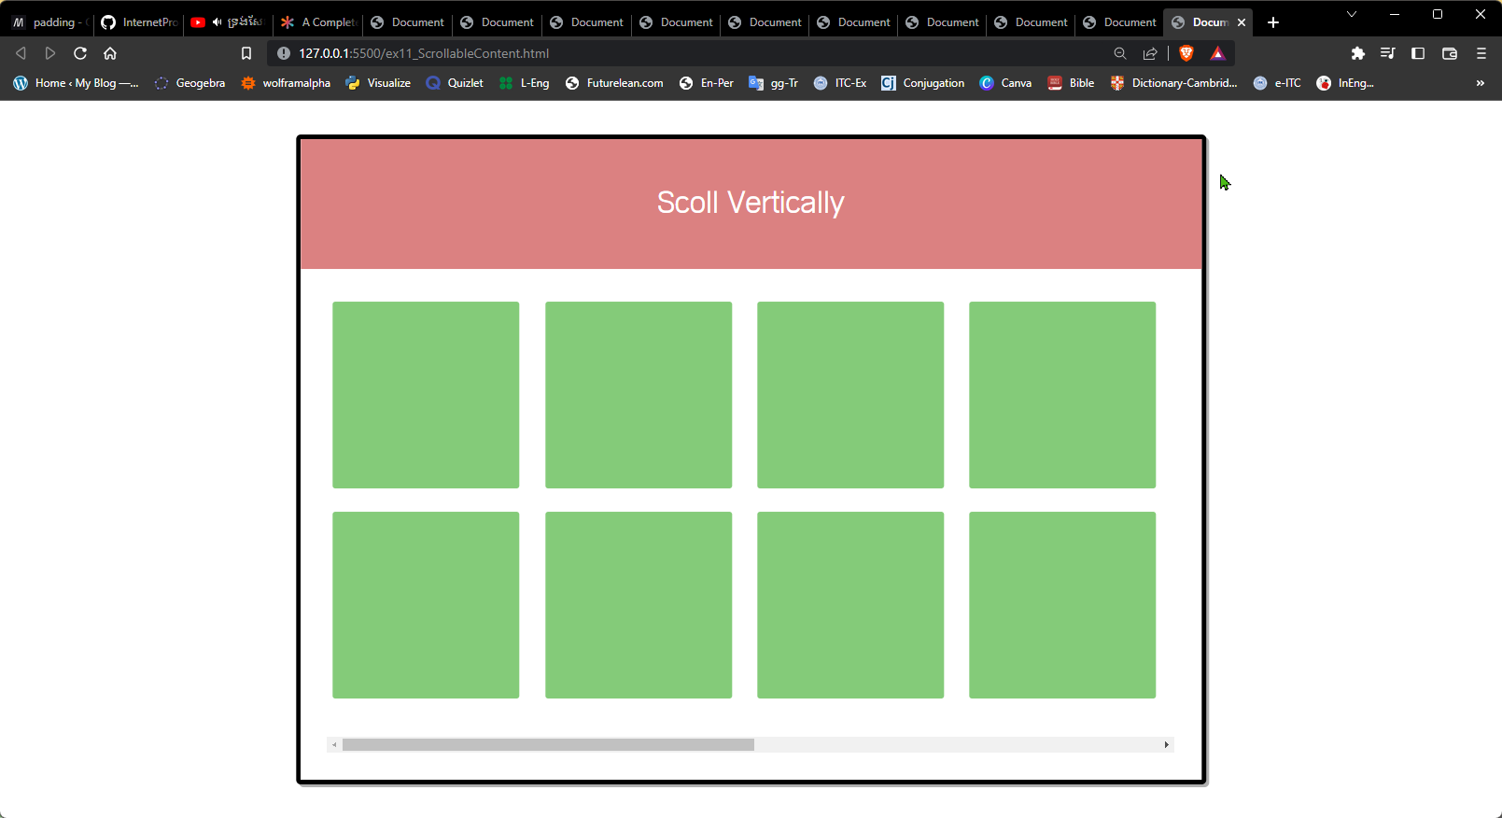
Ex11. Scrollable Content

Slide 13
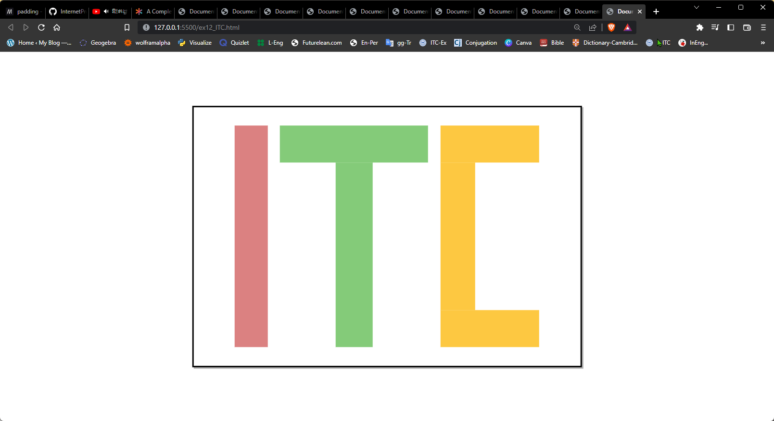
Ex12. Scrollable Content

